Slide 1
Tic-Tac-Toe
Vocabulary
English Primary Department
The slides that follow can be used with the themes suggested in the Supporting Documents for Level 5 and Level 6. We suggest that the vocabulary is adapted to suit the linguistic abilities of the learners.

Slide 2
Reference to Learning Outcomes/Syllabi
Reference to LO: LS 5.13 (Yr 3)
I can ask questions and make simple contributions in a discussion.
Reference to Syllabi: 5.1.5, 6.1.8 (Yr 5 and Yr 6)
Give descriptions of characters, scenes, objects and pictures.

Slide 3
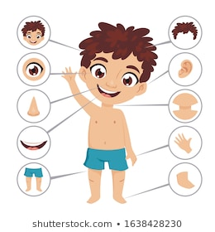
The Body and the face
stomach | elbow | head
nose | eyes | finger
curly | tooth | beard

Slide 4
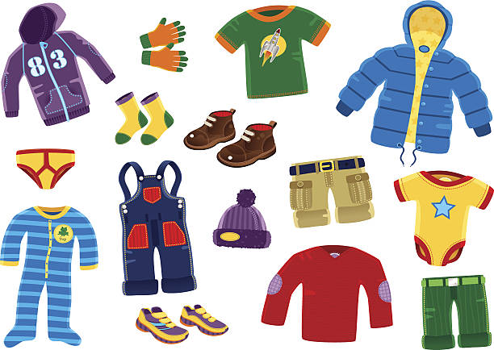
Clothes
glasses | trousers | vest
boots | shoes | skirt
uniform | pyjama | pocket

Slide 5
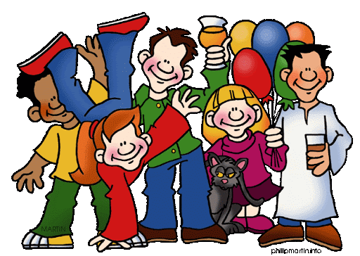
Family and Friends
brother | surname | family
parent | daughter | neighbour
grown-up | grandparents | aunt

Slide 6
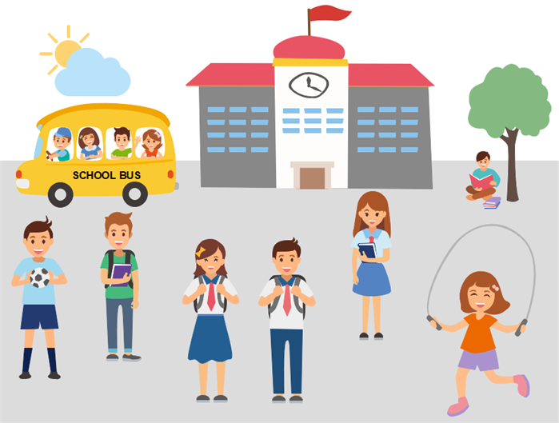
School Life
teacher | dictionary | homework
lesson | library | whiteboard
lunch | science | games

Slide 7
Food and Drink
biscuit | hungry | pizza
glass | chopstick | milkshake
dinner | honey | taste

Slide 8
Health
bandage | doctor | temperature
dentist | medicine | earache
cold | cough | hospital

Slide 9
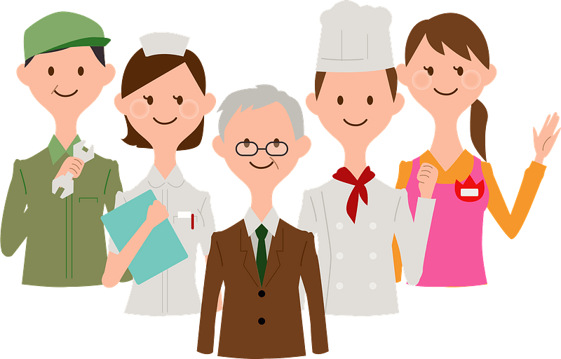
Occupations
astronaut | waiter | pilot
queen | meeting | police station
cook | singer | hospital

Slide 10
Sports and Free time
swimming pool | football | television
holiday | walk | cinema
music | collect | magazine

Slide 11
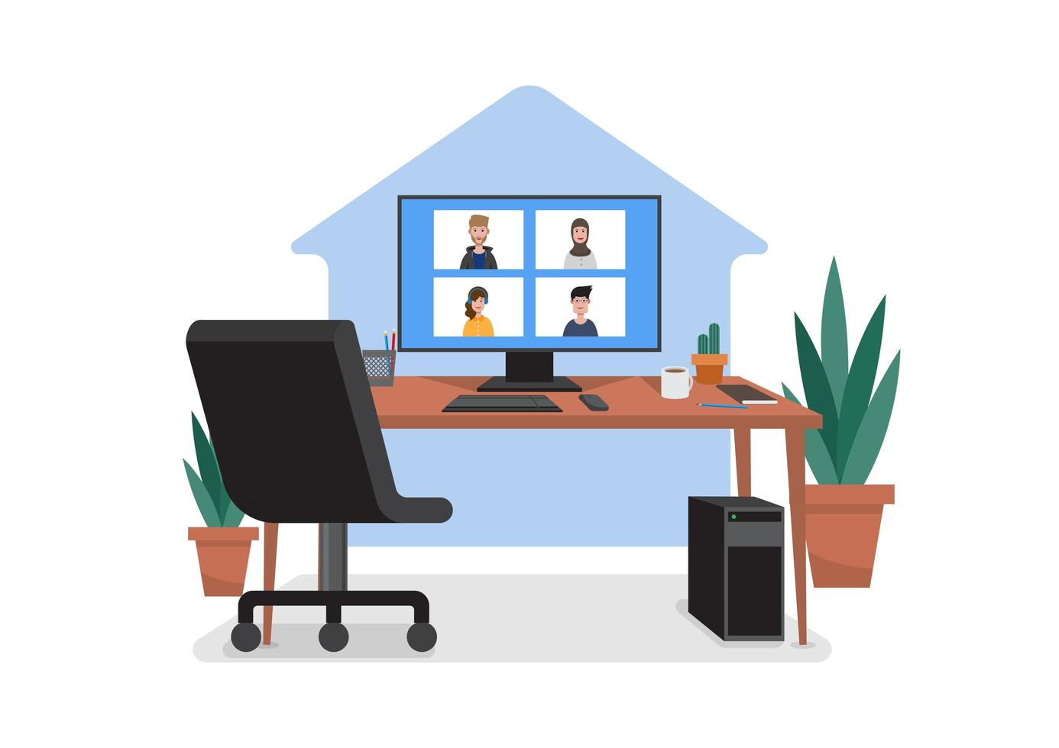
The home
apartment | cupboard | upstairs
room | fridge | entrance
garden | balcony | window

Slide 12
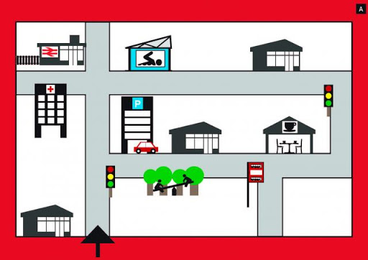
Places and directions
building | street | shop
playground | corner | near
city | factory | bus stop

Slide 13
Transport
ambulance | drive | ticket
fly | train | bicycle
journey | station | tractor

Slide 14
Animals
dinosaur | lizard | insect
shark | butterfly | swan
kitten | dolphin | wild

Slide 15
The world around us
ocean | planet | space
pond | island | beach
stone | street | field

Slide 16
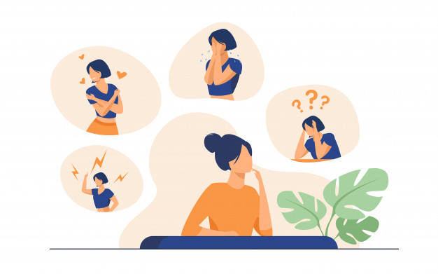
Personal Identification
name | enjoy | good looking
job | surname | favourite
hobbies | young | blonde

Slide 17
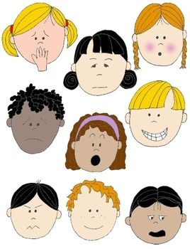
Feelings and Emotions
lovely | strong | bossy
ashamed | mad | favourite
strange | brave | pleasant

Slide 18
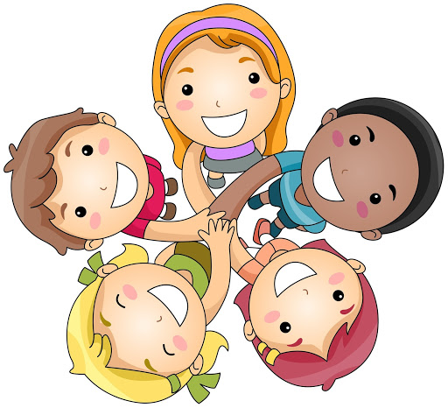
Relationships
friendly | pleasant | meet
cousins | best friend | relative
marriage | couple | partner

Slide 19
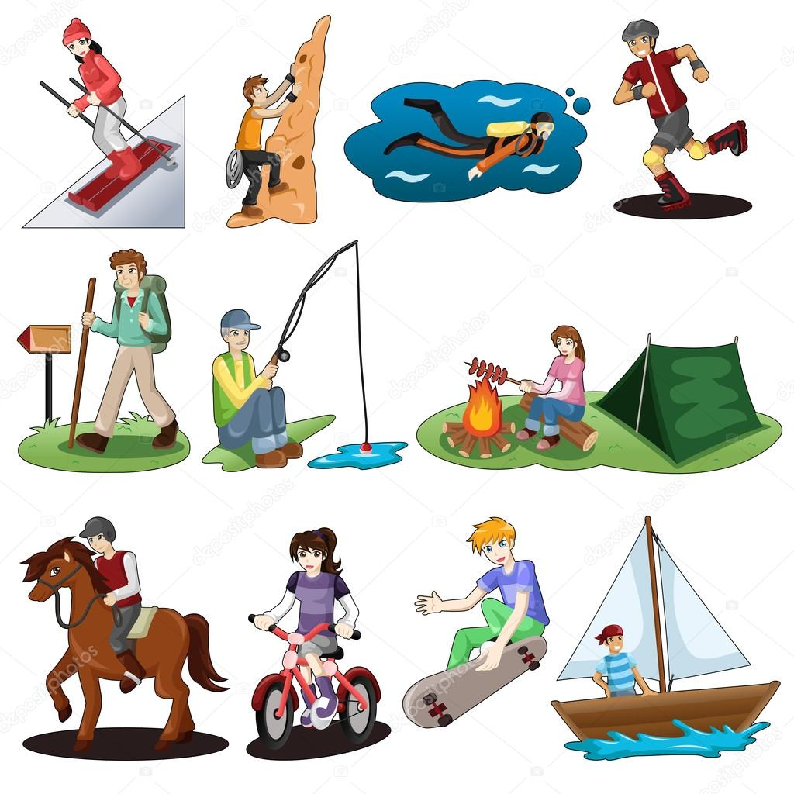
Hobbies and Leisure
painting | computer | park
club | sightseeing | camera
hobby | board games | collect

Slide 20
Entertainment
concert | museum | pop music
dance | fireworks | musician
orchestra | audience | advert

Slide 21
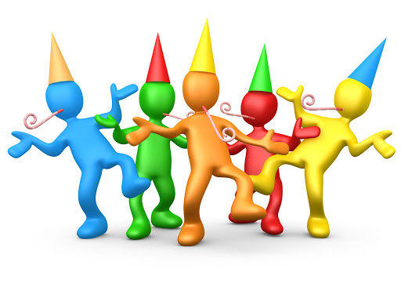
Celebrations
party | guests | cake
birthday | party hat | music
invitation | crowd | parade

Slide 22
Personal Stories and adventures
panic | breakfast | fierce
tremble | family | lost
friends | school | pet

Slide 23
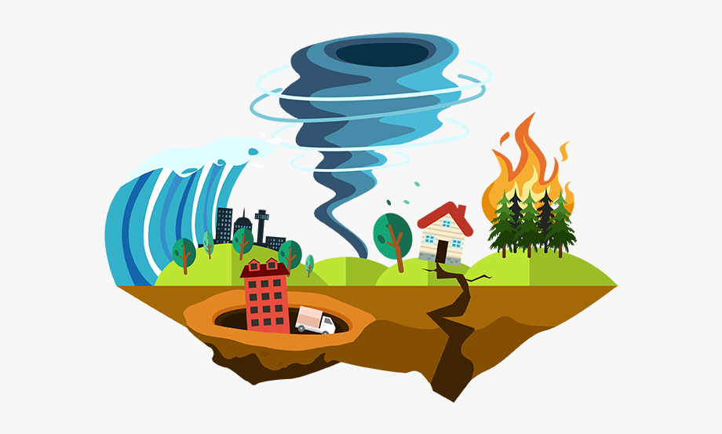
Weather and natural disasters
air | sunshine | flood
storm | shower | windy
hot | forecast | hail

Slide 24
Environment
pollution | litter | climate
recycling | rubbish | traffic
petrol | trees | nature

Slide 25
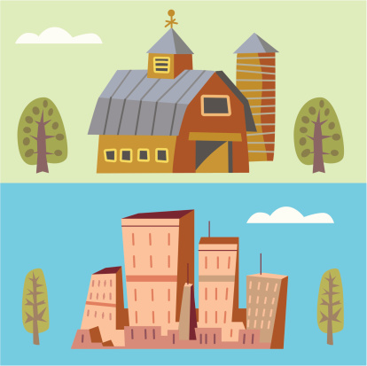
Town and country
crossroad | shopping centre | street
playground | roundabout | signpost
bridge | corner | pavement

Slide 26
Travel
coach | arrival | passport
boarding pass | take off | suitcase
train | hotel | plane

Slide 27
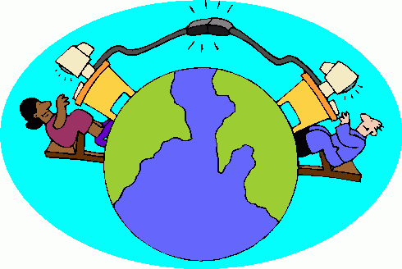
Communication and Technology
address | tablet | connect
laptop | mobile | password
website | printer | chat

Slide 28
Shopping and Services
bargain | cinema | cheap
spend | receipt | cash
restaurant | hairdresser | hotel

