Slide 1
Tic-Tac-Toe
Discussion Questions
The slides that follow can be used with the themes suggested in the Supporting Documents for Level 5 and Level 6. We suggest that questions are adapted to suit the linguistic abilities of the learners.

Slide 2
Reference to Learning Outcomes/Syllabi
Reference to LO:
LS 5.13 I can ask questions and make simple contributions in a discussion.
LS 5.9 I can use appropriate language and specific vocabulary fluently to suit different purposes when interacting with others.
LS 5.10 I can listen to others, letting them put forward their point of view and take turns in
a discussion and/or conversation.
Reference to Syllabi: 5.1.5, 5.1.6 6.1.8 (Yr 5 and Yr 6)
5.1.5/6.1.5 Give descriptions of characters, scenes, objects and pictures.
5.1.6/6.1.7 Use appropriate and grammatically correct language to communicate meaningfully with a purpose
5.1.14/6.1.14Participate enthusiastically in oral activities

Slide 3
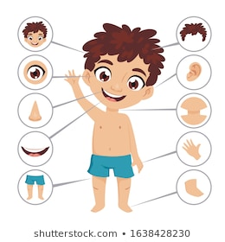
The Body and the face
Why do we have two legs, two arms, two eyes, etc., but only one head? | Is your body now the same as your body five years ago? Why/Why not? | How can food change your body?
Why do people have hair on their heads? | Why does our body need sleep? | How can exercise change your body?
Talk about a time that a part of your body was hurt. | Would you like to be a doctor? Why? | Why are some people bald?

Slide 4
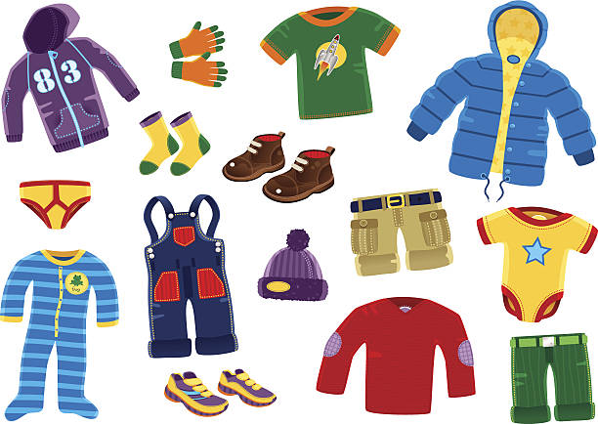
Clothes
Why do we need clothes? | How long does it take you to decide which clothes to wear? | Do you ever buy second-hand clothes?
Do you have a favourite clothes shop? | What new clothes would you like to buy if you had lots of money? | What do you do with your old clothes? Why?
Why are you wearing the clothes you have on now? | Is shopping for clothes your favourite kind of shopping? | Do you have clothes in your wardrobe that you never wear?

Slide 5
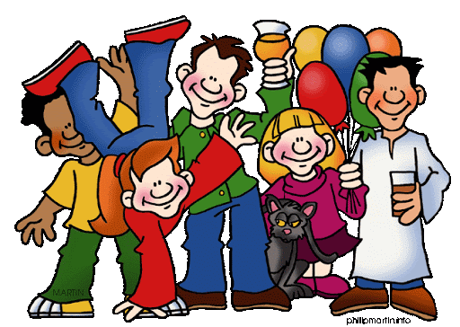
Family and Friends
What comes to mind when you hear the word ‘family’? | Do you get on well with all of your family members? | How many people are there in your family?
Who is the oldest person in your family? | How many cousins do you have? Where do they live? | Who do you like most in your family?
Describe what someone in your family looks like. | Talk about an occasion when you had a big family get-together. | Who is the funniest person in your family?

Slide 6
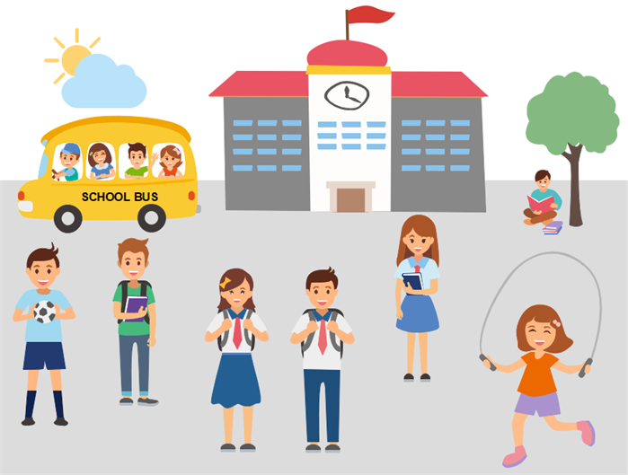
School Life
Why do people go to school? | Do you like school? Why? /Why not? | Do you think teachers have easy jobs? Why? /Why not?
What are your favourite subjects? | Are you a good student? Why? / Why not? | What are some advantages of sitting at the front of the class?
Mention three ways you can get good grades in school. | Should the school day be longer or shorter? Why? | Do you have fun at school? Why? / Why not?

Slide 7
Food and Drink
What do you usually eat for breakfast? | What’s your favourite food? Why? | Are you a good cook? Why? /Why not?
Give some examples of healthy food. Do you think you eat enough healthy food? | What’s the name of your favourite restaurant? Describe it. | What’s your favourite drink? How often do you drink it?
Are you hungry now? Why? / Why not? | Give some examples of junk food. What’s your favourite junk food? | Would you like to work in a restaurant? What job would you do?

Slide 8
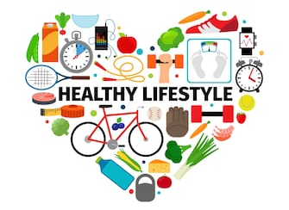
Health and Fitness
Have you ever been to a hospital? Talk about it. | Would you like to work as a nurse or a doctor? Why? | Talk about a time when you caught a cold.
Mention ways how you stay healthy. | How can exercise keep you healthy? | Why is smoking bad for you?
What are ‘germs’? What can you do to avoid them? | Do you think you eat enough healthy food? | Do you want to be over 100 years old? Why? /Why not?

Slide 9
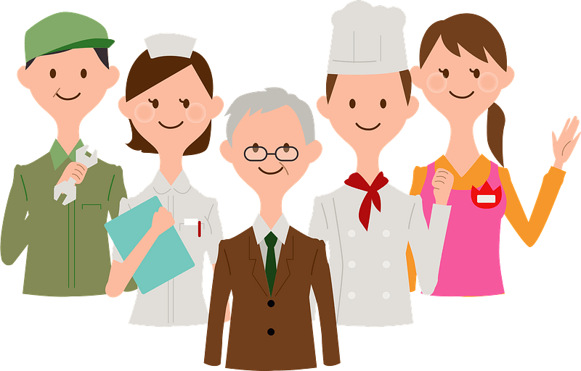
Occupations
What job would you like to have when you’re a grown-up? | What are some jobs that earn you very high salaries? | Which jobs are very dangerous?
Is it better to work inside or outside? | Why do people need to have jobs? | How can a person find a job?
Would you rather be a student or go to work? Why? | Think of a job you like. Describe a typical day doing this job. | What does a ‘boss’ do?

Slide 10
Sports and Free time
What is your favourite sport? | Do you think you get enough exercise ever week? | What hobbies have you got?
What is the most popular sport in the world? Do you like it? | Do you like keeping a collection? Why? / Why not? | What after school activities do you do?
Why is reading a good free time activity? | Do you ever go to the cinema? Talk about a film you saw. | What fun activities did you do last weekend?

Slide 11
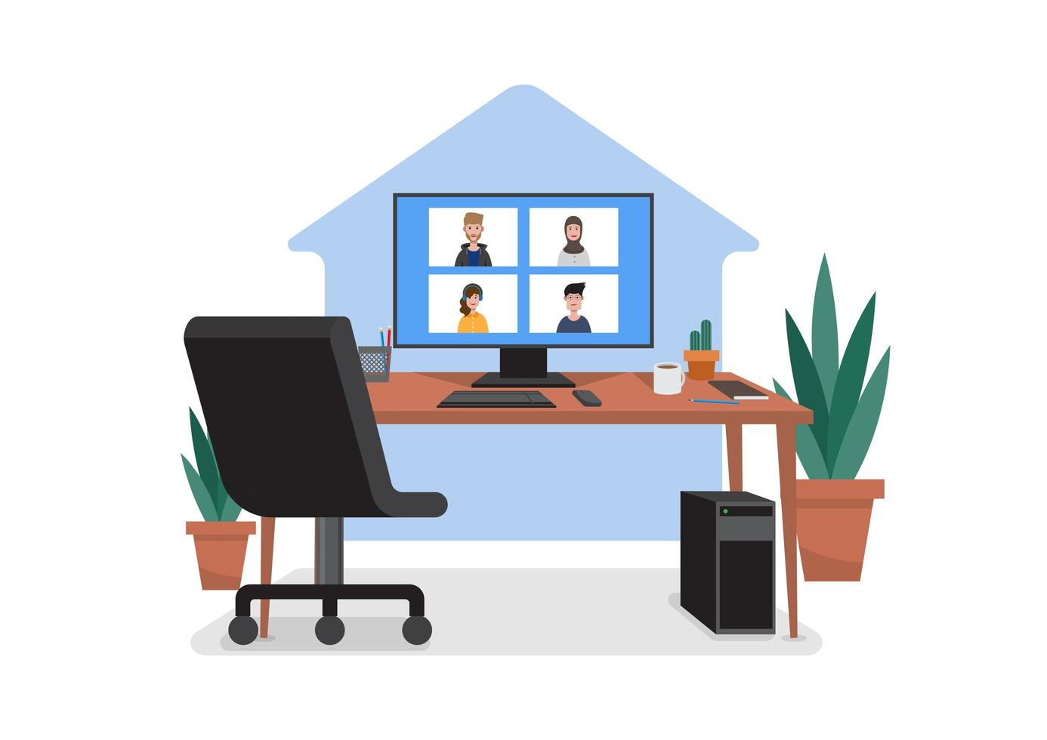
The home
Describe where you live. | Which room in your house is used the most? | Mention some different rooms in your house. Which is your favourite room?
What household chores do you do? | Have you got any plants at home? Who takes care of them? | If you could add one room to your house what room would it be? Why?
What does your dream home look like? | Have you got any balconies or outdoor space at home? How is this space used? | What do you see when you look through the window/door in your room?

Slide 12
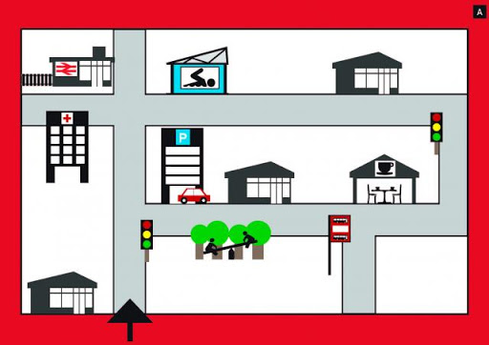
Places and directions
Where are you right now? Who is on your left and on your right? | How do you usually get to school? | Mention some things that you usually see on your way to school/ home.
Describe how to reach the School Hall from your classroom. | Describe the neighbourhood around your school. | Is there a park in your town/village? Do you like it? Why? / Why not?
What is the most famous place in your town or city? | Look down. Describe in detail what you see. | Which shops in your town / village do you often go to?

Slide 13
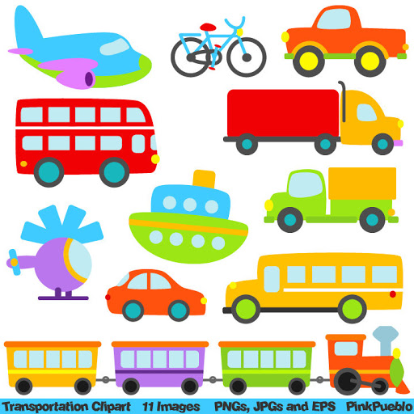
Transport
Mention three different kinds of land transportation. | How do you come to school? What about some of your friends? | What kinds of transport do you enjoy the most?
What is car-pooling? Why is this a good way to travel? | Do you think air travel is safe? | Would you like to be a taxi driver? Why? / Why not?
Would you like to drive a motorbike? Why? / Why not? | What are some advantages of using the bicycle to travel? | Is walking a good way to travel?

Slide 14
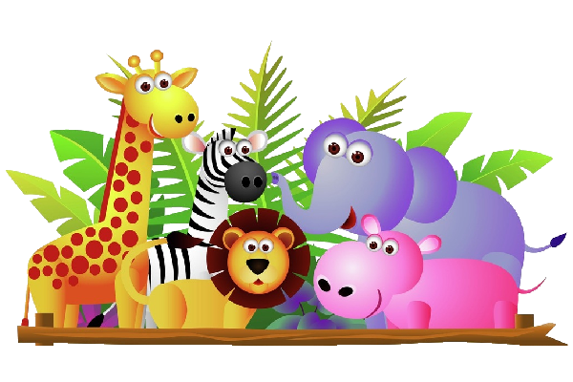
Animals
Do you have any pets? Why? / Why not? | Should animals be free or is it okay to keep them in zoos? Why? / Why not? | What is the largest animal in the world?
Are dogs better than cats? Why? / Why not? | Are there any dinosaurs still alive today? Why? / Why not? | Which is your favourite animal? Where does this animal live?
Do you like to watch TV programmes about animals and birds? | Do you like animals? Why? / Why not? | How can we protect animals and birds?

Slide 15
The world around us
Mention some creatures that live in the sea. | What are some ways we can help the environment? | Mention some animals that are endangered.
Would you like to live on the mountains? Why? / Why not? | Have you ever planted a tree? Why should we plant trees? | Why do people like spending time at the seaside?
If you go for a walk in the countryside what things might you see around you? | How can you help to save water at home? | Where do you like to go to enjoy nature?

Slide 16
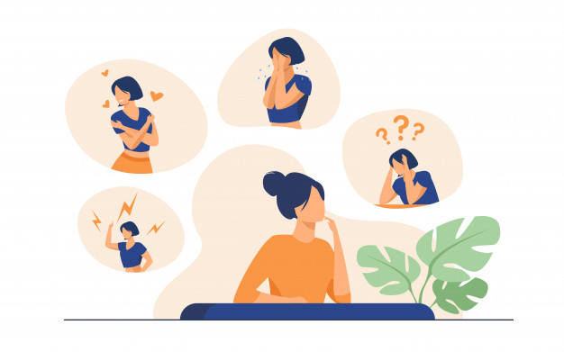
Personal Identification
Do you have any pets? | Have you ever lived in another country? | Do you have brothers or sisters?
What do you do on Saturdays? | What’s something you do well? | Which sports do you like?
What are your hobbies? | Which is your favourite food? | Who do you live with?

Slide 17
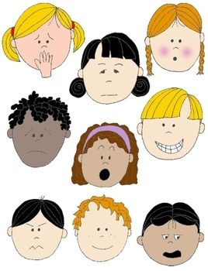
Feelings and Emotions
What makes you angry? | What makes you happy? | Do you like to watch comedies?
Do you ever feel lonely? | What do you usually do when you feel sad? | What are you frightened of?
Have you ever felt embarrassed? | Do you get annoyed easily? | Do you think animals have emotions?

Slide 18
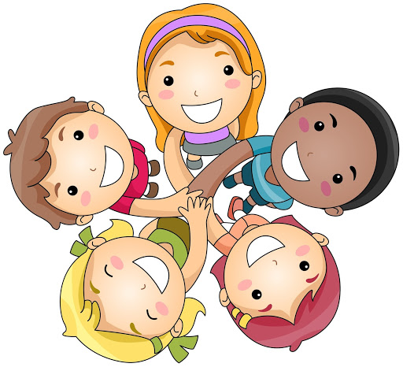
Relationships
Describe your best friend. | What do you disagree with your friends about? | Is it easy for you to make friends?
What’s a good way to make new friends? | Who is the oldest member in your family? | Describe your family.
How do family members help each other? | Describe one of your cousins. | Describe a fun family activity.

Slide 19
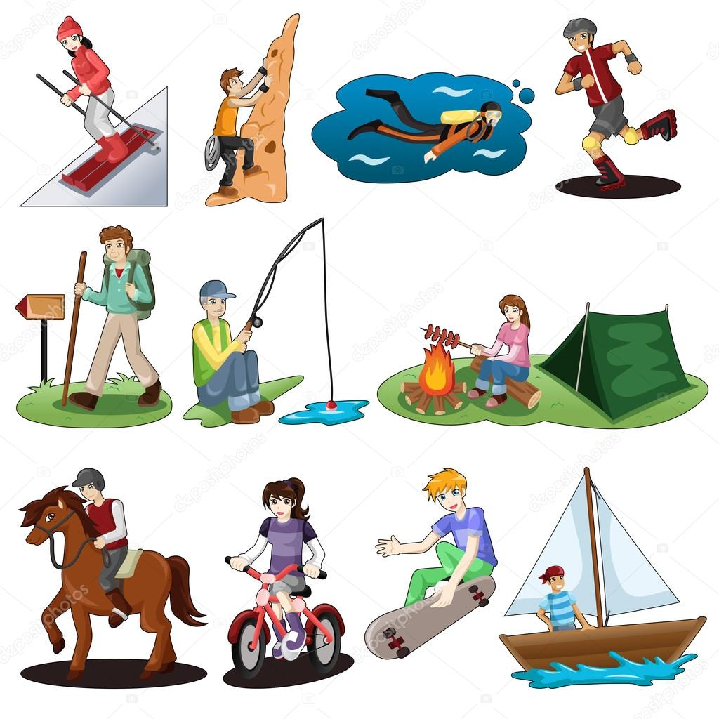
Hobbies and Leisure
What is your hobby? | How long have you had a hobby? | Why do people have hobbies?
What did you do last weekend? | Do you like to watch movies? | What new activity would you like to try?
Do you spend money doing your hobby? | Do you have enough free time? | What do you do to have fun in the weekend?

Slide 20
Entertainment
Do you like to watch cartoons? | Have you ever been to the theatre? | Do you ever visit museums?
What computer games have you played? | What did you watch on TV yesterday? | What kind of music do you like?
Have you ever been on holiday? | What was the last book you read? | Have you ever been to the cinema?

Slide 21
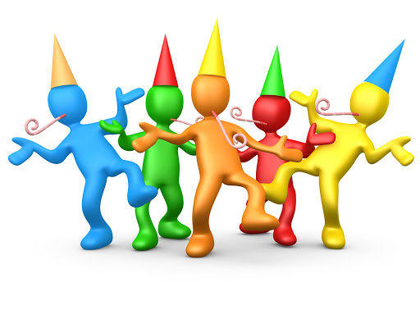
Celebrations
What is your favourite holiday? | Do you like Halloween? | What is the strangest holiday you’ve ever heard about?
What do you like to do on your birthday? | What is your favourite holiday food? | Do you get together with your family on holidays?
What is the best gift you have ever received? | Would you rather travel or stay at home during the holidays? | Describe one of your Carnival costumes.

Slide 22
Personal Stories and adventures
What is your favourite kind of story? | Do you prefer to read a story on a book or watch a film on TV? | Which is your favourite storybook character?
Does anyone tell you stories? | Who is your favourite hero? | Tell your group a true story that happened to you.
Have you ever been on an adventure? | What super power would you like to have? | Tell your group what you did this morning before you came to school.

Slide 23
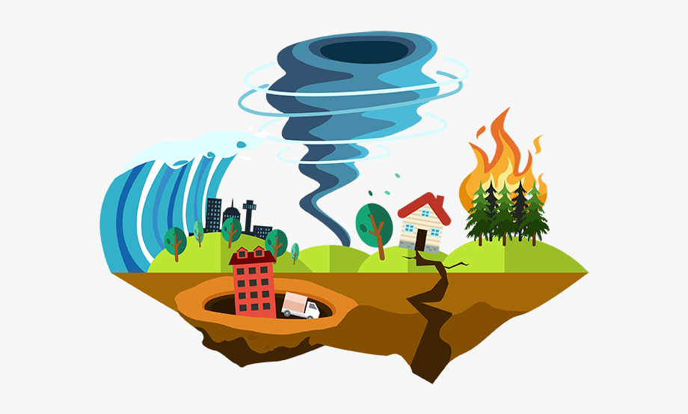
Weather and natural disasters
What is your favourite season? | Describe one of the seasons in your country. | What do you usually wear on cold, winter days?
When is it useful to check weather forecasts? | What do you eat or drink to keep yourself cool in summer? | Does your country experience floods?
How are forest fires caused? | How many types of natural disasters can you name? | Do you like to suntan or do you wear sunblock?

Slide 24
Environment
Do you turn off the water when you brush your teeth? | Why are some animals endangered? | Which is better: a paper bag or a plastic bag?
What things did you throw away yesterday? | Describe one thing you do to help the environment. | What can we do to reduce traffic?
Do you turn off the lights when you leave the room? | Why are trees important for people? | What is recycling and why is it important?

Slide 25
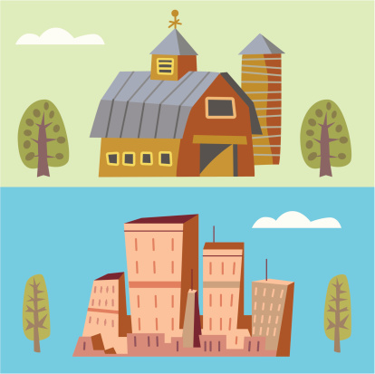
Town and country
What are some things that you can see in the city? | What is your favourite city? | Is it better to grow up in the city or in the countryside?
How do you get around in the city? | What city would you like to visit? | What are some things that you can see in the countryside?
Where do you like to go in the countryside? | How do people get around in the countryside? | Are there shops in the countryside?

Slide 26
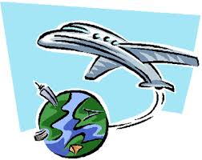
Travel
Have you ever been abroad? | Do you prefer to travel on foot or by car? | How do you get to school?
Which country would you like to visit? | Have you ever been on a plane? | What three things would you put in your suitcase if you’re going abroad?
Where do you stay when you travel? | How much luggage do you usually carry? | Have you ever been on a ferry?

Slide 27
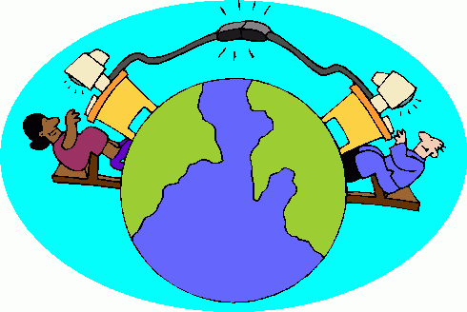
Communication and Technology
What do you use a tablet for? | How much time do you spend online each week? | Which is your favourite online game?
Do you like using technology to learn? | Have you ever used the Internet to learn English? | How do people communicate nowadays?
How did people communicate in the past? | How will people communicate in the future? | Should students be allowed to bring mobile phones at school?

Slide 28
Shopping and Services
What is your favourite place to shop? | Does your family ever shop online? | How does shopping make you feel?
Would you like to own or work in a shop? | When do people usually get a receipt? | When you buy something do you pay in cash?
Which is your favourite restaurant? | Is online shopping a good idea? Why? | What does a beautician do?

