Slide 1
Slide 1
Sports
Notes:
These can be changed to reflect your school’s specific rules.

Slide 2
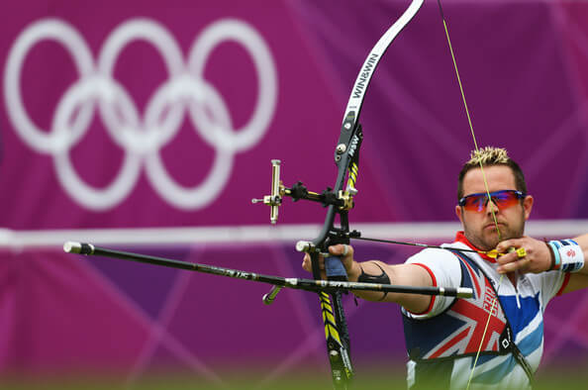
Slide 3
Archery

Slide 3
Slide 4
Canoeing

Slide 4
Slide 5
BE RESPECTFUL
Taekwondo
Notes:
*Change this verbiage to the language your school uses.

Slide 5
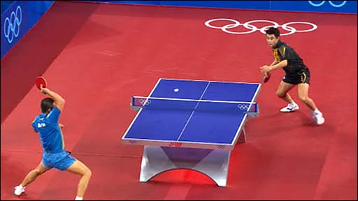
Slide 6
BE SAFE
Table tennis

Slide 6
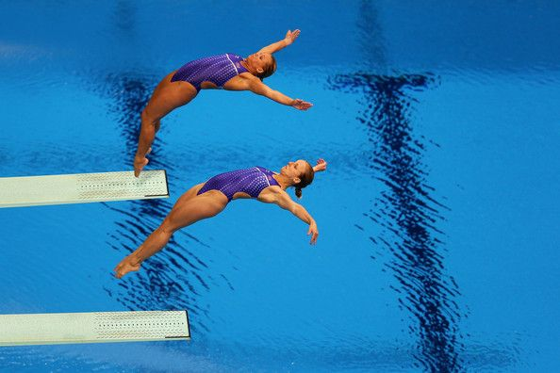
Slide 7
Diving Board

Slide 7
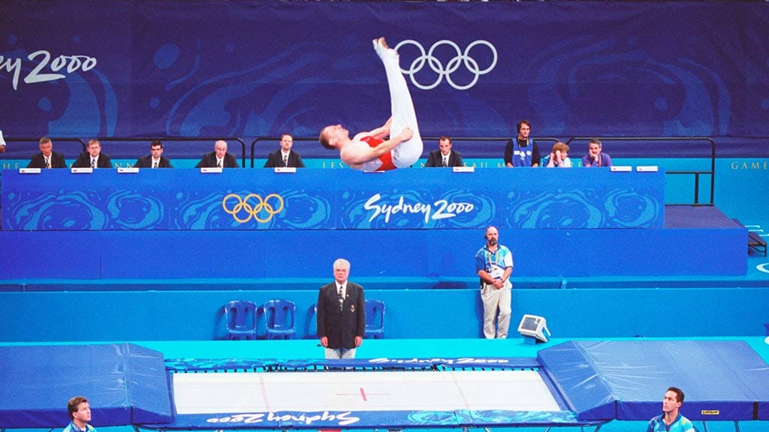
Slide 3
Trampoline

Slide 8
Slide 5
Weights
Notes:
*Change this verbiage to the language your school uses.

Slide 9
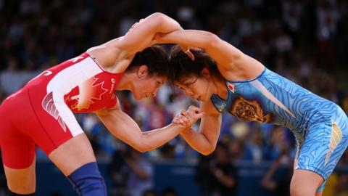
Slide 7
Wrestling

Slide 10
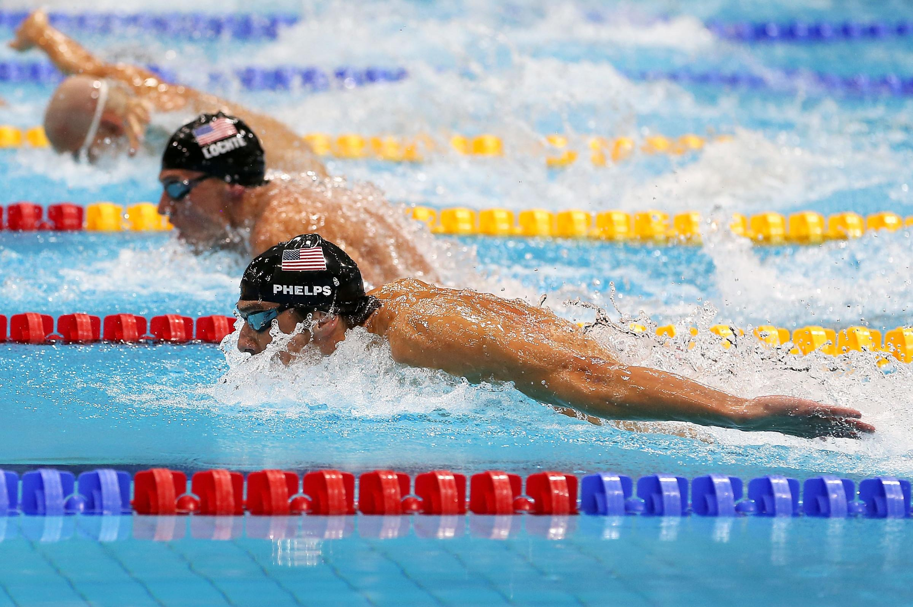
Slide 7
Swimming Pool

Slide 11
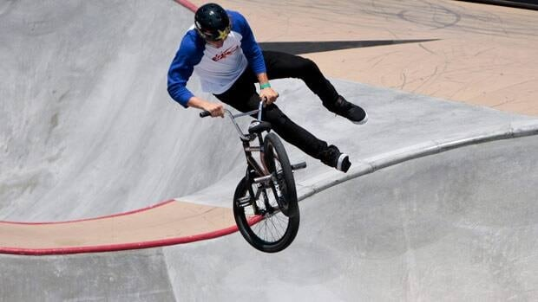
Slide 7
BMX

Slide 12
Slide 7
Mountain Bike

Slide 13
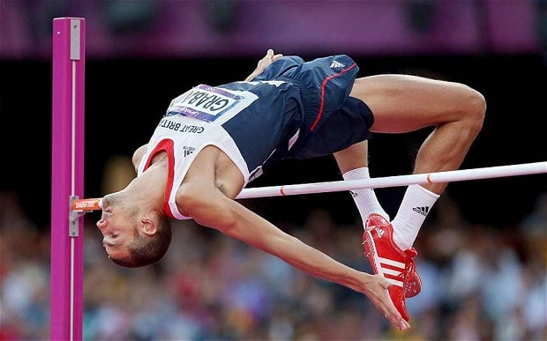
Slide 7
High Jump

Slide 14
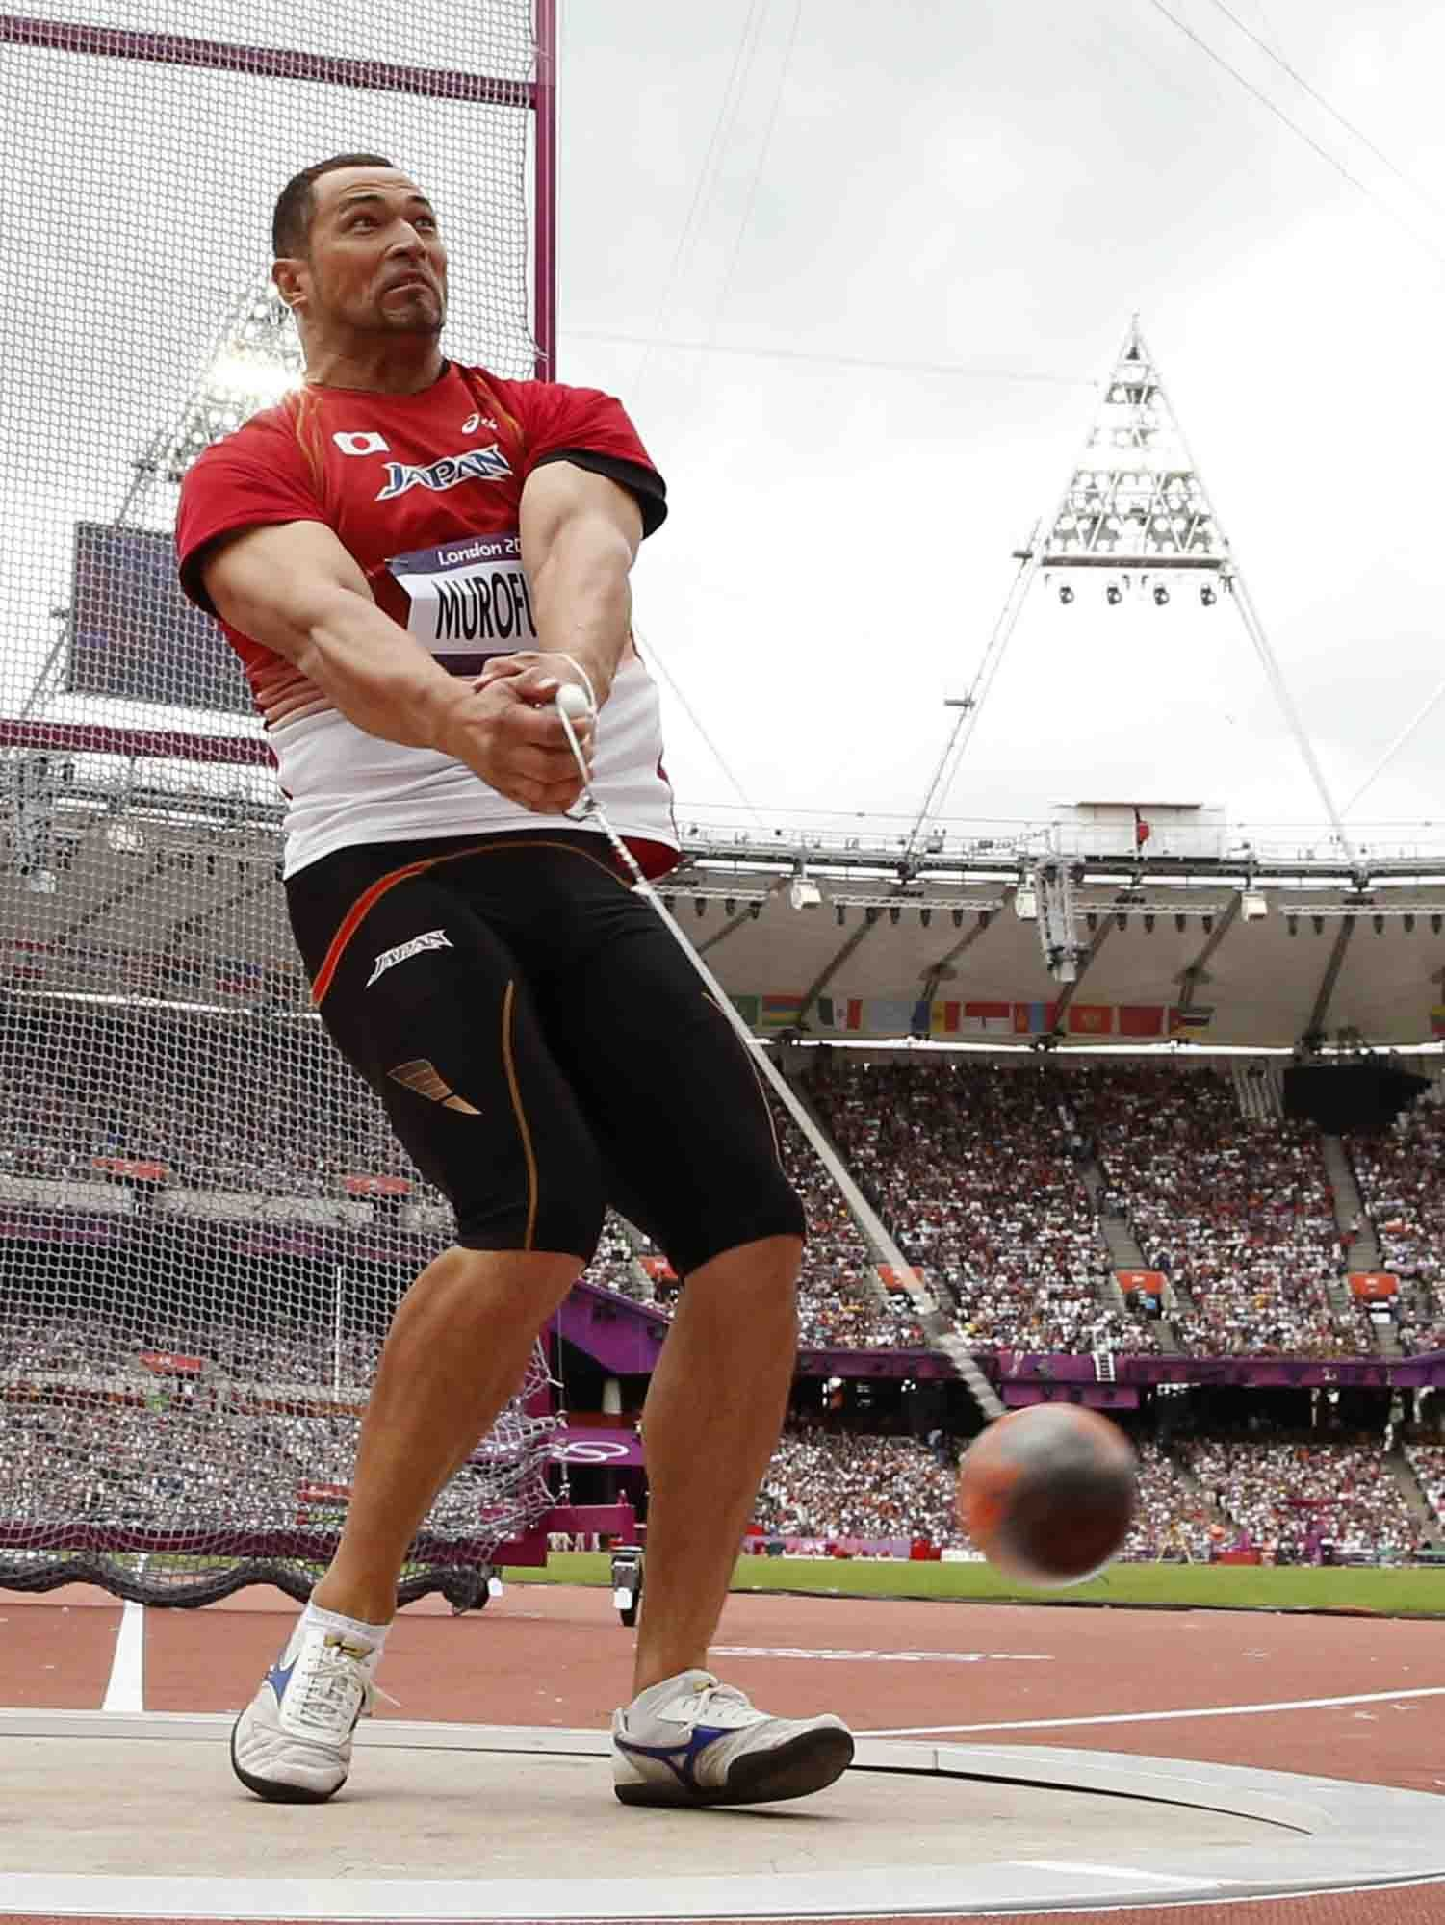
Slide 7
Hammer Throwing

Slide 15
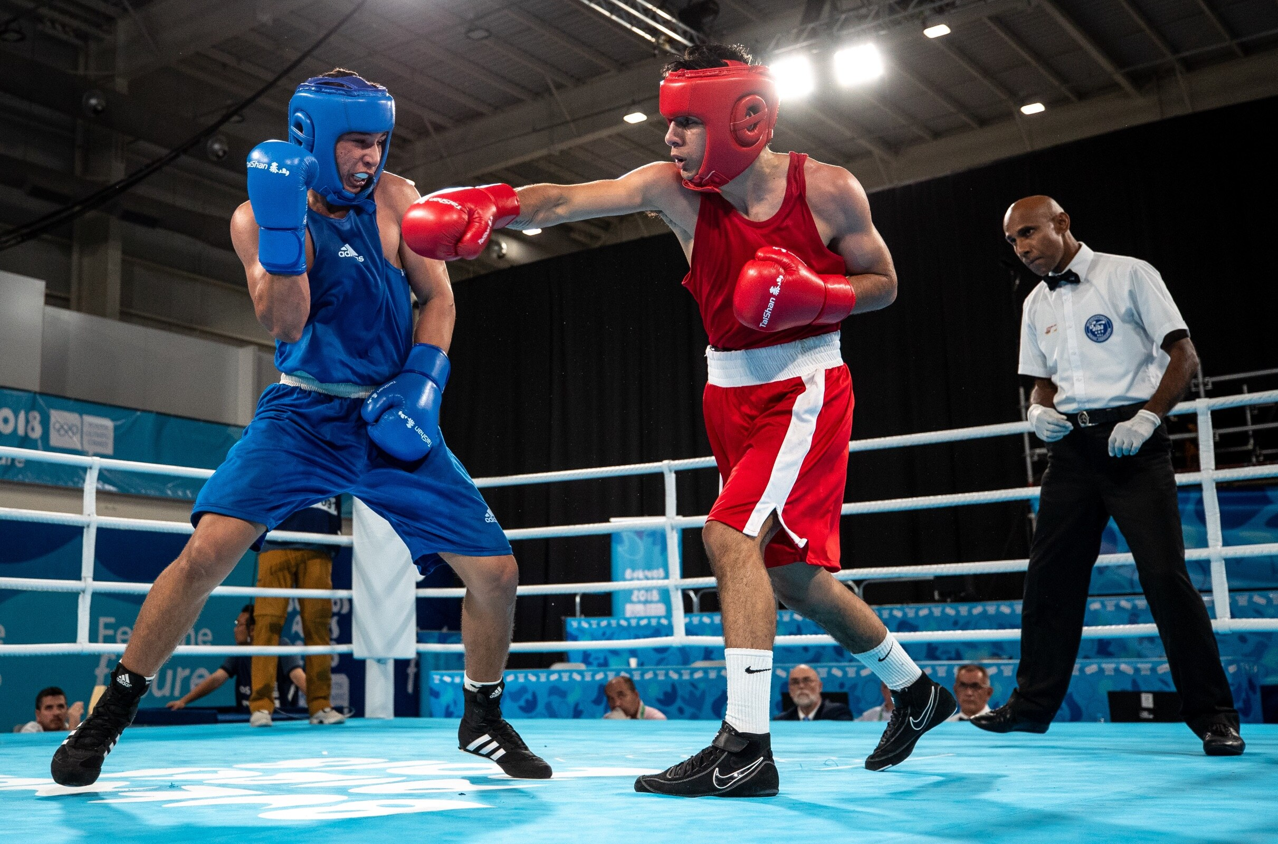
Slide 7
Boxing

Slide 16
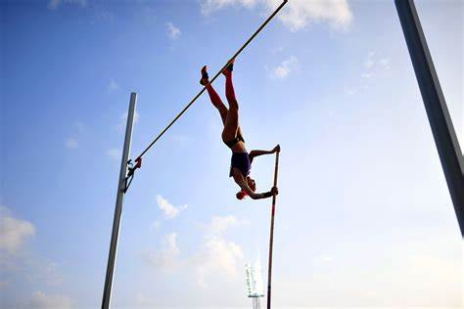
Slide 7
Pole Vault

Slide 17
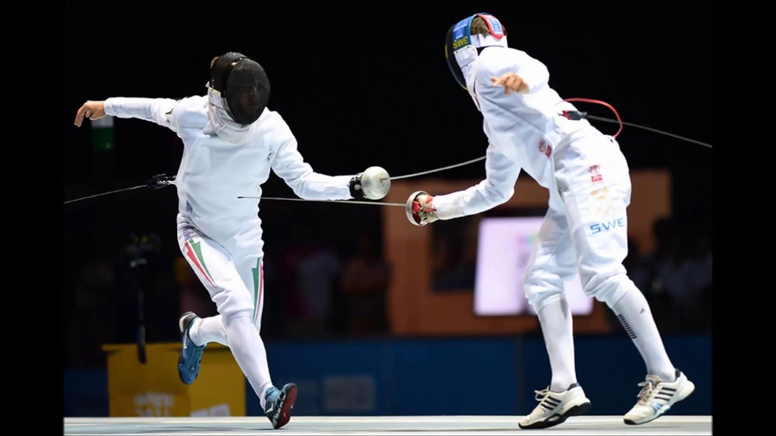
Slide 7
Fencing

Slide 18
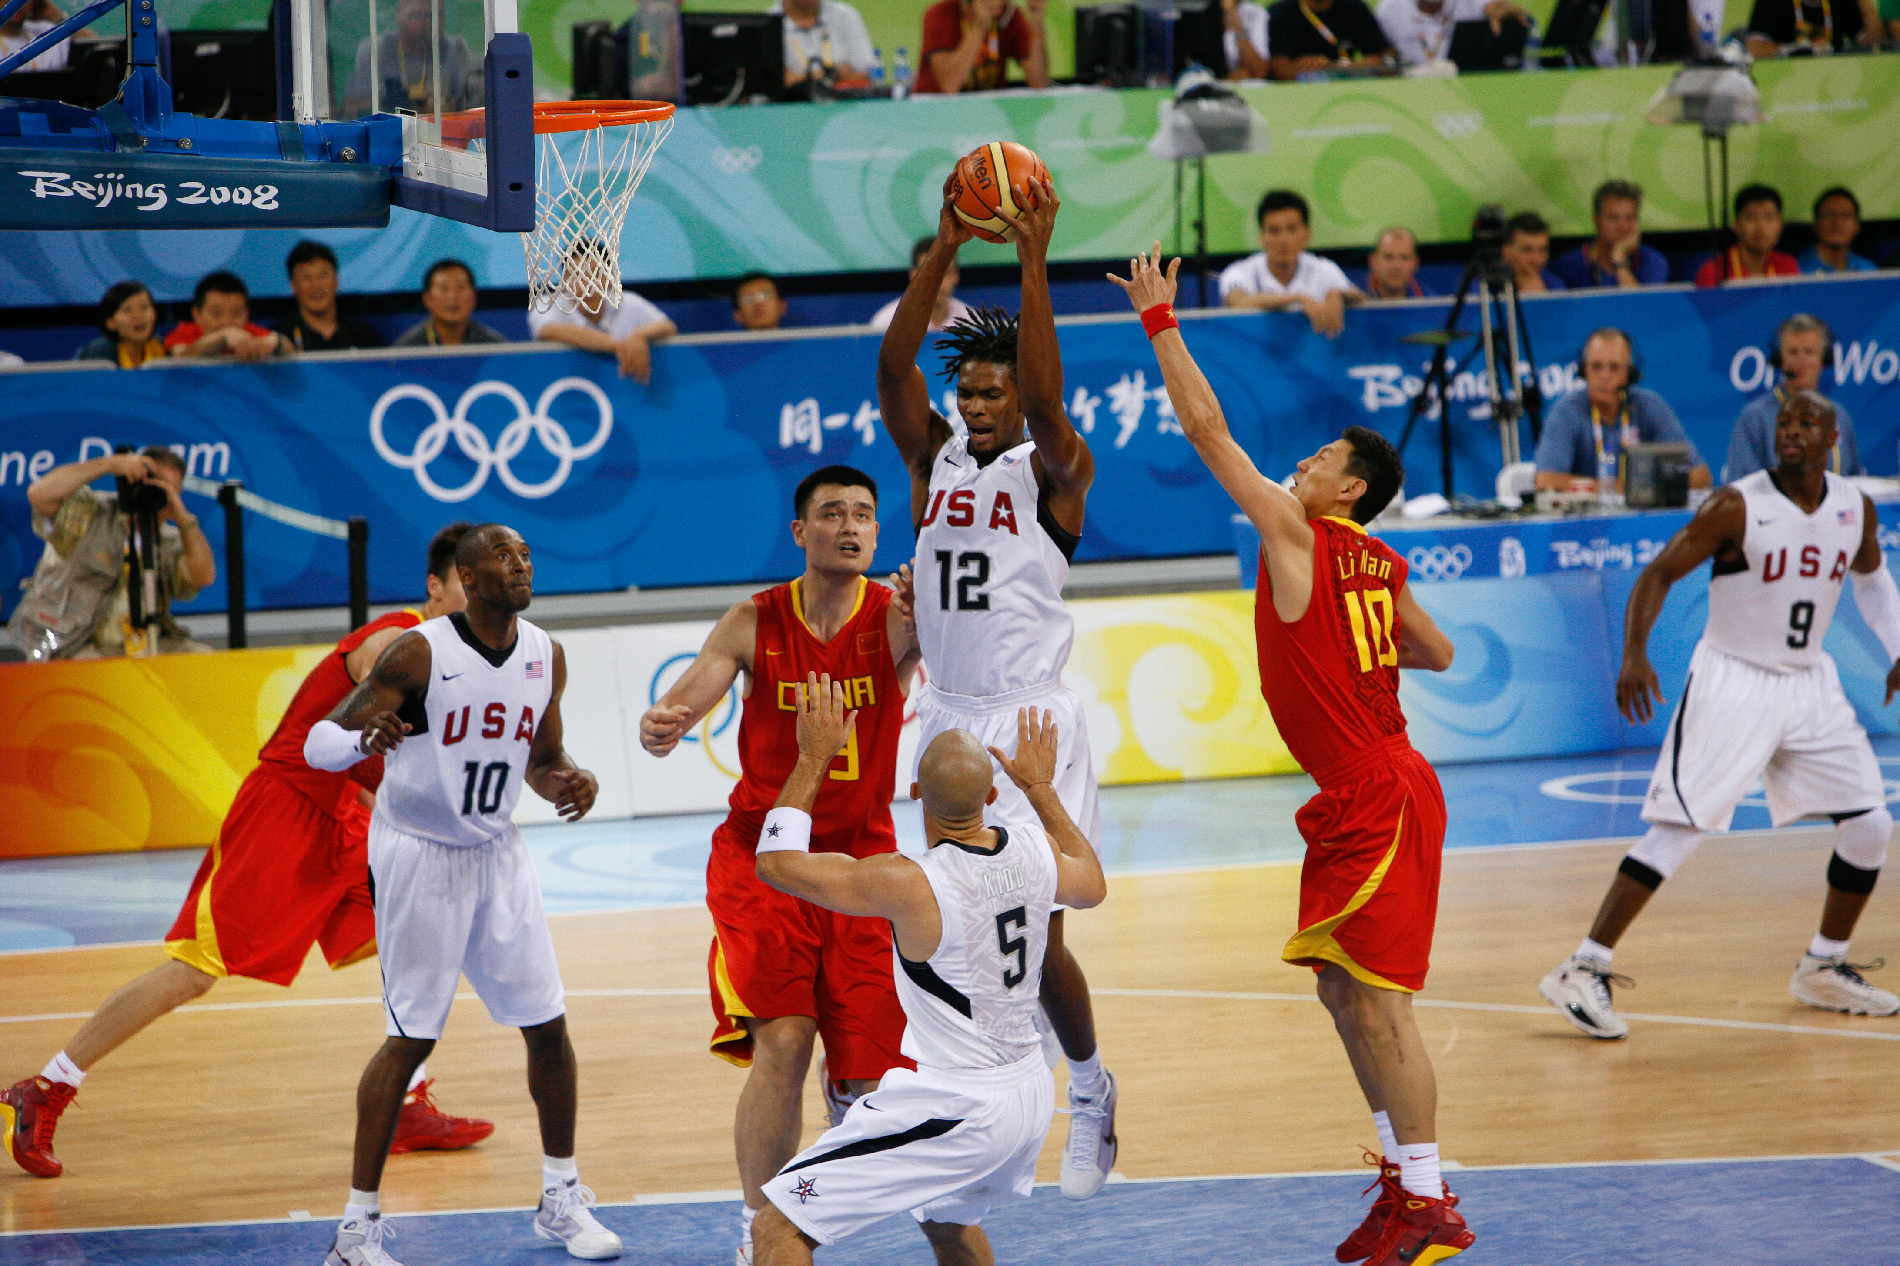
Slide 7
Basketball

