Slide 1
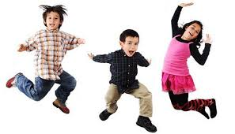
Lesson 1: Listening Topic: Entertainment Year: 4

Slide 2
Lesson Objectives:
In this lesson I will:
listen attentively to a text.
answer questions about a text.
learn about types of entertainment.

Slide 3
Download these resources:
Questions Worksheet
Answers Handout
Listening Text Handout
Post-Task Worksheet

Slide 4
What is Entertainment?
Entertainment is a form of activity that holds the attention and interest of an audience as it gives pleasure and delight.

Slide 5
People entertain themselves differently. Some prefer listening to music or watching a play performed at the theatre. Other prefer watching or playing football, going to the zoo or to the cinema, spending a weekend break in a hotel, the day at the beach …
Which are your preferred places of entertainment?
How often do you visit them?
Do you wish to visit these places more often?

Slide 6
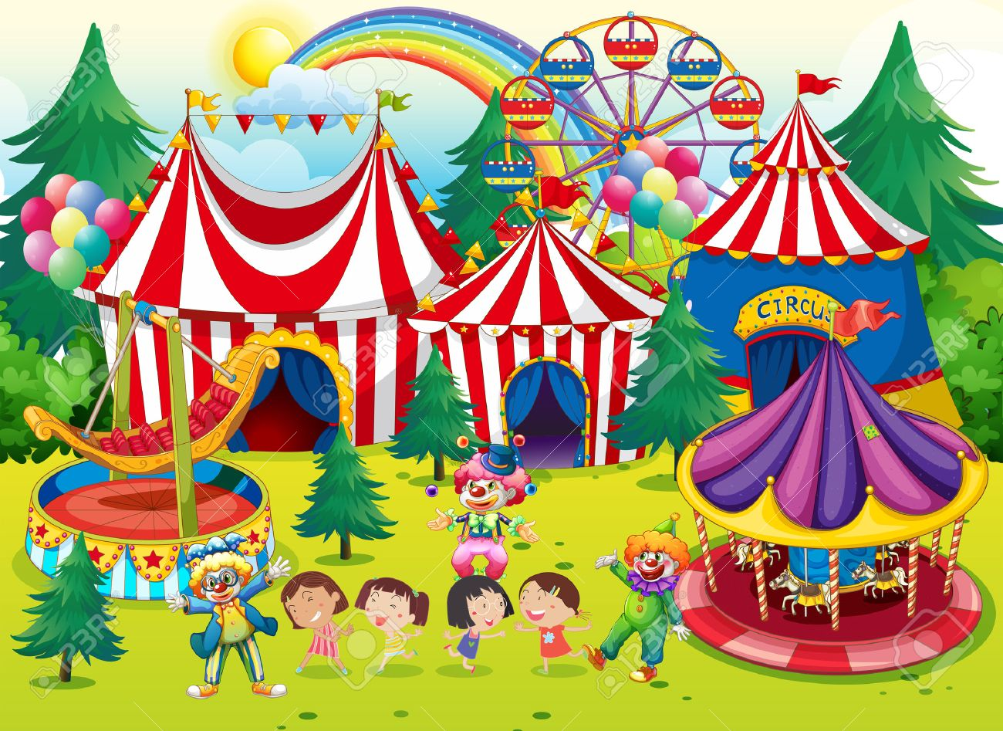
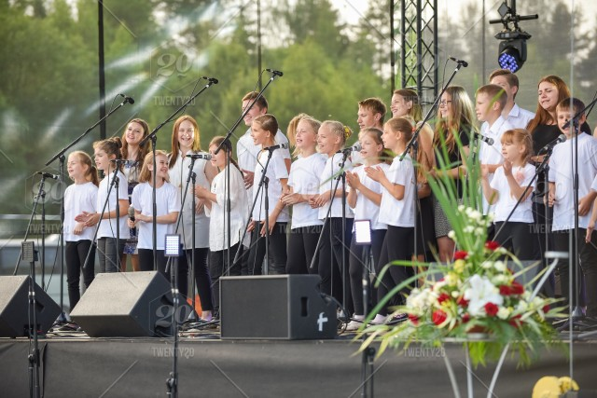
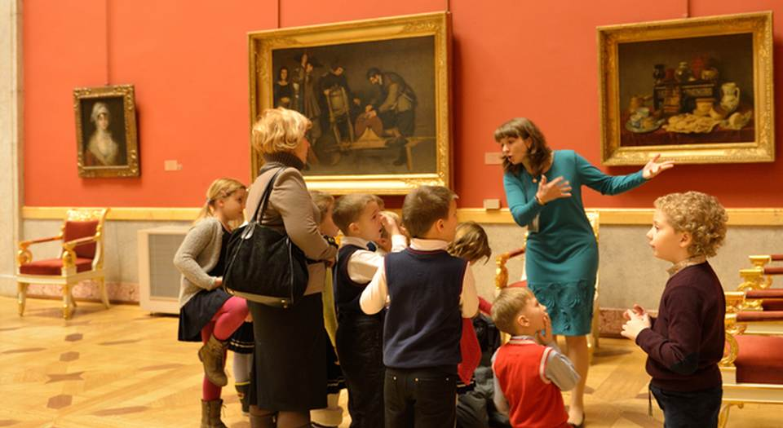
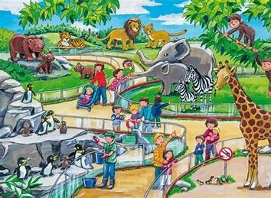
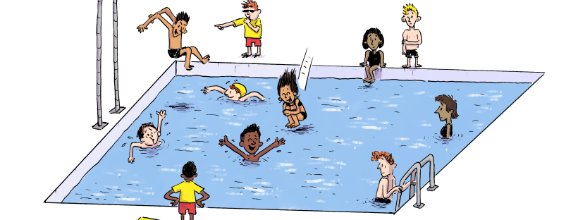

Slide 7
LISTENING TEXT

Slide 8
Pre-Teaching of Words: proudly: having a feeling of pleasure or satisfaction unicycle: a vehicle that has a single wheel and is usually propelled by pedals trapeze artist: a performer or acrobat who walks along a free-swinging bar attached to two ropes fantastic: remarkable

Slide 9
Step 1: READ silently the questions on the worksheet.

Slide 10
Step 2:
LISTEN carefully while I read the text.
LISTEN carefully, while I read the questions.
START ANSWERING the questions.

Slide 11
Step 3:
LISTEN to me read the text for the second time.
LISTEN while I read the questions again.
Try to ANSWER any unanswered questions.

Slide 12
Step 4:
Revise the answers.

Slide 13
Step 5:
CHECK your answers using the answers handout.

Slide 14
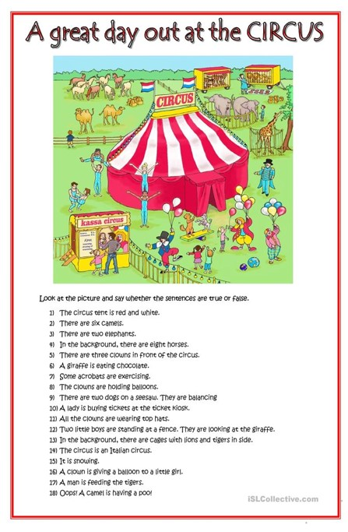
Post-Listening Task

