Slide 1
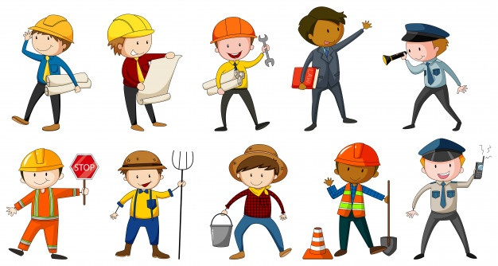
Jobs and Occupations
Lesson 2 - Literature

Slide 2
Notes for the Educator
This lesson is pegged directly to Learning Outcome LIT 5.3 I can respond to simple poems, stories, and plays by speaking and writing briefly about how I feel about the literary texts and about the events and characters in these texts.
Teachers are to refer to the Scheme of Work where each lesson is explained in more detail.
Effects are included to make the presentation more interactive. Please present the PowerPoint in Slideshow Mode.
Wherever possible we have included the use of online apps to enhance the teaching and learning experience.
The Notes section underneath the slides may contain some further points to help you during the lesson.
Teachers are encouraged to adapt and make the necessary changes to this document as required to meet the learners’ language needs.
Audio files or links to websites may be included.
The tasks included in the PowerPoint presentation are also being shared as handouts.
For any comments, feedback or suggestions please email us at: marie-claire.camilleri@ilearn.edu.mt; urieth.attard@ilearn.edu.mt; mary.jude.camilleri@ilearn.edu.mt. You may also call the office on: 25983683.

Slide 3
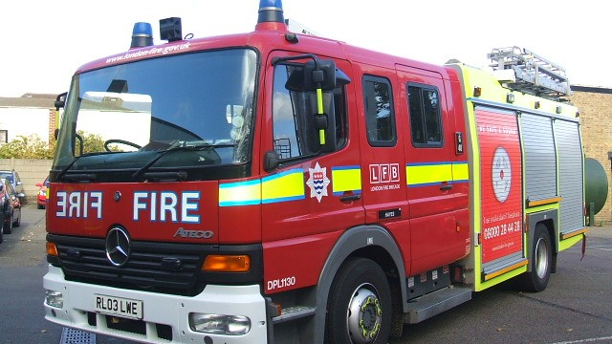
Notes:
We are going to talk about Firefighters.
Look at the lettering on the front of the fire engine. What do you notice about it? Do you know why it is written in this way? This is called ‘mirror writing’. Can you think why it is necessary to have it written in reverse?

Slide 4
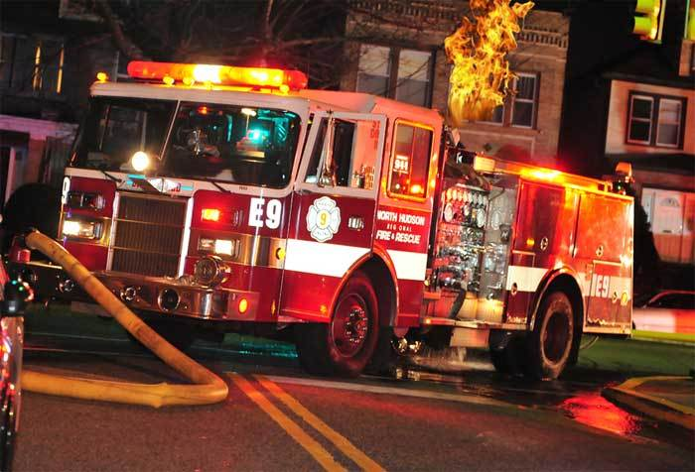
Notes:
How else can drivers know that a fire engine is approaching behind them? They can hear the sound of the siren approaching.
What should drivers do if a fire engine or other rescue service vehicle (ambulance, police car) is approaching behind them? Do you know what number you need to call in case of a fire? 112

Slide 5
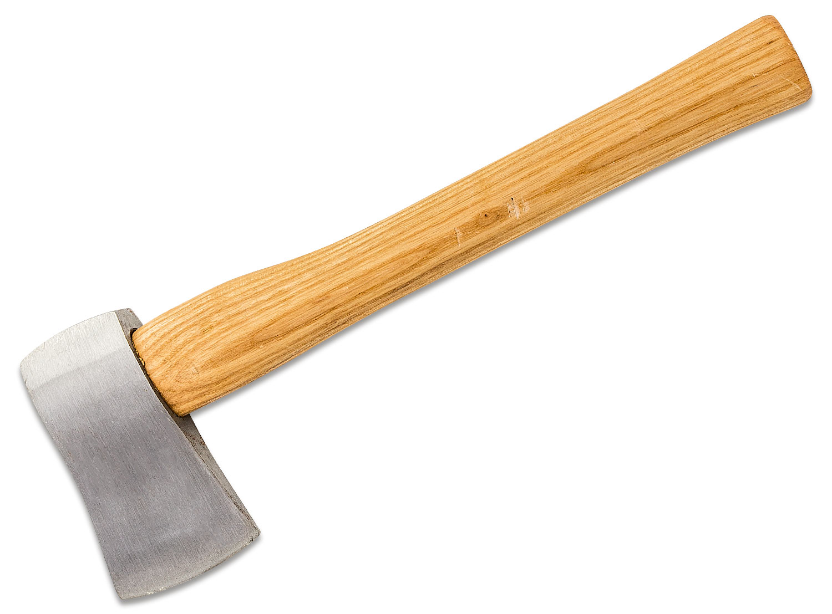
axe
hose

Slide 6
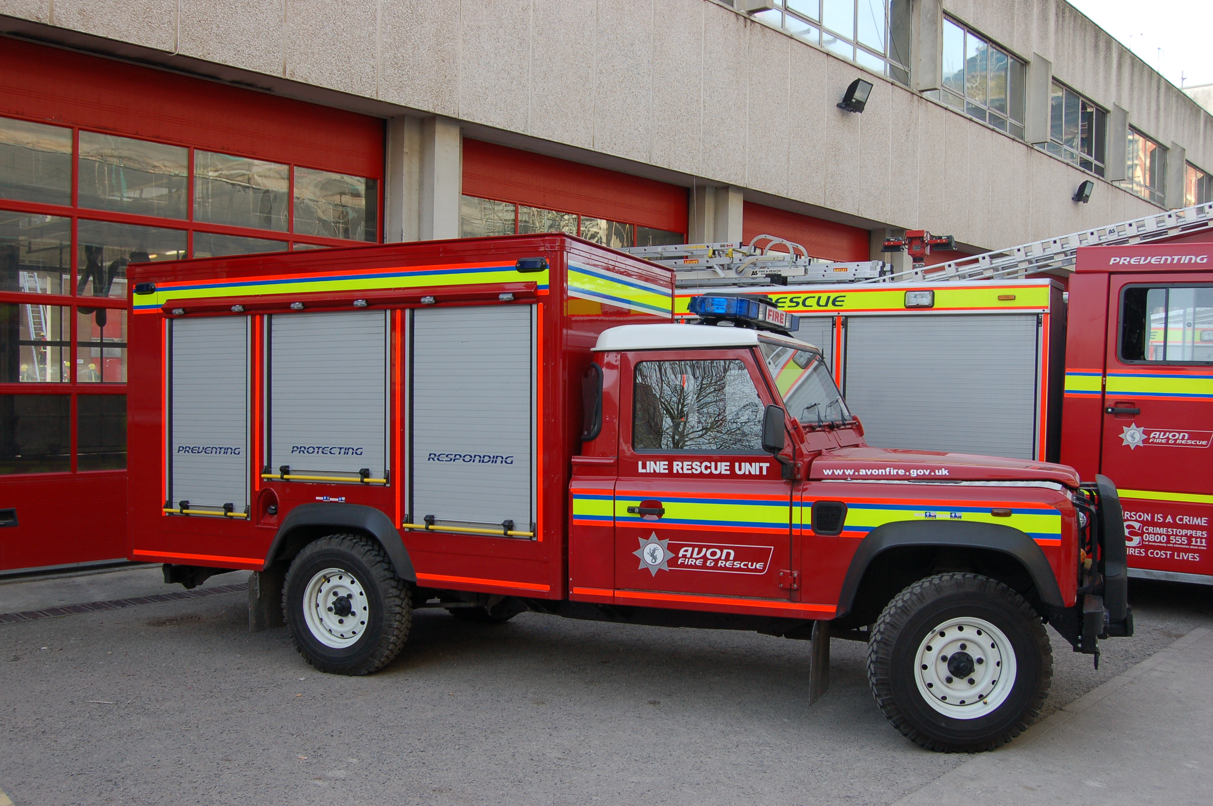
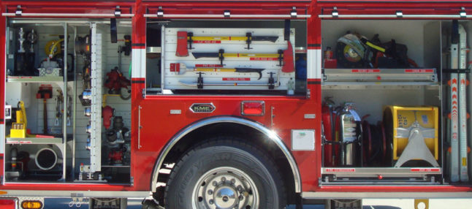
squad car

Slide 7
I am learning how to respond to a story.
I can talk about the main events of the story.
I can look for rhyming words.
I can answer questions about the story.

Slide 8
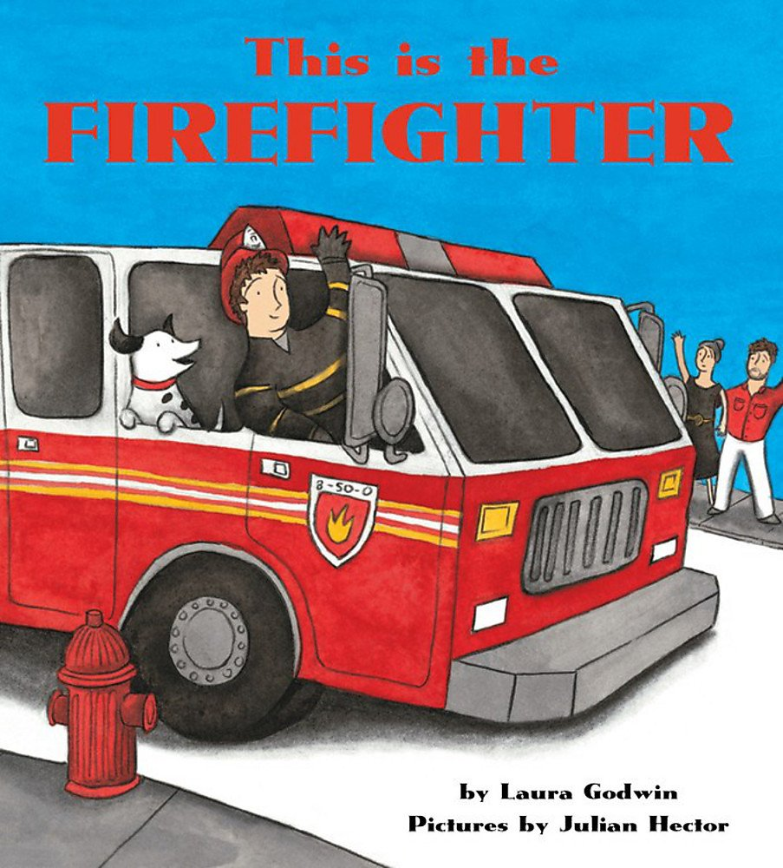
title
picture
author and illustrator

Slide 9
I see…
I think…
I wonder…
Notes:
Let’s take a closer look at the picture now. I see a big red fire truck, a fire man and a dog. I think the fireman is waving to the couple because he saved them from a fire; I wonder how the fire started.

Slide 10
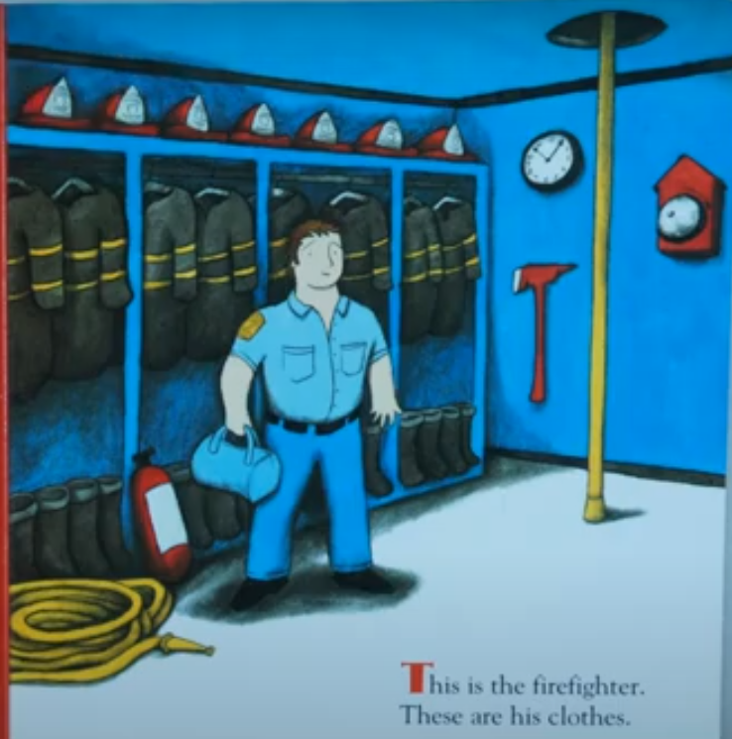
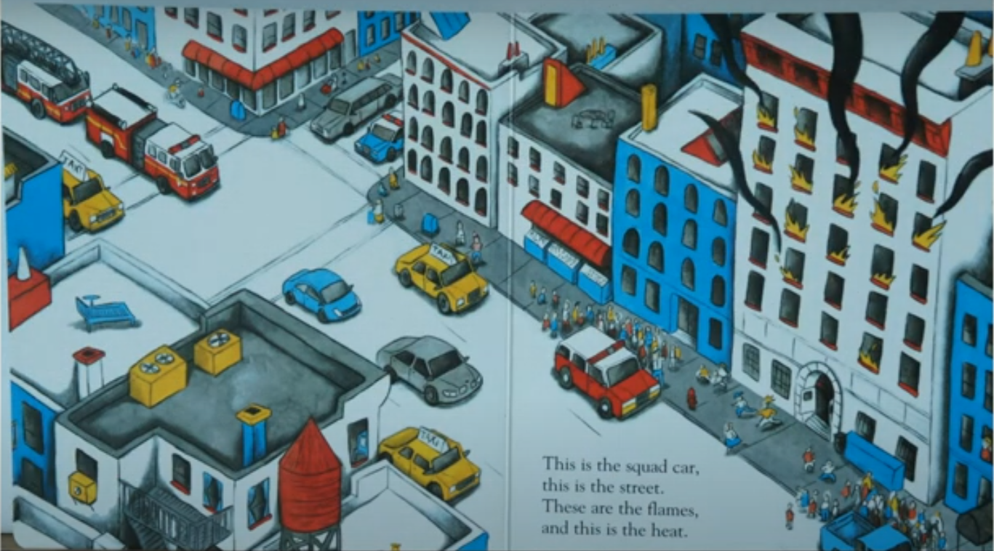
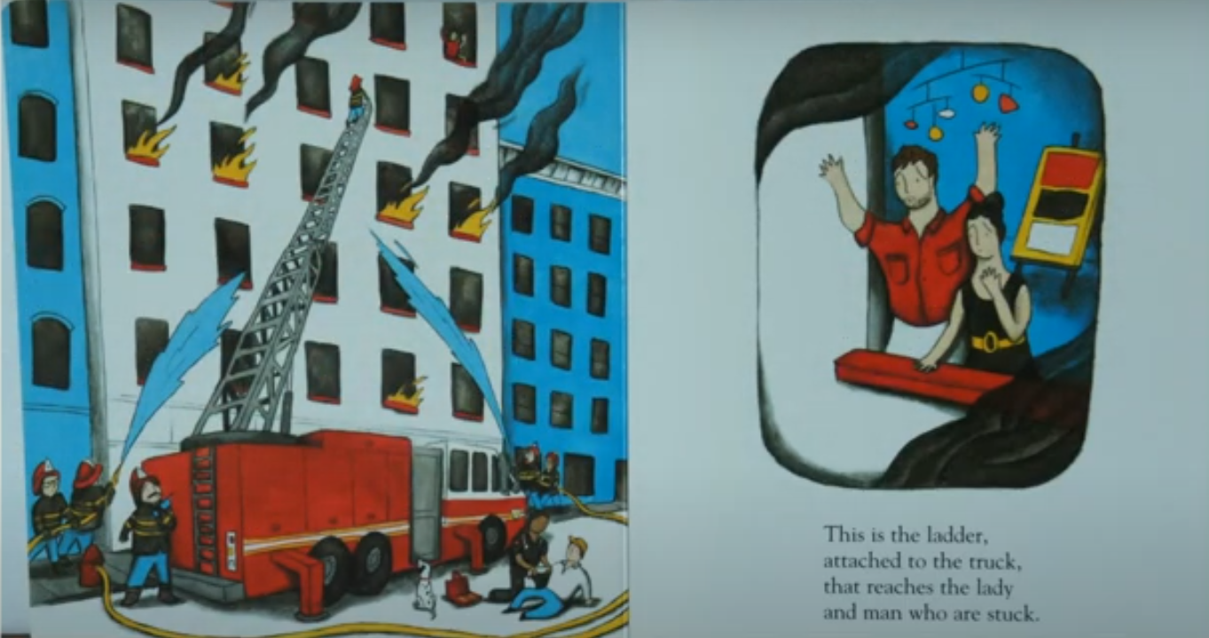
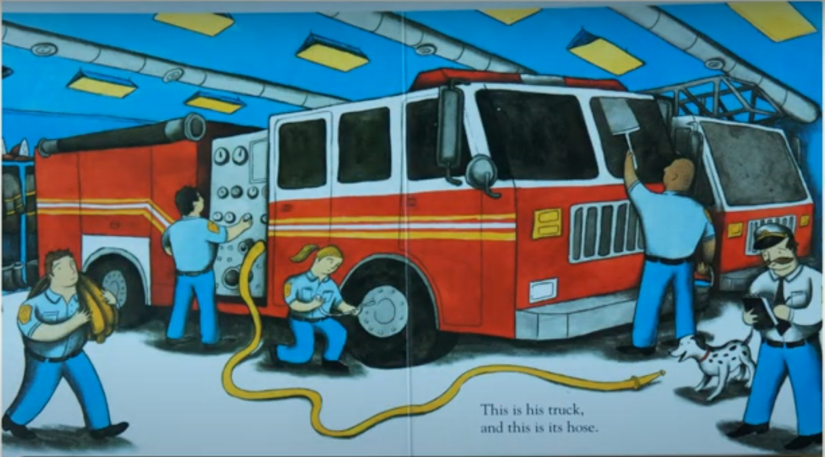
Notes:
As you can see by looking at some of the pictures this book tells us a story. Have you ever read a book or seen a film about fires? Or perhaps, do you know someone who is a fire fighter? What dangers do fire fighters face? Would you like to become a fire fighter, when you grow up?

Slide 11
What was the main problem in the story?
How was it solved?
What was the author’s purpose in writing this book?
Notes:
As I read the story, think carefully about the following questions…

Slide 12
Notes:
Instead of reading the story from the Powerpoint, learers can watch the story via Youtube: https://www.youtube.com/watch?v=2nCbLtBWxxA&t=11s

Slide 13
This is the firefighter.
These are his clothes.

Slide 14
This is the truck,
and this is its hose.

Slide 15
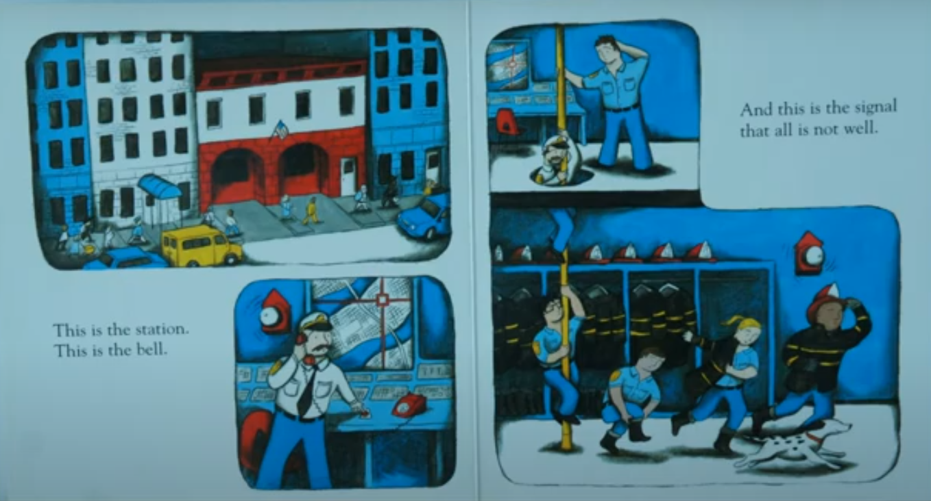
And this is the signal
that all is not well.
This is the station.
This is the bell.

Slide 16
This is the squad car,
this is the street.
These are the flames,
and this is the heat.

Slide 17
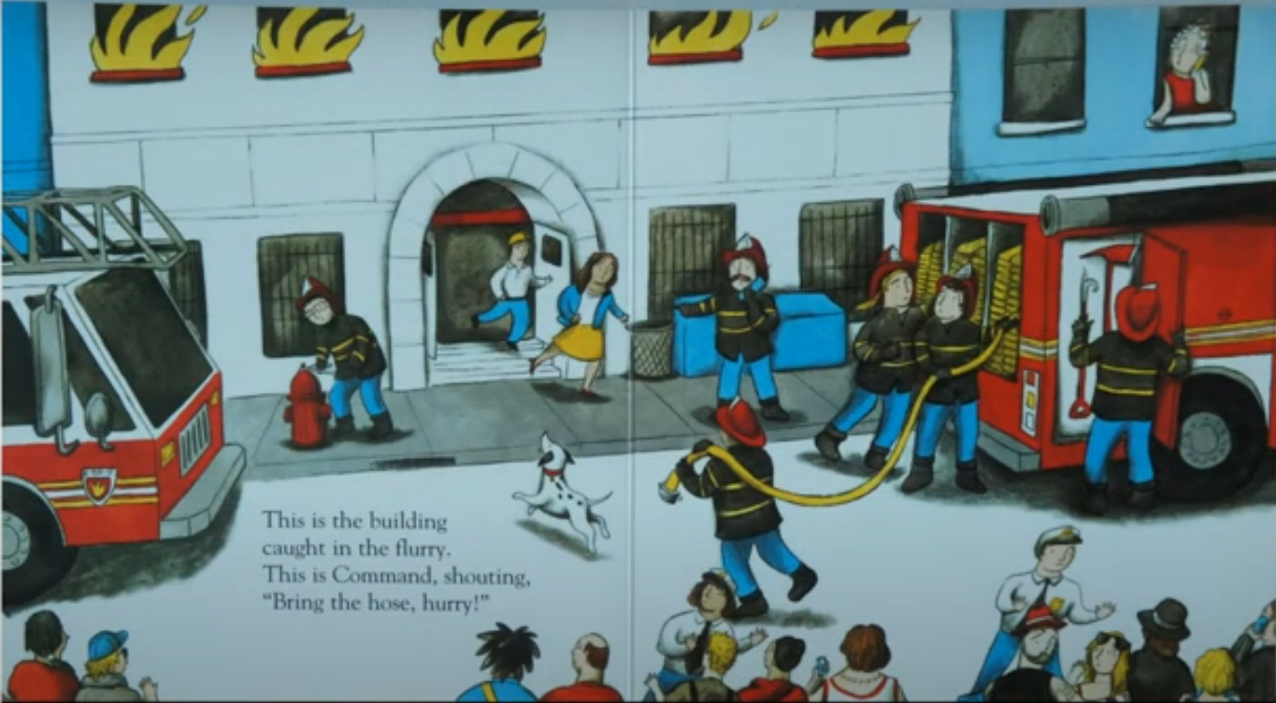
This is the building
Caught in the flurry.
This is Command, shouting,
“Bring the hose, hurry!”

Slide 18
This is the axe
that knocks down
the door.
These are the people
who wait on the floor.

Slide 19
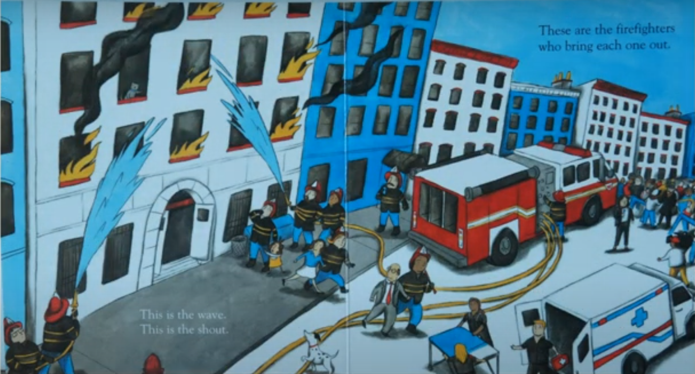
This are the firefighters
who bring each one out.
This is the wave,
This is the shout.

Slide 20
This is the ladder,
Attached to the truck,
that reaches the lady
and man who are stuck.

Slide 21
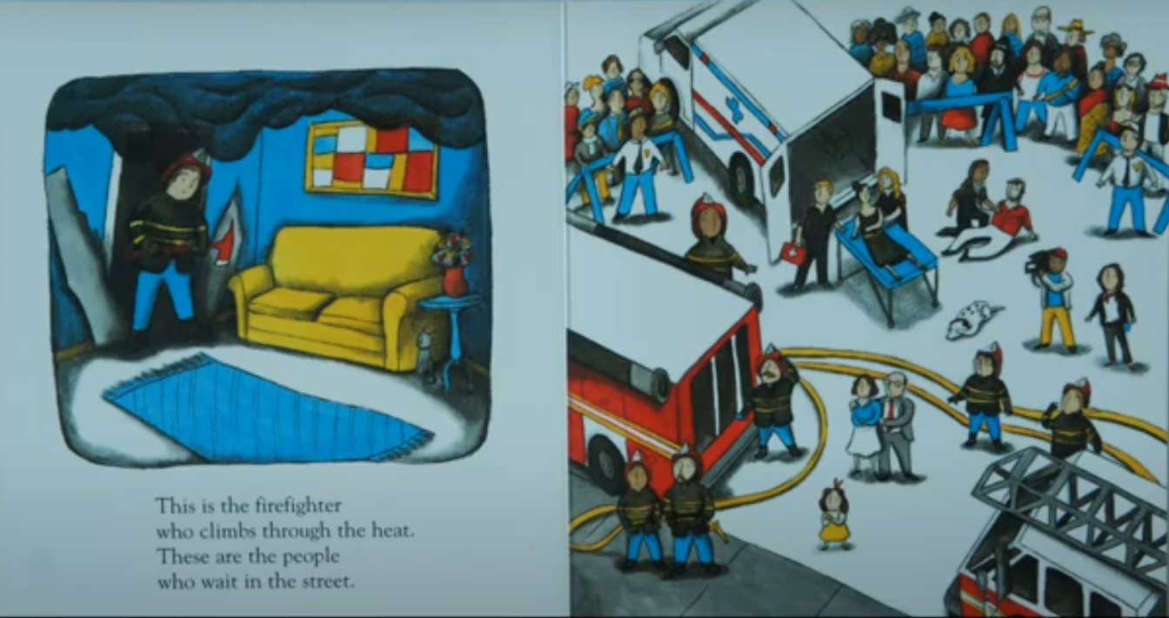
This is the firefighter
who climbs through the heat.
These are the people
who wait in the street.

Slide 22
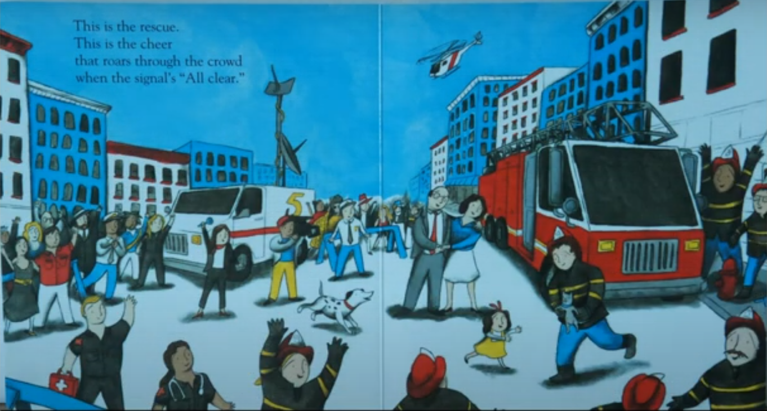
This is the rescue.
This is the cheer
that roars through the crowd
when the signal’s “All clear.”

Slide 23
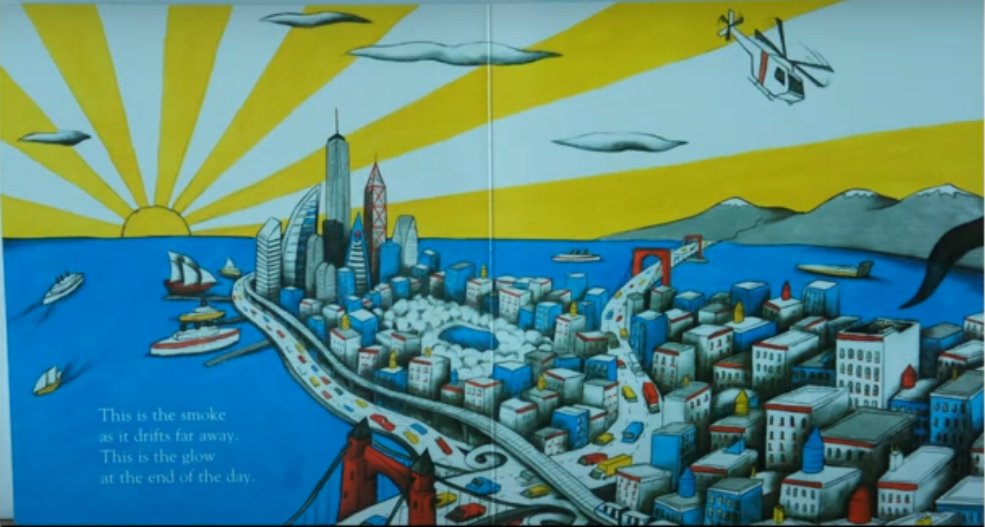
This is the smoke
as it drifts far away
This is the glow
at the end of the day.

Slide 24
This is the company
Eight-fifty-zero.
This is the firefighter.
This is the hero.

Slide 25
1. What is the main problem in the story?
A building caught fire and some people were trapped inside.

Slide 26
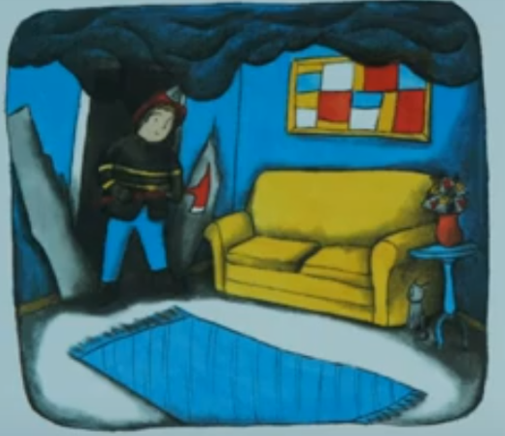
2. How was this problem solved?
The firefighters put out the fire.
They rescued the people by climbing up a ladder.

Slide 27
2. What was the author’s purpose in writing this story?
To entertain the reader with an interesting story.
✓
To inform the reader or give more information.
To persuade the reader to do or believe something.

Slide 28
This is the firefighter.
These are his clothes.
This is the truck,
and this is its hose.
Notes:
Identify rhyming words

Slide 29
This is the station.
This is the bell.
And this is the signal
that all is not well.

Slide 30
This is the squad car,
this is the street.
These are the flames,
and this is the heat.

Slide 31
This is the building
Caught in the flurry.
This is Command, shouting,
“Bring the hose, hurry!”

Slide 32
This is the axe
that knocks down the door.
These are the people
who wait on the floor.

Slide 33
This is the wave,
This is the shout.
These are the firefighters
who bring each out.

Slide 34
Responding to the story: Imagine you were in the street when the firefighters were putting out the fire. What did you see, hear, smell and think?
see
hear
smell
think

