Slide 1
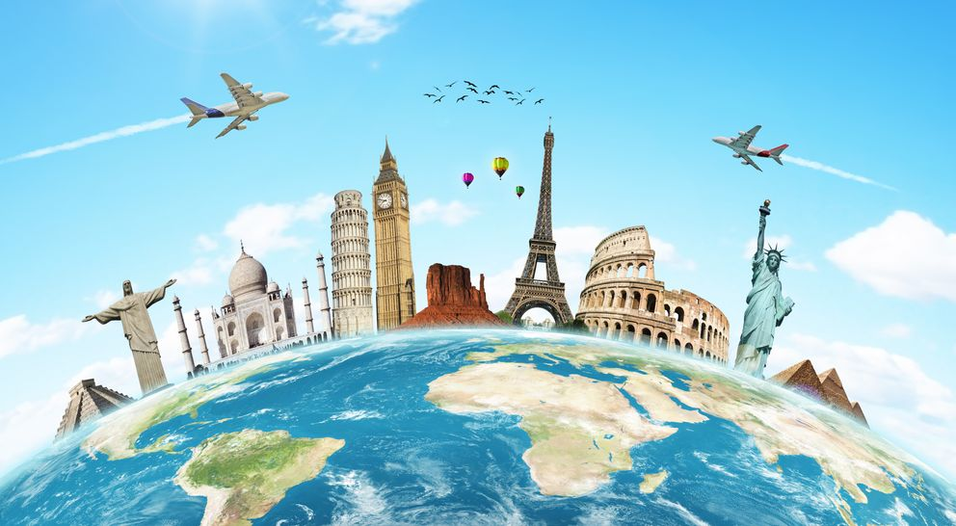
The World Around Us
Lesson 4: Speaking
Notes:
Welcome to our fourth lesson of the unit The world around us. In this lesson we are going to focus on Speaking. We will see photos of different landmarks around the word and use words to describe how these landmarks look.

Slide 2
Notes for the Educator
This lesson is pegged directly to Learning Outcome LS 5.8 I can communicate my own experiences, likes and dislikes fluently and accurately with some allowance to self-correct in the process.
Teachers are to refer to the Scheme of Work where each lesson is explained in more detail.
Effects are included to make the presentation more interactive. Please present the PowerPoint in Slideshow mode.
Wherever possible we have included the use of online apps to enhance the teaching and learning experience.
The Notes section underneath the slides may contain some further points which can be developed during the lesson.
Teachers are encouraged to adapt this PowerPoint presentation to meet the learners’ language needs.
Audio files or links to websites may be included.
Tasks included in the PowerPoint presentation are also being shared as handouts.
For any comments, feedback or suggestions please email us at: marie-claire.camilleri@ilearn.edu.mt; urieth.attard@ilearn.edu.mt; mary.jude.camilleri@ilearn.edu.mt. You may also call the office on: 25983683.
Notes:
.

Slide 3
I am learning how to talk about and describe places of interest.
I can use adjectives to describe how the place looks.
I can describe what I can see and do at this place.
I can self correct some mistakes I make while speaking.
Notes:
So the aim of this lesson is to learn how to talk about and describe different places of interest. We will know that we are doing so by being able to use adjectives to describe how the landmark looks, talk about what you can do or see at this place and by being able to self correct mistakes while speaking.

Slide 4
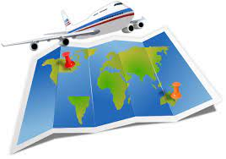
Where did they go?
Activity 1
Notes:
So, let’s get started with our first activity. We are going to meet some people who have just returned from a holiday abroad. They are going to say something say about where they went and what they saw.

Slide 5
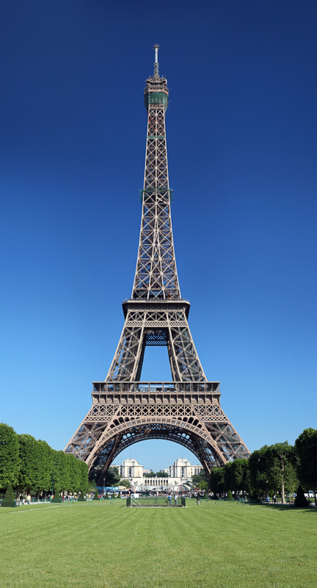
Name | Mark
When | Last month
Destination | Paris, France
Places visited | Eiffel Tower
Description | A very tall metal tower Memorable experience Beautiful view from the top
Eiffel Tower
Mark
Hello. I’m Mark. Last month I visited Paris in France. I saw the Eiffel Tower. It is a very tall metal tower. It was a memorable experience and the view from the top of the tower is beautiful.
Notes:
So let’s understand the information in the table. This person is Mark. Last month he went to Paris in France and there he visited the Eiffel Tower. He says that the Eiffel Tower is a very tall metal tower. He says that it is a memorable experience, something that he will always remember and that the view from the top of the tower is beautiful. Now let’s see what he’s going to say. The parts in red are the information in the table.

Slide 6
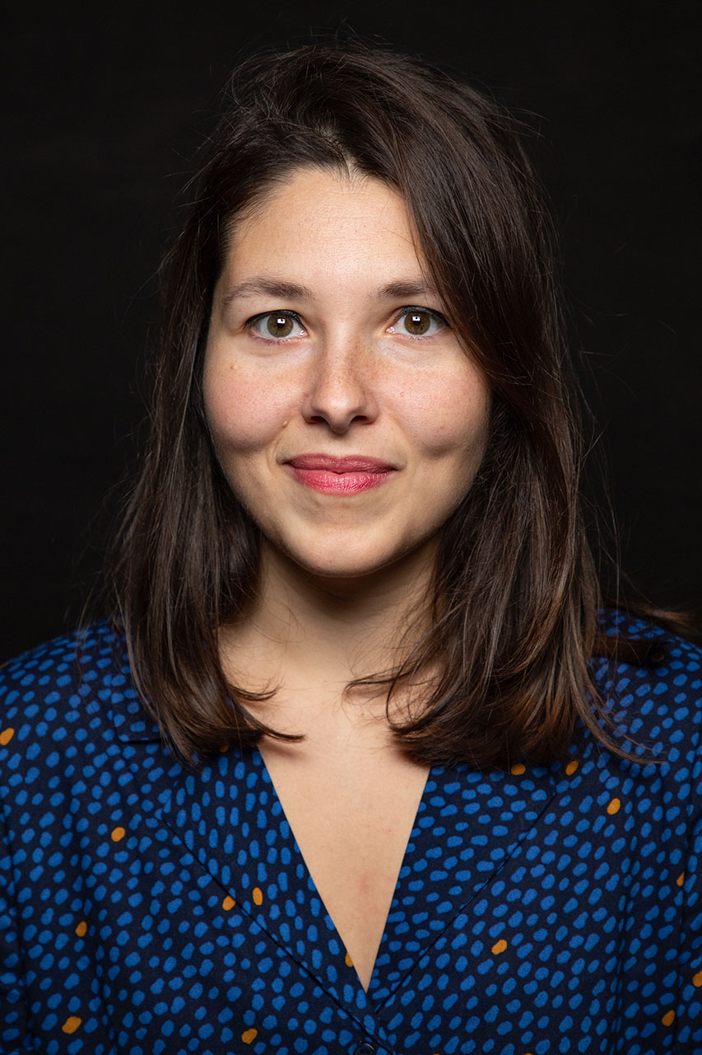
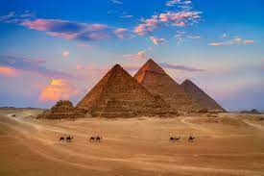
Name | Sasha
When | In January
Destination | Giza, Egypt
Places visited | Pyramids
Description | Huge, historic Built a long time ago by the ancient Egyptians tombs
Sasha
Hello. I’m Sasha. In January I visited Giza in Egypt. I saw three huge pyramids there. They are very old and they were built a long time ago by the ancient Egyptians. They were used as tombs.
Pyramids of Giza
Notes:
.

Slide 7
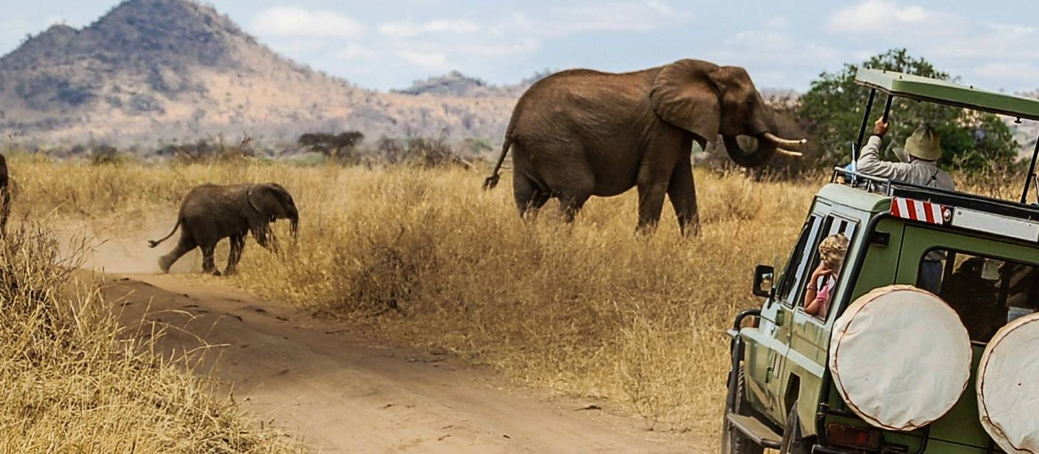
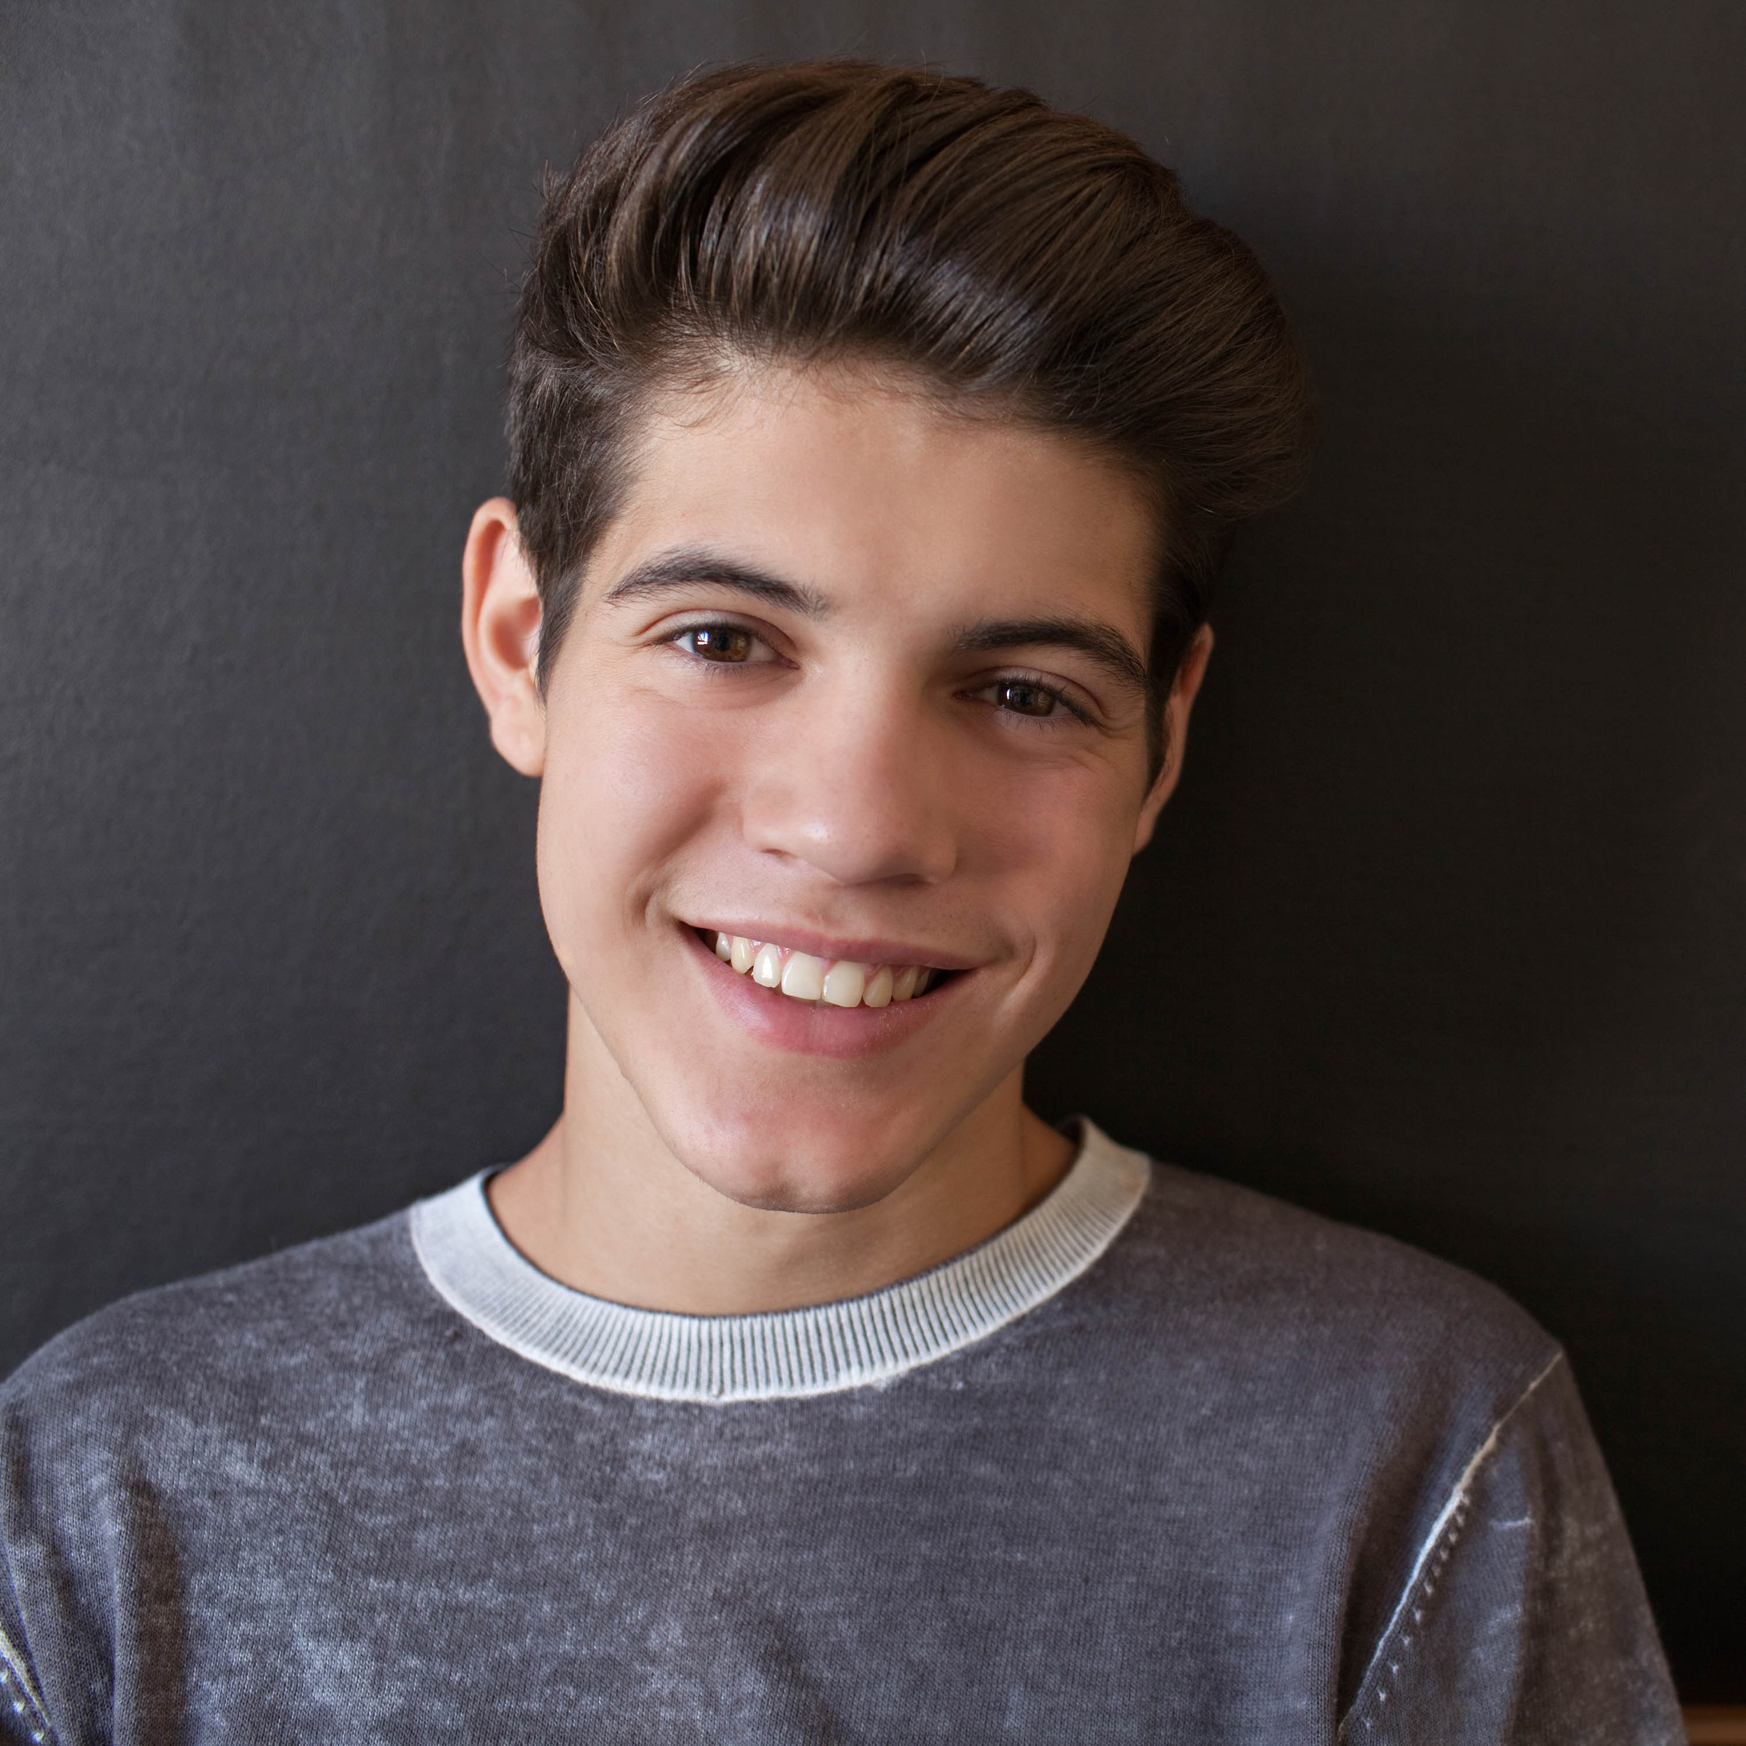
Name | Rob
When | Last year
Destination | Kenya, Africa
Places visited | Safari tour
Description | Wild animals : Elephants, giraffes, zebras, leopards and tigers Amazing adventure
Rob
Safari tour
Hi! I’m Rob. Last year I went on a Safari Tour in Kenya in Africa. There I saw a lot of ____________________such as _______________________________. It was ________________________!

Slide 8
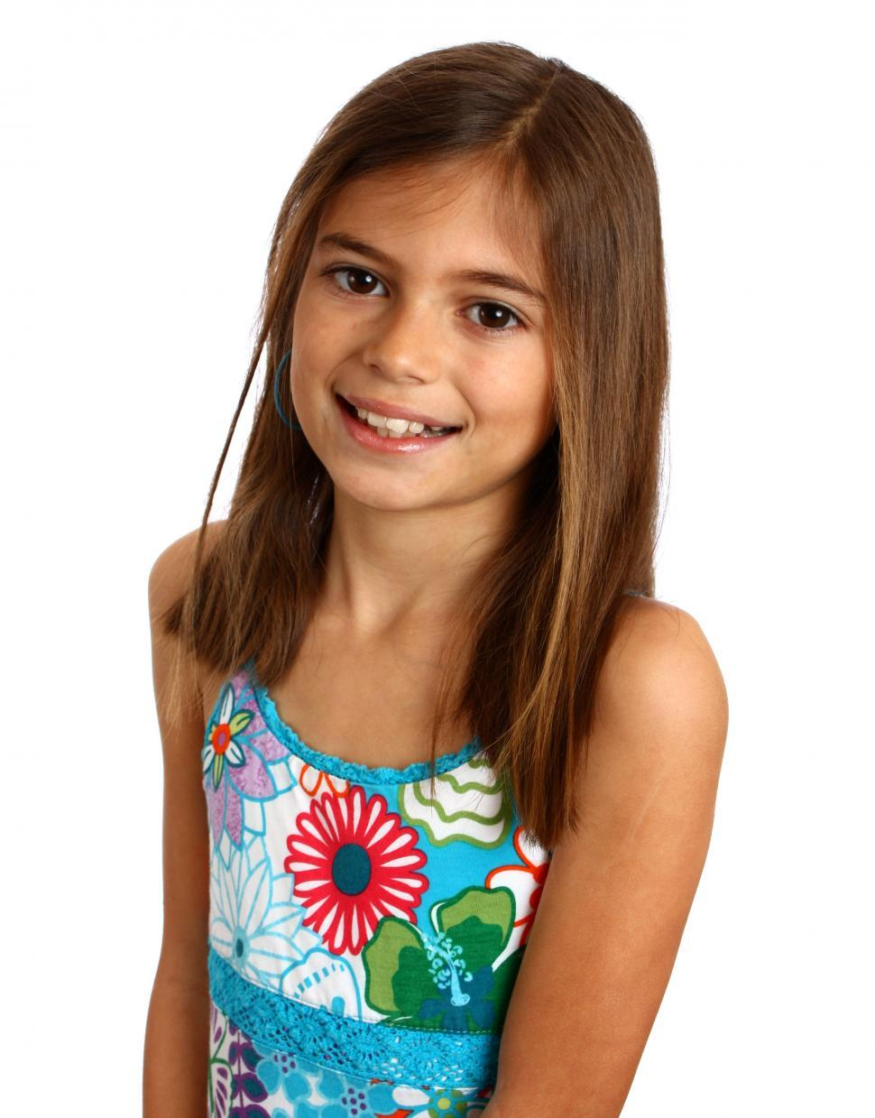
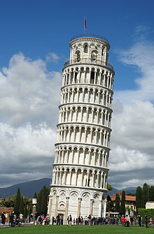
Lisa
Name | Lisa
When | Last Summer
Destination | Pisa, Italy
Places visited | Tower of Pisa
Description | Leaning Famous Historic Built a very long time ago
Tower of Pisa
Hi! I’m Lisa. Last Summer I went to ___________________.. There I saw the _____________________. It is a ___________________ because it was ____________________________.

Slide 9
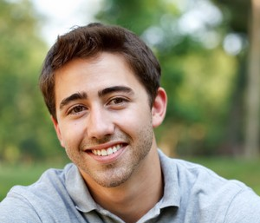
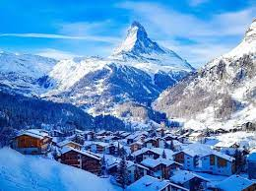
Name | Adam
When | During the Christmas holidays
Destination | Swiss Alps, Switzerland
Places visited | mountains
Description | High, steep Very cold Snow covered impressive
Adam
Swiss Alps
Hi! I’m Adam. _____________________________I went _________________________________.. The mountains were quite ________________ and most were _____________________. It was very ____________________________..

Slide 10
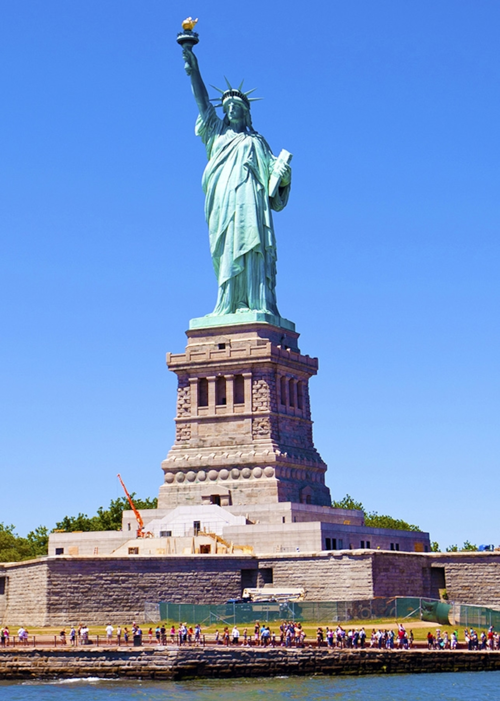
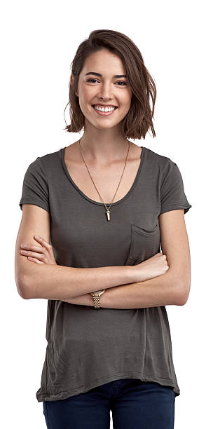
Rebecca
Name | Rebecca
When | A month ago
Destination | New York, America
Places visited | Statue of Liberty
Description | made of copper famous A woman holding a torch with a burning flame, wearing a crown on her head
Hi! I’m Rebecca. ______________I went to ____________ in ______________.. There I saw the _________________ ________________________________________. It is made ________________________________. It shows a woman ________________________________________..

Slide 11
A trip around the Maltese Islands
Activity 2
Notes:
We have been talking a lot about different countries in the world and different places and environments. Now it’s time to take a look at what is around us. We are going on a tour around the beautiful Maltese islands, our home islands.

Slide 12
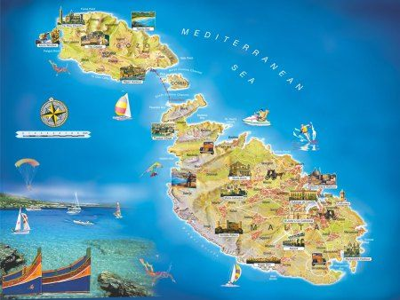
Notes:
In our first lesson of this unit, I asked you to think about and research some popular sights in Malta. Which places did you write about? Let’s see if you thought of these places

Slide 13
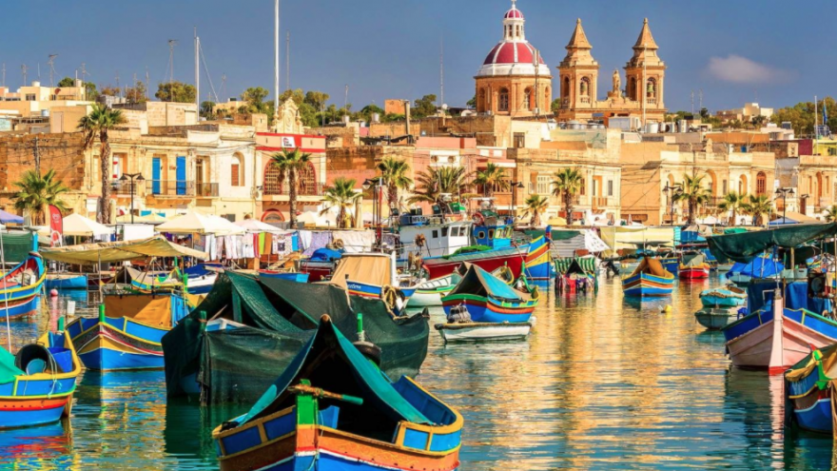
This is Marsaxlokk.
It is a fishing village in Malta.
Here you can see many boats with bright colours floating on the calm water.
Marsaxlokk is very popular with tourists.
Notes:
Do you recognise this place? It is a fishing village called Marsaxlokk. Here you can see the traditional luzzu or kajjikk, boats used for fishing. Now, imagine you visited this place and took this picture with the camera on the mobile. How can you describe it? You can start by saying This is….

Slide 14
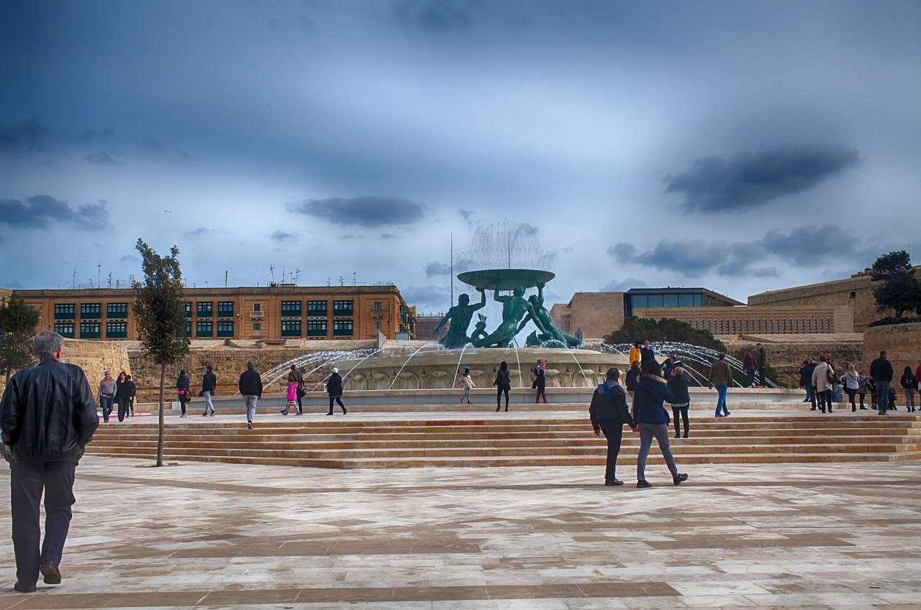
Triton Fountain
Valletta
big and beautiful
large square before entering Valletta
many people taking photos
This is the __________ in _____.
It is ___________ .
Many people stop to _____________

Slide 15
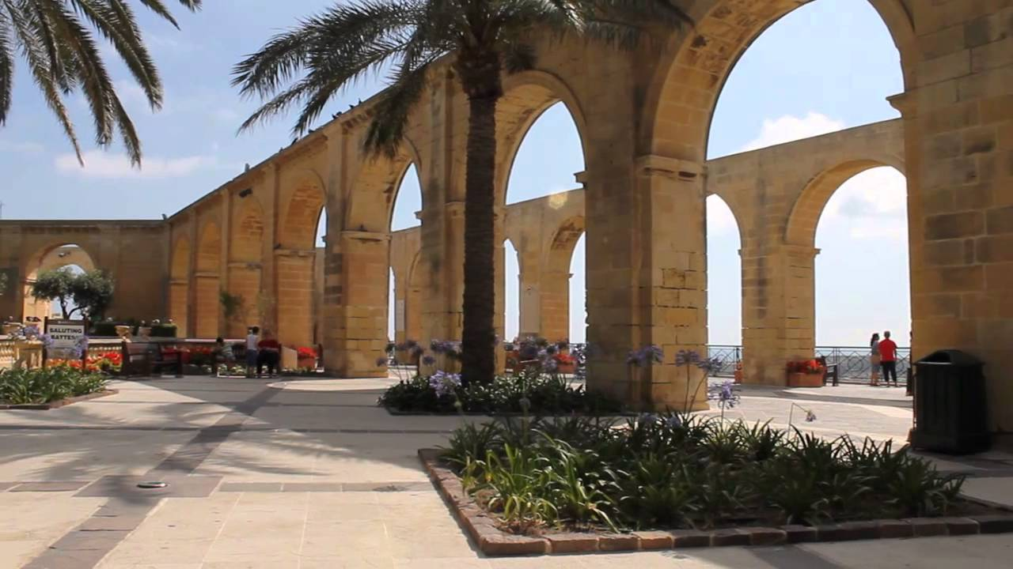
Upper Barrakka Gardens
Valletta
fantastic views of the Grand Harbour
canons fired everyday at noon
These are the __________ in _____.
From here, you can enjoy ___________ .
Everyday _____________

Slide 16
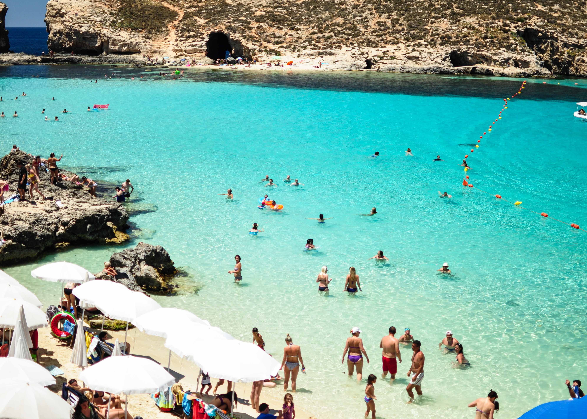
Blue Lagoon
Comino
crystal clear/ clear blue water
rocky beach
amazingly beautiful
crowded - Summer
This is ______________.
The water here is ___________.
There is a _________.
In Summer it ____________.

Slide 17
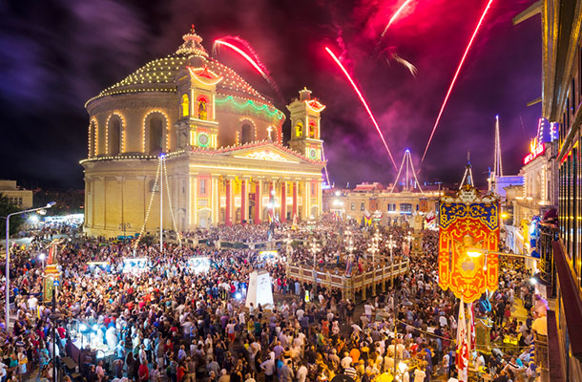
a village feast
Mosta
round church – big dome
many people visit
band marches / decorations / fireworks show
This is ______________.
The church is _________________.
Many people visit ____________.
The streets are _____________.

Slide 18
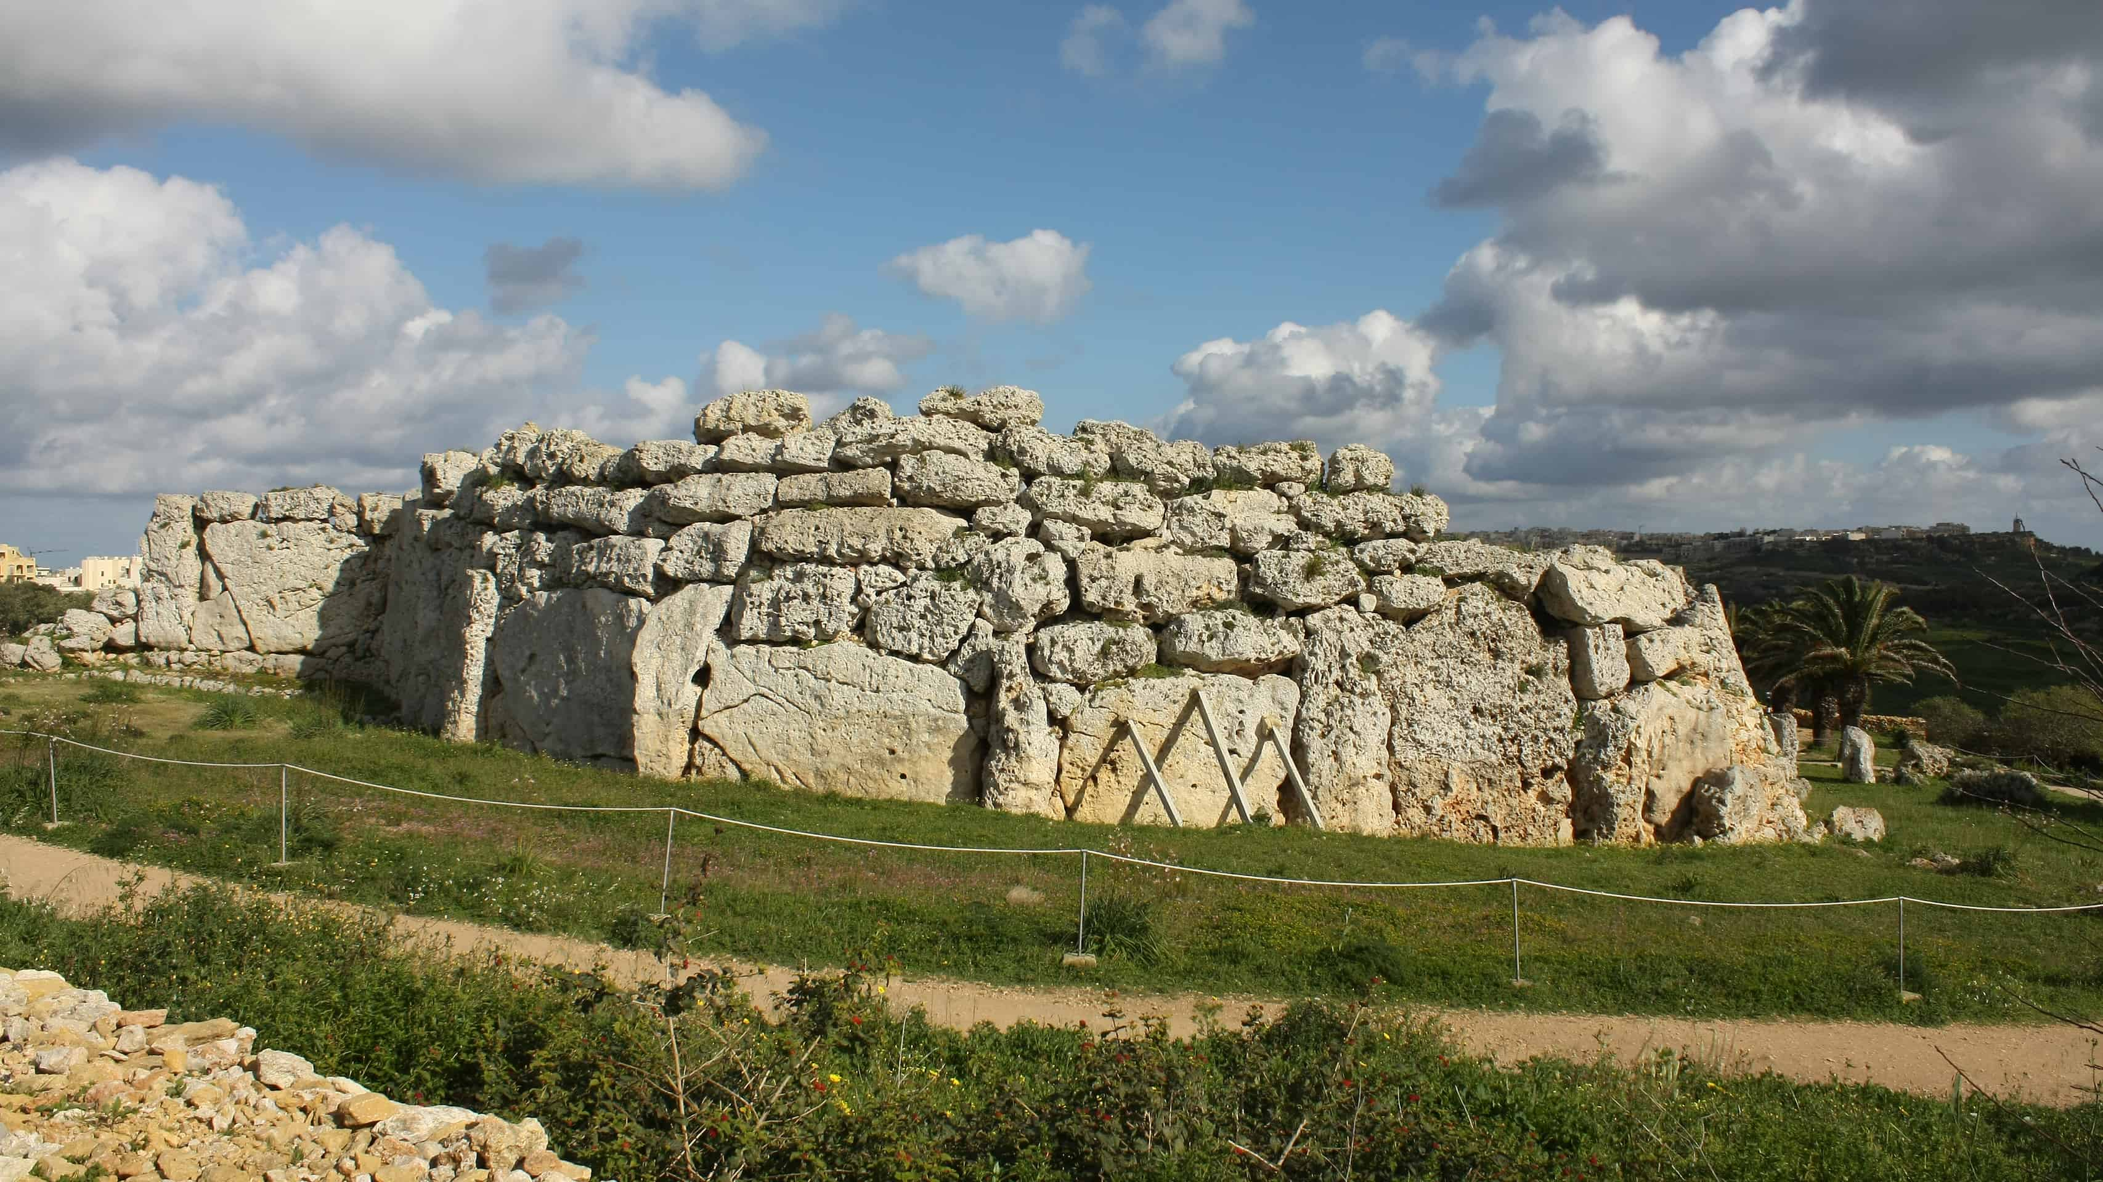
Ggantija Temples
Gozo
pre-historic – over 5500 years old
gigantic stones
beautiful and impressive
This is ______________.
These temples are ________ because _______.
You can see _________.

Slide 19
This is ______________.
Here you can see_____________.
It is very popular with _______.
Notes:
Now, you can do the same for another important local site of your choice. Use the word bank to help you come up with adjectives to describe your place of interest.

Slide 20
Thank you for using this resource. Check out our latest resources below.

