Slide 1
Lesson 2 Reading
Year 5
English

Slide 2
Lesson Objectives
You will:
learn what an argumentative article is.
learn how to use the dictionary to find the meaning of new words.
listen to a text being read aloud.
read a text silently and aloud.
answer questions about the text.

Slide 3
Lesson Resources
Dictionary
Reading Text
Questions Worksheet
Answers Handout

Slide 4
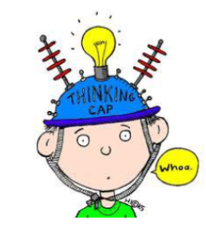
Pre-Reading
Look at the reading text worksheet.
What do you think the text is about?
Why do you think so?
Where do you think the text was taken from?

Slide 5
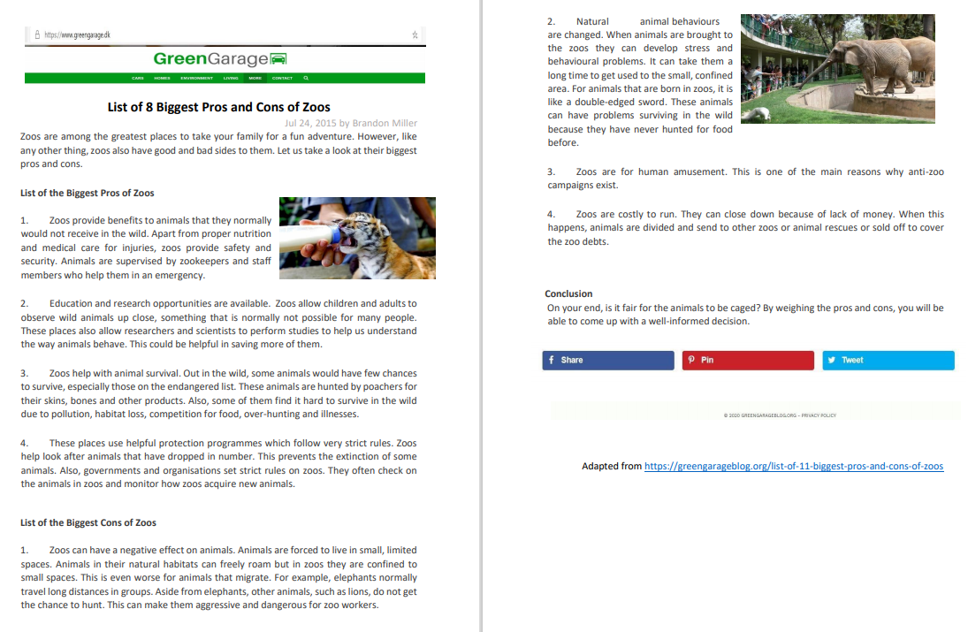

Slide 6
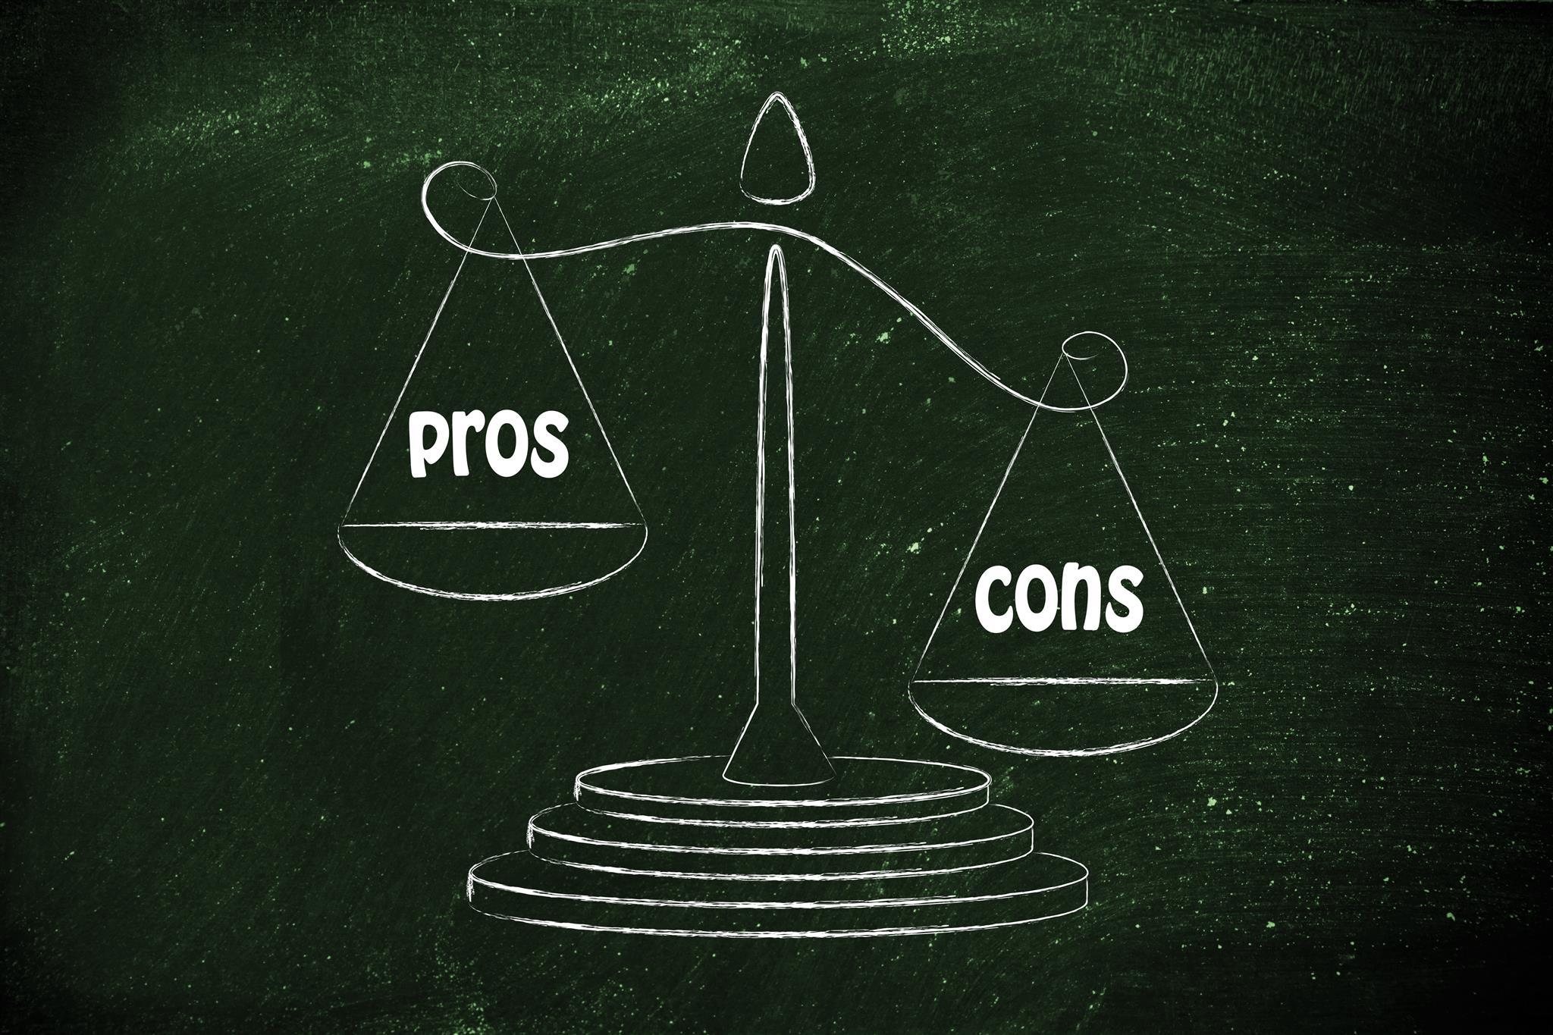
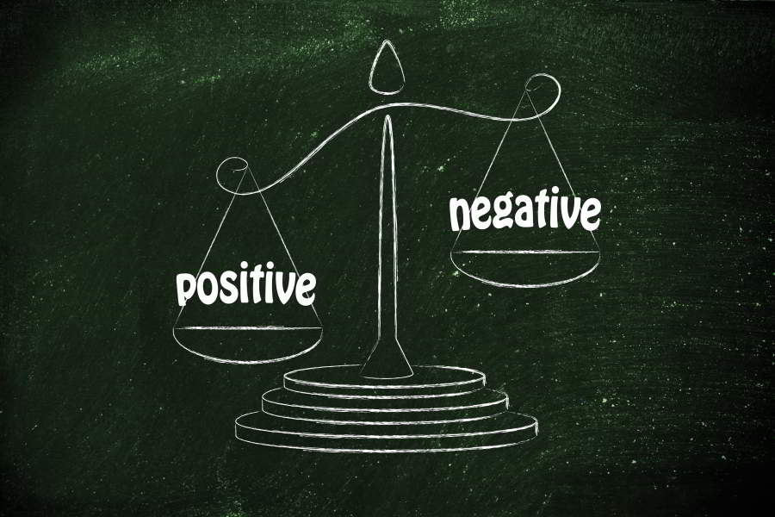
Argumentative Article
What is an argumentative article?

Slide 7
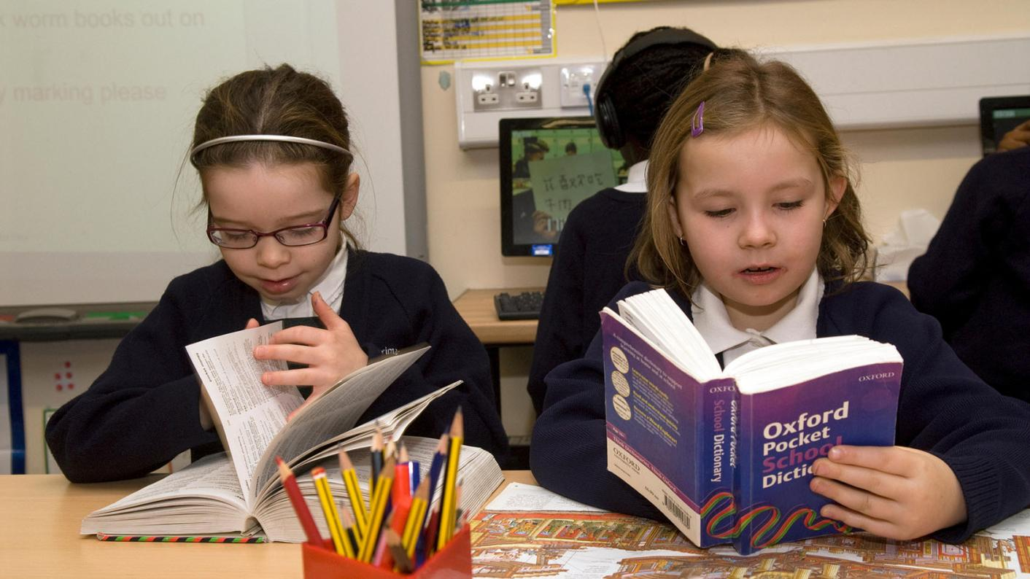
Using a dictionary!

Slide 8
New Words
nutrition …
the kind of food you eat and the way it affects your health

Slide 9
New Words
security endangered poachers extinction roam migrate aggressive confined amusement campaigns debts

Slide 10
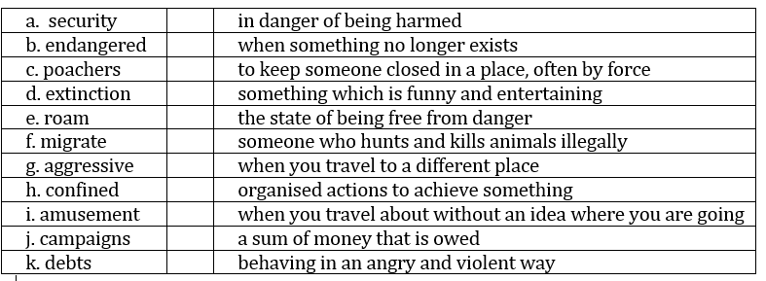
Match

Slide 11
Step 1
READ the text on the handout and the questions on the worksheet.

Slide 13
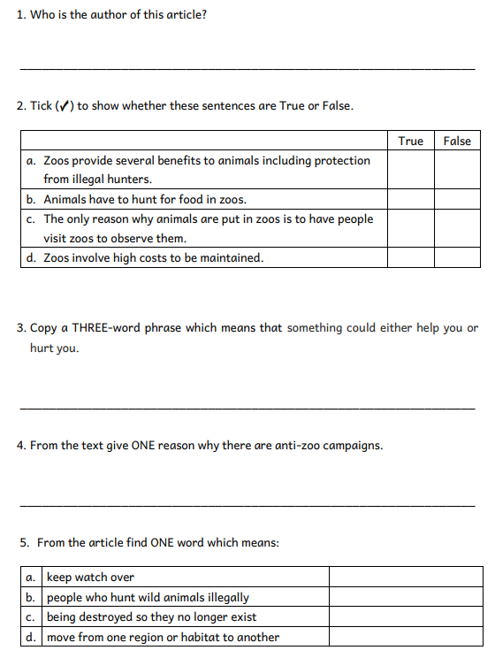
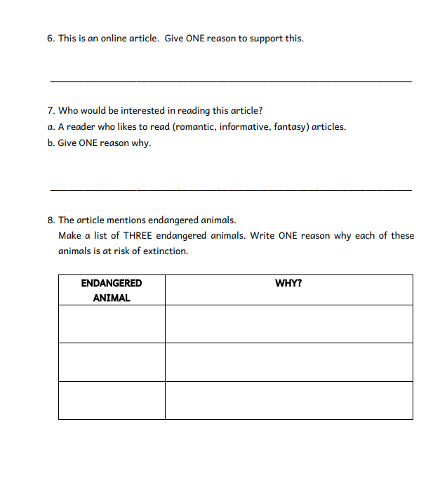

Slide 14
Step 1
After you read the text and questions you should be able to ANSWER the following question:
WHAT IS THE TEXT ABOUT?

Slide 15
Step 2: Discuss the question
What is the text about?
The text is an argumentative article.
It consists of four advantages and four disadvantages of zoos.
The four advantages are:
nutrition, medical care, safety, security, help in case of an emergency.
education and research opportunities.
protect animals from the dangers of living in the wild e.g. pollution, poachers, habitats destruction …
preserve animals that are at risk (endangered animals).

Slide 16
Step 2: Discuss the question
The four disadvantages are:
animals live in small, limited spaces - they cannot roam or hunt.
the natural animal behaviour changes – if they have lived in the wild, they will find it difficult to get used to zoo life; if they were born in a zoo they will not have the skills to cope in the wild.
animals are kept in captivity for humans to amuse themselves.
if the zoo closes down the animals have to be taken somewhere else.

Slide 17
Step 3
READ the text and questions again.
Then try to ANSWER the following questions:
Who has written the article?
When was the article written?
Why are zoos useful to researchers and scientists?
Why are animals hunted by poachers?
What problems can elephants and lions have in a zoo?
Which animals will find it difficult to hunt for themselves?

Slide 18
Step 4: Discuss the questions
Who has written the article?
Brandon Miller
When was the article written?
It was written on the 24th of July, 2015.
Why are zoos useful to researchers and scientists?
They can perform studies on animals to understand them more.
Why are animals hunted by poachers?
For their skins, bones and other products.
What problems can elephants and lions have in a zoo?
Elephants cannot roam and lions cannot hunt.
Which animals will find it difficult to hunt for themselves?
Animals which are born in a zoo.

Slide 19
Step 5
LISTEN to me as I
READ the text.

Slide 21
Step 6
READ the text ALOUD.

Slide 22
Step 7
Let’s DISCUSS the
Questions Worksheet.

Slide 24
Step 8
WORK OUT
the
Questions Worksheet.

Slide 25
Step 9

Slide 26
Step 10
CHECK your answers using the
Answers Handout.

Slide 27
Thank You!

