Slide 1
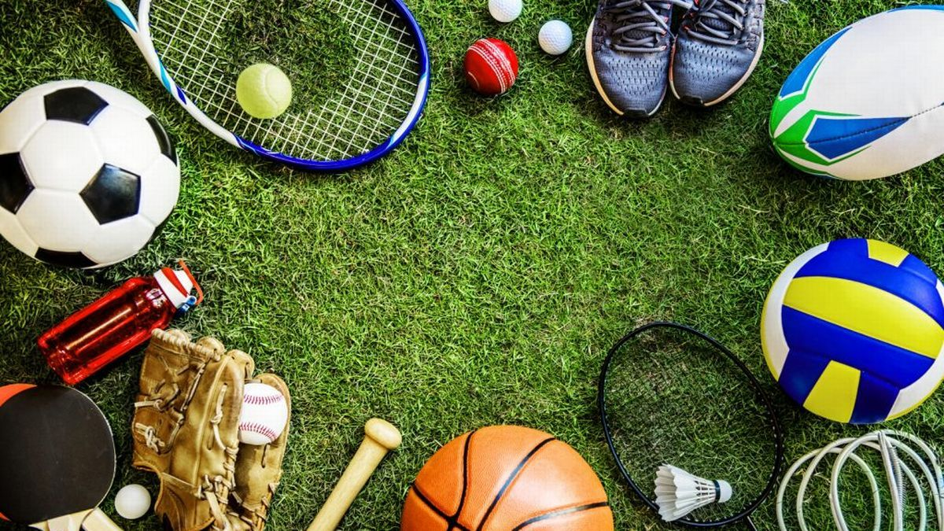
Sports and Games
Lesson 1: Listening

Slide 2
Notes for the Educator
This lesson is pegged directly to Learning Outcome 6.1.1.Demonstrate enjoyment, interest and attentiveness during listening and viewing activities.
The material for this lesson was adapted from Cambridge Global English Stage 5
Teachers are to refer to the Scheme of Work where each lesson is explained in more detail.
Effects are included to make the presentation more interactive. Please present the PowerPoint in Slideshow mode.
Wherever possible we have included the use of online apps to enhance the teaching and learning experience.
The Notes section underneath the slides may contain some further points which can be developed during the lesson.
Teachers are encouraged to adapt this PowerPoint presentation to meet the learners’ language needs.
Tasks included in the PowerPoint presentation are also being shared as worksheets.
For any comments, feedback or suggestions please email us at: marie-claire.camilleri@ilearn.edu.mt; urieth.attard@ilearn.edu.mt; and mary.jude.camilleri@ilearn.edu.mt. You may also call the office on: 25983683.

Slide 3
Listen to some children talking about their favourite sport.
Read an article about different games that you can play during the holidays.
Read and respond to a story about a girl who has a big dream.
Carry out an interview and try to persuade your friend to join your sports club.
Write an email to your friend to invite them to join your sports club.

Slide 4
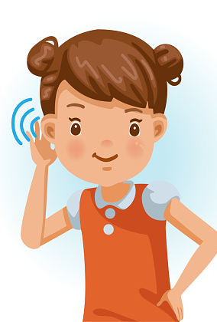
I am learning how to listen for specific information.
I can identify certain information within the conversations.
I can listen attentively to the listening text.
I am able to complete the tasks.

Slide 5
Notes:
Take some time to look at these photos of different sports. Can you name some of the sports? Do you do any of these sports? Which ones do you do? Where and when do you do this sport?
Now, which of these pictures shows football?

Slide 6
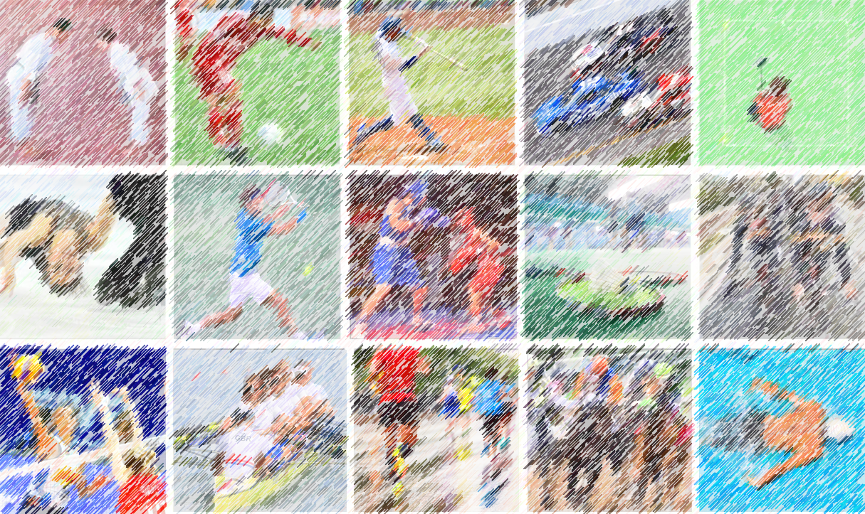
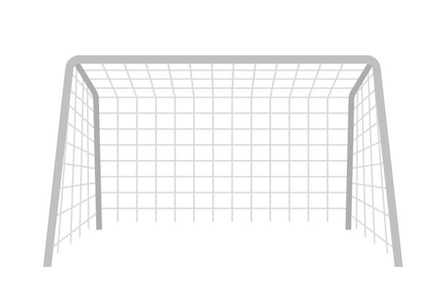
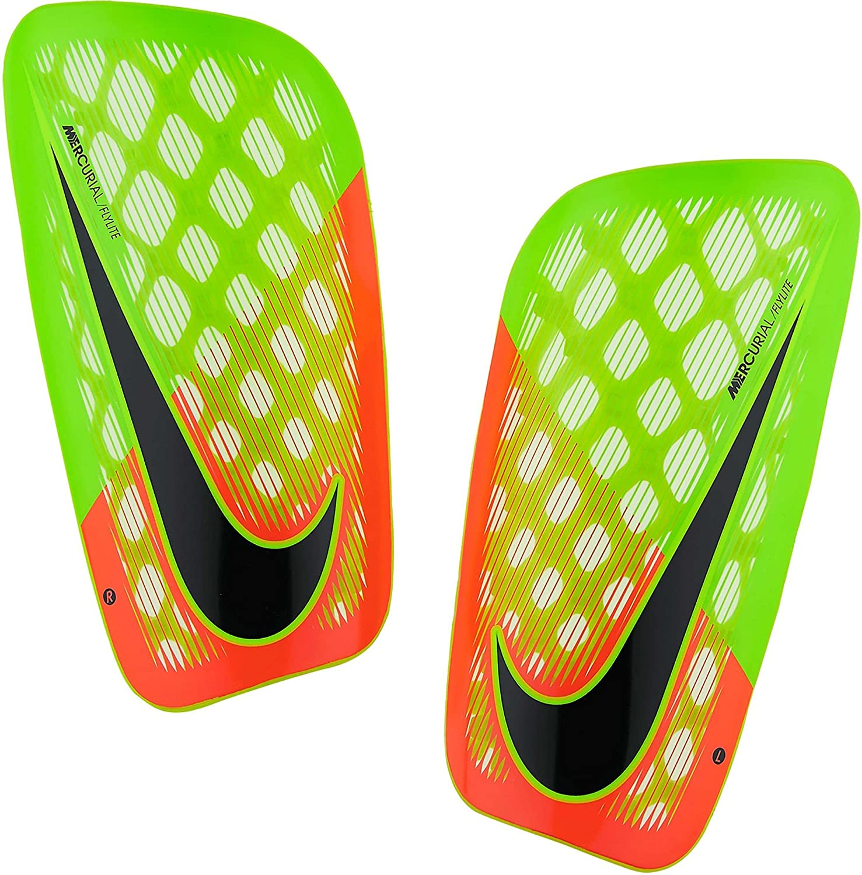
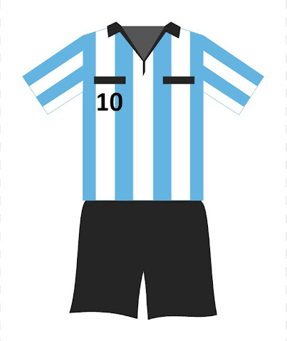
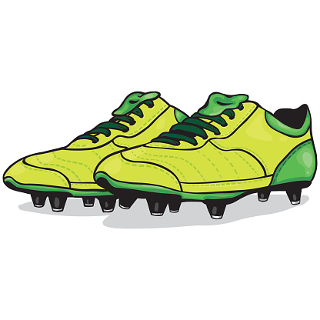
football
gear
football shoes
goal post
shin guards
Notes:
What are some things you need to play football? You need a goalpost, of course. Next you need to wear a gear, to show that you are part of a team. You need to wear special football shoes to help you run across the pitch. Footballers also wear shin guards to protect their legs, the part between their knees and their ankles.

Slide 7
Notes:
which of these sports is badminton?

Slide 8
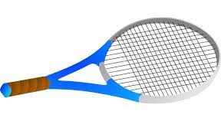
badminton
shuttlecock
racquet
Notes:
What are some things you need to play badminton? You need a racquet and a special ball called a shuttlecock. Badminton is played on a rectangular court and there needs to be a net. It can be played indoors or outdoors.

Slide 9
Notes:
Right, let’s see if we can spot the next sport…Volleyball?

Slide 10
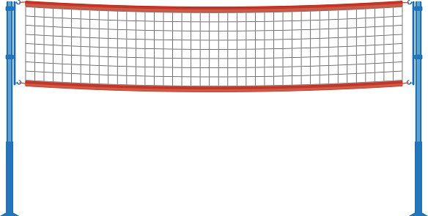
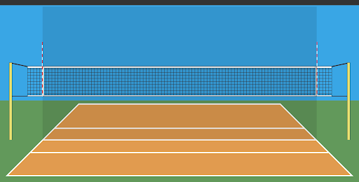
volleyball
net
court
volleyball
Notes:
Volleyball is usually played in an indoor court with a net in the middle. You need a special ball for this sport, called a volleyball. It is a team game and team members usually wear the same gear.

Slide 11
Notes:
can you spot tennis, now?

Slide 12
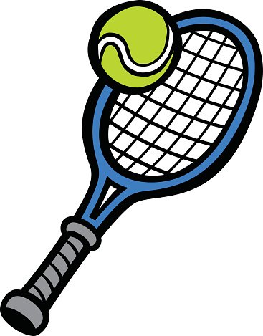
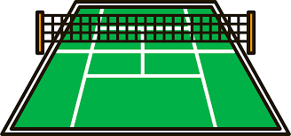
c
racquet and ball
tennis
court
Notes:
Tennis is usually played in pairs and it can also be played in fours. It is played on an outdoor court with a net in the middle. You need a racquet and a small yellow tennis ball for this sport.

Slide 13
Notes:
Can you find swimming?

Slide 14
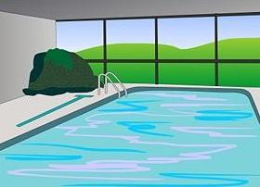
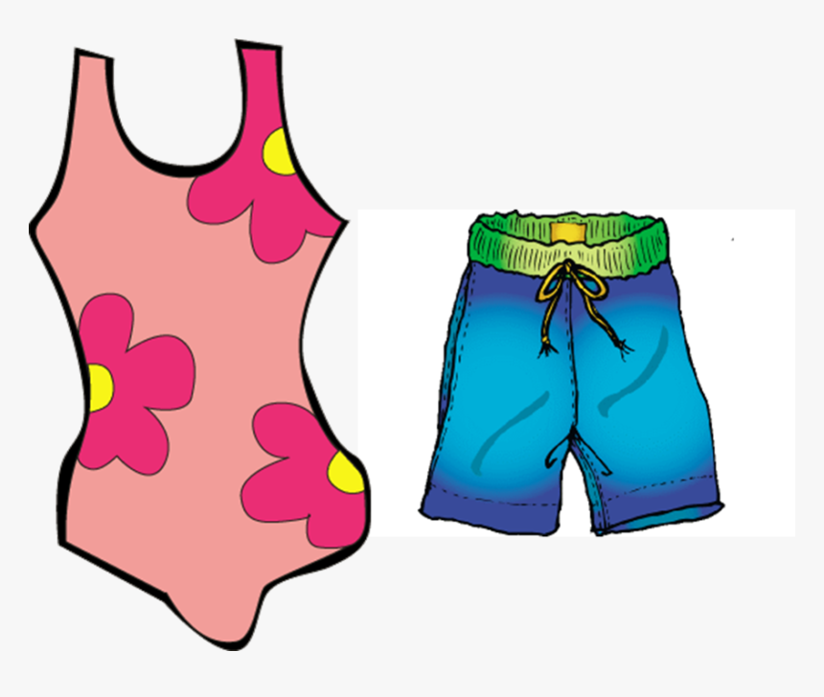
c
goggles
cap
pool
swimsuit
swimming trunks
swimming
Notes:
We need a pair of goggles and a cap. You need to wear a swimsuit or swimming trunks. This sport is practiced in a pool. Do you enjoy swimming in the sea or in the pool?

Slide 15
Notes:
Let’s see if you can find cycling now.

Slide 16
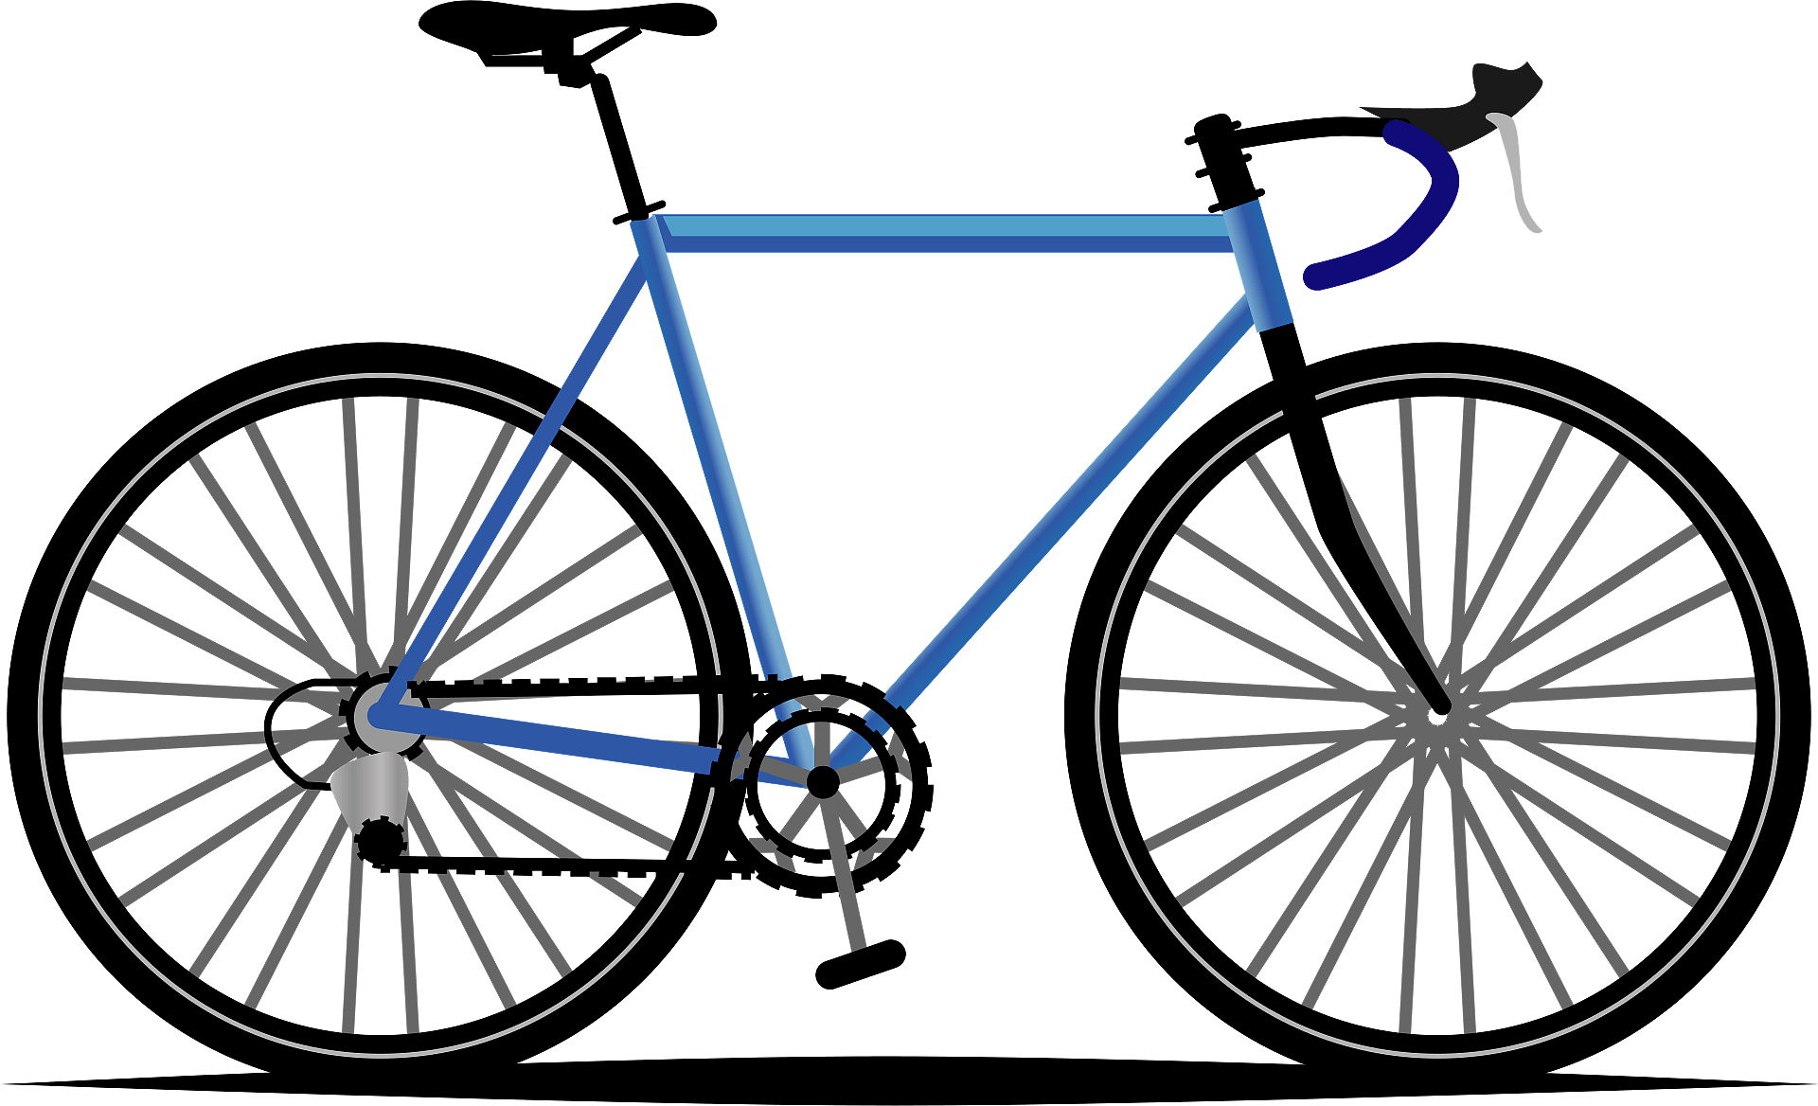
helmet
road bike
cycling
mountain bike
Notes:
What things does a cyclist need? Obviously a road bike or a mountain bike depending where they will ride their bike. They also need a helmet to protect their head against injury in case of a fall.

Slide 17
Notes:
Let’s see if you can find hockey now.

Slide 18
hockey stick
hockey
puck
shin guards
shin pads
Notes:
There it is. To play hockey you need a hockey stick and a ball. You also need to wear shin guards or shin pads to cover your legs, just like in football. Hockey can also be played on ice, that’s why it is called ice-hockey. When playing on ice, players use a puck instead of a ball. Hockey is not a very popular sport in Malta.

Slide 19
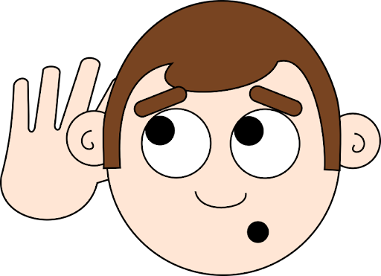
Listening Task 1:
Listen to the children describing their favourite sport.
Notes:
Great! Now, we are ready to listen to the audio for today. As I told you already, we will be listening to some children describing their favourite sports. Listen carefully.

Slide 20
Task 1: Which of these sports are the children talking about?
football
judo
gymnastics
tennis
basketball
badminton
athletics
swimming
volleyball
hockey

Slide 21
Listening Task 2:
Continue the table with the missing information.
Notes:
Now, in our 2nd Listening Task, you need to continue the table with the children’s symptoms and the doctor’s prescriptions and advice.

Slide 22
Task 2: Fill in the table with the missing information.
Speaker | Sport | Where | Equipment
1 | football |  | ball, goalposts
2 |  | pitch
3 | swimming |  | trunks, goggles
4 | badminton
beach, park, playing field, pitch
hockey
stick, shin pads
pool
racquets, shuttlecock
court

Slide 23
Listening Task 3:
Are these statements True or False? Correct the wrong answers.
Notes:
Now, we are going to listen to the audio for the 3rd time. In our final task we need to tick whether the statements are True or False. We also need to correct the wrong answers, so you might need to take down notes while listening.

Slide 24
Task 3: Are these sentences True or False?
 |  | True | False
a. | Speaker 1 loves his sport because he can play it in lots of different places.
b. | Speaker 2 likes being in a team because they always win.
c. | Speaker 3 often feels good after doing his sports.
d. | Speaker 4 likes her sport because she can play it in a big team.

Slide 25
Task 3: Are these sentences True or False?
a. | Speaker 1 loves his sport because he can play it in lots of different places.
b. | Speaker 2 likes being in a team because they always win.
c. | Speaker 3 often feels good after doing his sports.
d. | Speaker 4 likes her sport because she can play it in a big team.
they work together and help each other.
with one other person or in a group of four.

Slide 26
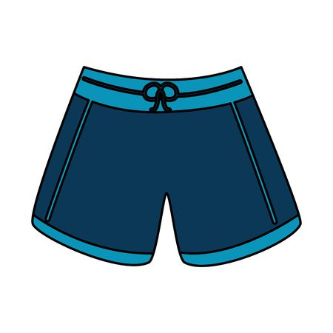
Talk about the sports equipment and what you need them for.
You need a shuttlecock to play badminton.
Notes:
To wrap up this lesson, I would like you to talk about the sports equipment that you can see and what you need them for. First, choose a sport equipment then say for which sport you need it. Let’s see an example: So, I picked shuttlecock, so I can say: you need a shuttlecock to play badminton. Now it’s over to you.
And that brings us to the end of our first lesson for this unit. I hope you enjoyed it and please join me in the next lesson, the Reading lesson.

Slide 27
Thank you for using this resource. Check out our latest resources below.

