Slide 1
Lesson 3 Writing
Year 5
English

Slide 2
Lesson Objectives
You will:
learn how to write an opinion article.
learn how to express your opinion in writing.
learn what are the success criteria for writing an opinion article.

Slide 3
Lesson Resources
Title of Opinion Article
Writing Frame Handout
Sentence Starters Handout
Success Criteria Handout

Slide 4
What is an opinion article?
In an opinion article writers express their point-of-view and back it up by examples and explanations.

Slide 5
Title
Should animals be kept in zoos?
Write an article for your school website to express your opinion.

Slide 6
Pay attention!
Genre:
OPINION ARTICLE
Audience:
YOUNG READERS
Purpose:
TO EXPRESS YOUR OPINION
G.A.P
G: GENRE
A: AUDIENCE
P: PURPOSE

Slide 7
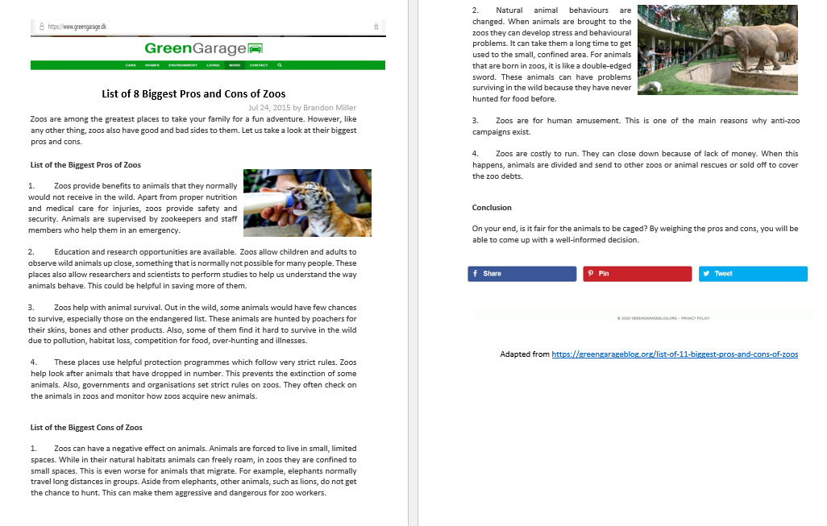
Reading Lesson

Slide 8
Let’s weigh the pros and cons!
Advantages (Pros)
a protected environment for rare and endangered species
get to see wild and exotic animals
protect animals from poachers
an educational opportunity for people
care by a veterinarian is available for the animals
researchers and scientists can carry out studies about animals
Disadvantages (Cons)
change the lifespan of the animals held in captivity
change the behaviour of the animals
animals are trapped in a small area
zoos can have poor conditions
zoos are places for human amusement
animals start losing some of their natural instincts or abilities – animals born in a zoo do not have the natural abilities to survive in the wild
Advantages (Pros)
Disadvantages (Cons)

Slide 9
Writing Model
Introduction
Opinion-
Introduction
Subject
Body 1
3 reasons in favour and why
Body 2
2 more reasons against and why
Body 2
1 reason against and why
Body 3
More reasons in favour and why
Conclusion
1 reason in favour and why
Conclusion
Summarise the topic

Slide 10
Opinion Article Structure
INTRODUCTION – Write what the article is about and share your opinion.
BODY 1 – Give some reasons (advantages) to support your opinion.
BODY 2 – Give some opposing reasons (disadvantages).
BODY 3 – Give more reasons to support your opinion.
CONCLUSION – Write a general sentence and one final, strong reason to support your point of view.

Slide 11
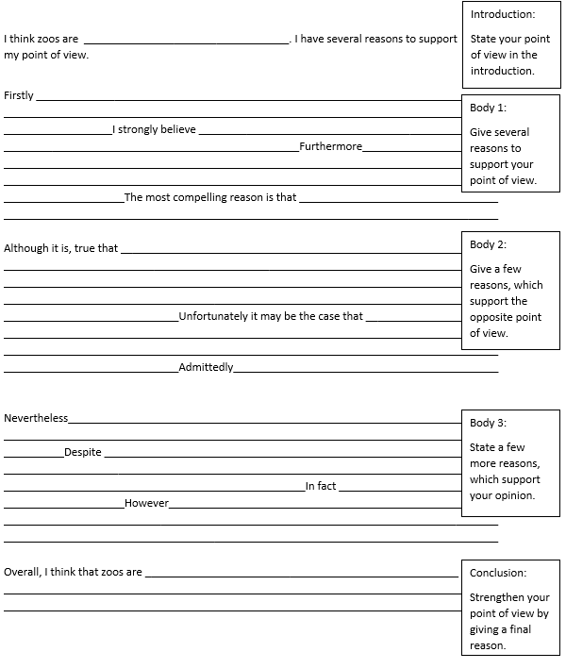
Writing Frame

Slide 12
Sentence Starters
I (really) apologise …
I am (really) sorry …
What can I say? ...
I shouldn’t have said ...
I shouldn’t have done it …
It’s my fault …
My bad!
I beg your pardon …
I am to blame for …
I hope you can forgive me ...

Slide 13
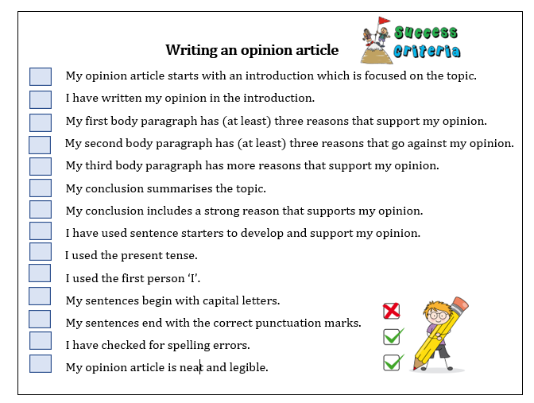
Success Criteria!
What are success criteria?
Success criteria are a list of steps you have to follow or a list of features you are to include in your task. They will make you aware of what is expected and help you self-assess your work.

Slide 14
Thank You!

