Slide 1
Lesson 1 Reading
Year 5
English

Slide 3
View and Listen!

Slide 4
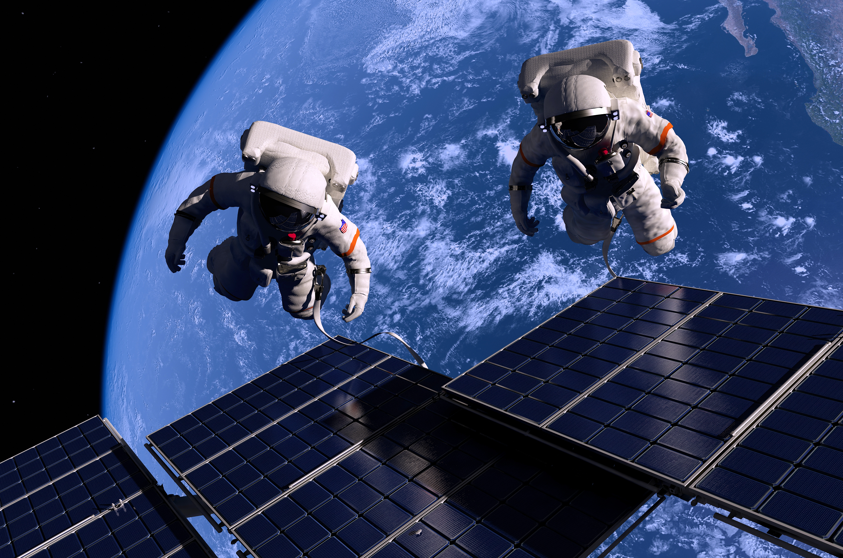
Space Travel

Slide 5
Lesson 1 Objectives
You will:
learn what a timeline is.
learn facts about space travel.
learn facts about a cosmonaut.
listen to a text being read aloud.
read a text silently and aloud.
answer questions about the text.

Slide 6
Lesson Resources
Dictionary
Reading Text
Questions Worksheet
Answers Handout

Slide 7
Timeline
A timeline is
a graph that shows events
in chronological order.

Slide 8
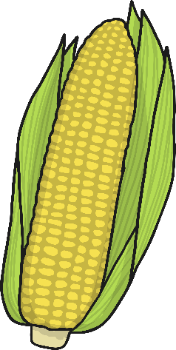
1942
The first rocket called the V2 was launched. It was designed by a German engineer called Wernher Von Braun.
1949
The first monkey was sent to space. His name was Albert II and was a Rhesus monkey. He flew 83 miles away from Earth!
1940
1945
1950
1947
The first animals were sent to space to see how they would react. The fruit flies were sent to space with some corn for food.

Slide 9
1957
Laika, the Russian space dog, became the first animal to orbit the earth. Her name means ‘barker’ in Russian.
1957
On the 4th October, Russia launched Sputnik, the first satellite into space. ‘Sputnik’ means ‘satellite’ in Russian. From this day on, the space age has begun!
1950
1955
1960
1959
Russian and American scientists were in a competition to send a spacecraft to the moon. Russia succeeded first. A space probe called Lunar 2 was sent and it travelled at such an immense speed that it would have killed a person if they were inside it!

Slide 10
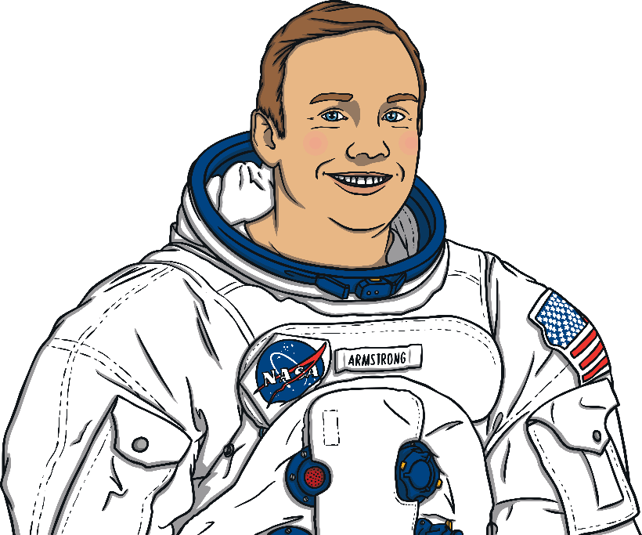
1961
Yuri Gagarin became the first man in space.
1963
Valentina Tereshkova was the first woman in space and a crater on the far side of the moon was named after her!
1960
1965
1970
1969
Neil Armstrong and Buzz Aldrin set foot on the moon!

Slide 11
1973
A Russian probe was sent to explore Mars. It stayed in orbit for a year but it was destroyed when the parachute failed to open upon landing.
1970
1975
1980

Slide 12
1980
1985
1990
1986
A terrible tragedy occurred as a rocket exploded shortly after it launched, killing seven astronauts. This happened on the 28th of January and reminded everyone just how dangerous space travel is and how brave astronauts are.

Slide 13
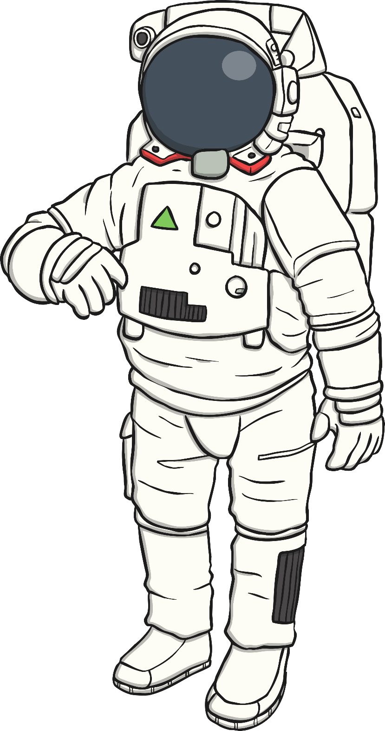
1991
Helen Sharman, born in 1963, Sheffield, won a competition to become the first British astronaut in space. She had to undergo 18 months of intensive training and was part of a mission to the MIR space station.
1990
1995
2000

Slide 14
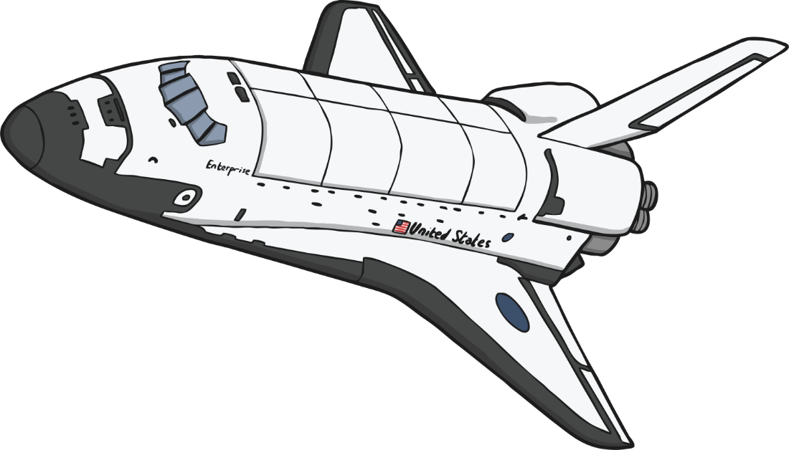
2001
American millionaire, Dennis Tito, became the first space tourist in a Russian spacecraft. He paid 20 million dollars for the privilege!
2000
2005
2010
2004
The first private space flights became available. Tickets for places on the spacecraft are available to buy now!

Slide 15
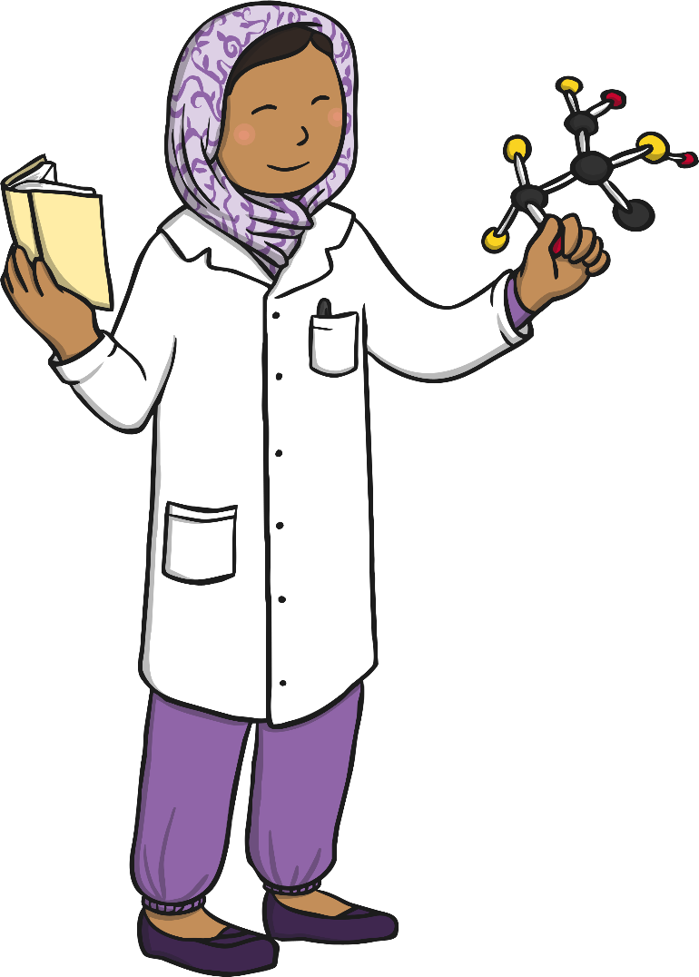
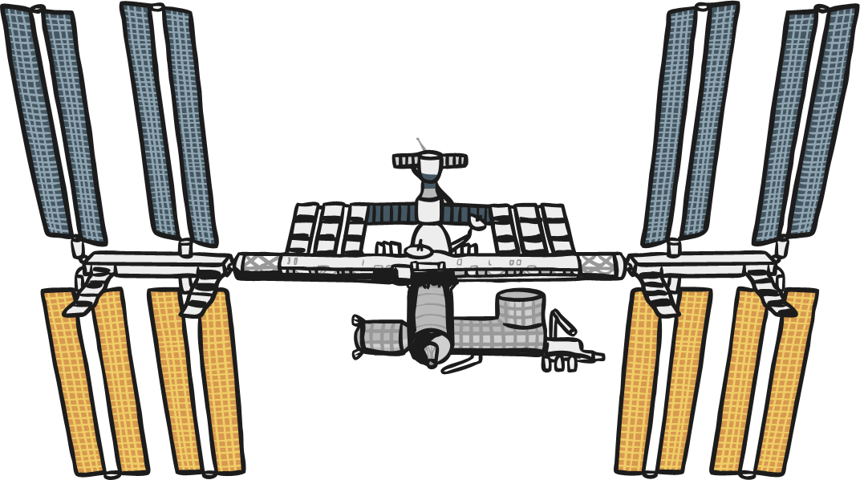
2015
Scientists found evidence of liquid water on Mars for the first time. This furthers the possibility of sustaining life on the planet.
2010
2015
2020
2020
The European Space Agency's Solar Orbiter probe took the closest ever photographs of the Sun. The probe got within 77 million km of the surface of the sun!
2015
Tim Peake became the first British ESA Astronaut to visit the International Space Station.

Slide 16
1961
Yuri Gagarin became the first man in space.
1963
Valentina Tereshkova was the first woman in space.
1960
1965
1970
1969
Neil Armstrong and Buzz Aldrin set foot on the moon!

Slide 17
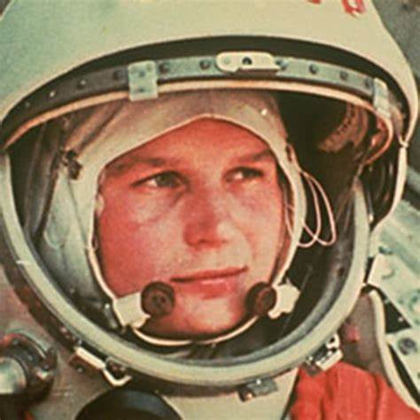
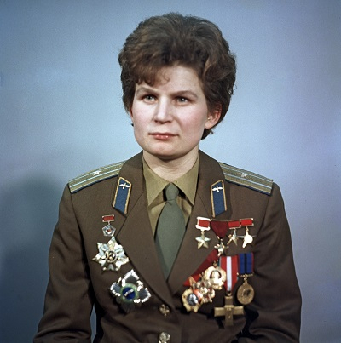
Valentina Tereshkova

Slide 18
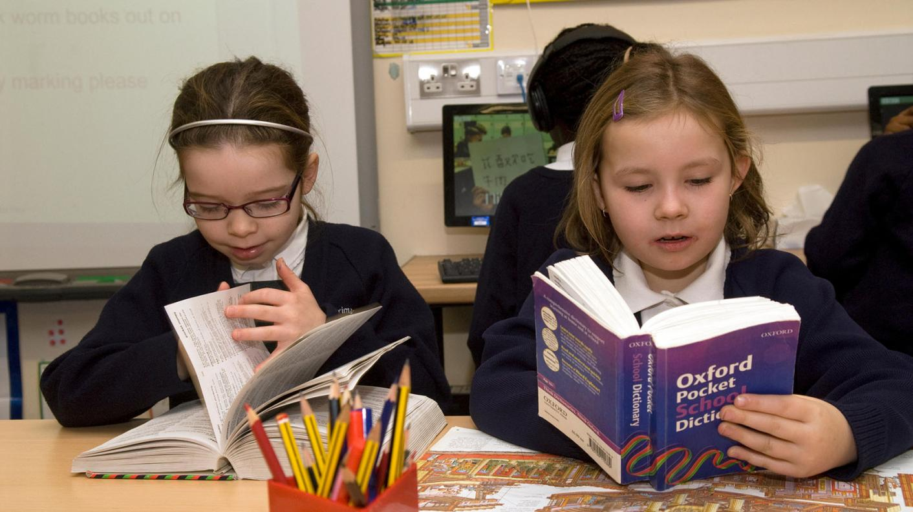
Using a dictionary!

Slide 19
New Words
legacy
cramped
inspiration
global warming
skill
eventually
cosmonaut
candidates

Slide 20
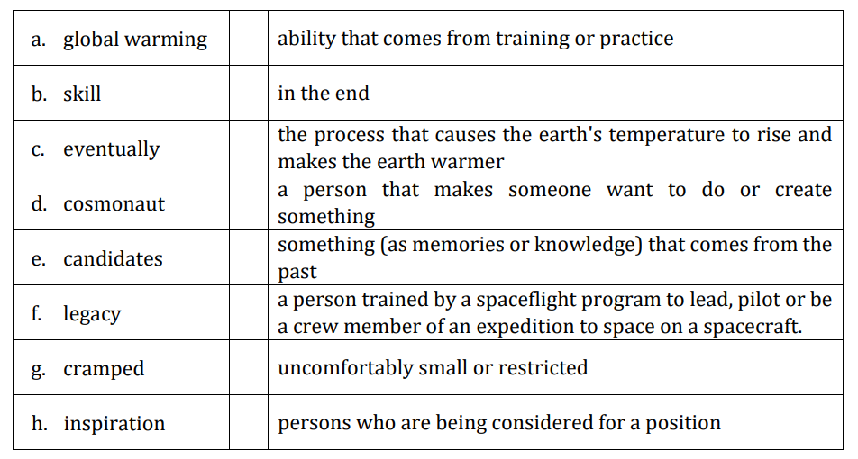
Match
QUESTIONS WORKSHEET

Slide 21
Step 1
READ the text
on the handout and
the questions on the worksheet.

Slide 22
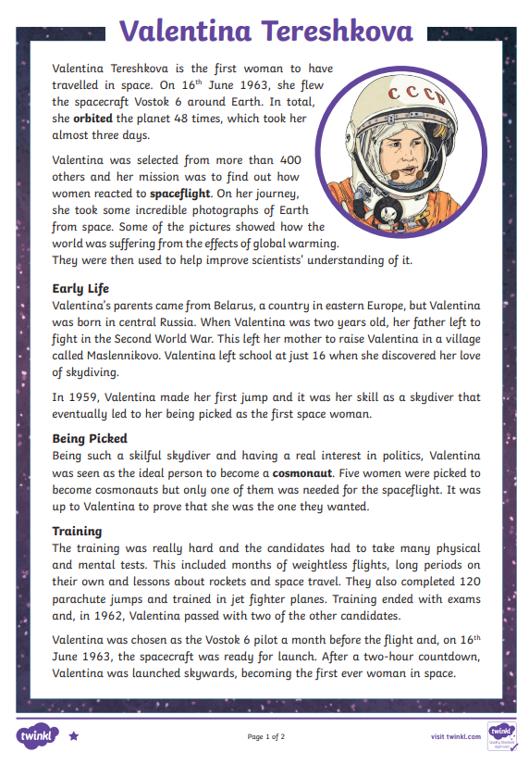
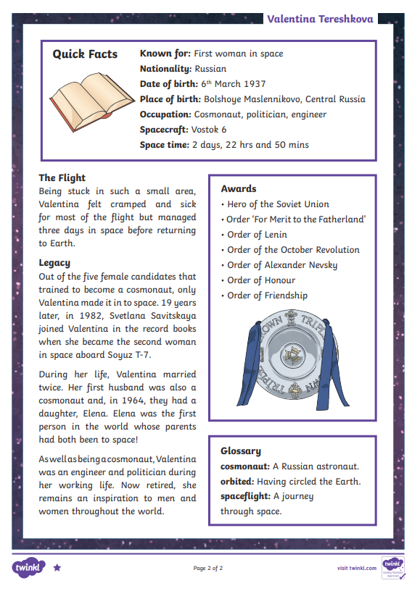

Slide 23
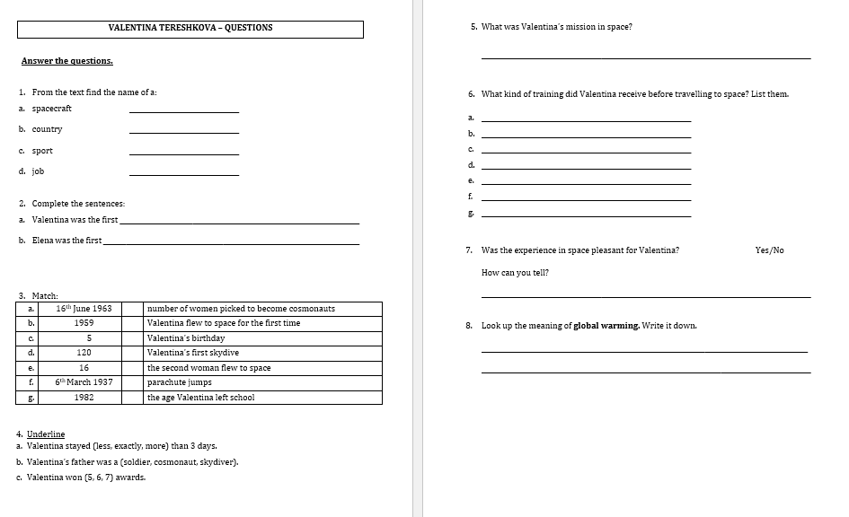

Slide 24
Before…
Look at the LAYOUT of the text.
What is particular about it?

Slide 26
Step 1
After you read the text and questions you should be able to ANSWER the following question:
WHAT IS THE TEXT ABOUT?

Slide 27
Step 2: Discuss the question
What is the text about?
The text is about the first woman who travelled in space. Her name is Valentina Tereshkova and she is a Russian cosmonaut, politician and engineer.
She went to space to find out how women reacted to spaceflight. She was selected out of 400 candidates.
When she was two years old, her father went to fight in World War II. Her mother had to raise her on her own. She left school at the age of 16 to practise skydiving.

Slide 28
Step 3
READ the text and questions again.
Then try to ANSWER the following questions:
When did Valentina fly to space?
Why were Valentina’s photos useful?
Who was from Belarus?
Why was Valentina considered an ideal candidate to become a cosmonaut?
Why is Valentina an inspiration to men and women?

Slide 29
Step 4: Discuss the questions
When did Valentina fly to space?
On the 16th of June, 1963.
Why were Valentina’s photos useful?
They showed how the world was suffering from the effects of global warming.
Who was from Belarus?
Valentina’s parents were from Belarus.
Why was Valentina considered an ideal candidate to become a cosmonaut?
She was a skillful skydiver and had a real interest in politics.
Why is Valentina an inspiration to men and women?
She has achieved a lot in her life. She is cosmonaut, a politician and an engineer. She received many awards.

Slide 30
Step 5
LISTEN to me as I
READ the text ALOUD.

Slide 32
Step 6
READ the text ALOUD.

Slide 33
Step 7
Let’s DISCUSS
the questions.

Slide 35
Step 8
WORK OUT the
Questions Worksheet.

Slide 36
Step 9

Slide 37
Step 10
CHECK your answers using the
Answers Handout.

Slide 38
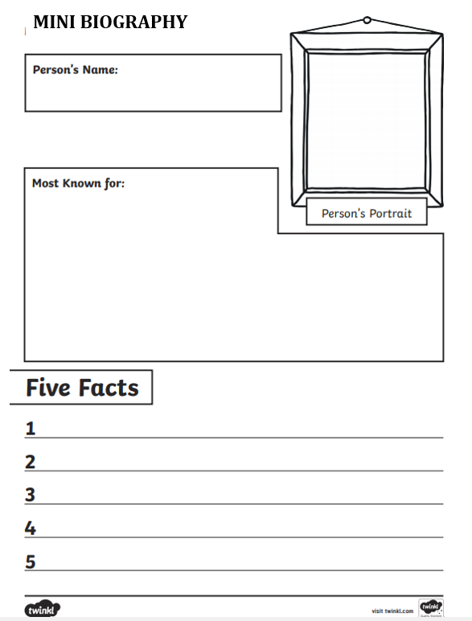
Writing Activity
A biography is a text written about someone else's life.
Fill in this mini-biography of Valentina Tereshkova.

Slide 39
Thank You!

