Slide 1
Lesson 1 Listening
Year 5
English

Slide 2
Lesson Objectives
You will:
listen attentively to a text.
answer questions about the text.
learn when and how to use adjectives.

Slide 3
Lesson Resources
Questions Worksheet
Answers Handout

Slide 4
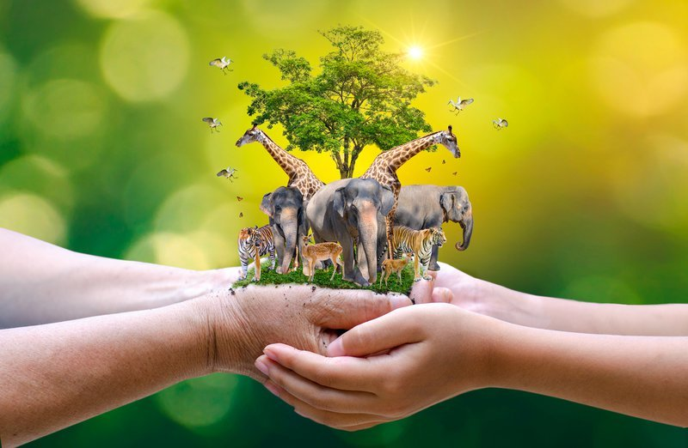
Guess the theme!
The Natural World
and Wildlife

Slide 5
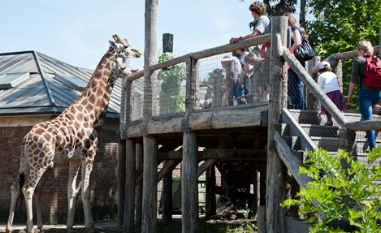
Picture 1
What can you see in this picture?
Where do you think this picture was taken?

Slide 6
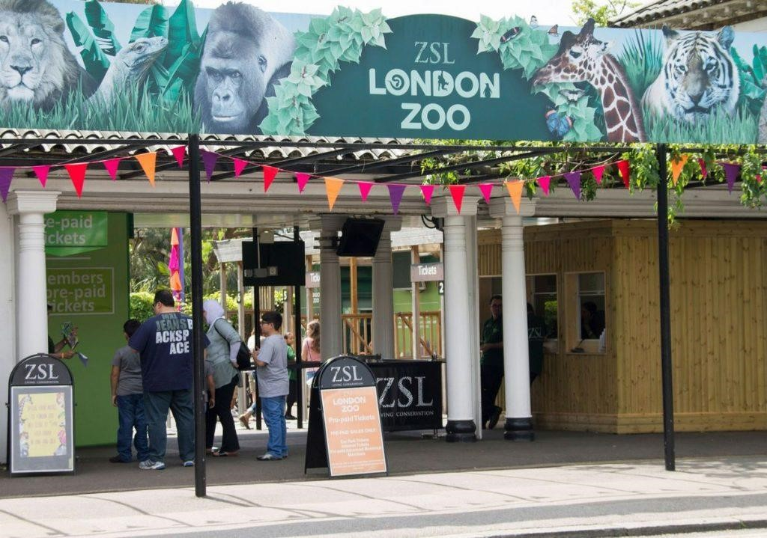
Picture 2
What can you see in this picture?
Have you ever been to such a place?

Slide 7
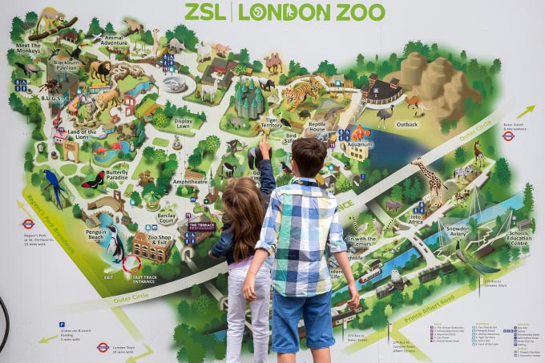
Picture 3
What can you see in this picture?
Where can we find this kind of picture?
How is this picture useful?

Slide 8
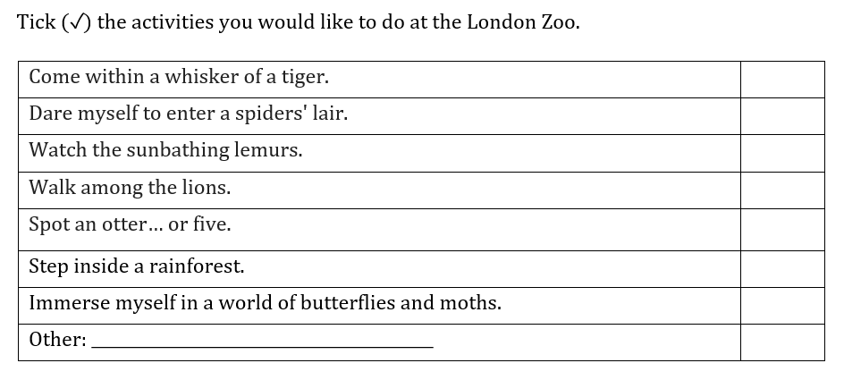
Think!
What would you like to do at the London Zoo?

Slide 9
What are adjectives?

Slide 10
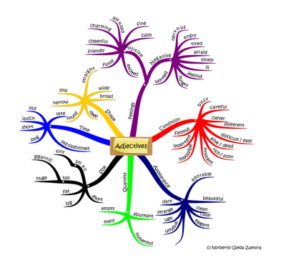
Words in the text!

Slide 11
Adjectives within the text
heavy tall long
big orange black
hairy excellent red
white lovely dangerous

Slide 12
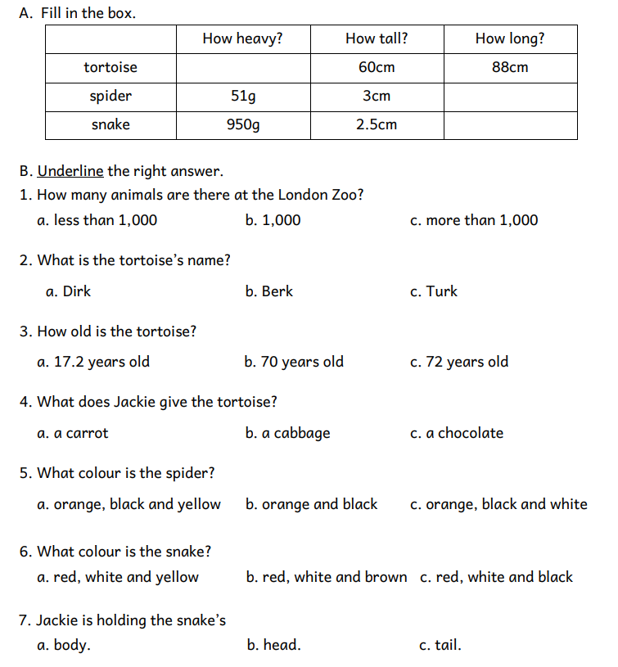
Step 1
READ the questions on the worksheet.

Slide 13
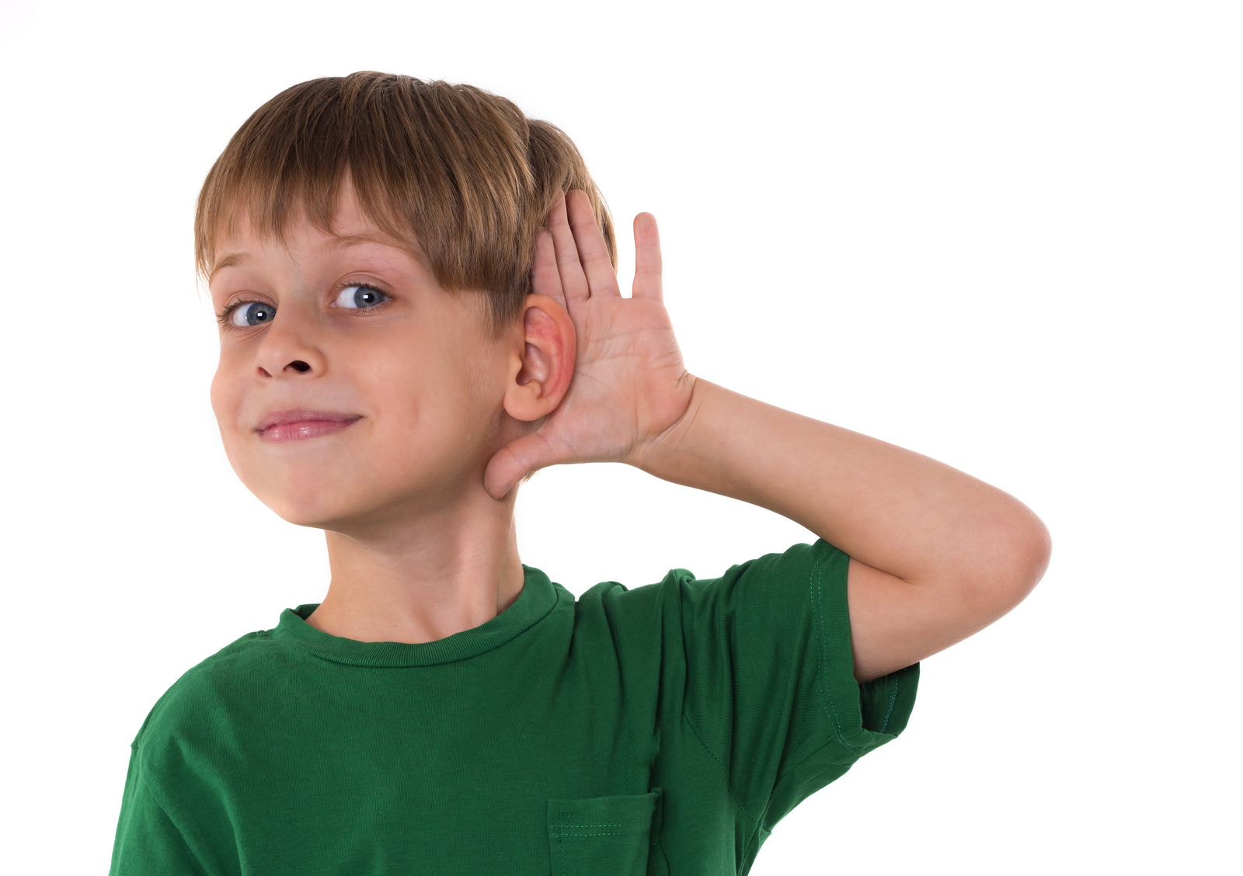
Step 2
LISTEN carefully to the text.
LISTEN carefully while I read out the questions.
START ANSWERING the questions.

Slide 14
Step 3
LISTEN to the text for
the second time.
LISTEN while I read the questions again.
Try to ANSWER any unanswered questions.

Slide 15
Step 4

Slide 16
Step 5
CHECK your answers using the
Answers Handout.

Slide 17
Let’s play a word game!
At the zoo …
A - African elephant
B - Boa
C - Crocodile
D -
Can you think of other zoo animals to complete this alphabetical game?
Challenge mode – Use a timer!
(3 minutes)

Slide 18
Thank You!

