Slide 1
Sports and Games
Lesson 3 - Literature

Slide 2
Notes for the Educator
This lesson is pegged directly to Learning Outcome LIT 5.3 I can respond to simple poems, stories, and plays by speaking and writing briefly about how I feel about the literary texts and about the events and characters in these texts.
A link to a poll is included (https://linkto.run/p/JQIIM8CU). Teachers may use this poll or create a similar one.
Teachers are to refer to the Scheme of Work where each lesson is explained in more detail.
Effects are included to make the presentation more interactive. Please present the PowerPoint in Slideshow mode.
Wherever possible we have included the use of online apps to enhance the teaching and learning experience.
The Notes section underneath the slides may contain some further points which can be developed during the lesson.
Teachers are encouraged to adapt this PowerPoint presentation to meet the learners’ language needs.
Tasks included in the PowerPoint presentation are also being shared as handouts.
For any comments, feedback or suggestions please email us at: marie-claire.camilleri@ilearn.edu.mt; urieth.attard@ilearn.edu.mt; mary.jude.camilleri@ilearn.edu.mt. You may also call the office on: 25983683.

Slide 3
I am learning how to read and understand a poem.
I can talk about the message the poet is giving.
I can look for rhyming words.
I can talk about the shape of the poem.

Slide 4
basketball
Played on a court
Two teams
5 players per team
Shoot the ball into the opponent’s basket
Notes:
The word basketball is made up of two words – encourage learners to look for smaller words in the big word.

Slide 5
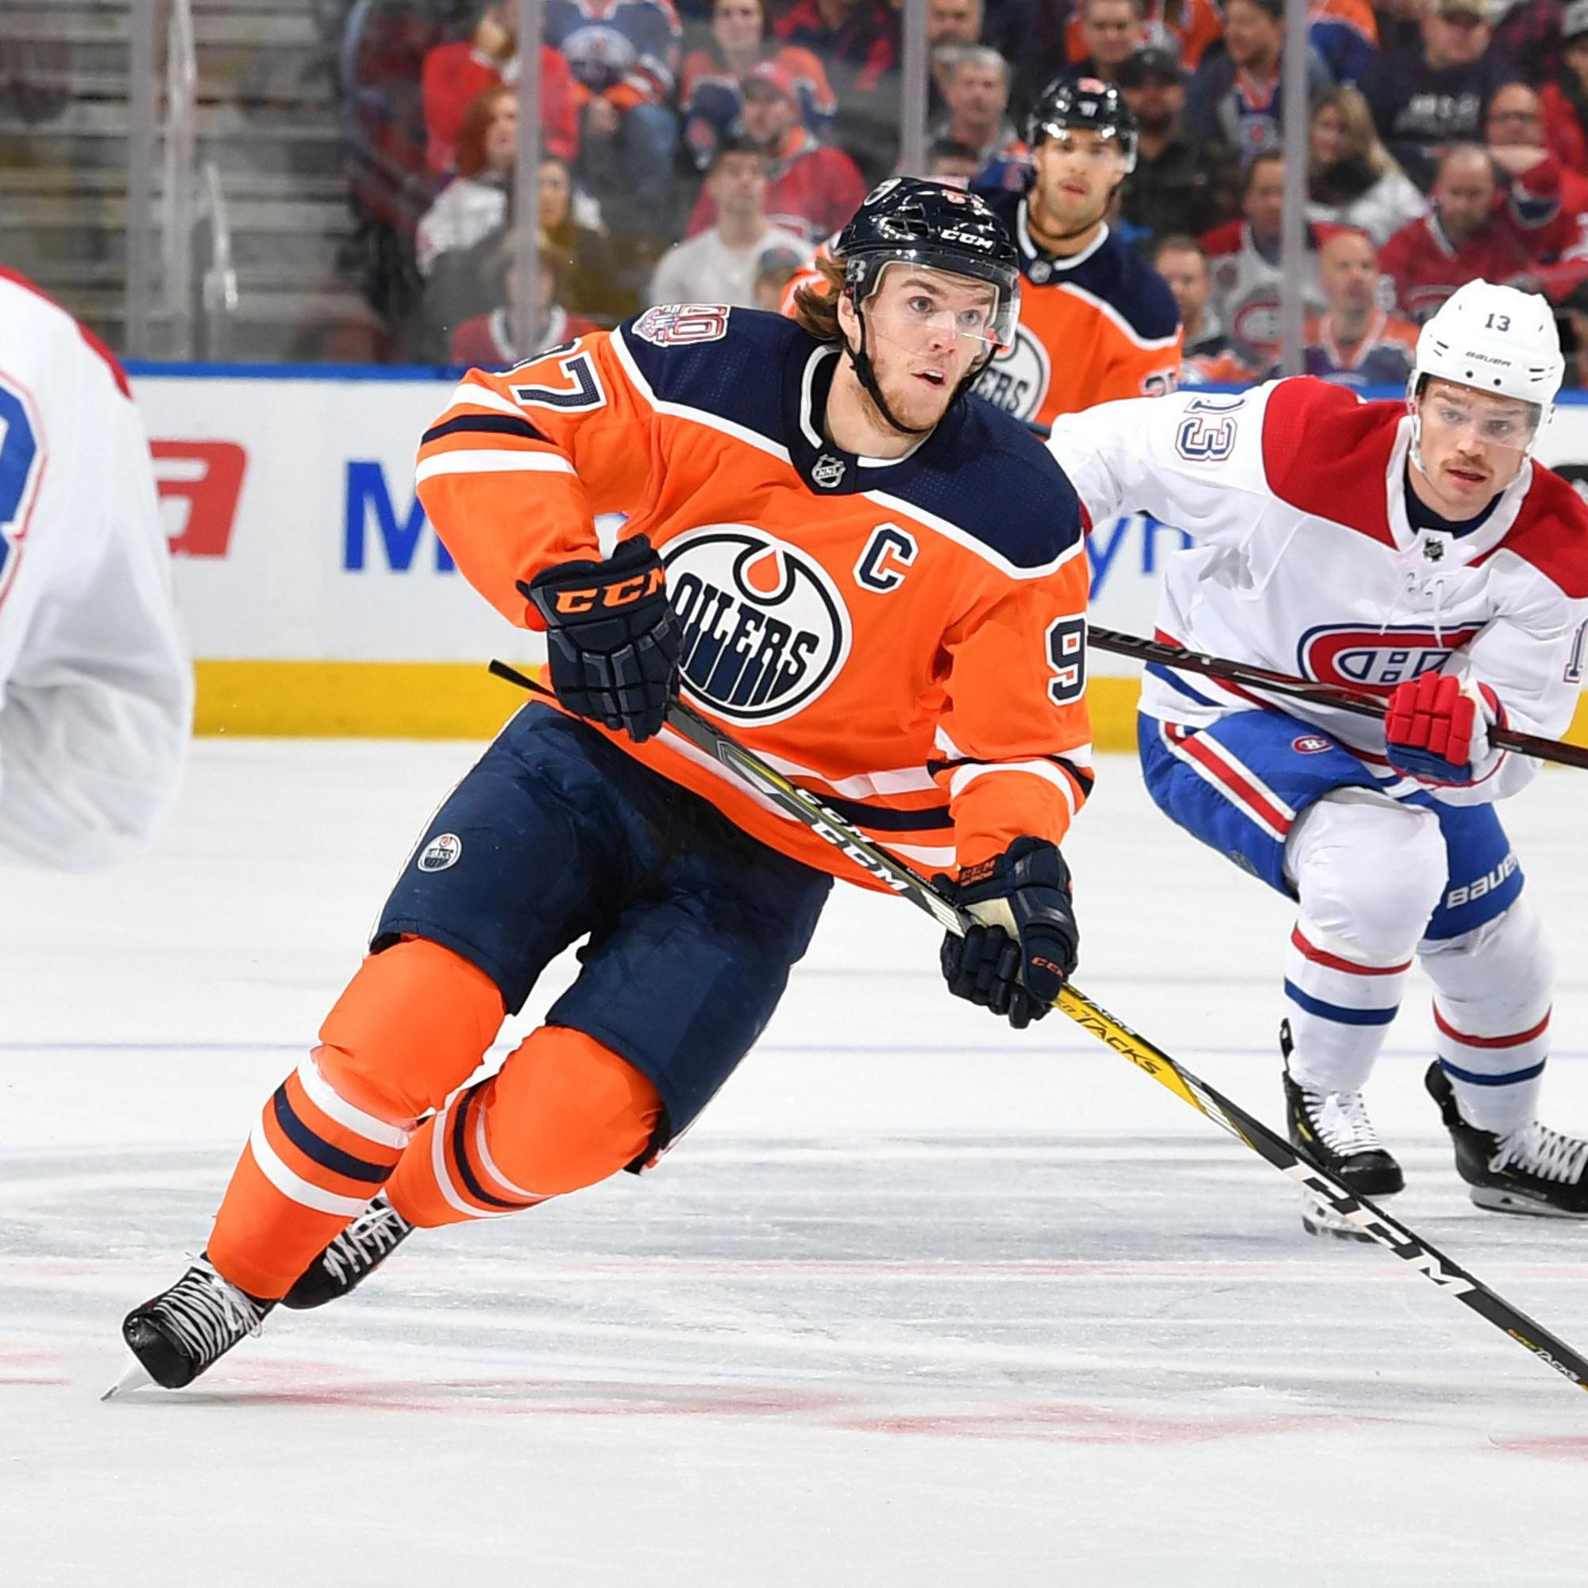
hockey
ice rink/field
Two teams
11 players per team
small hard ball and a a stick curved at one end
Hit the ball into the opponent’s goalpost.

Slide 6
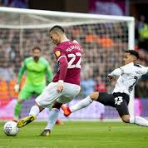
soccer
pitch
two teams
11 players per team
kick the ball into the opponent’s goalpost.

Slide 7
Basketball is Lots of Fun
title of the poem
Basketball is lots of fun. It’s my favourite sport. But I’m so bad that, when I play, they throw me off the court.
Now hockey is my favourite sport. The trouble is I stink. So every time I hit the ice they throw me off the rink.
Now soccer is the game I like. There’s just one little hitch; I kick and run too slow, and so they throw me off the pitch.
At last I found some sports that I can play and not get thrown. I now play soccer, basketball, and hockey on my phone.
Kenn Nesbitt
name of poet
Notes:
Let’s have a look at the poem now. At the top, there is the name of the poem. What is this poem called?
At the very bottom, we can see the name of the poet, that is the person who wrote the poem, in this case Ken Nesbitt. Ken Nesbitt is a famous children’s author who writes a lot of poems and stories suitable for children. You might want to check out his website later. It is written it at the bottom of the handout.

Slide 8
Basketball is Lots of Fun
Basketball is lots of fun. It’s my favourite sport. But I’m so bad that, when I play, they throw me off the court.
Now hockey is my favourite sport. The trouble is I stink. So every time I hit the ice they throw me off the rink.
Now soccer is the game I like. There’s just one little hitch; I kick and run too slow, and so they throw me off the pitch.
At last I found some sports that I can play and not get thrown. I now play soccer, basketball, and hockey on my phone.
Kenn Nesbitt
1
2
3
4
Notes:
Let’s look at how the poem is presented. Does it look like a story in a book? What can you notice about the sentences?
The poem is divided into 4 paragraphs called stanzas. Each stanza is made up of four verses. The sentences are short, and some of them run onto the next line.

Slide 9
Basketball is Lots of Fun
Basketball is lots of fun. It’s my favourite sport. But I’m so bad that, when I play, they throw me off the court.
Now hockey is my favourite sport. The trouble is I stink. So every time I hit the ice they throw me off the rink.
Now soccer is the game I like. There’s just one little hitch; I kick and run too slow, and so they throw me off the pitch.
At last I found some sports that I can play and not get thrown. I now play soccer, basketball, and hockey on my phone.
Kenn Nesbitt
Notes:
If we look closely at some of the words in the poem, particularly the words at the end of the line, we will notice that some words rhyme, that means they sound the same. Let’s take an example: sport rhymes with court. Let’s see if we can spot some others: let’s look at the second stanza more closely. Can you find any rhyming words here? Let’s do the same for the third and the fourth stanzas.

Slide 10
Read the poem on your own. Think about what the poet is saying. Which words were difficult to read?
Notes:
https://www.poetry4kids.com/poems/basketball-is-lots-of-fun/

Slide 11
The title makes us think that the poet loves basketball.
Basketball is lots of fun
Basketball is lots of fun. It’s my favourite sport. But I’m so bad that, when I play, they throw me off the court.
Repetition. The poet wants the reader to believe that he really loves basketball.
The poet does not know how to play basketball.
Meaning: poet is stopped from playing because he plays so badly.
the space where basketball is played
The coach/ referee.
Notes:
So, let’s look at the first stanza:
What do the words “I’m so bad that…” mean? Does this mean that the poet is good at basketball or that he doesn’t play well? It means that he doesn’t know how to play basketball that well and sIt’s the space where the players play basketball. It is a rectangular floor with a basket on each end. I can write that down, here. Now what does the expression “throw me off the court” mean? It means that he is stopped from playing because he plays so badly. Good so now that I have taken down some notes, I can understand this part of the poem better. metimes they “throw him off the court.” What is the court?

Slide 12
He tried a new sport and he enjoys playing it a lot.
The reader can tell that the poet doesn’t know how to play this sport, either.
Now hockey is my favourite sport. The trouble is I stink. So every time I hit the ice they throw me off the rink.
An expression that suggests that the poet is very bad at this sport.
He falls to the ground.
where hockey is played.
He was stopped from playing…again!
Notes:
The 2nd stanza starts with the word ‘Now’. The poet first tried playing basketball and he realised he wasn’t good at it so now he has taken up hockey. But there is a problem. He says “I stink”. What does he mean by this? Does he mean that he’s smelly? No, it’s an expression to mean that he’s very bad at this sport. Next, we have “I hit the ice”. What do you think this means? Does it mean that he hits the ice with his hands? No, it means that he falls to the ground. And once again, we have “they throw me off the rink.” We have already established that to throw off means to stop someone from doing something, and we also know that a rink is the place where hockey is played.

Slide 13
He already failed at basketball and hockey.
Now soccer is the game I like. There’s just one little hitch; I kick and run too slow, and so they throw me off the pitch.
one little problem
He is stopped from playing once again.
football ground.
Notes:
Great, let’s move on to the third stanza. Again this stanza starts with the word ‘Now’ which indicates that after failing at basketball and hockey he is now going to try a new sport: soccer. We have already seen how soccer is similar to football. Now, here we have, “there’s just one little hitch.” I wonder what this means? I think it means the same as there’s just one little problem. And again, the stanza ends with “they throw me off the pitch”, which we now know it means that they ask him to stop, to go out of the game because he plays so badly.

Slide 14
Finally, after all the attempts.
At last I found some sports that I can play and not get thrown. I now play soccer, basketball, and hockey on my phone.
He plays these sports on his phone.
Notes:
Onto, the last stanza now. In this stanza, the poet finally finds a solution to his problem. He can now play all his favourite sports without being stopped because he plays badly. What solution does the poet find? He plays them on his phone – kind of like a video game or an app that you can download and play on the phone or tablet. This part makes us smile, perhaps because we weren’t expecting it. He is happy too because he is not thrown off the court and he can play to his heart’s content.
Now, we can really understand the poem and what the poet is saying. I can tell what the poem is about, I can see that the poet is repeating certain phrases such as “throw me off” to stress how bad he is at playing these kinds of sports. The reader really gets the idea that he plays badly. I can say that the tone of poem is humourous, it is funny and it makes us wonder what sports he will try next and we smile at the end, because playing basketball or football or hockey on the phone is not the same as playing the sport for real.

Slide 15
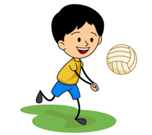
Which of these sports has the poet tried? Choose two (2).
tennis | volleyball
ice hockey | basketball

Slide 16
Why does the poet say he is thrown off the court?
He needs to drink. | He needs to answer his phone.
He plays badly. | He was hurt.

Slide 17
“The trouble is I stink.”
I stink means…
I smell badly. | I’m very bad at this sport.
I need a bath. | I like to think aloud.

Slide 18
“There’s just one little hitch.”
One little hitch is the same as…
one little ball | one small basket
a little problem | one player

Slide 19
Why is the poet stopped from playing football?
Choose one.
He is not a fast runner.
He gets tired easily.
He falls all the time.
He picks up fights.

Slide 20
Why is playing soccer, basketball and hockey on his phone a good solution for the poet?
He can stay at home.
He doesn’t get tired.
He isn’t stopped from playing.

