Slide 1
Being Healthy

Slide 2
Notes for the Educator
This lesson is pegged directly to Learning Outcome LS 5.2 I can understand audio-visual texts across a range of genres, identifying the main idea and specific information.
It also targets other language outcomes such as: LS 5.8 I can communicate my own experiences, likes and dislikes fluently and accurately with some allowance to self-correct in the process.
The material for this lesson has been adapted from https://learnenglishkids.britishcouncil.org/poems/being-healthy
Teachers are to refer to the Scheme of Work where each lesson is explained in more detail.
Effects are included to make the presentation more interactive. Please present the PowerPoint in Slideshow mode.
Wherever possible we have included the use of online apps to enhance the teaching and learning experience.
The Notes section underneath the slides may contain some further points which can be developed during the lesson.
Teachers are encouraged to adapt this PowerPoint presentation to meet the learners’ language needs.
Audio files or links to websites may be included.
Tasks included in the PowerPoint presentation are also being shared as handouts.
For any comments, feedback or suggestions please email us at: marie-claire.camilleri@ilearn.edu.mt; urieth.attard@ilearn.edu.mt; mary.jude.camilleri@ilearn.edu.mt. You may also call the office on: 25983683.

Slide 3
Think of different ways how you keep yourself healthy.
Notes:
Teacher can create a Padlet or use AnswerGarden.

Slide 4
sister
brush my teeth
bath
brother
night
clean
morning
mum
dad
vegetables
body
Notes:
Give the meaning to a word and ask learners to say you the word. You can make the words disappear by choosing the disappear exit effect from the Animations ribbon.

Slide 5
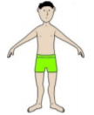
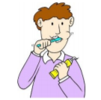
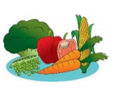
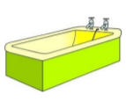
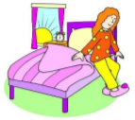
Task 1: Match the pictures with the words.
bath
body
brush my teeth
vegetables
night
morning

Slide 6
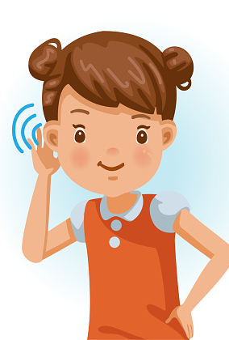
I am learning how to listen and respond to an audio-visual text.
I can understand the main idea.
I can listen to specific details and keywords.
I am able to complete the tasks.

Slide 7
Listen to what each family member tells the boy.

Slide 8
Task 2: What does each person tell the poet to do?
My mum tells me to
take a bath.
My dad tells me to
eat vegetables every day.
My brother tells me to
brush my teeth.
My sister tells me to
wash my hands.

Slide 9
Listen to the rhyming words in the poem.

Slide 10
Task 3. Match the rhyming words.
clean
tell
skin
between
day
play
well
win

Slide 11
Listen to the body parts.

Slide 12
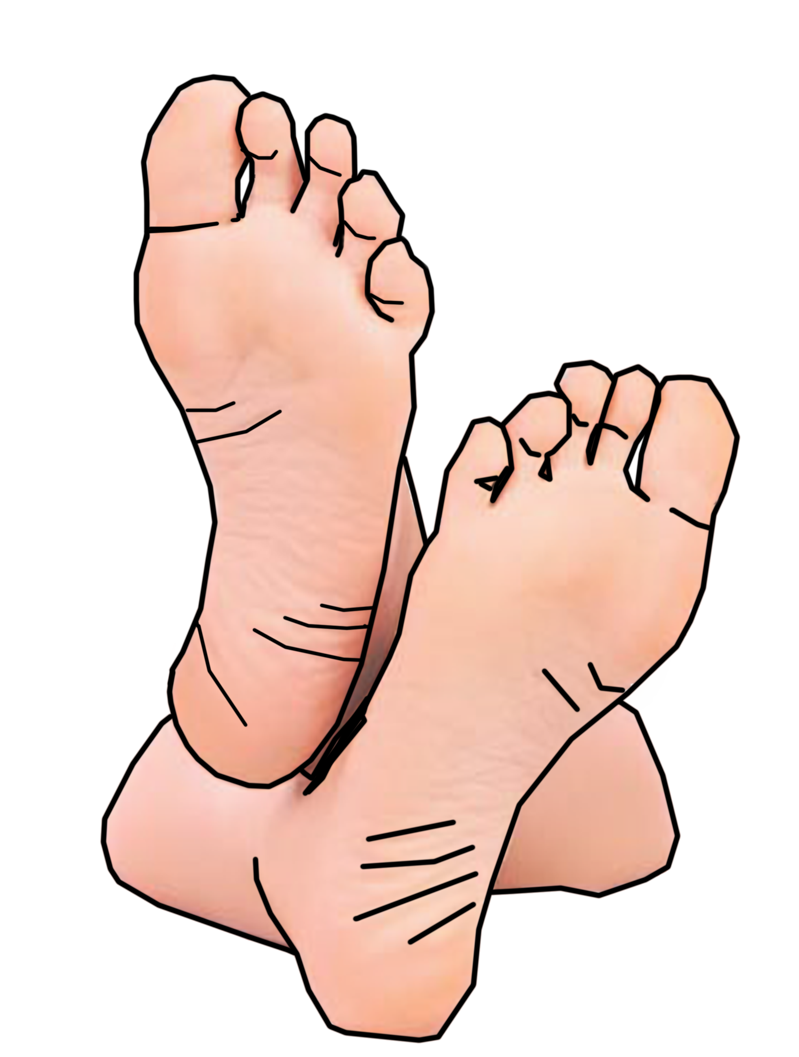
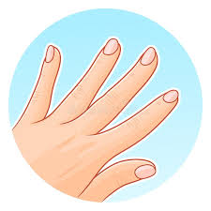
Task 4. Write the body part.
Your _______ look and taste better if you brush them.
teeth
nails
feet

Slide 13
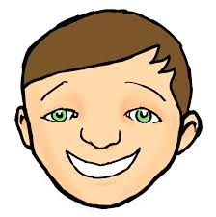
Your _______ feels clean and fresh if you wash.
hair
body
face

Slide 14
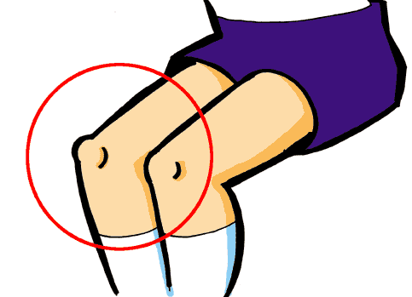
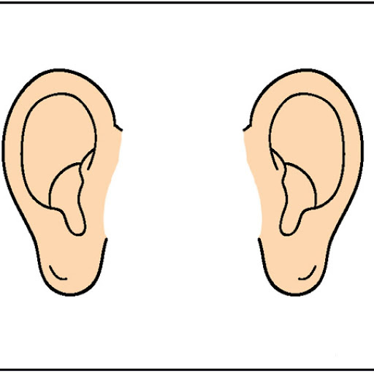
Your ______ feel good when they are clean.
hands
ears
knees

Slide 15
wash
brush
eat
dry
clean
open
close
walk
jump

Slide 16
Mum tells me to brush my teeth.
Brush your teeth!

Slide 17
Dad tells me to take a bath.
Take a bath!

Slide 18
My brother tells me to wash my hands.
Wash your hands!

Slide 19
My sister tells me to eat vegetables.
Eat vegetables!

Slide 20
Thank you for using this resource. Check out our latest resources below:

