Slide 1
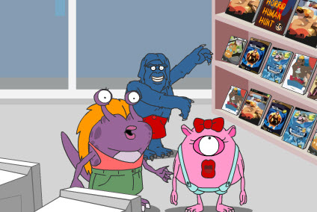
Lesson 5: Literature Topic: Shopping and Services Year: 4

Slide 2
Lesson Objectives:
I will:
read a text silently and aloud.
listen to the text being read aloud.
answer questions about it.

Slide 3
Download these resources:
Monster Shopping Trip Text Handout
Monster Shopping Trip Worksheets
Monster Shopping Trip Answers Handout

Slide 4
Watch the following video clip and then answer the question:
What is the video clip about?

Slide 5
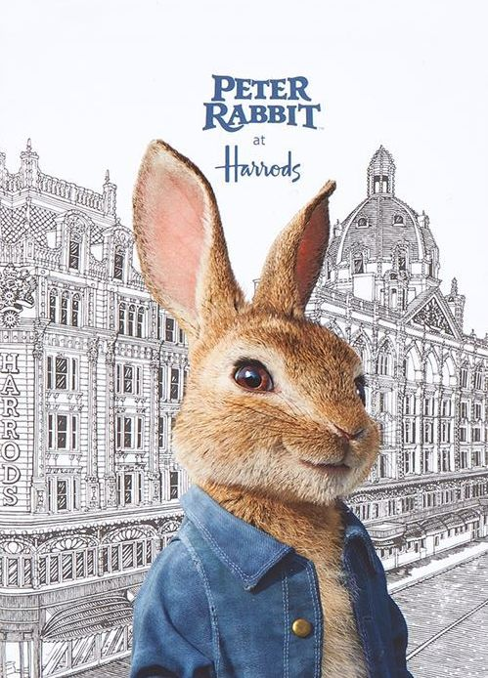
https://www.youtube.com/watch?v=MPuwf8Tb4HY

Slide 6
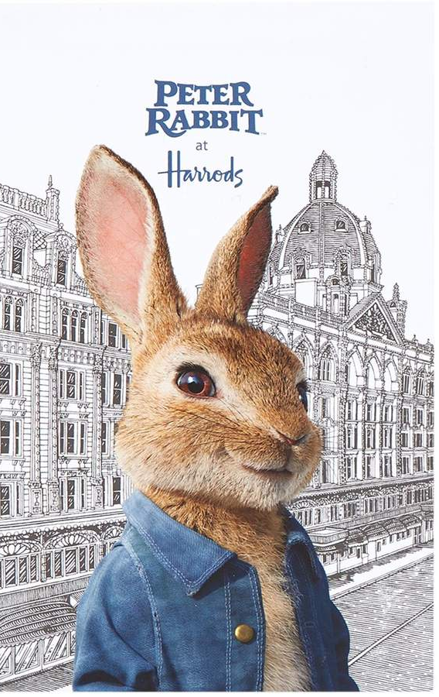
Let’s discuss the question: The video clip is about when Peter Rabbit visits the shopping outlet Harrods, in London.

Slide 7
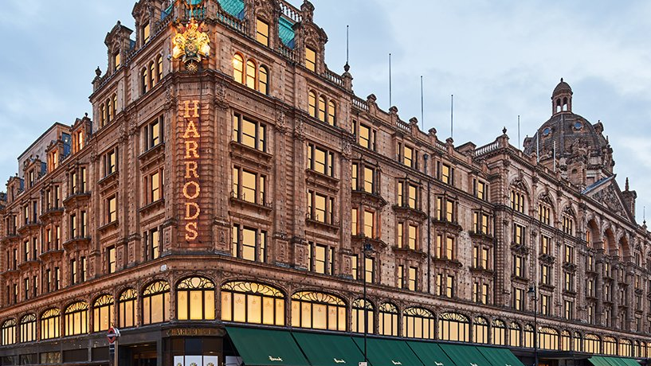

Slide 8
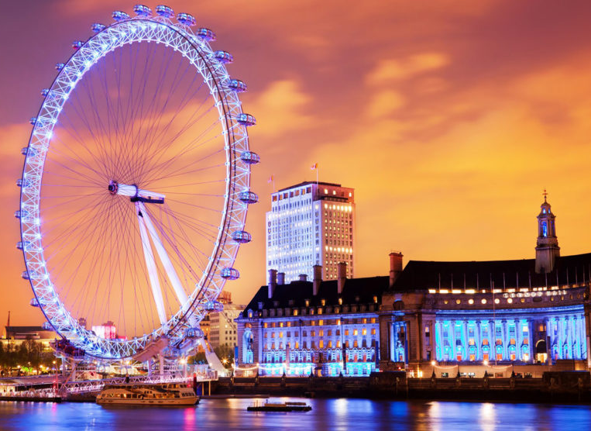
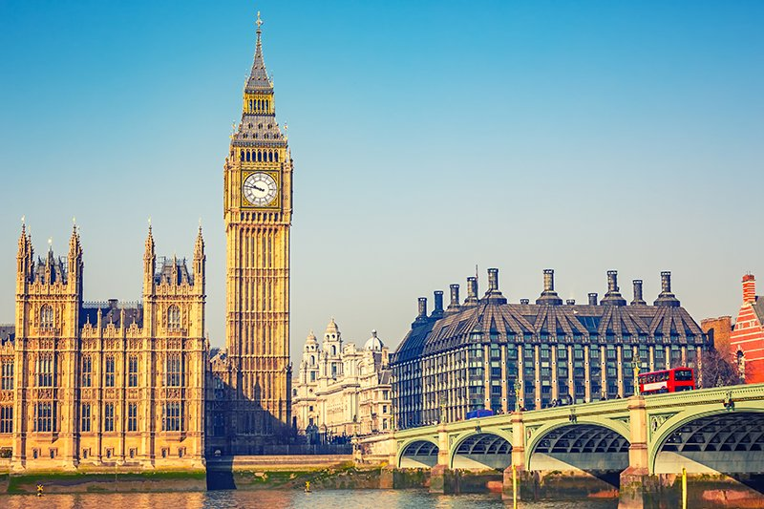
In the video we mentioned the shop Harrods in London.
Have you ever been to London?
How would you reach London?
Which shops would you visit in London?
Which attractions would you not miss?

Slide 9
Pre-Teaching of Text
handsome = having a pleasing appearance
nearby = very close, not far
horrible = extremely bad
deserves = earns

Slide 10
Step 1:
READ the text silently.
Try to ANSWER the following question.
What is the text about?

Slide 11
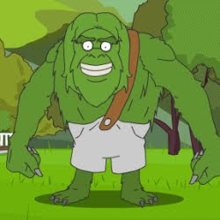
Step 2: Let’s discuss the question:
The text is about Hairy Henry, the green monster who was going to celebrate his birthday soon.
His friends decide to go to London and buy him a present. They each buy him something different.

Slide 12
Make a list of the shops Hairy Henry’s
friends visited:
computer shop
clothes shop
cake shop

Slide 13
Step 3:
READ the text again.
Try to ANSWER the following questions.
What is Hairy Henry going to celebrate?
What did his friends decide to do?
What did Loony Lou and Gorgonzola decide to buy Hairy Henry?

Slide 14
Step 4: Let’s ANSWER the questions.
What is Hairy Henry going to celebrate? He is going to celebrate his birthday.
What did his friends decide to do? They decided to buy him a present.
What did Loony Lou and Gorgonzola decide to buy Hairy Henry?
They bought him a very special monster computer game for catching horrible humans. Afterwards Gorgonzola bought him a tie which lights up and sings the ‘Happy Birthday’ song. Finally, they bought him the biggest cake ever.

Slide 15
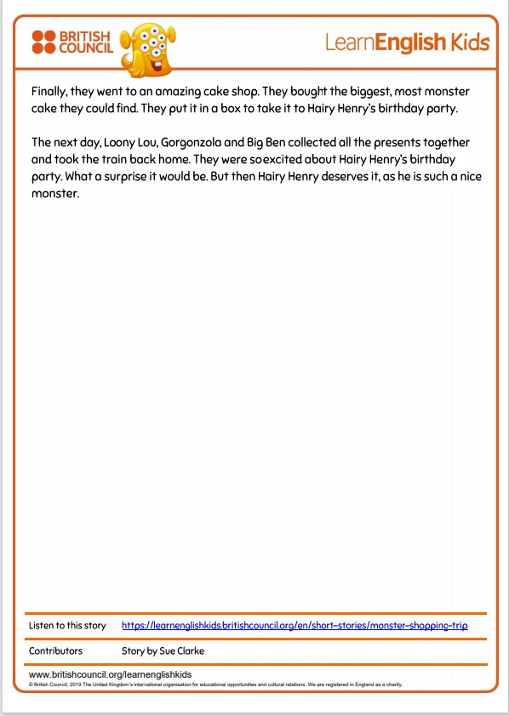
Step 5:
LISTEN to me while I read the text and the questions aloud.

Slide 16
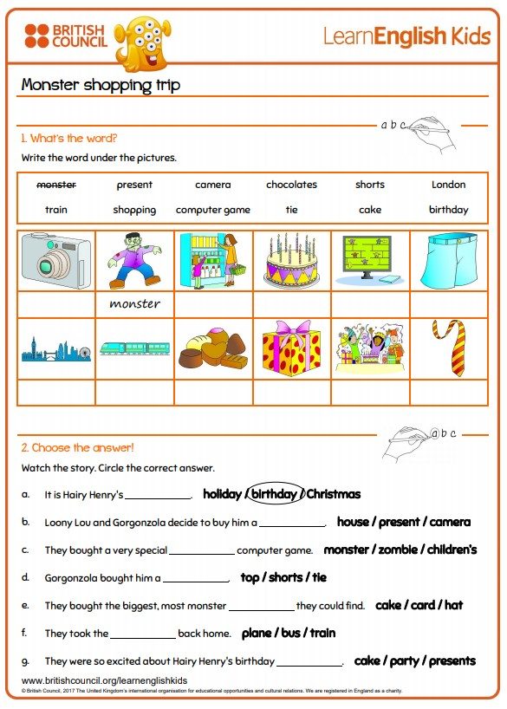

Slide 17
Step 6:
READ the reading text and then
ANSWER the questions.

Slide 18
Step 7:
ANSWER all the questions. When you are ready, REVISE your answers.

Slide 19
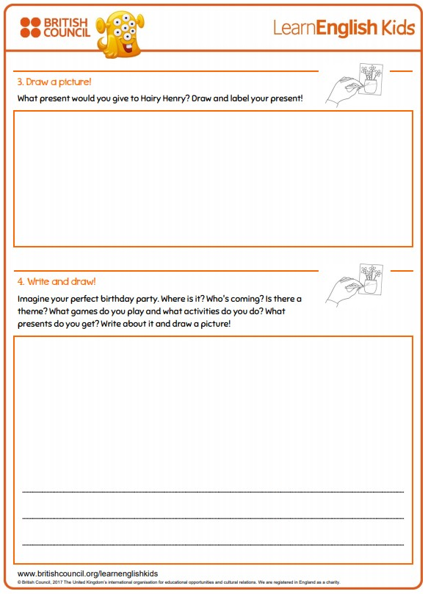
Post-Task Activity:
Fill in this worksheet!

Slide 20
Now watch this video.
Enjoy!

Slide 21
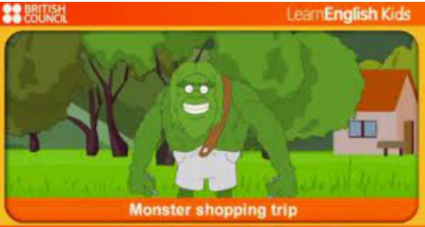
https://www.youtube.com/watch?v=nEciUDh59x8

