Slide 1
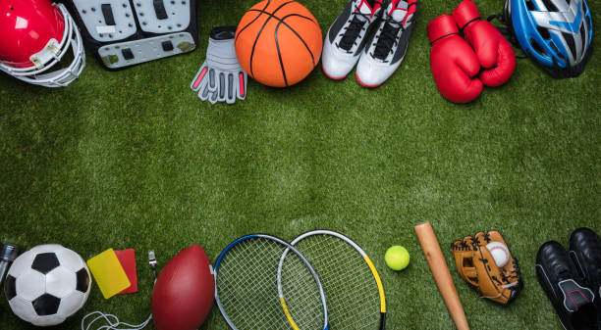
Sports and Games
Lesson 2 - Reading

Slide 2
Notes for the Educator
This lesson is pegged directly to Learning Outcome R 5.5 I can use a range of strategies to aid comprehension and find the required information in the text and R 5.7 I can make informed assumptions about a text or long work from its title and introductory material
A link to a poll is included (https://linkto.run/p/JQIIM8CU). Teachers may use this poll or create a similar one.
Teachers are to refer to the Scheme of Work where each lesson is explained in more detail.
Effects are included to make the presentation more interactive. Please present the PowerPoint in Slideshow mode.
Wherever possible we have included the use of online apps to enhance the teaching and learning experience.
The Notes section underneath the slides may contain some further points which can be developed during the lesson.
Teachers are encouraged to adapt this PowerPoint presentation to meet the learners’ language needs.
Tasks included in the PowerPoint presentation are also being shared as handouts.
For any comments, feedback or suggestions please email us at: marie-claire.camilleri@ilearn.edu.mt; urieth.attard@ilearn.edu.mt; mary.jude.camilleri@ilearn.edu.mt. You may also call the office on: 25983683.

Slide 3
You have 15 seconds to look at the sports collage on the next slide.
How many sports can you remember?

Slide 4
football

Slide 5
Think about this sport…
Is it a team sport or an individual sport?
How many players are there in a team?
Where is it played?
What is the aim?
Is it a sport for boys or girls? Or both?
team
11
playing field / pitch
score a goal
both
Notes:
Let’s have a look at this picture. Can you guess what sport this is? That’s right. We are going to talk about Football.
Let’s quickly gather some ideas about this sport. You can discuss these questions with an adult sitting next to you.

Slide 6
I am learning how to read an information text and respond to it.
I can scan the text to look for specific answers.
I can say what the text is about by looking at the pictures and title.
I am able to complete the tasks.

Slide 7
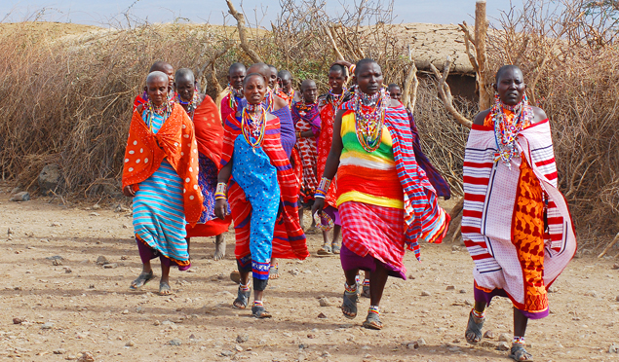
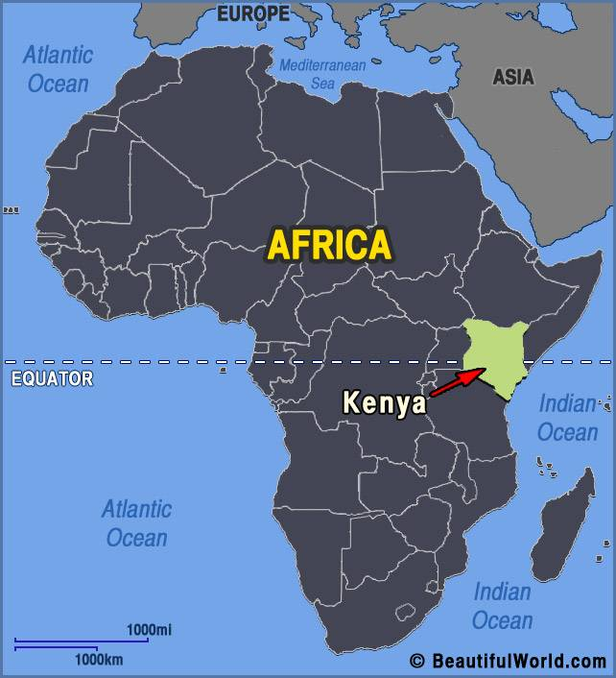
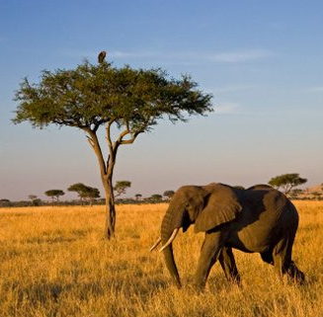
Notes:
Kenya is a big country located in East Africa. Even if you’ve never been to Kenya, chances are you know what it looks like. Kenya’s savannah is familiar from movies, TV shows, books and even adverts. If you are familiar with the film Lion King, then you know what a savannah looks like. You can see many different animals such as elephants, zebras, hippos, lions, cheetahs and more.

Slide 8
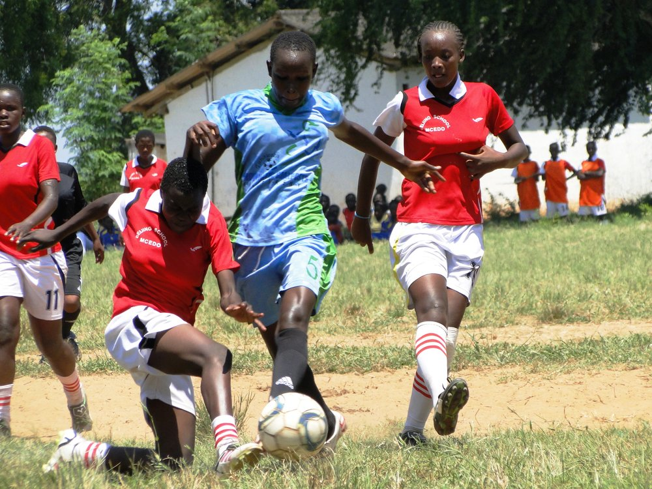
playing field
girls
team sport
football gear
match
clapping
cheering

Slide 9
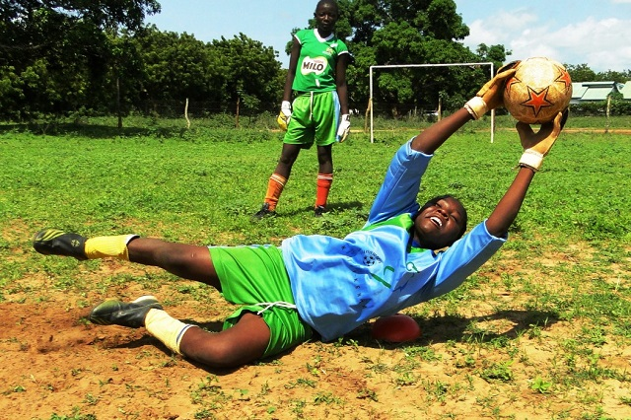
training
goalpost
practise
football gloves
soil
goalkeeper
dust

Slide 10
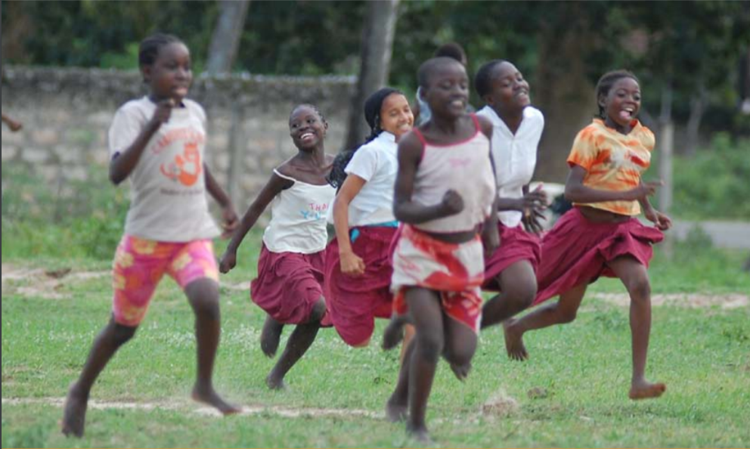
running
happy
barefoot
race

Slide 11
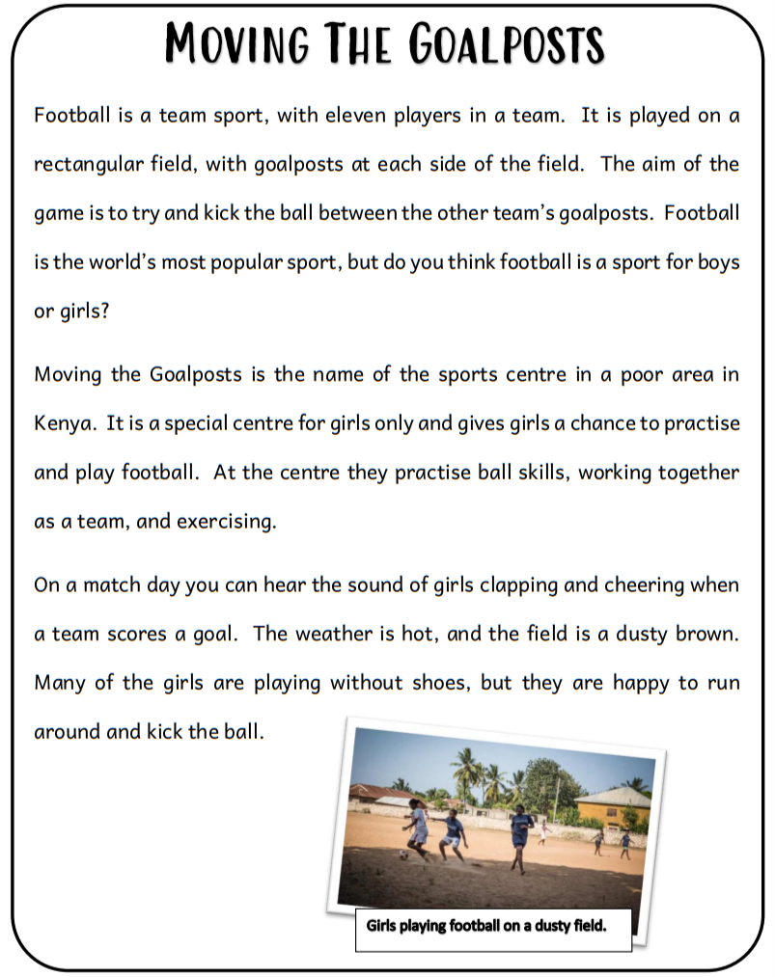
title
information text giving facts about football and the sports club
photo
caption
Notes:
Is this a story? How do you know? Is it about something which is made up or something that is real? How can we tell?

Slide 12
What is the main idea of the text?
What are some difficulties the players face?
What are some good things about this centre?

Slide 13
1st reading: Follow along as I read the text aloud.
2nd reading: Read the text to yourselves.

Slide 14
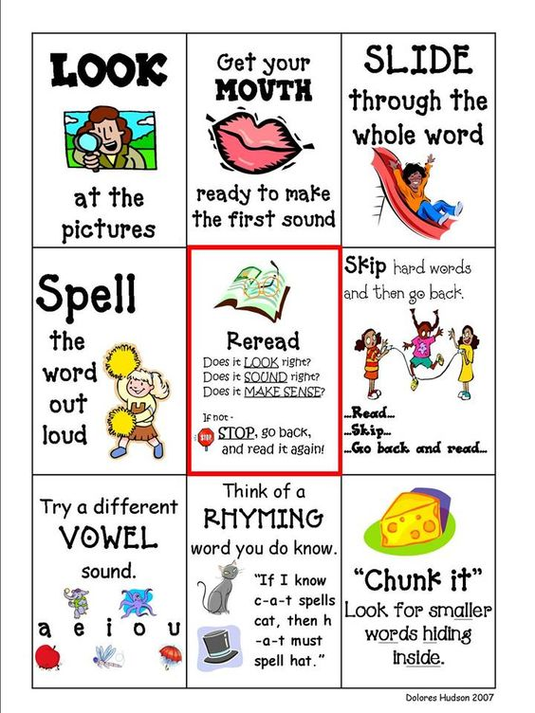
When you get stuck on a word:
Notes:
These are decoding strategies. Learners should be made aware of the strategies they are using when they come across a word which is new or unfamiliar. Strategies should be introduced gradually, so that eventually they would develop a repertoire of strategies.

Slide 15
Good readers check if they understand what they are reading.
Notes:
This is a comprehension strategy. For this lesson, explain and model checking understanding by stopping to reflect on what you read. Does it make sense? Is a difficult word stopping them from understanding? Can they try rereading that bit more slowly or read it aloud to help them understand?

Slide 16
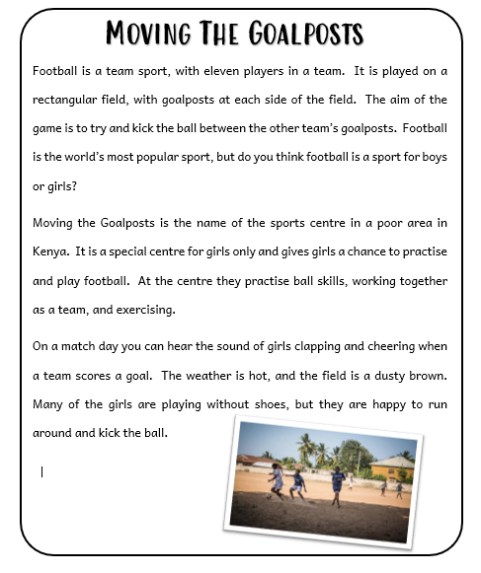
1. What is the main idea of the text?
Moving the Goalposts is a sports centre in Kenya.
The centre is for girls only and they get a chance to play football.

Slide 17
2. What are some difficulties the players face?
Hot weather
Dusty field
They have no shoes

Slide 18
3. What are some good things about the centre?
Girls get a chance to practise and play football
Practise ball skills, work as a team and do exercise.

Slide 19
Task 1. Tick all the things we learnt about football.
✓
It is a team sport.
Each team has 10 players.
There is a goalpost at each side of the field.
The aim is to kick the ball over the goalpost.
✓

Slide 20
Task 2. Continue these sentences with a word from the text.
poor
The Sports Centre is in a ________ area in Kenya.
Only ______ can play at this centre.
During a _________the girls clap and cheer.
Many girls play football without wearing any __________.
girls
match
shoes

Slide 21
Task 3. What was the author’s purpose in writing this text?
To entertain the reader with an interesting story.
To inform the reader or give more information.
✓
To persuade the reader to do or believe something.

