Slide 1
Lesson 1 Listening
Year 5
English

Slide 2
MEDIA
What is media?
The term media, which is the plural of medium, refers to the communication channels through which we share news, music, movies, education, promotional messages and other data … such as TV, radio, newspapers and magazines.

Slide 3
View this clip!

Slide 4
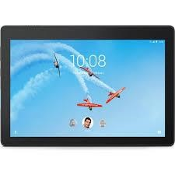
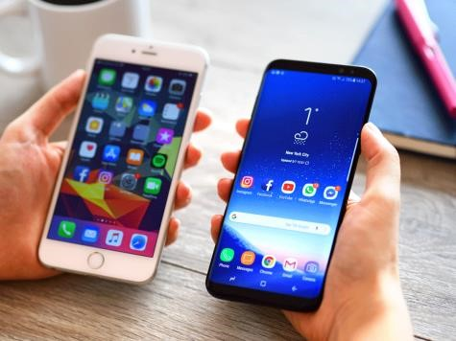
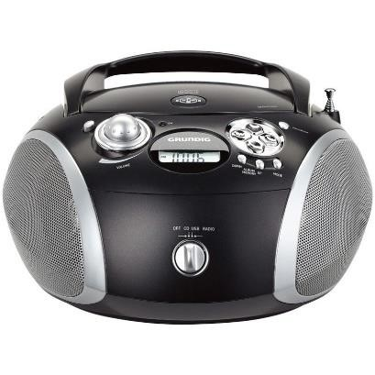
Activity!
Which ones have become a necessity? Why?
Put them in order of importance in your life.
1
2
3
4
5
6

Slide 5
Lesson 1 Objectives
In Lesson 1 you will:
listen to an interview.
answer questions about the interview.
share your opinion about a given topic.

Slide 6
Lesson Resources
Questions Worksheet
Answers Handout
What do you think? Handout

Slide 7
What is the listening text about?
Alex, the reporter

Slide 8
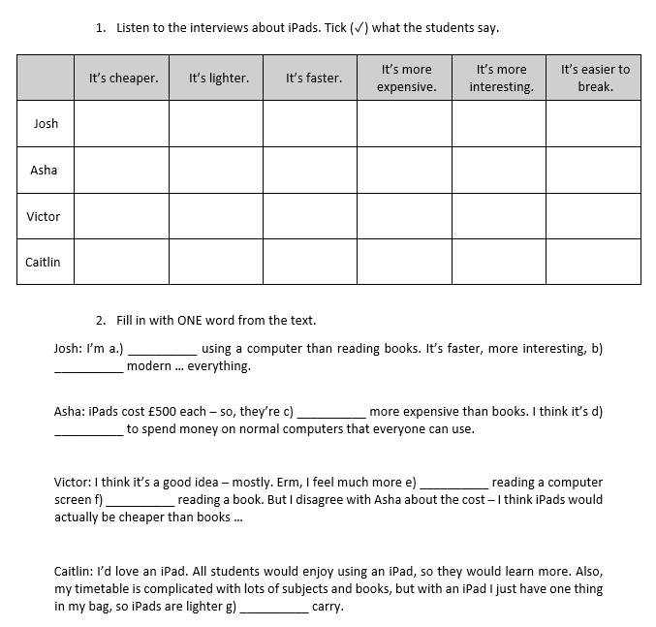
Step 1
READ the questions
on the worksheet.

Slide 9
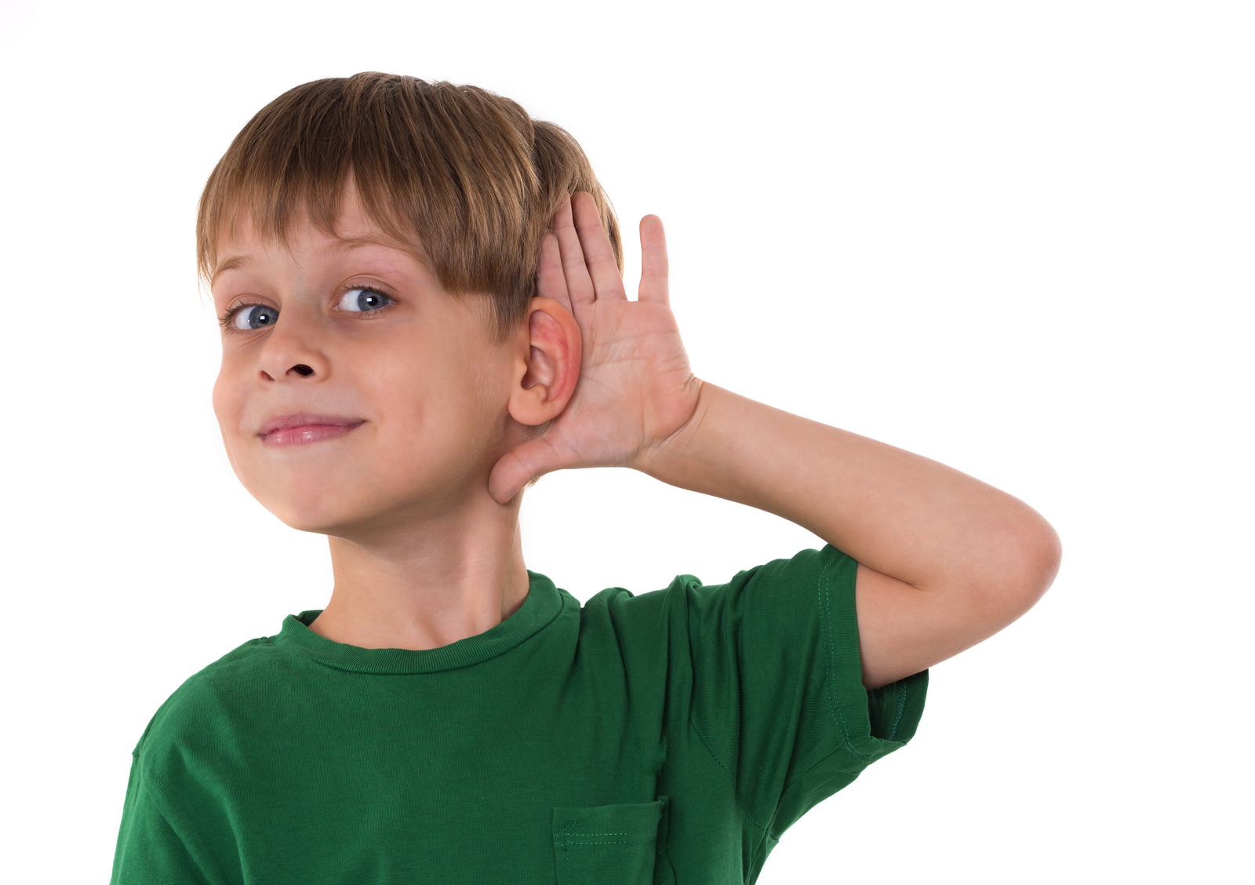
Step 2
LISTEN carefully to the text.
LISTEN carefully while I read the questions.
START ANSWERING the questions.

Slide 10
Step 3
LISTEN to the text for
the second time.
LISTEN while I read the questions again.
Try to ANSWER any unanswered questions.

Slide 11
Step 4

Slide 12
Step 5
CHECK your answers using the
Answers Handout.

Slide 13
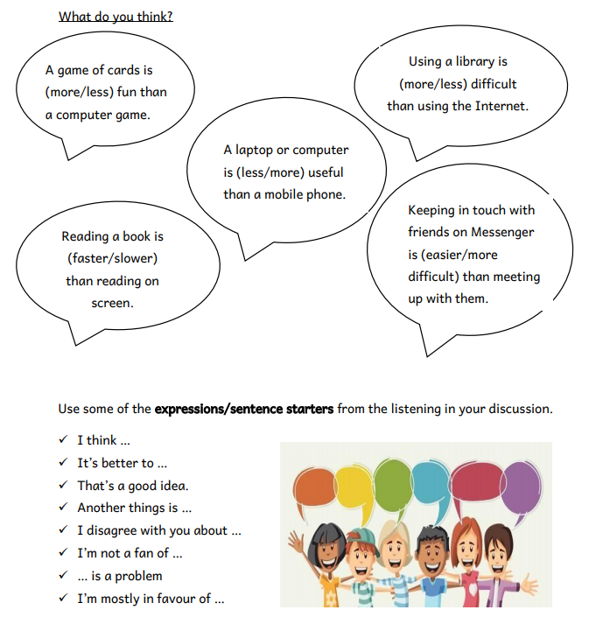
Post-Task Activity
Sharing your opinion about …

Slide 14
Thank You!

