Slide 1
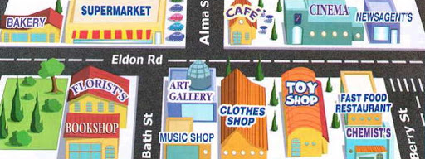
Places and Directions
Lesson 4: Speaking

Slide 2
Notes for the Educator
This lesson is pegged directly to Learning Outcome LS 5.15 I can convey a message accurately and clearly.
Teachers are to refer to the Scheme of Work where each lesson is explained in more detail.
Effects are included to make the presentation more interactive. Please present the PowerPoint in Slideshow mode.
Wherever possible we have included the use of online apps to enhance the teaching and learning experience.
The Notes section underneath the slides may contain some further points which can be developed during the lesson.
Teachers are encouraged to adapt this PowerPoint presentation to meet the learners’ language needs.
Audio files or links to websites may be included.
Tasks included in the PowerPoint presentation are also being shared as handouts.
For any comments, feedback or suggestions please email us at: marie-claire.camilleri@ilearn.edu.mt; urieth.attard@ilearn.edu.mt; mary.jude.camilleri@ilearn.edu.mt. You may also call the office on: 25983683.
Notes:
.

Slide 3
I am learning how to give and follow directions.
I can use vocabulary of position.
I can describe the correct route to a place.
I can self correct some mistakes I make while speaking.

Slide 4
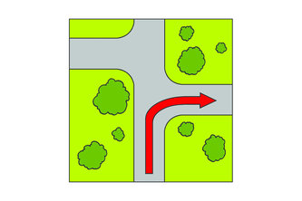
turn right
Notes:
Before we start the first activity, let’s revise some vocabulary of position. We have already gone through these in our first lesson so you should be familiar with them. I will show you the picture and if you know it, shout out the answer.

Slide 5
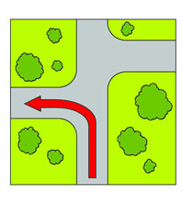
turn left

Slide 6
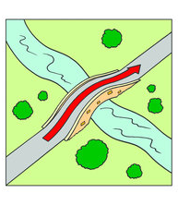
go over

Slide 7
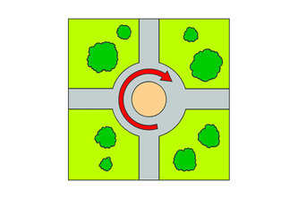
go round

Slide 8
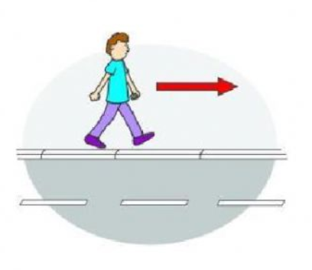
go along

Slide 9
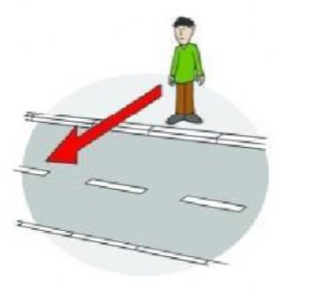
cross the road

Slide 10
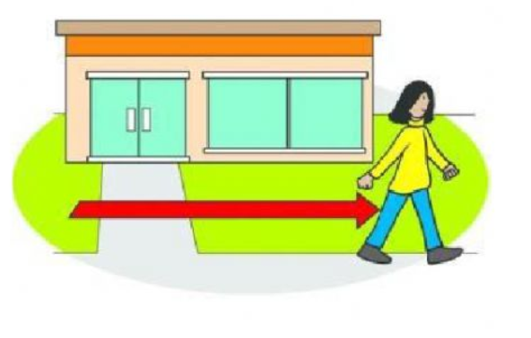
go past

Slide 11
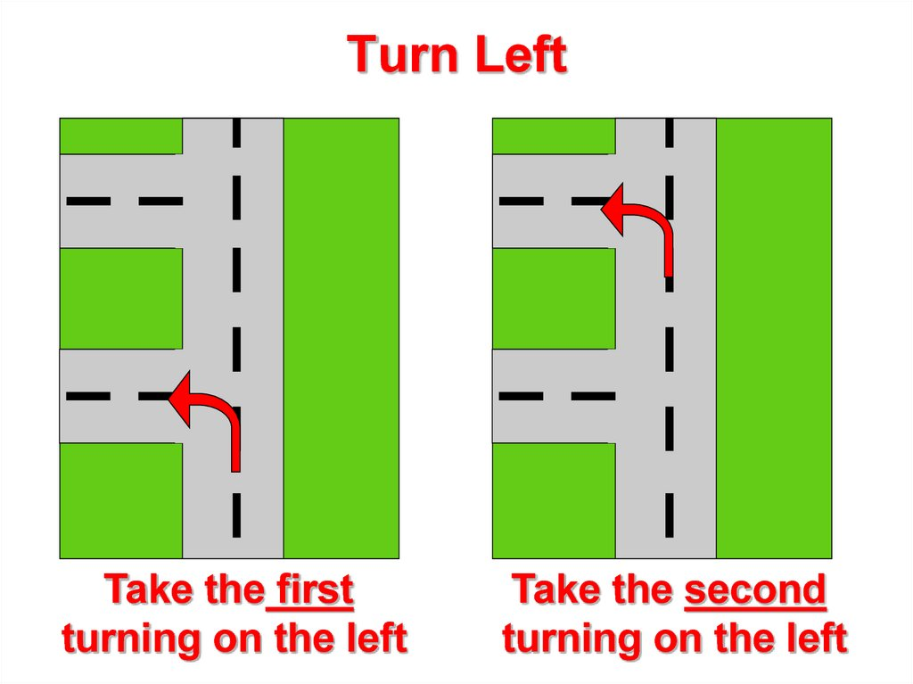
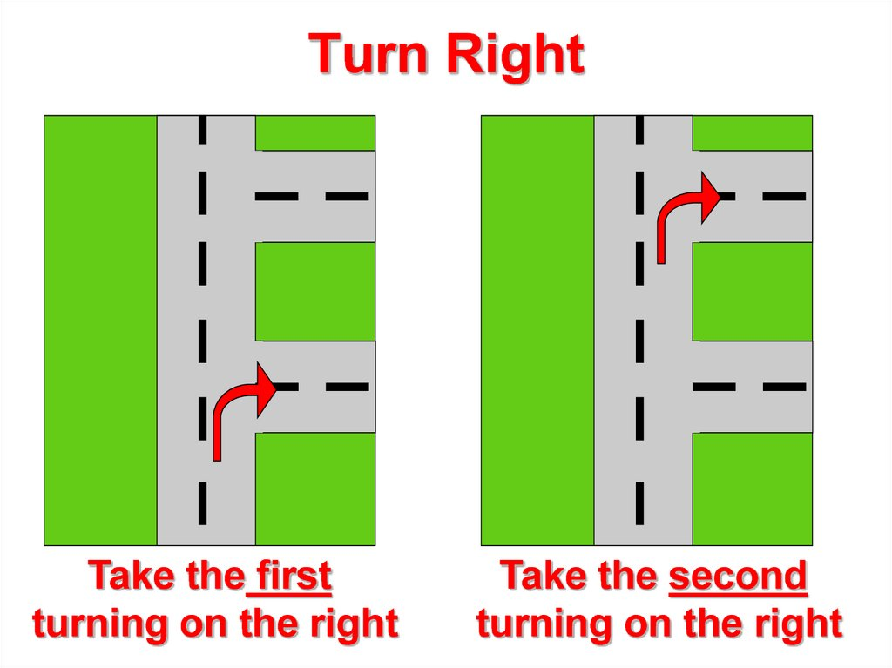
Notes:
When we say turn left, sometimes we can also say, take the first or second turning left, especially if there are more streets further along the road. We can do the same for turn right – we can say take the first turning right, meaning turn onto the first street you come across.

Slide 12
Guess where?
Activity 1

Slide 13
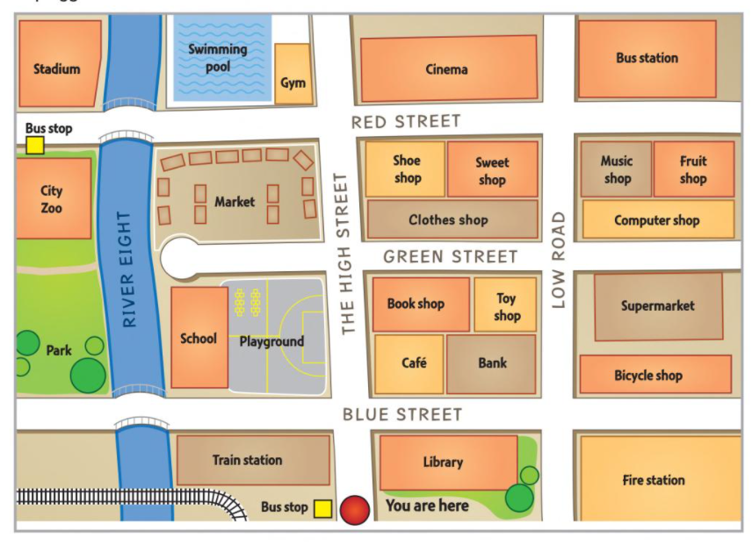
Notes:
Look carefully at this map. Let’s identify some important places on the map.
So first of all, we are going to start off on the red spot, here.
Then, we have the name of the streets: Blue Street, Green Street and Red Street running horizontally and The High Street and Low Road going vertically across. On the left hand side, there is a river called River Eight. There is also a park and a swimming pool. What other places can you mention?

Slide 14
Notes:
Go along the High Street and take the first turning right. Walk along this road. What’s on the corner, on the left, oppostite the library?

Slide 15
Notes:
Go along the high street. Take the third street on the left and stop after the river. What’s on the right?

Slide 16
Notes:
Go along the high street and take the second street on the left. Walk past the playground. What’s next to it?

Slide 17
Notes:
Go straight on. Take the second street on the left. What’s at the end of the street?

Slide 18
Notes:
Go along the High Street and take the third street on the right. Go across Low Road and it’s next to the music shop.

Slide 19
Giving directions
Activity 2
Notes:
In this activity you need to give directions yourself.

Slide 20
Turn left
Turn right
Take the first turning right
Take the first turning left
Go across
Walk past
Go over
Cross the road
Next to
Opposite
On the corner

Slide 21
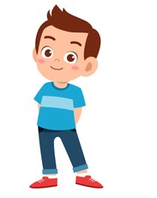
Of course. How can I help?
Can you help me, please?
Walk along The High Street and take the first turning right, onto Blue Street. It’s opposite the library, next to the café.
Where is the bank, please?

Slide 22
Thank you for using this resource. Check out our latest resources below.

