Slide 1
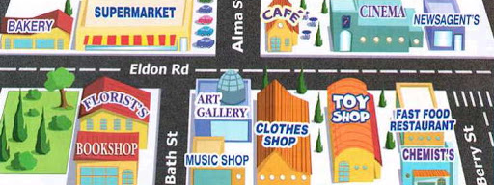
Places and Directions
Lesson 3: Literature
Notes:
Hello children and welcome to our third lesson. This lesson will focus on literature and we will be working on a poem.

Slide 2
Notes for the Educator
This lesson is pegged directly to Learning Outcome LIT 5.3 I can respond to simple poems, stories, and plays by speaking and writing briefly about how I feel about the literary texts and about the events and characters in these texts.
Teachers are to refer to the Scheme of Work where each lesson is explained in more detail.
Effects are included to make the presentation more interactive. Please present the PowerPoint in Slideshow mode.
Wherever possible we have included the use of online apps to enhance the teaching and learning experience.
The Notes section underneath the slides may contain some further points which can be developed during the lesson.
Teachers are encouraged to adapt this PowerPoint presentation to meet the learners’ language needs.
Tasks included in the PowerPoint presentation are also being shared as handouts.
For any comments, feedback or suggestions please email us at: marie-claire.camilleri@ilearn.edu.mt; urieth.attard@ilearn.edu.mt; mary.jude.camilleri@ilearn.edu.mt. You may also call the office on: 25983683.

Slide 3
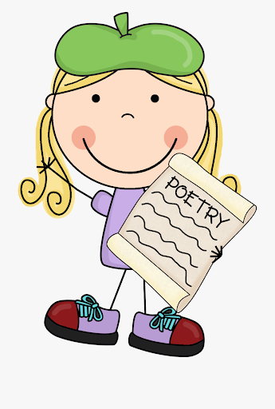
I am learning how to understand a poem.
I can make a mental picture of what I am reading.
I can read the poem in a loud and clear voice.
I can answer questions about it.
Notes:
In this lesson we are learning more about how to read and understand a poem. We will know that we are doing so by being able to make a picture in our minds of what the poem is about, talk about the language used in the poem and answer questions about it.

Slide 4
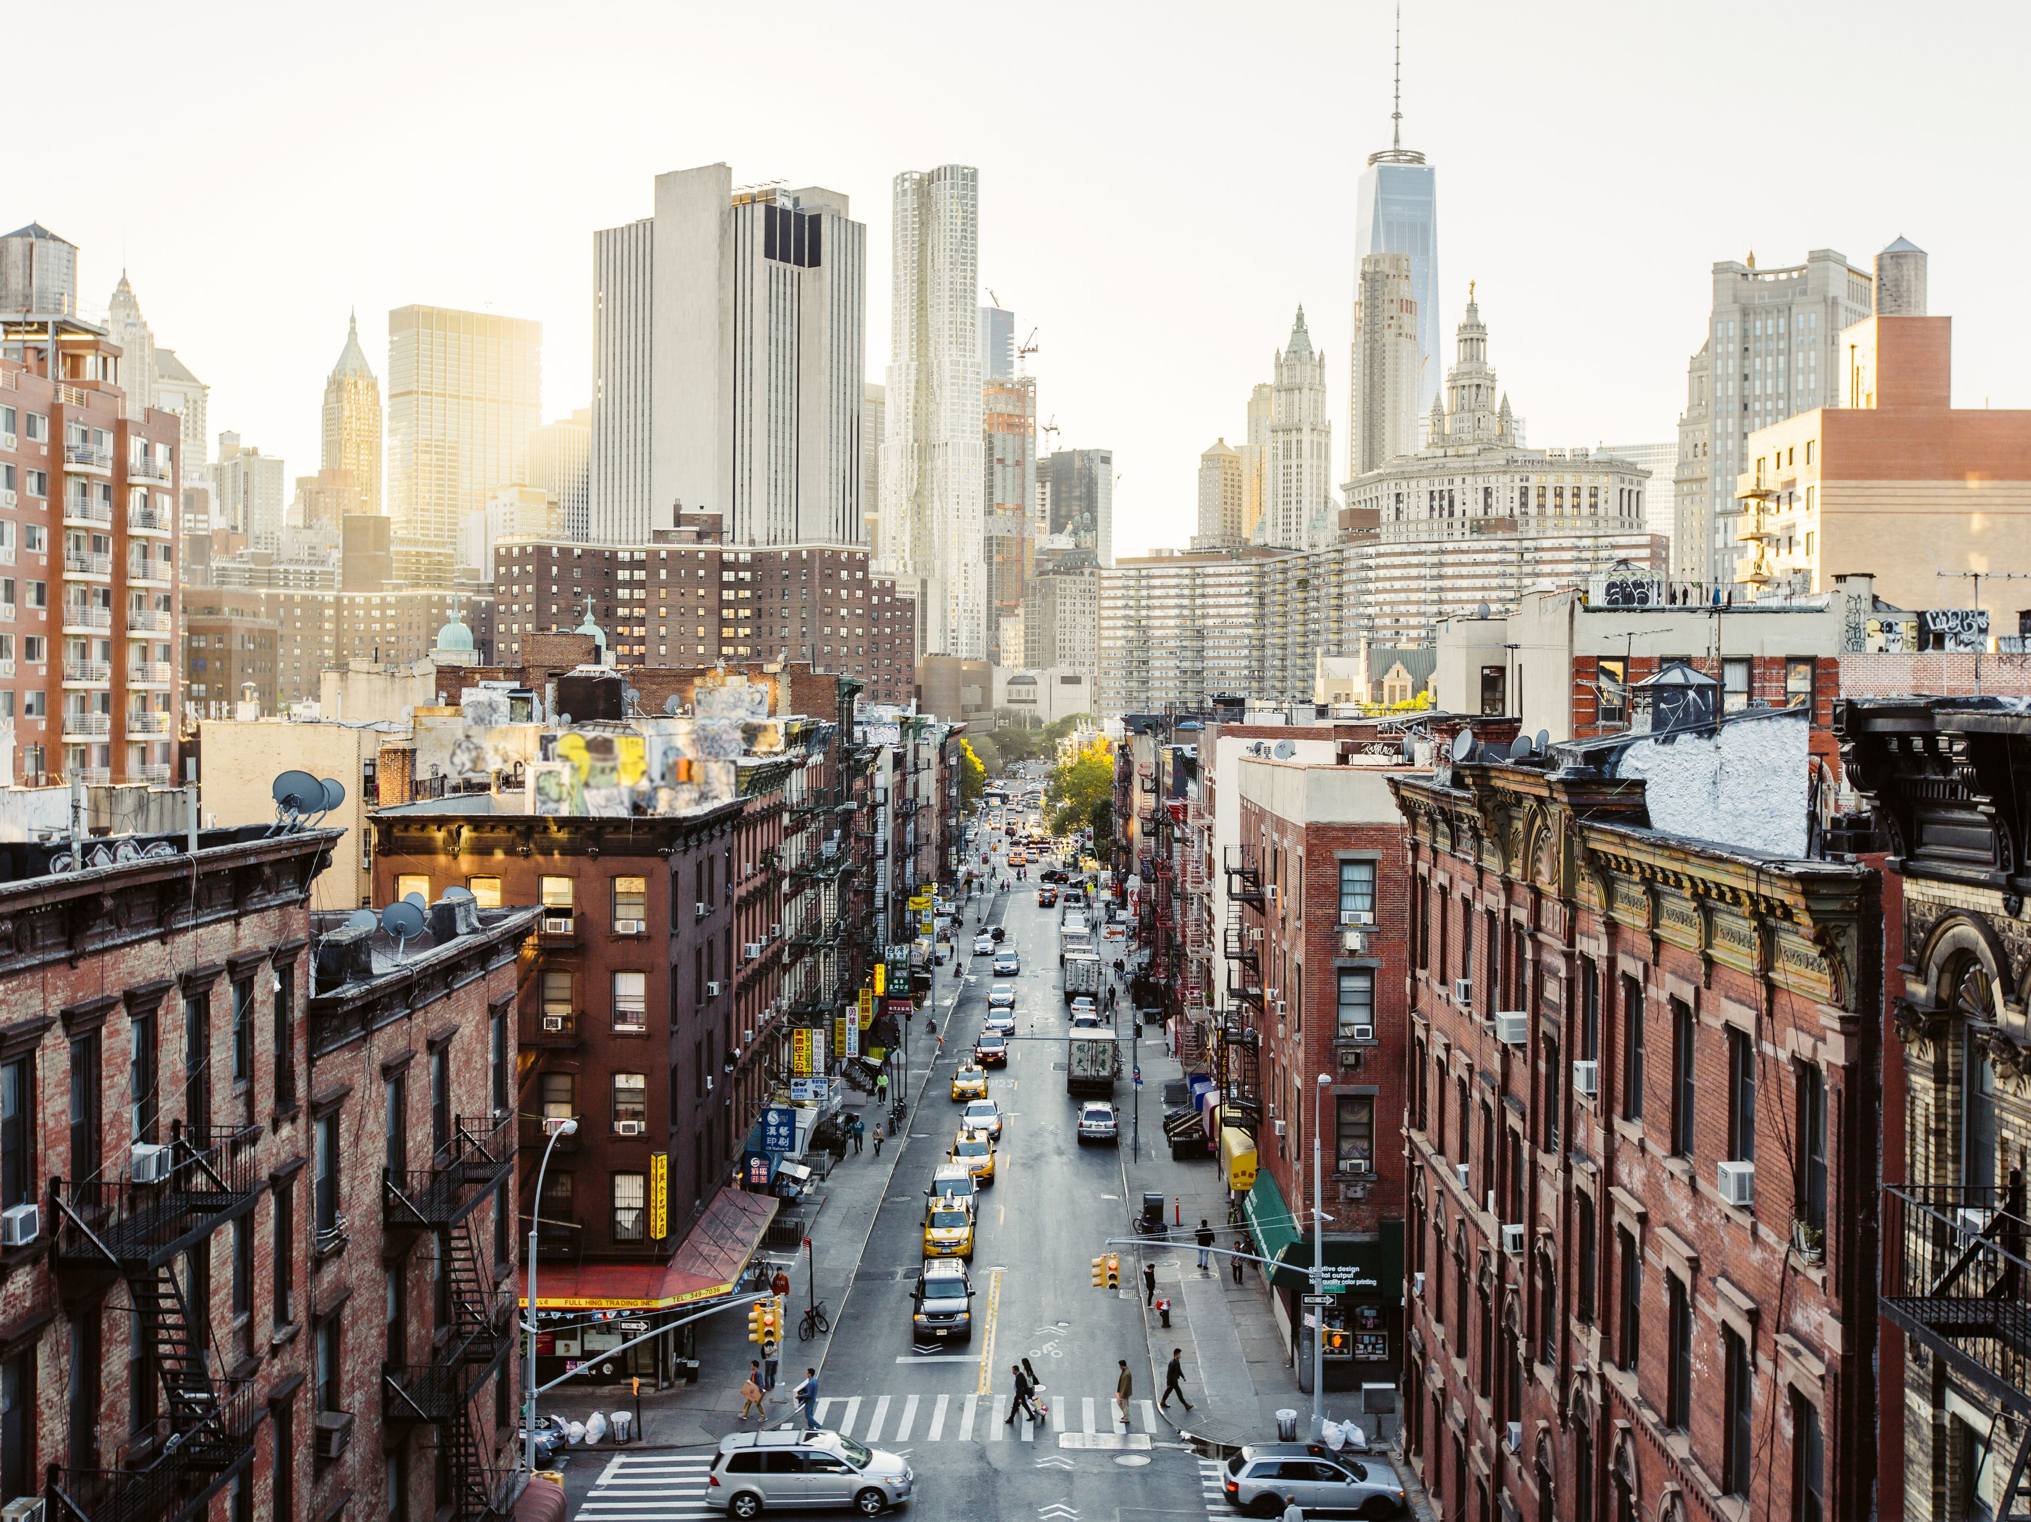
gleaming skyscrapers
red brick buildings
tall buildings
people walking across the zebra cross
a line of cars
Notes:
What comes to mind when you see this picture? Look at it carefully and think of words that you can use to describe what you are seeing.

Slide 5
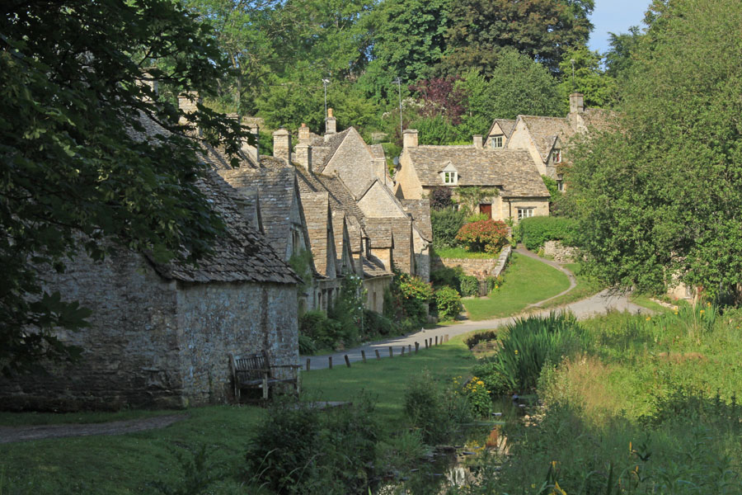
tall trees
old cottages and houses
peaceful and quiet
a gurgling stream of water
country lane

Slide 7
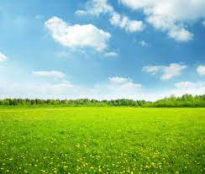
meadow

Slide 8
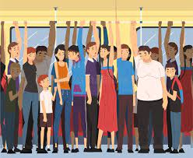
crowded

Slide 9
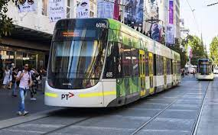
trams

Slide 11
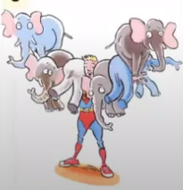

Slide 12
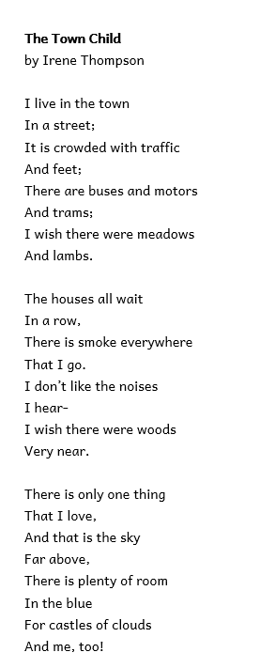
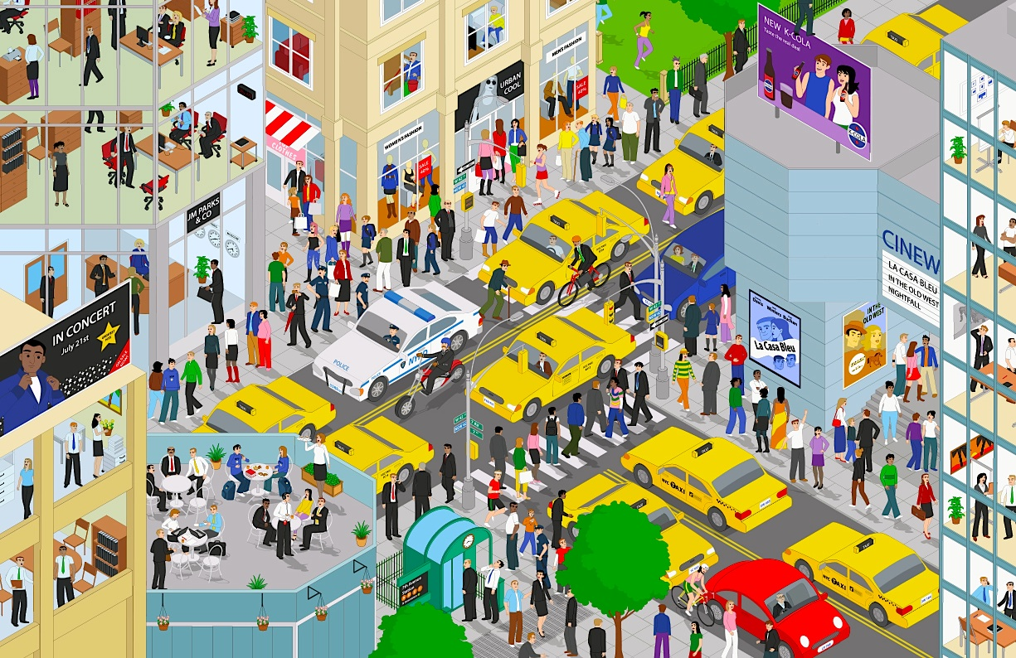
Notes:
Let’s look at the poem and discuss our first thoughts about it. I like this poem because it helps the reader come up with images while reading it. When I read I can form pictures in my head .
What is the title of the poem? It is The Town Child so, immediately we think of a child who lives in a busy town. So just by reading the title I can already form an image in my mind.

Slide 13
Name of the poem
Poet – person who wrote the poem
8 verses in each stanza
3 Stanzas
Rhyming words: street – feet/ trams - lambs
Notes:
Now, let’s look at the poem and say something about the way it looks and its features. There is the name of the poem, and underneath it there is the name of the poet: Irene Thompson, that is the person who wrote the poem.
We can clearly see that there are three stanzas, and each stanza is made up of 8 verses.
Some verses are long, others are short with most of them having 2 words. Now, as we read the poem, you will see how there are some rhyming words – words that sound the same.

Slide 14
Main Idea
Visualise
Notes:
Right. Now I am going to read the poem aloud so that we can see what the main idea of the poem is. Follow along from your worksheet.
What was the main idea of the poem. The poet says that the child lives in the town but longs for the wide open spaces of the countryside. So, that is the main idea of the poem.
Next, I would like you to visualise the busy town, using the words from the poem. First, we need to go through the poem to underline the words that help us form a picture in our minds.

Slide 15
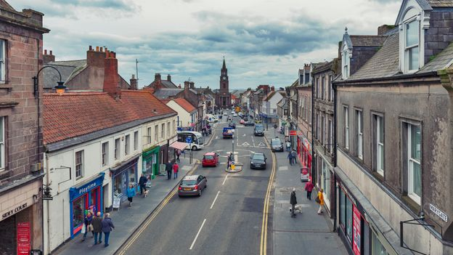
I live in the town
In a street;
Notes:
Let’s read the poem bit by bit and stop to discuss certain parts to help you understand it better.
In this part, the poet says that the child lives in a town on a street, so immediately we imagine a busy town not a quiet village.

Slide 16
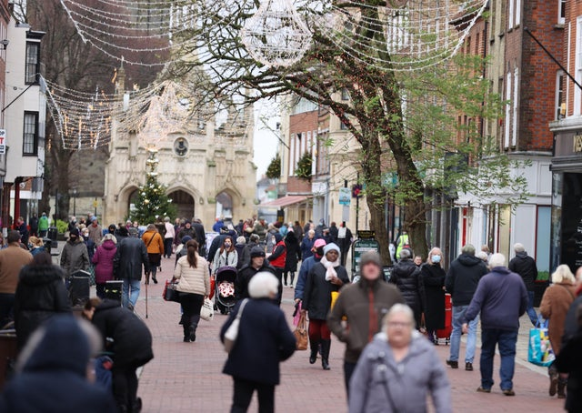
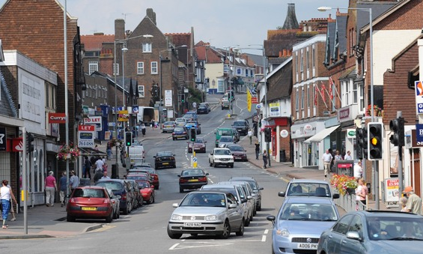
It is crowded with traffic
And feet;
Notes:
The child lives in a town on a street where it is busy with traffic and people are busy crossing the roads and taking part in the complete hustle and bustle of the town.

Slide 17
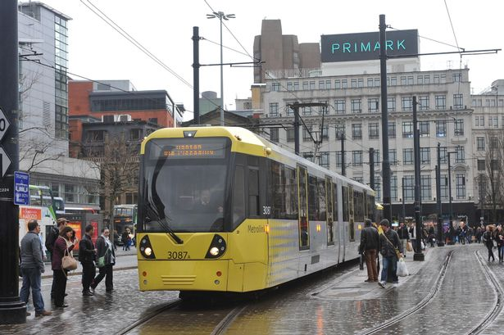
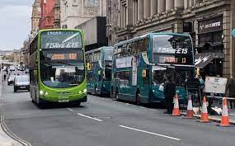
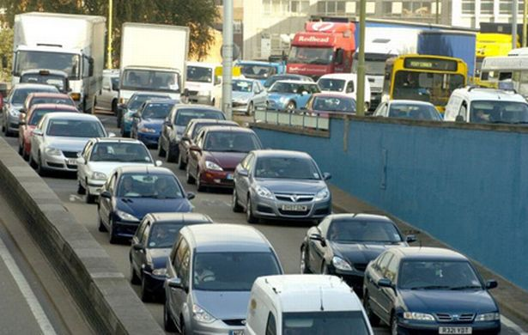
There are buses and motors
And trams;
Notes:
There are different vehicles such as buses and trucks that make it look and sound very busy.

Slide 18
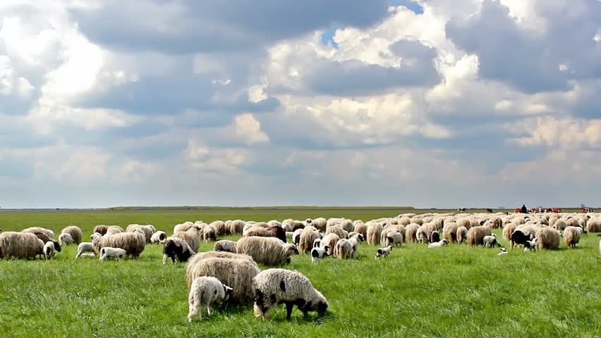
I wish there were meadows
And lambs.
Notes:
The child wishes for open land such as meadows full grazing lambs.

Slide 19
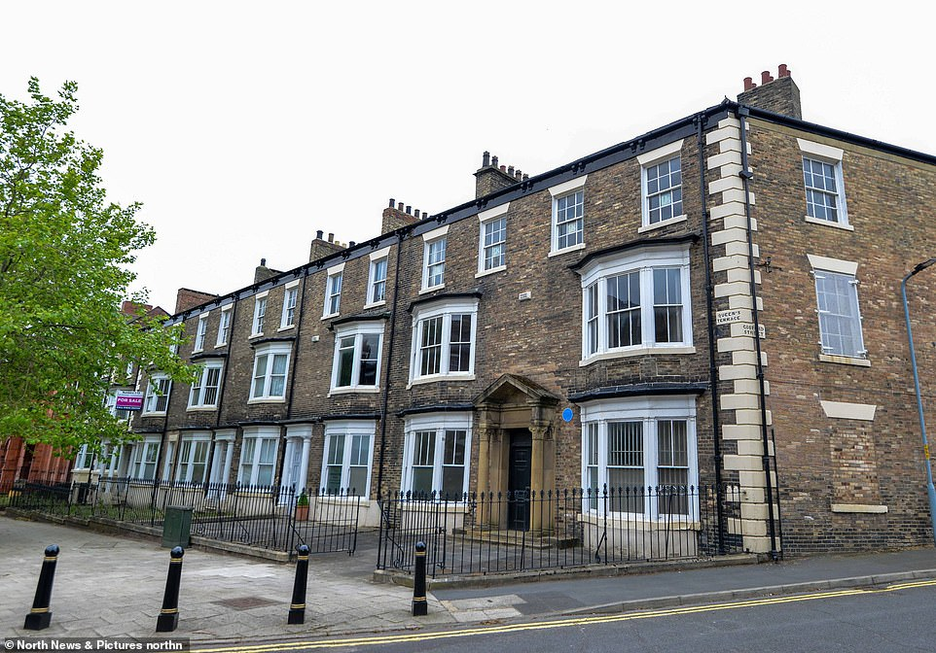
The houses all wait
In a row,
Notes:
Instead, where she lives the houses all stand neatly in row, in a line

Slide 20
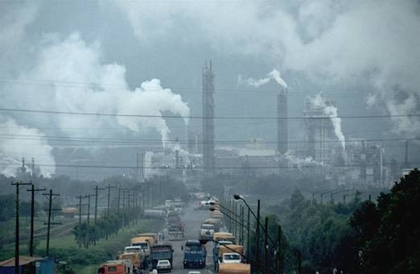
There is smoke everywhere
That I go.
Notes:
We get the idea that the air is not very clean, but rather it is full of smoke coming out from chimneys or cars.

Slide 21
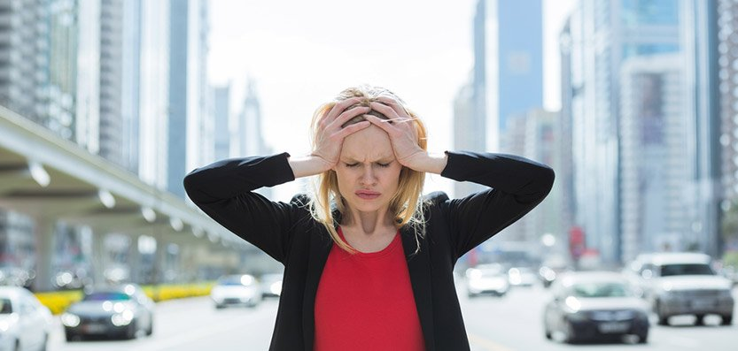
I don’t like the noises
I hear-.
Notes:
The child doesn’t like all the noises that he or she hears everyday.

Slide 22
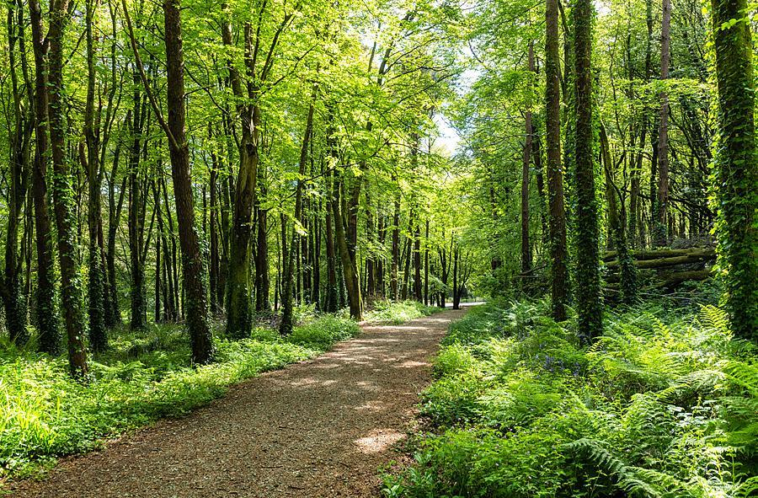
I wish there were woods
Very near.
Notes:
And in fact, he or she wishes that there are woods nearby.

Slide 23
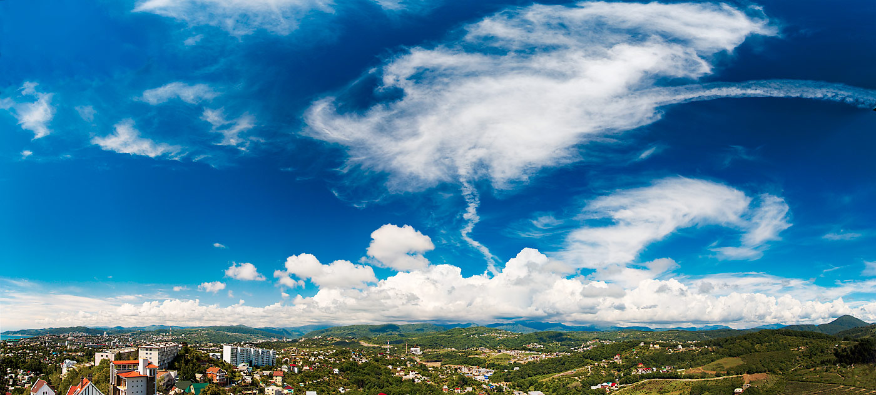
There is only one thing
That I love,
And that is the sky
Far above,
Notes:
In the last part of the poem, the child tells the reader how much he or she likes the sky above.

Slide 24
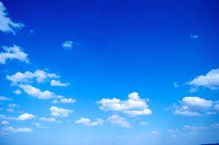
There is plenty of room
In the blue
For castles of clouds
And me, too!
Notes:
The sky is vast, and there is plenty of space for the child to imagine castles of clouds. She also imagines herself in the sky.

Slide 25
Think about this text…
Where does the town child want to live?
In the countryside.

Slide 26
Think about this text…
There is one thing that the town child loves. What is it?
The child loves the sky because it is big and vast.
Notes:
Let’s answer the questions together.
Justify answers from extract

Slide 27
Think about this text…
Describe the country from the child’s point of view?
The child imagines open meadows with grazing lambs and woods with trees.

Slide 28
Think about this text…
Which vehicles does the child see?
buses
motors
trams
Notes:
In this question we have to predict, because we haven’t watched the whole clip or we haven’t read the whole story. Therefore we need to make a guess. Who usually roars – could be an angry giant, a dragon. There is no right or wrong answer.

Slide 29
Think about this text…
Where is there plenty of space?
In the sky.

Slide 30
When I read a poem, I need to:
Use a clear voice
Make sure I can be heard
Use feeling and expression
Change the tone of my voice to suit the meaning of the words
Speak confidently

Slide 31
Thank you for using this resource. Check out our latest resources below.

