Slide 1
The World Around Us
Lesson 5: Writing
Notes:
Hello children and welcome once again to our English lesson. In this lesson we will be focusing on writing a postcard.

Slide 2
Notes for the Educator
This lesson is pegged directly to Learning Outcomes W 5.9 I can write a paragraph appropriately for and audience and with a purpose and W5.14 I can use resources to help me plan my written work and present it accurately.
Teachers are to refer to the Scheme of Work where each lesson is explained in more detail.
Effects are included to make the presentation more interactive. Please present the PowerPoint in Slideshow mode.
Wherever possible we have included the use of online apps to enhance the teaching and learning experience.
The Notes section underneath the slides may contain some further points which can be developed during the lesson.
Teachers are encouraged to adapt this PowerPoint presentation to meet the learners’ language needs.
Audio files or links to websites may be included.
Tasks included in the PowerPoint presentation are also being shared as handouts.
For any comments, feedback or suggestions please email us at: marie-claire.camilleri@ilearn.edu.mt; urieth.attard@ilearn.edu.mt; mary.jude.camilleri@ilearn.edu.mt. You may also call the office on: 25983683.

Slide 3
I am learning how to write a postcard.
I can use the appropriate format and layout.
I can explain what I have seen and done using informal language.
I can check my work, improve my writing and correct mistakes.

Slide 4
You are Matt and you are on holiday in Malta with your family. Write a postcard to your friend Kate to describe what you have seen and done during the last four days in Malta. Address the postcard to Kate Green, 42, Chapel Hill, Manchester, M12 6AE
Notes:
So let’s take a look at the writing task and try to identify the genre, the audience and the purpose.

Slide 5
G
postcard
A
Your friend Kate
P
To describe what you have seen and done while in Malta
Notes:
With regards to genre, we are going to write a postcard. A message is an informal piece of writing – the tone is more friendly, and you can also use abbreviations as we shall see, very soon. With regards to audience – this means the persons for whom we are writing the messages – in this case, we are writing the message for our friend Kate. Finally, we need to consider the purpose, that is why we are writing the messages – in this case to describe the place where we are and to tell him about our adventures.

Slide 6
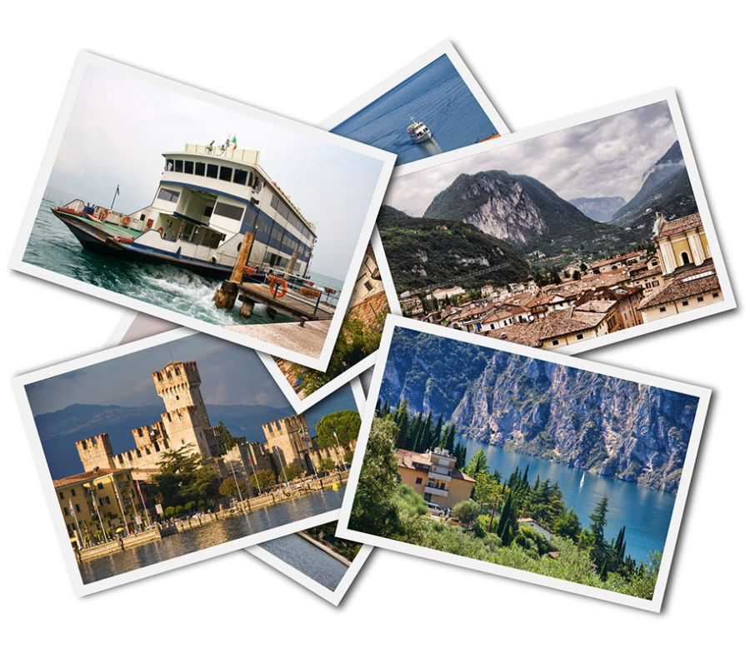
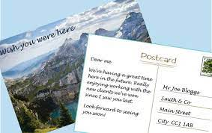
What are postcards?
Notes:
A postcard or post card is a rectangular piece of paper or cardboard, which is intended to send a short message by post. Usually, a postcard is mailed without an envelope, but you do need to put a stamp so that it may be delivered to the person you are addressing it to. Modern postcards usually have a photo or an image on one side of the card, the other side contains space for writing the address and a short message.
Today, many people send postcards when they are on holiday, with pictures of the places they are visiting.

Slide 7
Space for a stamp.
Space to write the message.
Address of the person receiving the postcard.
Notes:
Let’s look at the layout of the postcard. So we already said that the front part of the postcard usually has a picture of the place you are in. Now we shall look at how the back part of the postcard looks like. On the left hand side, we have the space to write our message. It must not be a long message – we have to keep it brief and mention only the most important things. On the right hand side, in the top corner there is a space where to put a stamp. Below it is where we write the address of the person receiving the postcard. Notice how the address is written, on the first line, the name of the person receiving the postcard, 2nd and 3rd line the address – usually, the house number, house name and street name and locality. At the bottom we add the postcode, which consists of three letters and four numbers and shows the exact area where you live.

Slide 8
Greeting: Dear + name
Introduction: Say where you are and what a lovely time you’re having.
Write about all the interesting places you’ve visiting and all the things you’ve seen and done.
What you’re doing next.
A finishing sentence.
Who it is from.
The use of abbreviations.
Notes:
Now, let’s read the actual message written on the postcard.
We start our postcard by greeting the person to whom we are addressing it. This postcard is addressed to grandma, so we say Dear Grandma. Next we start by saying what a lovely time we’re having. In this case, Lucy wrote that there are lots of things to see and do. We can also say something along the lines: I’M having a lovely time in London. The next paragraph is where you say what you did and what you have seen. Lucy mentions all the famous attractions in London: the Big Ben, the London Eye, the Tower Bridge and Buckingham Palace. Finally, it is time to close off your message, so you write See you soon, or Love and then under it you write your name.

Slide 9
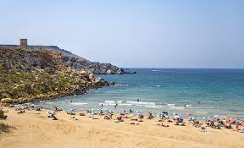
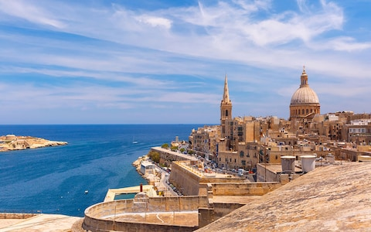
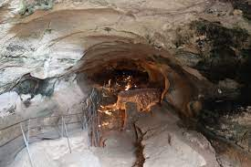
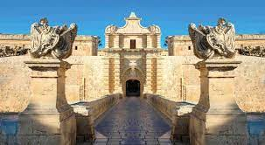
Your week in Malta
Monday | Visit the capital City - Valletta
Tuesday | Għar Dalam
Wednesday | Sandy beach – Golden sands
Thursday | Mdina – quiet city - bastions
Friday | Time to go home!
Notes:
We need to write about how we spent four days in Malta, so first we need to plan what we are going to write about. I created this table with the days of the week and next to them I will write the places that Matt visited during that day – you can make your own plan, switching the places around or perhaps you would like him to visit other places that I have not mentioned.

Slide 10
Graphic organiser: writing a postcard
1. Greeting
Dear….
2. Introduction
lovely time - so much to do – warm and sunny weather – explore the islands.
3. Mention what you’ve done and seen while staying there.
On Monday – walk around Valletta.
On Tuesday – visit Ghar Dalam caves – fossils of animal bones.
Wednesday – Golden Bay – dip in the sea – build sandcastles on the sand.
Thursday – visit Mdina – walk around the narrow streets - bastions
Friday evening – time to go home!
4. Closure
See you soon,
name
Notes:
Right, I am going to use this graphic organiser to help me plan what i need to write in the postcard. First I need to start with the Greeting

Slide 11
Dear Kate
I’m on holiday in Malta. There are lots of things to see and do here. The weather is nice and warm, so we can enjoy being outdoors.
On Monday, we walked along the busy streets of the capital city, Valletta. On Tuesday, we visited the pre-historic caves of Ghar Dalam. We saw many fossils of animal bones, there. On Wednesday, we spent the day on a lovely, sandy beach and I built a huge sandcastle. Yesterday, we visited Mdina, an old city surrounded by bastions. Today is Friday and we are coming back to England.
See you soon!
Love, Matt
Ms Kate Green
42, Chapel Hill
Manchester
M12 6AE
Notes:
This is is how your finished postcard should look like. On the left hand you should write your message and on the right hand side, the name of the person who will be receiving the postcard and thier address.

Slide 12
Notes:
You can check your work by using this checklist for writing a postcard. We need to check our postcard against these criteria.

Slide 13
Step 1
Choose a favourite place.
Step 2
Plan the postcard.
Step 3
Write a draft of the postcard.
Step 4
Edit and revise your writing.
Step 5
Rewrite postcard, neatly and draw a picture for the front side.

Slide 14
Thank you for using this resource. Check out our latest resources below.

