Slide 1
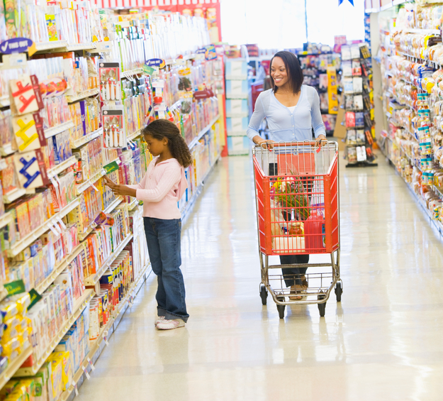
Lesson 1: Listening Topic: Shopping and Services Year: 4

Slide 2
Lesson Objectives:
In this lesson I will:
listen attentively to a text.
answer questions about a text.
learn about shopping and services.

Slide 3
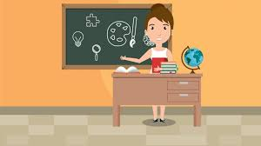
Download these resources:
Questions Worksheet
Answers Handout

Slide 4
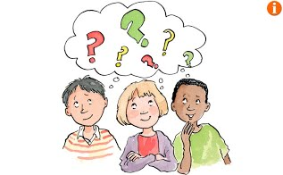
Pre-Listening Task: Brainstorming Activity
Where do you go shopping?
Who do you go shopping with?
Why do you go shopping?
Which shops do you visit the most?
Which shops do you like visiting the most?
Which shops do you like visiting the least?

Slide 5
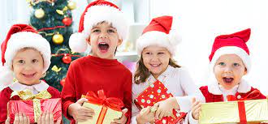
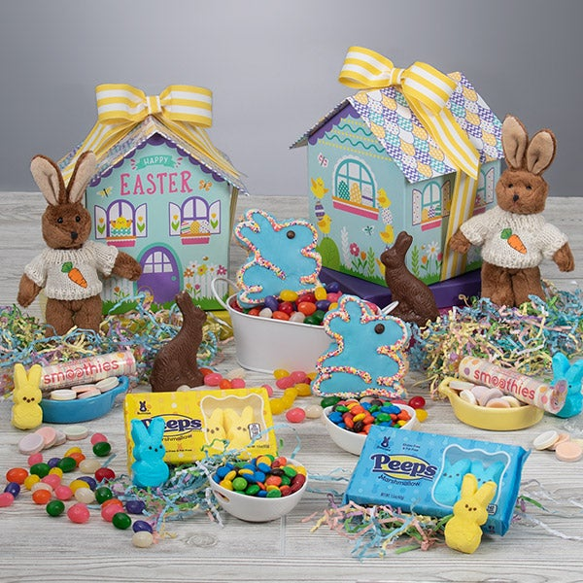
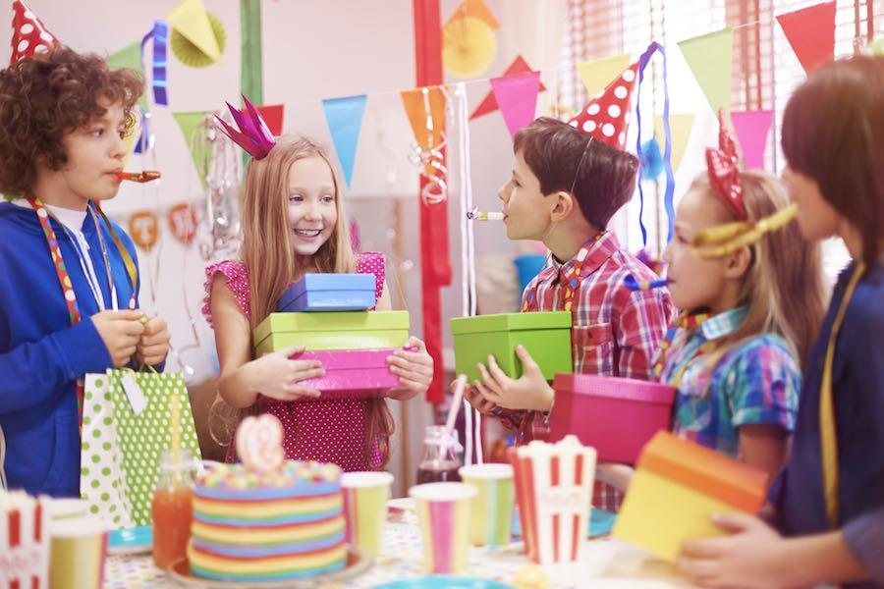
When do we buy gifts?

Slide 6
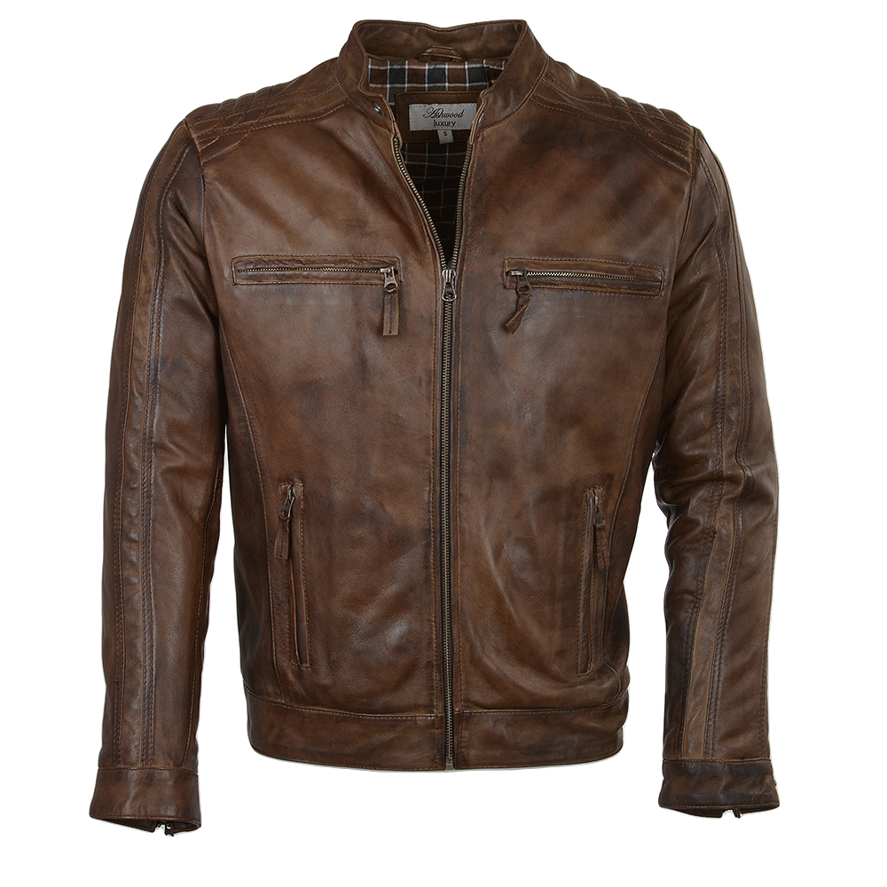
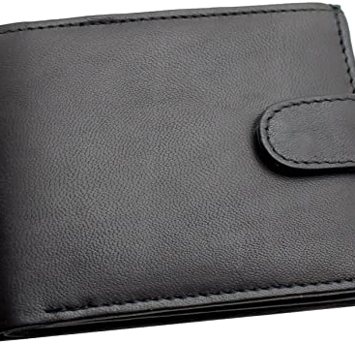
Pre-Teaching of Words:
wallet
a small flat case used for carrying money and personal papers
expensive
costing a lot of money
leather
the skin of an animal used as material (e.g. shoes, bags, jackets ...)

Slide 7
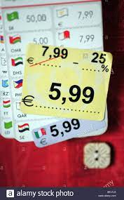
price tag a piece of paper or plastic that is attached to a
product and has the product's price on it
afford to be able to pay for something
earn money received for work done
design visual look or a shape given to a certain object

Slide 8
Step 1: READ silently the questions on the worksheet.

Slide 9
Step 2:
LISTEN carefully while I read the text.
LISTEN carefully, while I read the questions.
START ANSWERING the questions.

Slide 10
Step 3:
LISTEN to me as I read the text for the second time.
LISTEN while I read the questions again.
Try to ANSWER any unanswered questions.

Slide 11
Step 4:
Revise the answers.

Slide 12
Step 5:
CHECK your answers using the answers handout.

Slide 13
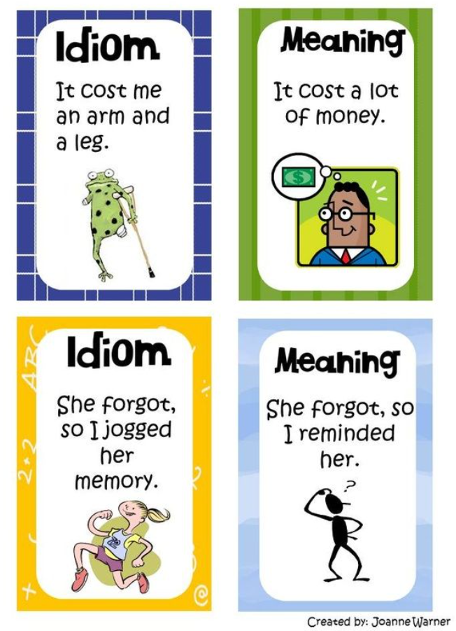
Post-Listening Task:
What are idioms?
Idioms are phrases that have a meaning that is very different from its individual parts.
Unlike most sentences that have a literal meaning, idioms have figurative meaning.

Slide 14
save for a rainy day = save something for when it is needed
Instead of spending money on a new TV, I’m going to save it for a rainy day. You never know when you’ll need it.
a dime a dozen = very common, usually inexpensive, and easy
to find.
For Dad’s birthday, I bought him a very pricey watch. Later, I discovered it is a dime in a dozen in other shops. What a disappointment!

Slide 15
to shop around
to shut up shop
to set up shop
to be like a bull
in a China shop
to behave carelessly
to open a business
when a business closes down
to compare prices in
different shops

