Slide 1
Lesson 5: Literature Topic: Weather and Natural Disasters Year: 4

Slide 2
Lesson Objectives:
I will:
read a poem silently and aloud.
listen to the poem being read aloud.
answer questions about the poem.

Slide 3
Download these resources:
Poem Handout
Poem Worksheet
Answers Handouts

Slide 4
Pre-Task:
CLICK on the link: https://www.natgeokids.com/au/discover/geography/physical-geography/tornado-facts/
READ the article.
VIEW the videoclip on the link:
https://www.youtube.com/watch?v=EpuDYZ_g0yg

Slide 5
New Vocabulary:
galoshes = high shoes worn over other shoes to keep the
feet dry especially in snow or wet weather
mist = tiny drops of water
twist = to bend or turn
fogbanks = areas of thick fog especially at sea
vaults = spaces covered by an arched structure
gallantly = bravely

Slide 6
Step 1:
Read the poem and the questions silently.

Slide 7
What is the poem about?
In this poem, the poet is describing a day with very bad weather.

Slide 8
Step 2: Read the poem and the questions again.
Try to answer the following questions:
How many stanzas does this poem have?
How is weather is the poem?
What does the expression ‘raining cats and dogs’ mean?
Do you think the poet stayed out for long? Why?

Slide 9
Step 3: Let’s discuss the questions.
How many stanzas does this poem have?
The poem has five stanzas.
How is the weather in the poem?
The weather is stormy.
What does the expression ‘raining cats and dogs’ mean?
This means it was raining heavily.
Do you think the poet stayed out for long? Why?
No, he gave up and went inside.

Slide 10
Step 4:
Now listen to me while I read the poem and the questions.

Slide 12
Step 5:
READ the poem and then ANSWER all the questions.

Slide 13
Step 6:
When you answer all the questions, REVISE your answers.

Slide 14
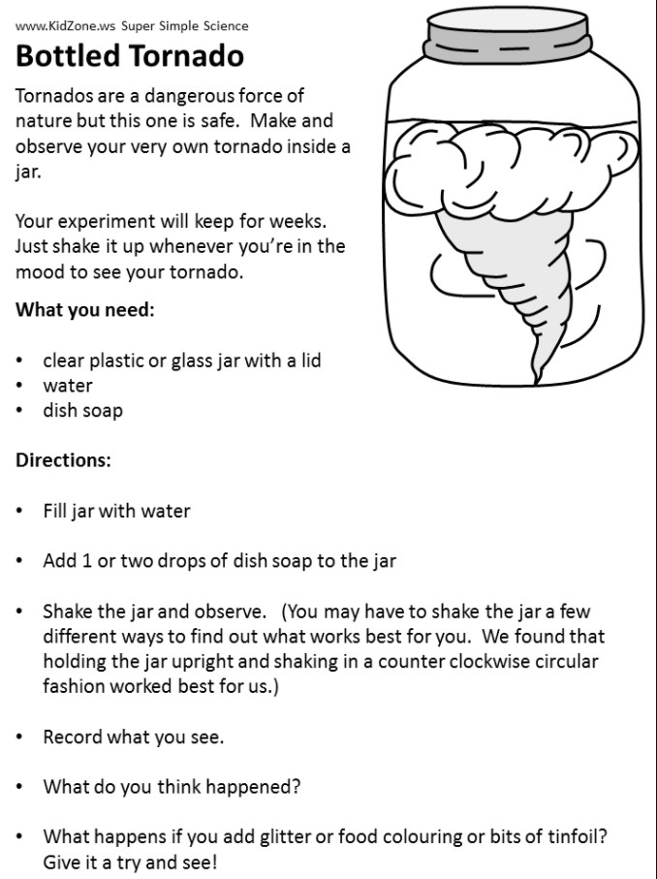
Post- Task:
Let’s do an experiment!
Click on the link to view the actual experiment:
https://www.youtube.com/watch?v=KvtIWNbMP9g

