Slide 1
Getting around
Lesson 5 - Writing
Notes:
In this lesson we are going to focus on writing an advert. We have already looked at an advert earlier on in this unit. WE have discussed that an advert might appear in a magazine or we can watch an advert on the TV or listen to it on the radio.

Slide 2
Notes for the Educator
This lesson is pegged directly to Learning Outcomes W 5.9 I can write a paragraph appropriately for and audience and with a purpose., W5.12 I can make a text more interesting or more relevant to me by changing the vocabulary and W5.14 I can use resources to help me plan my written work and present it accurately.
Teachers are to refer to the Scheme of Work where each lesson is explained in more detail.
Effects are included to make the presentation more interactive. Please present the PowerPoint in Slideshow mode.
Wherever possible we have included the use of online apps to enhance the teaching and learning experience.
The Notes section underneath the slides may contain some further points which can be developed during the lesson.
Teachers are encouraged to adapt this PowerPoint presentation to meet the learners’ language needs.
Audio files or links to websites may be included.
Tasks included in the PowerPoint presentation are also being shared as handouts.
For any comments, feedback or suggestions please email us at: marie-claire.camilleri@ilearn.edu.mt; urieth.attard@ilearn.edu.mt; mary.jude.camilleri@ilearn.edu.mt. You may also call the office on: 25983683.

Slide 3
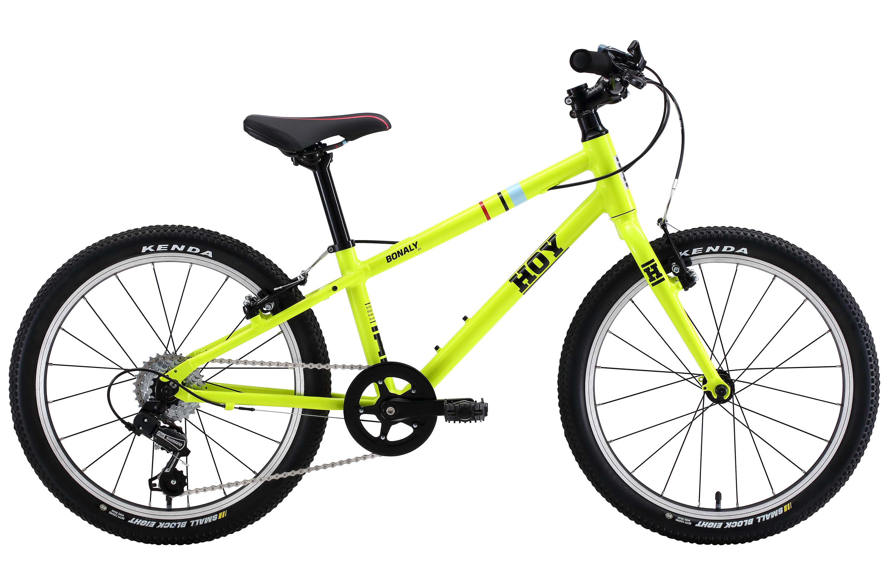
You have outgrown your bicycle and you would like to sell it. Design an advert to persuade other children to buy your bike. Make your advert bold and colourful.
Notes:
Let’s read the description of our task carefully and try to identify the genre, audience and purpose.

Slide 4
G
advert
A
other children
P
To persuade
Notes:
With regards to genre, we are going to write an advert for a bike we no longer use. With regards to audience – this means the persons for whom we are writing the advert – in this case, the advert will be directed to children your own age. Finally, we need to consider the purpose, that is why we are writing the advert – to persuade other children to buy your bicycle.

Slide 5
I am learning how to write an advert.
I can use resources to help me plan my advert.
I can write a description of the item I want to sell.
I can check my work, improve my writing and correct mistakes.
Notes:
We are learning how to write an advert. We will know that we are working towards this learning intention by using resources to help us plan the advert, writing a good description of the item we want to sell and finally by checking our work and correcting mistakes.

Slide 6
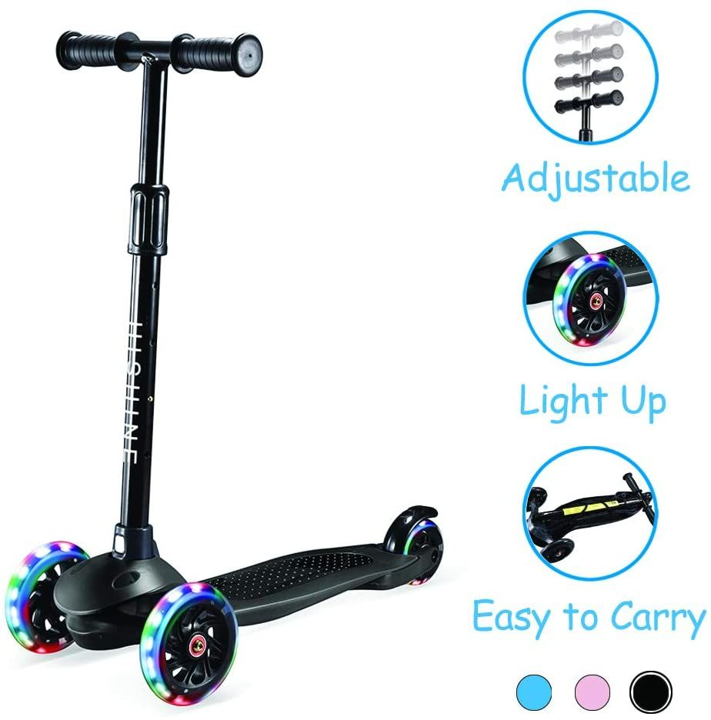
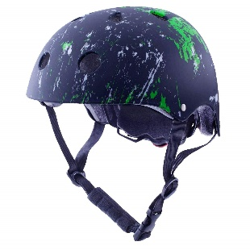
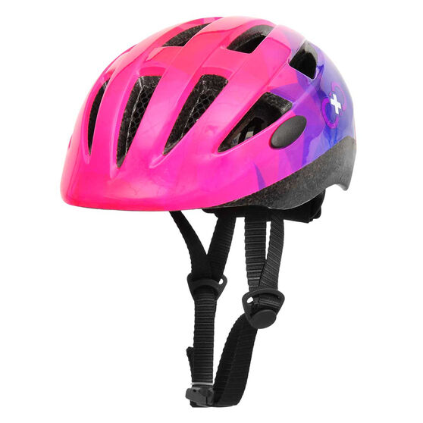
Are you tired of always following your parents around on foot?
Starts off with a rhetorical question to hook you in. and to make a connection with the reader, to make him/her feel that he or she really needs it.
There is another way…
Use a mix of facts and persuasive language.
99
Use carefully chosen language to appeal to the interest of their target audience. (Light Up, Coolest, Fastest, Brand New, Top Fun)
Get a new FREE helmet with your purchase!!
Make you feel like you are doing a bargain.
Use word play to come up with catchy slogans.
The COOLEST and FASTEST way to get around!
Get it Now from The Toy Room!
Notes:
Before we start planning our own advert, let’s see if we can remember the features of an advert.

Slide 7
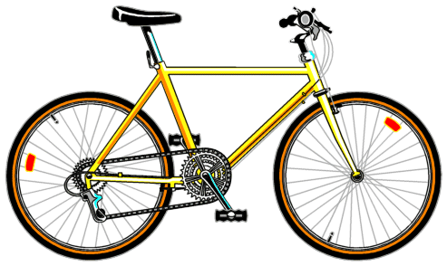
pedal
saddle
tyre
chain
spokes
handlebar
reflector lights
Notes:
Now, since we need to describe a bicycle, we need to make sure that we know the names of some of parts of a bicycle. Let’s try to label this picture of a bicycle. If you have a bicycle of your own, you might be familiar with these parts already.
Spokes – wire rods connecting the centre of a wheel to its outer edge.

Slide 8
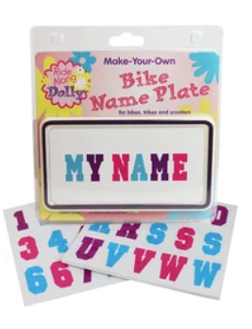
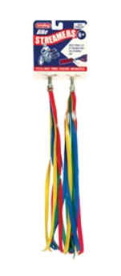
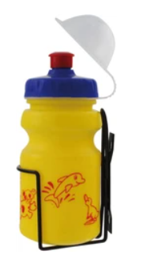
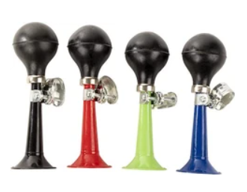
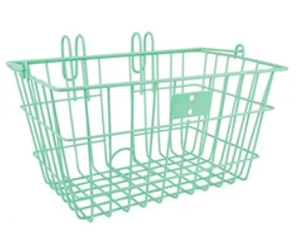
personalised name plate
colourful bike beads
police siren
streamers
bottle holder
wire basket
bike bell
bike horn
Notes:
We can add some accessories to our bicycle. For example we can add a bell or a horn. It can have streamers on the handlebars. It might have a basket in case you want to carry something with you. Some bicycles have a convenient bottle holder where you can place your bottle. You need to decide if your bicycle has any of these accessories, because you will want to say in your advert that it has some accessories as it will make it sound more exciting for the readers..

Slide 9
Planning an advert
Who is it for?
boy/girl/ aged between….
teenager/adventure lover/bicycle lover/children who like the outdoors/ sport lover
Are you a/an
Do you like…
Are you tired of…
2. What product are you selling? Describe it. Highlight its positive features
Looks like new/minor scratches/stored in a garage/well serviced/repainted
3. How much does it cost? Are you giving away any extras?
4. What is your slogan?
Ride like the wind!
Be the envy of your friends!
Cycle your way to new adventures!
5. How can it be purchased?
Call now for a viewing…./Email me at…
Notes:
Now, let’s look at the Planning an Advert Graphic Organiser to help us plan the advert.

Slide 10
Notes:
To help me plan I can also refer to the Writing an Advert Word Mat. Let’s look at it together.

Slide 11
Planning an advert
Who is it for?
boy/girl/ aged between….
teenager/adventure lover/bicycle lover/children who like the outdoors/ sport lover
Are you a/an
Do you like…
Are you tired of…
2. What product are you selling? Describe it. Highlight its positive features
Looks like new/minor scratches/stored in a garage/well serviced/repainted
3. How much does it cost? Are you giving away any extras?
only €50.
helmet and wire basket
BMX bike for sale in very good shape.
For children between 5 to 8 years.
Used few times. reflector lights
Are you tired of your old bike?
4. What is your slogan?
Ride like the wind!
Be the envy of your friends!
Cycle your way to new adventures!
Get ready for new cycling adventures!
5. How can it be purchased?
Call now for a viewing…./Email me at…
Come and see it now! Call me on 99987609
Notes:
Now, let’s fill this graphic organiser together. This will serve you as a model when you fill in yours.

Slide 12
Notes:
It is also important to refer to the Writing an Advert Success criteria. We need to make sure that we write our advert we include these criteria. Let’s go through them.

Slide 13
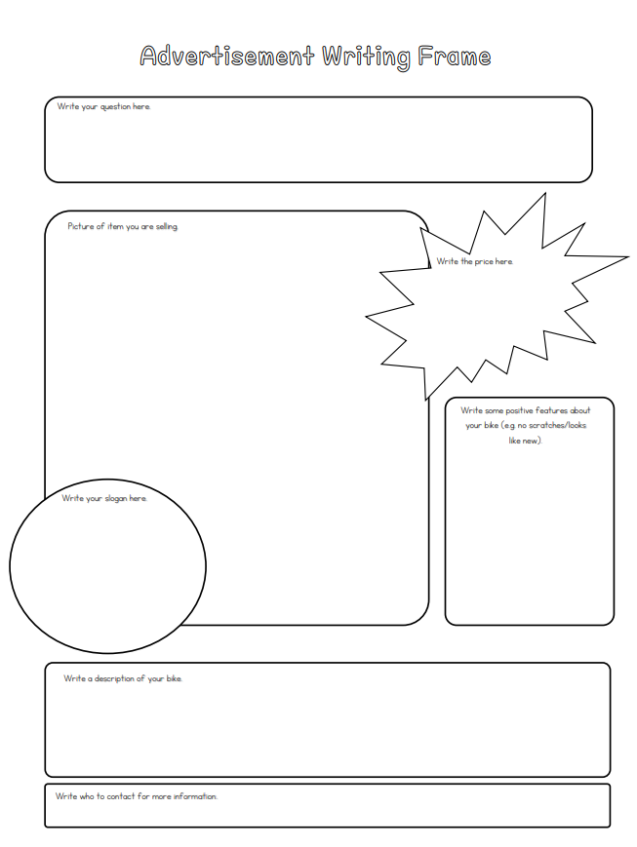
Write your question here.
Write the price.
Draw a picture of your bike here.
Highlight some positive features.
Write your slogan.
Write a description of your bike.
Give your contact detqils.
Notes:
Right, now that we have a clear idea of what to write in our advert, let’s take a look at the advert writing frame that we can use for our writing. You don’t need to use this particular writing frame, you can be as creative and imaginative as you like with how you design and present your advert. But, if you would like there is the writing frame included.

Slide 14
Step 1
Plan the advert.
Step 2
Write a draft of the advert.
Step 3
Revise and edit it.
Step 4
Rewrite the advert neatly and publish it.
Notes:
We have gone through the process of writing an advertisement. Now, it’s your turn to plan and draft your advert. You can refer to the writing an advert word mat and the success criteria which you can download. Let’s quickly go through the steps that you need to follow.

Slide 15
Thank you for using this resource. Check out our latest resources below.

