Slide 1
Lesson 4: Writing Topic: Weather and Natural Disasters Year: 4

Slide 2
Lesson Objectives:
Today I will learn:
how to write a non-chronological report.
the success criteria for
writing a non-chronological report.

Slide 3
Download these resources:
Non-Chronological Report
Writing Frame
Success Criteria Handout
Post-Task Handout

Slide 4
https://www.youtube.com/watch?v=3aKJ3B1w-3U

Slide 5
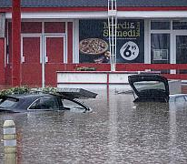
What is the video clip about?
The video clip is about the floods that took place in Germany in July, 2021. It shows the destruction left after the floods. At least 70 people died and dozens went missing.

Slide 6
These natural disasters occur from time to time around the world.

Slide 9
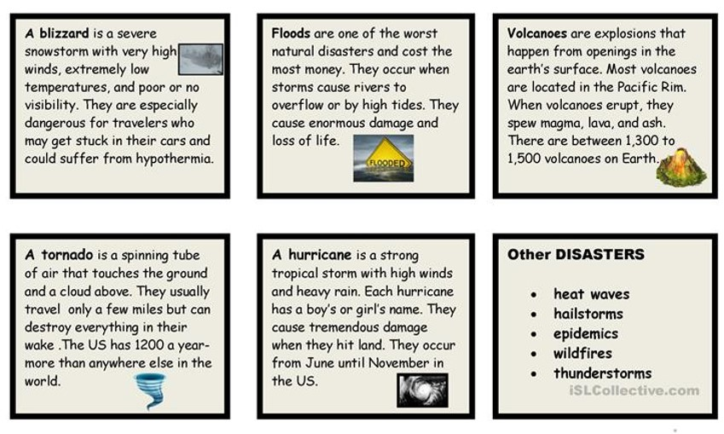

Slide 10
What is a non-chronological report?
A non-chronological report is a non-fiction report which is not written in time order. It focuses on a single topic and includes various facts about this topic. It includes a title and headings with different information underneath.

Slide 12
Writing Model 1

Slide 13
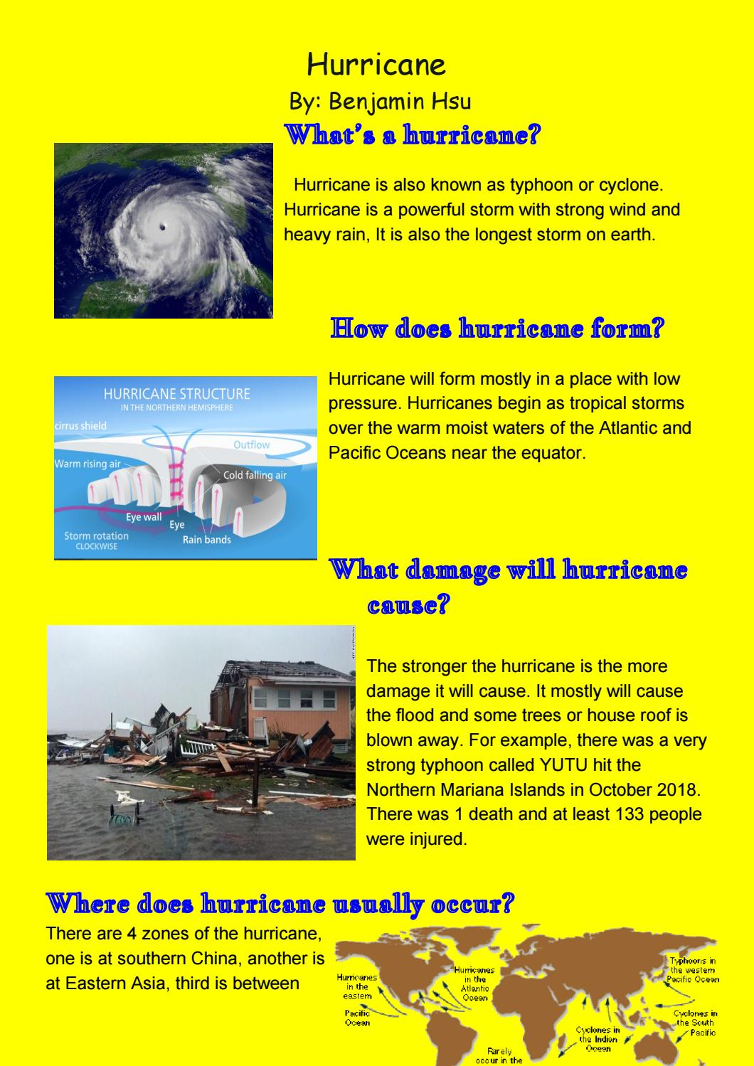
Writing Model 2

Slide 14
Writing Model 3

Slide 15
Writing Task Title:
Choose a natural disaster which interests you. Write a non-chronological report about it. Share it with your class teacher.

Slide 16
Keep in mind the GAP:
GENRE: non-chronological report
AUDIENCE: young readers
PURPOSE: to learn facts about a natural disaster

Slide 17
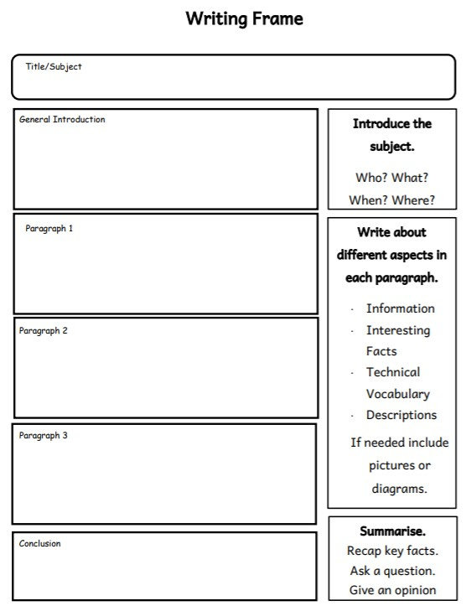
Non-Chronological Report Writing Frame

Slide 18
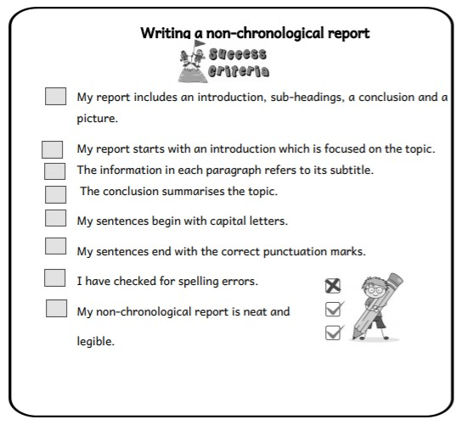
Success Criteria

