Slide 1
Lesson 3 Literature
Year 5
English

Slide 2
Lesson 3 Objectives
You will:
use the dictionary to find the meaning of new words.
read an extract from a book silently and aloud.
listen to a piece of prose being read aloud.

Slide 3
Lesson Resources
Dictionary
Reading Text Handout
Questions Worksheet
Answers Handout

Slide 4
Types of Shops

Slide 5
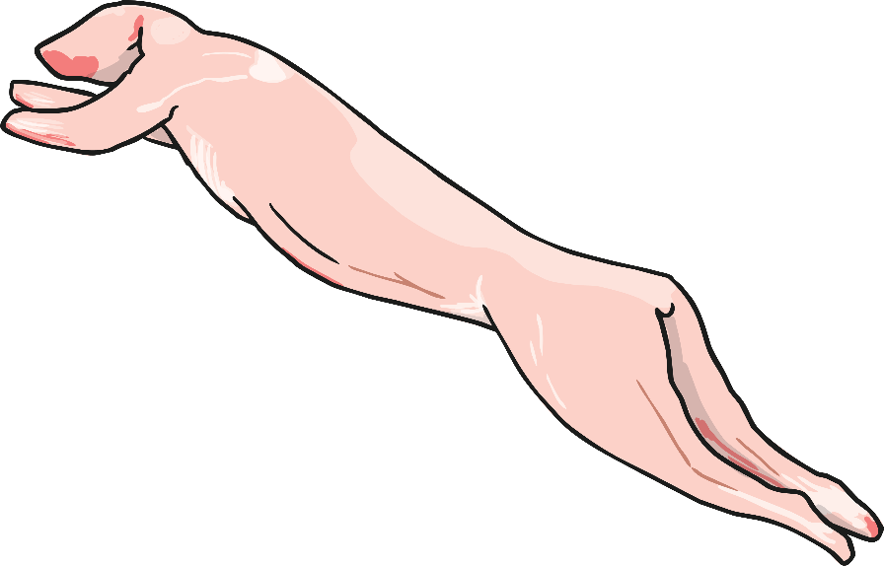
the butcher’s

Slide 6
the bakery

Slide 7
the fishmonger’s

Slide 8
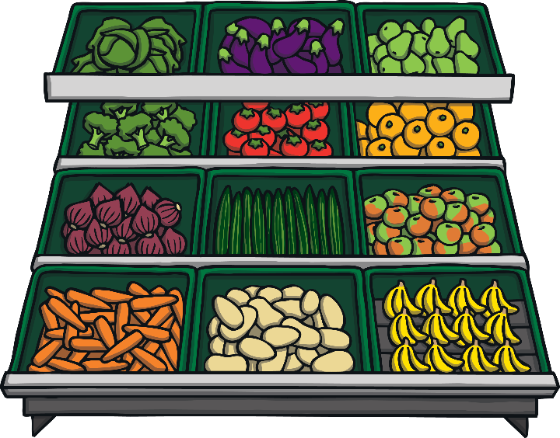
the supermarket

Slide 9
the café

Slide 10
the florist

Slide 11
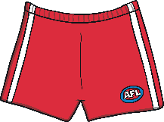
the clothes shop

Slide 12
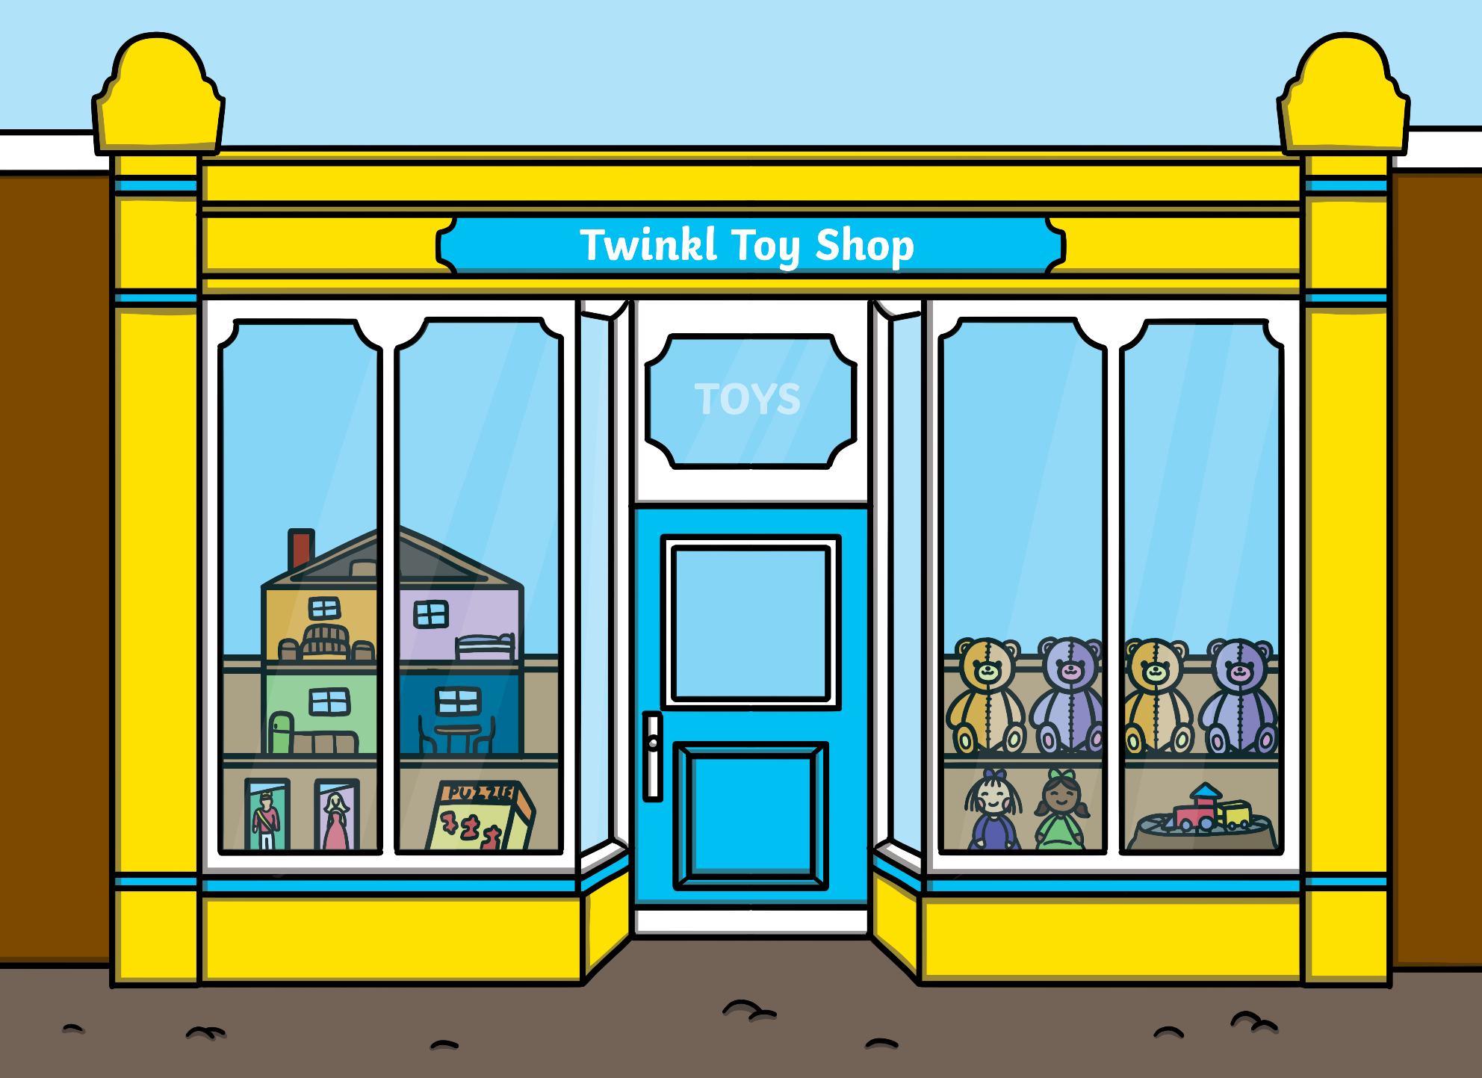
the toy shop

Slide 13
Think!
Clue:
a favourite among
sweet-toothed people

Slide 15
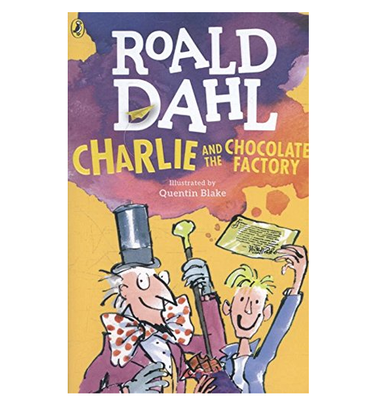
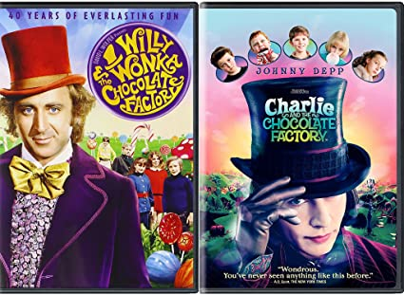

Slide 16
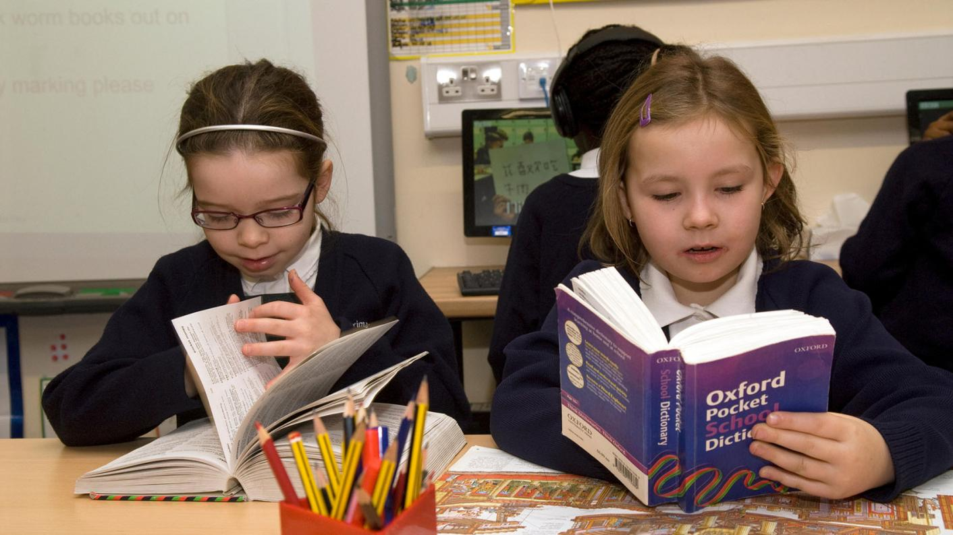
NEW WORDS - Using a dictionary!

Slide 17
New Words
damp bulged
cram wolfing
marvellously

Slide 18
damp
bulged
cram
wolfing
marvellously
stuck out
stuff
eating greedily
wonderfully
moist

Slide 19
Step 1
READ the text silently.
After you read the text
ANSWER the following questions:
WHAT IS THE TEXT ABOUT?
HOW DID IT MAKE YOU FEEL?

Slide 20
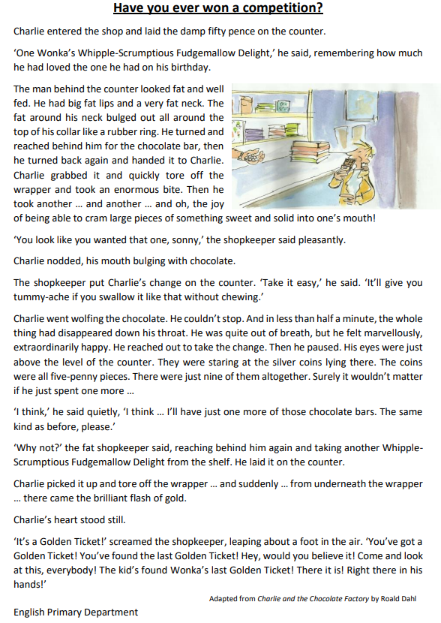

Slide 21
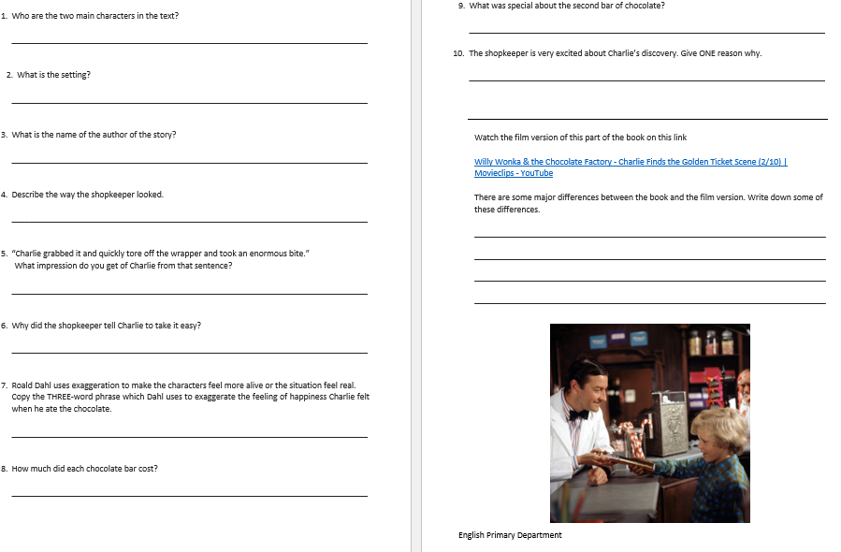

Slide 22
Step 2 - Discuss the question
What is the extract about?
The extract has been taken from the book Charlie and the Chocolate Factory. This book was written by Roald Dahl.
In this extract, Charlie, visits a candy shop and buys one chocolate bar. With the change, he decides to buy a second one. When he unwraps the second bar, he finds the Golden Ticket. The shopkeeper was stunned and kept telling others to go and have a look.

Slide 23
Step 3
READ the text again.
Then try to ANSWER the following questions.

Slide 24
Step 3: Answer these questions!
What is the setting of the story?
Who are the main characters in this extract?
Find one word in the text, which physically describes the man.
Find the sentence which shows that Charlie ate the chocolate quickly.
How much change did the man give Charlie?
What was ‘the brilliant flash of gold’?
How can you tell that the shopkeeper got excited?

Slide 25
Step 4 - Discuss the questions
1. What is the setting of the story?
A candy shop
2. Who are the main characters in this extract?
Charlie and the shopkeeper
3. Find one word in the text, which physically describes the man.
The word is ‘fat’.
4. Find the sentence which shows that Charlie ate the chocolate quickly.
‘And in less than half a minute, the whole thing had disappeared down his throat.’
Nine five-penny pieces (45p)
5. How much change did the man give Charlie?
6. What was ‘the brilliant flash of gold’?
The Golden Ticket
7. How can you tell that the shopkeeper got excited?
He screamed, leapt about a foot in the air and told everyone to look at the ticket.

Slide 26
Step 5
LISTEN and READ SILENTLY.
Then LISTEN to me while I EXPLAIN the worksheet.

Slide 29
Step 6
READ the text yourself.

Slide 30
Step 7
WORK OUT
the worksheet.

Slide 31
Step 8

Slide 32
Step 9
CHECK your answers using the
Answers Handout.

Slide 33
Final Task
Watch the video clip taken from the movie
Charlie and the Chocolate Factory.
There are some major differences
between the text and the film clip.
Then write down some of these differences
on the Questions Worksheet.

Slide 35
Thank You!

