Slide 1
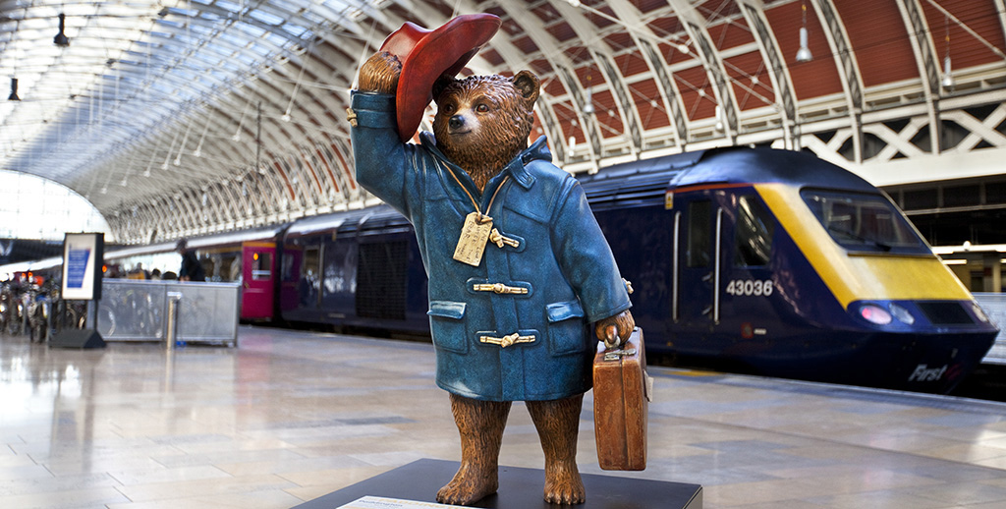
Lesson 2: Reading
Topic: Travel
Year 4

Slide 2
Lesson Objectives:
During this lesson I will:
learn the meaning of new words.
listen to a text being read aloud.
read a text silently and aloud.
answer questions about the text.

Slide 3
Download these resources:
Reading Text Handout
Questions Worksheet
Answers Handout

Slide 4
Pre-Task:
Did you know that the first trains were pulled by horses?

Slide 5
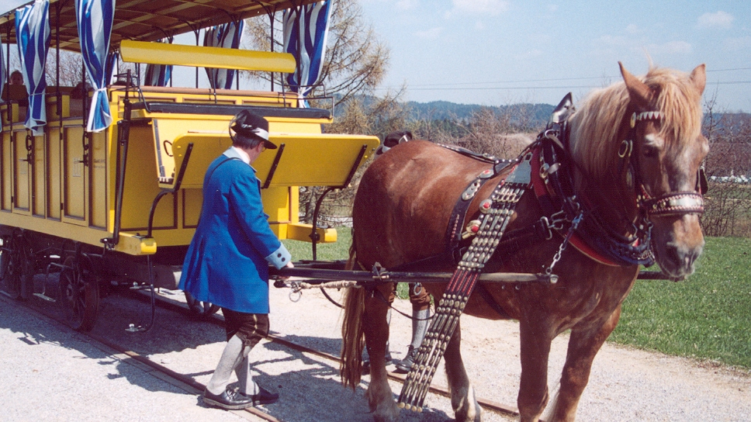
Trains pulled by horses.

Slide 6
After the invention of the steam engine by James Watt, steam powered trains developed.

Slide 7
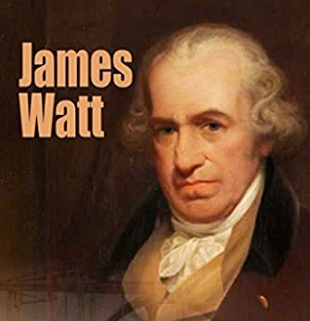
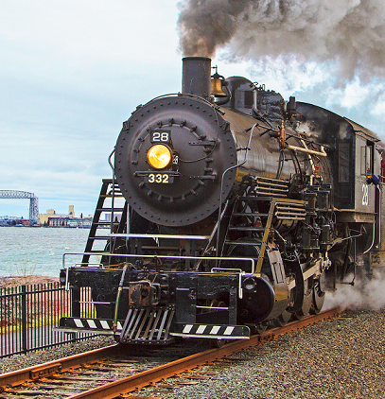

Slide 8
These days, trains run on diesel-powered engines and even electricity.

Slide 9
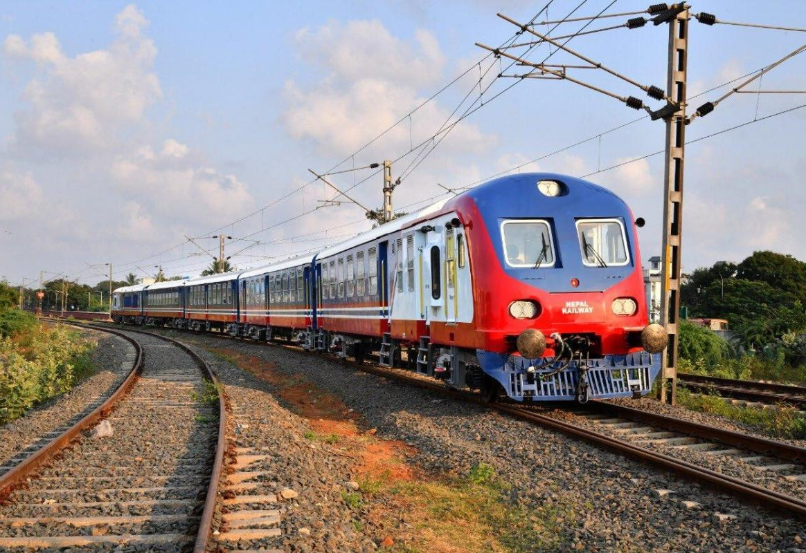
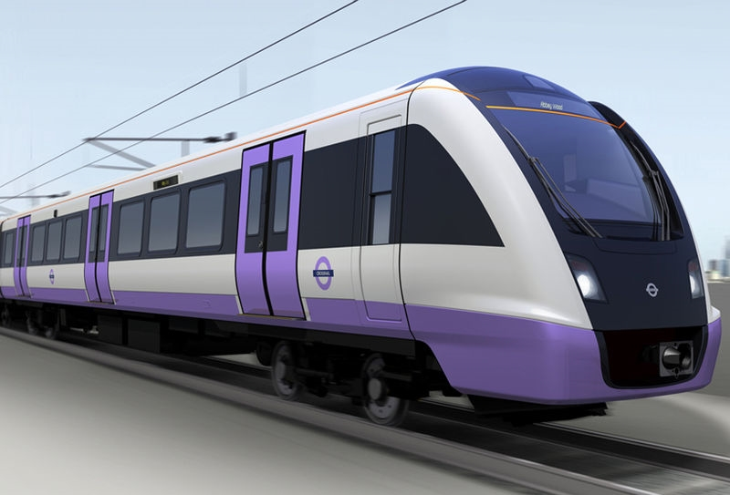
Modern Trains

Slide 10
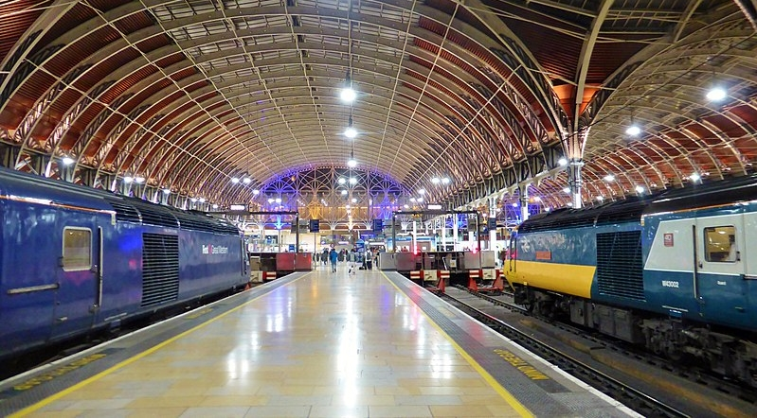

Slide 12
Watch this video clip.
Then try to answer these questions:
What is the video clip about?
Have you ever watched the film Paddington?

Slide 13
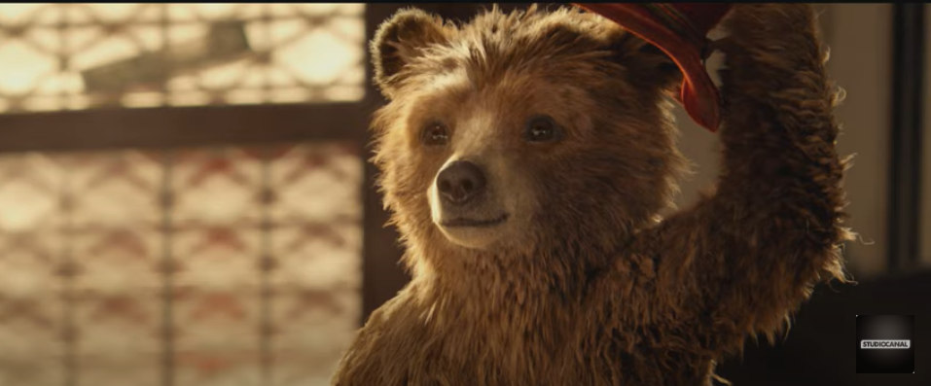
Link for audio-visual: https://www.youtube.com/watch?v=sCgnuhb45ik

Slide 14
What is the video clip about?
The video clip is about an orphan bear from Peru, who was all alone at Paddington Station. Mary Brown stops to chat with him. She takes pity on him and offers him help. The family takes the bear to a restaurant. The bear is very clumsy and the husband is annoyed at him. Mrs Brown invites the bear to their home. Since the Browns cannot pronounce his ‘bear name’, they call him PADDINGTON.

Slide 15
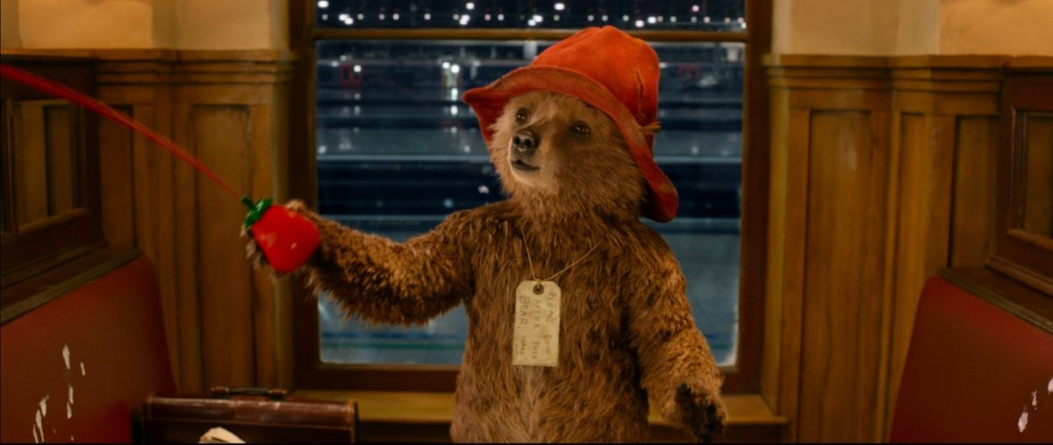
Let’s answer these questions about the video clip together:
Where was the bear going to sleep that night?
In a bin, at the train station.
How did the bear get to Paddington Station?
He hid himself inside a life-boat.
What did the bear eat during his journey?
He ate marmalade.
What did Mr Brown, want to call the bear?
He wanted to call him Ketchup.

Slide 16
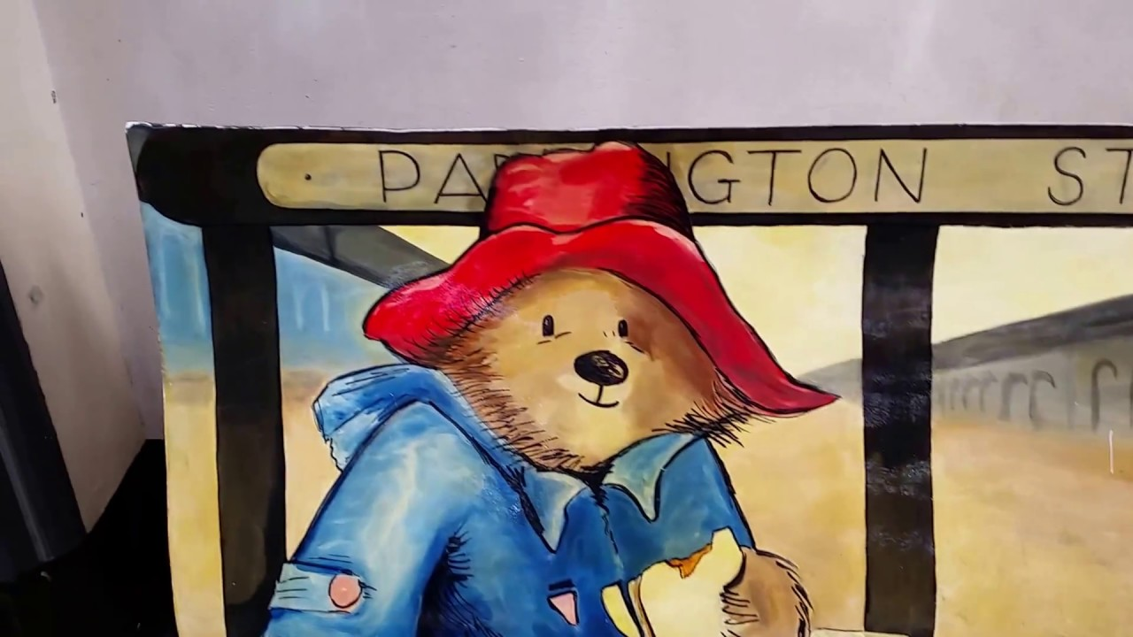
Pre-Teaching of Words:
adjusted arranged, fixed
distinctly clearly
laden heavily loaded
triumphantly successfully
dimly to make less clear or bright
battered damaged or worn

Slide 17
Step 1:
READ the story on the handout.
READ the exercises on your worksheet.
Then try to ANSWER the question:
WHAT IS THE STORY ABOUT?

Slide 18
Step 2: Let’s answer the questions.
This text is an extract from the book A Bear called Paddington written by Michael Bond. In this extract, the Browns, go to Paddington Station to pick up their daughter. There, they meet a bear, sitting on a suitcase.

Slide 19
Step 3:
READ the story and questions again.
Then try to ANSWER these questions.
Name three sounds you can hear at the train station.
Who spotted the bear first?
Explain why Mrs Brown said, “There can’t be!”.

Slide 20
Step 4: Let’s ANSWER the questions
Name three sounds you can hear at the station.
People talking on loudspeakers, trains humming, porters shouting at each other.
Who spotted the bear first?
Mr Brown spotted the bear first.
Explain why Mrs Brown said, “There can’t be!”.
Mrs Brown did not believe her husband, when he told her that there was a bear.

Slide 21
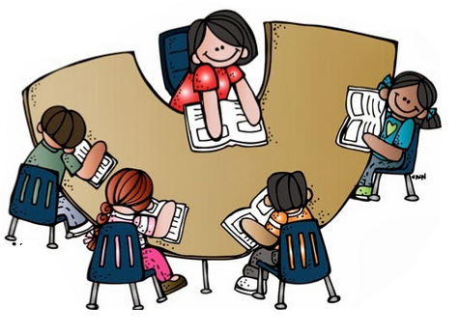
Step 5:
LISTEN to me as I read the story and the questions aloud.
FOLLOW your text and READ it silently.

Slide 22
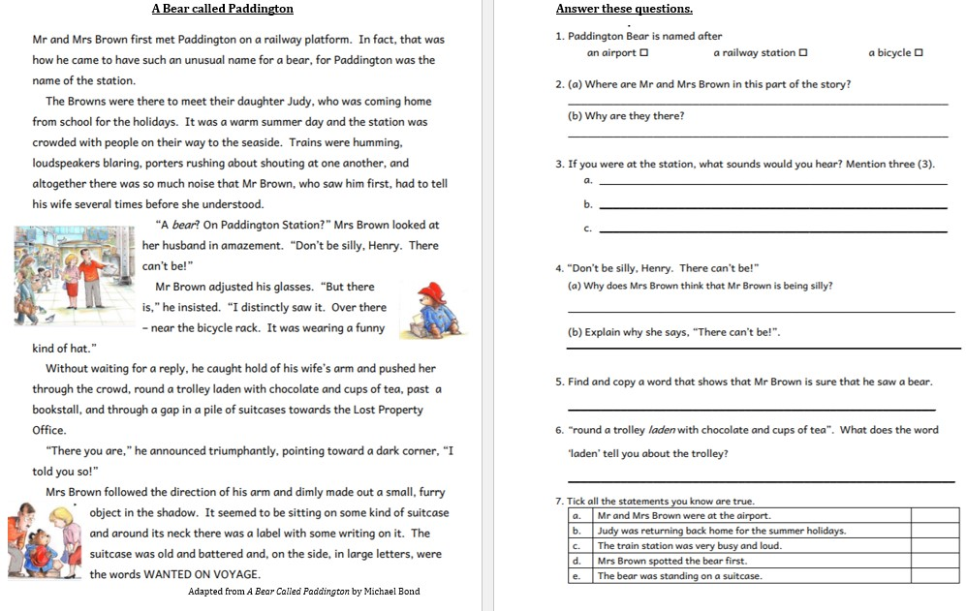

Slide 23
Step 6:
READ the text ALOUD.
PAUSE the recording.

Slide 24
Step 7:
WORK OUT the Questions Worksheet.

Slide 25
Step 8:

Slide 26
Step 9:
CHECK your work using the Answers Handout.

Slide 27
Post-task:
1. Watch the video clip again.
2. Compare the reading text with the video clip.
Fine ONE DIFFERENCE and ONE SIMILARITY.

Slide 28
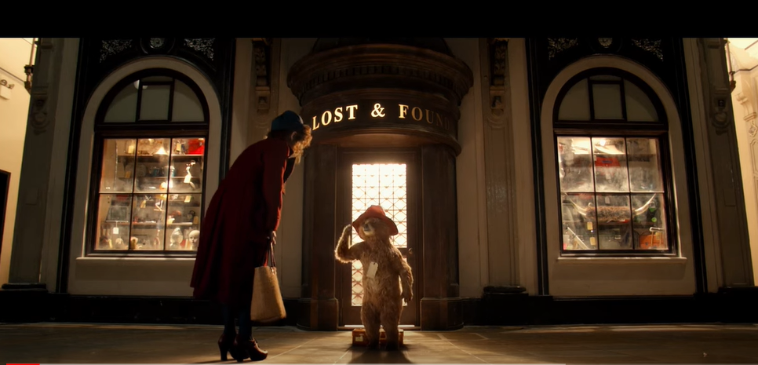
https://www.youtube.com/watch?v=Q0uj8Yv1yUk

Slide 29
SIMILARITY
In both the text and in the video clip, the bear is in front of the Lost and Found office.
DIFFERENCE
In the video clip, Mrs Brown spots the bear first. In the text it is Mr Brown who sees the bear first.

