Slide 1
Lesson 2 Reading
Year 5
English

Slide 2
Lesson 2 Objectives
In Lesson 2 you will:
listen to a text being read aloud.
read a text silently and aloud.
answer questions about the text.

Slide 3
Lesson Resources
Dictionary
Reading Text
Questions Worksheet
Answers Handout

Slide 4
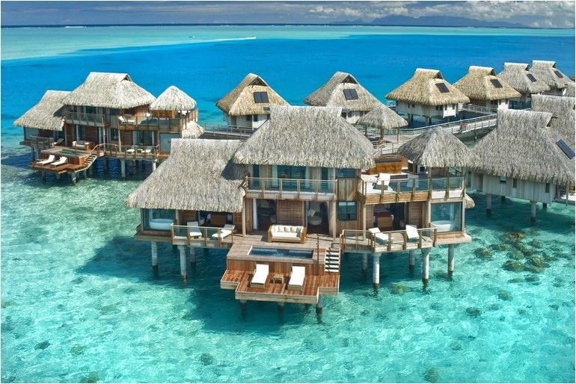
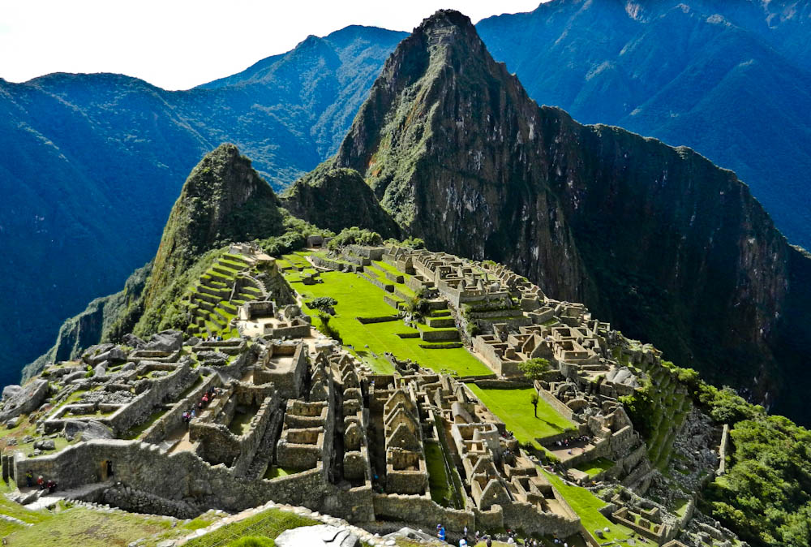
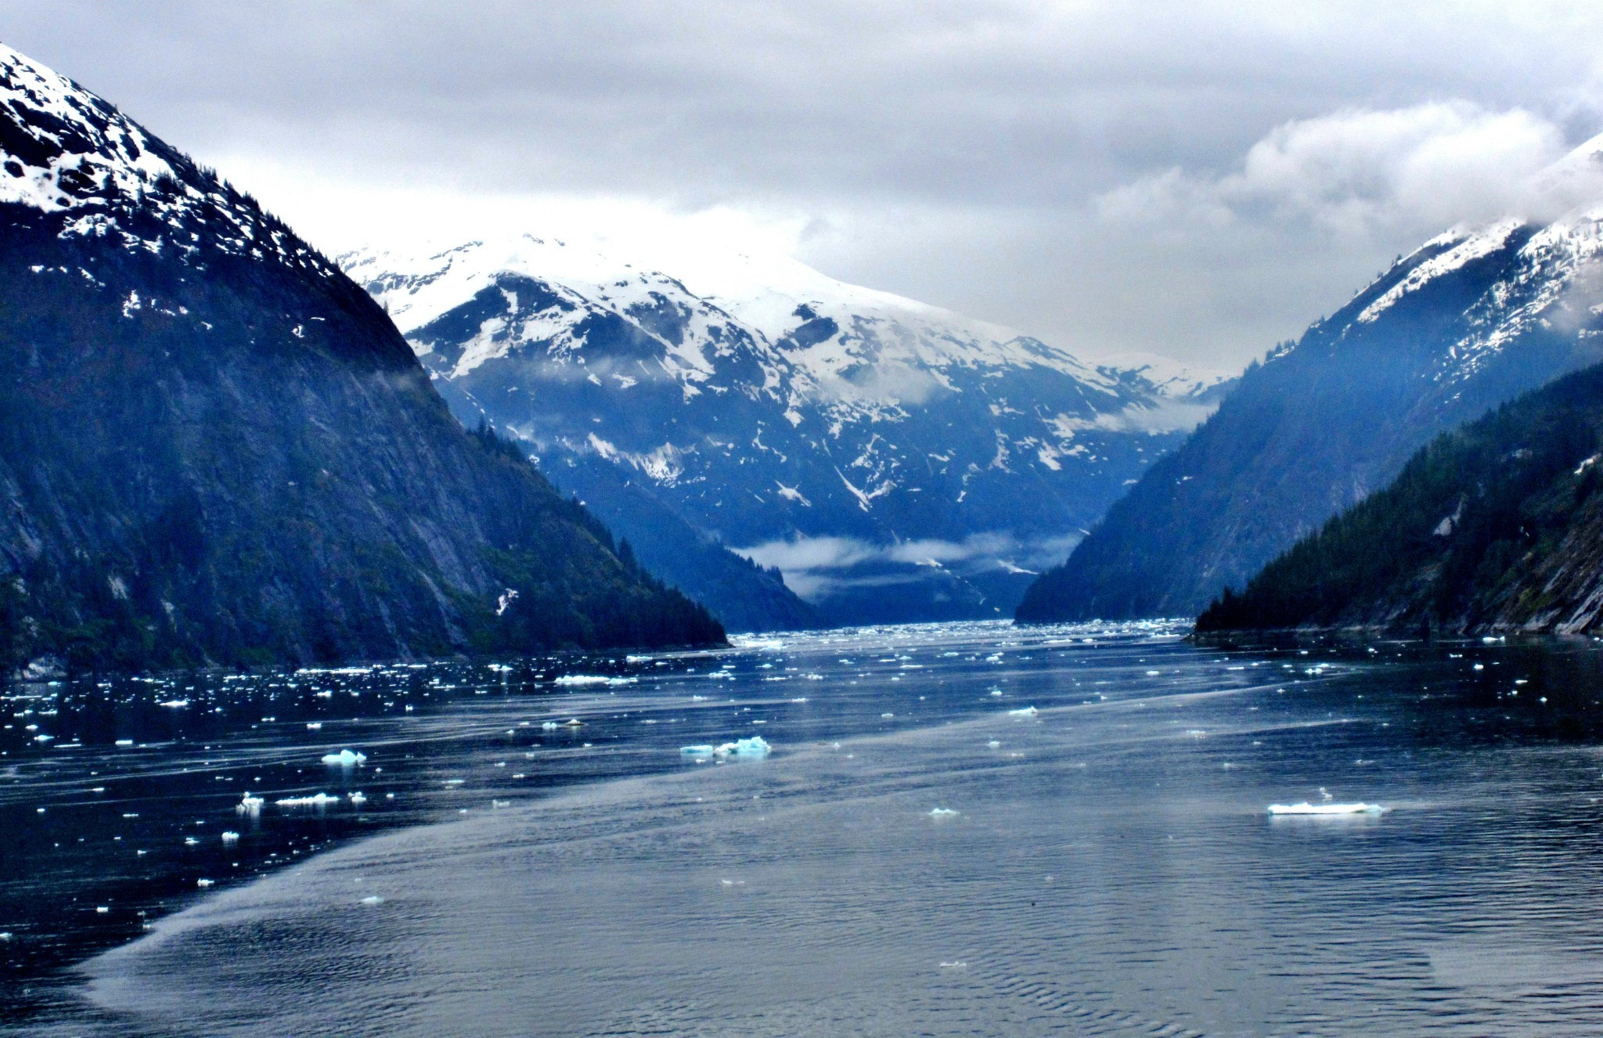
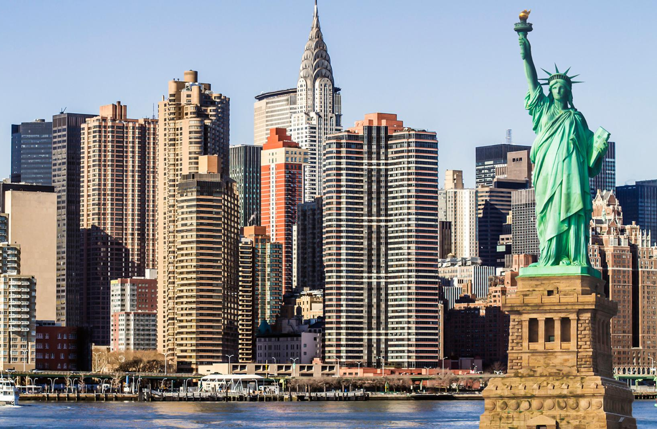
Think!
What is your dream destination?

Slide 5
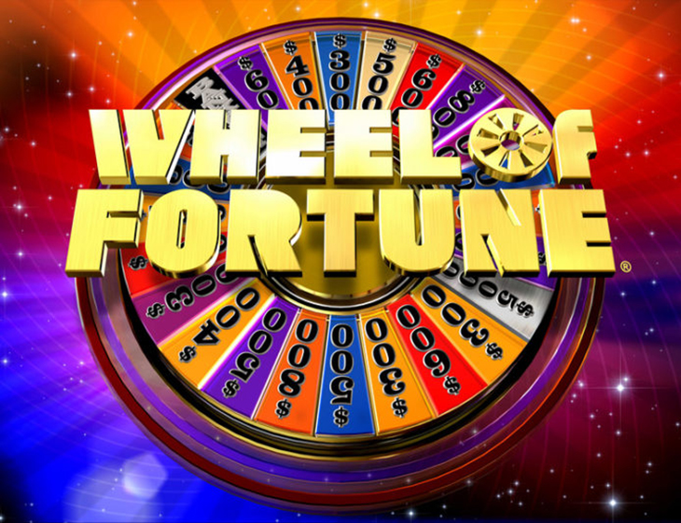
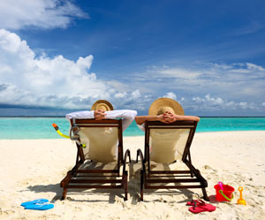
What do these pictures have in common?

Slide 6
Using a dictionary!

Slide 7
New Words
expenses
applause
contestants
commercial
addict
drifted off
merchandise

Slide 8
New Words
fell asleep
goods to be bought or sold
addict
drifted off
merchandise
costs
advertisement
participants in a competition
clapping
expenses
applause
a person who likes
something excessively
contestants
commercial

Slide 9
Step 1
READ the text
on the handout and the questions on the worksheet.

Slide 11
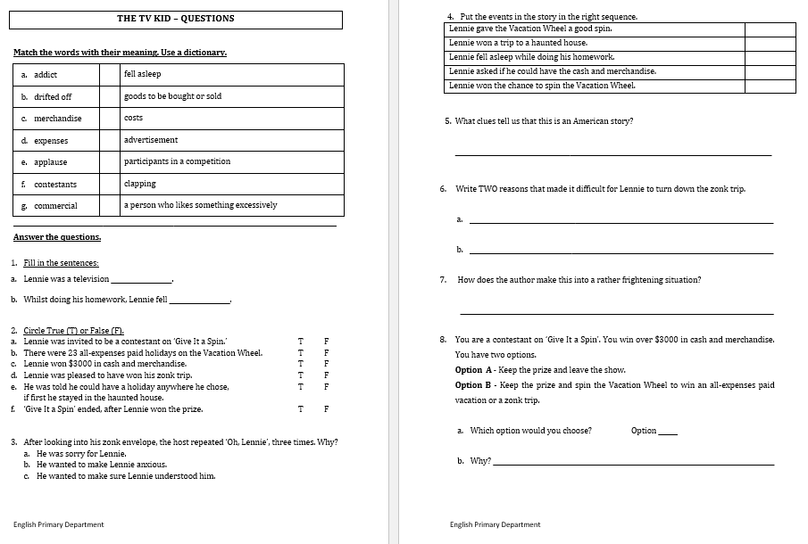

Slide 12
Step 1
After you read the text and questions you should be able to ANSWER the following question:
WHAT IS THE TEXT ABOUT?

Slide 13
Step 2: Discuss the question
What is the text about?
The text is about a boy, Lennie who loved watching TV. He was a TV addict. One day, he fell asleep and dreamed that he was a participant in a TV quiz show called Vacation Wheel.
Lennie won $3,000 in cash and merchandise and an all-expenses paid vacation to …. A HAUNTED HOUSE!

Slide 14
Step 3
READ the text and questions again.
Then try to ANSWER the following questions:
Did Lennie do his HW properly? Why?
Why did Lennie feel good at the beginning of the story?
Which cities and countries were mentioned in the text?
How do we know that Lennie had an audience?
How did the host make the trip to the haunted house, scarier?

Slide 15
Step 4: Discuss the questions
Did Lennie do his HW properly? Why?
No, he didn’t. His eyes would wander towards the TV set.
2. Why did Lennie feel good at the beginning of the story?
He had won over three thousand dollars in cash and merchandise
and the chance to spin the Vacation Wheel.
3. Which cities and countries were mentioned in the text?
Rome, London, Paris, Hawaii, Mexico, Spain, Egypt and Rio.
4. How do we know that Lennie had an audience?
The host asked the audience to applaud Lennie.
5. How did the host make the trip to the haunted house, scarier?
The host told him that it was located on a dark, scary
outskirts and invited him back to the quiz, only if he survived.

Slide 16
Step 5
LISTEN to me as I
READ the text ALOUD.

Slide 18
Step 6
READ the text ALOUD.
PAUSE THE VIDEO!

Slide 19
Step 7
Let’s DISCUSS
the questions.

Slide 21
Step 8
WORK OUT the
Questions Worksheet.

Slide 22
Step 9

Slide 23
Step 10
CHECK your answers using the
Answers Handout.

Slide 24
Thank You!

