Slide 1
Lesson 4: Writing Topic: Shopping and Services Year: 4

Slide 2
Lesson Objectives:
During this lesson I will:
play a memory game.
form a list.
write a recount.
learn the success criteria for writing a list and a recount.

Slide 3
Download these resources:
Recount Writing Frame
Success Criteria for List Writing Worksheet
Success Criteria for Recount Writing Worksheet

Slide 4
Pre-Task 1. Look carefully at the picture. 2. When I remove the picture, you have three minutes to write a list of all the shopping items in the trolley.

Slide 5
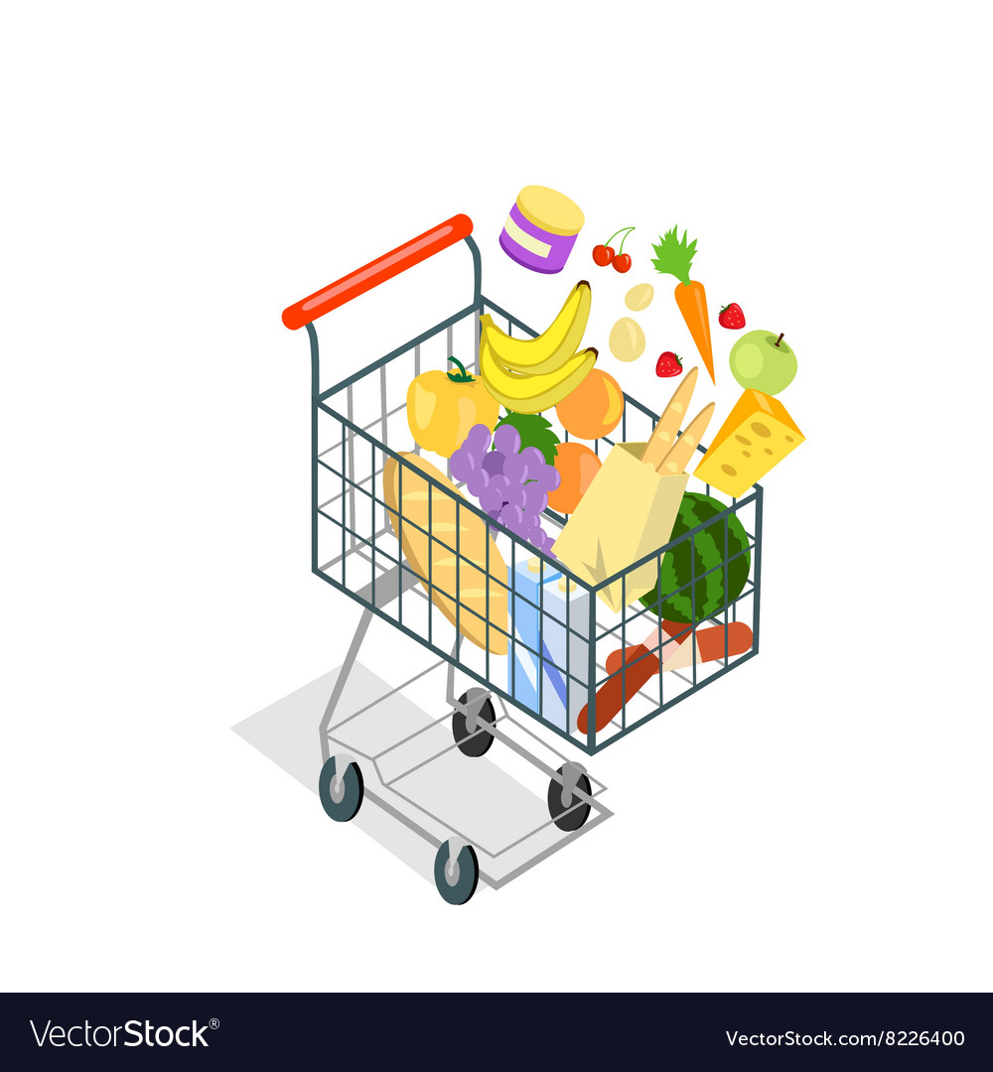

Slide 6
What did you write in your list?
a carrot
two strawberries
a bunch of bananas
a yellow pepper
a bunch of grapes
a loaf of bread
two baguettes in a brown bag
a watermelon
a block of cheese
a bunch of cherries
two cartons of milk
two oranges
a green apple
a jar of food
two pieces of salami

Slide 7
Short Writing Task: Forming a List

Slide 8
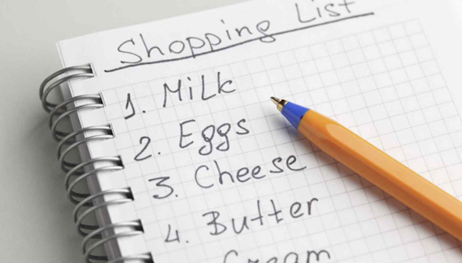
What is a list? A list is a series of items written or mentioned. They follow one another. Examples of lists: - writing a list of friends to invite for your birthday party - writing a shopping list - writing a list of books which you need to take to school A list is usually numbered or bulleted.

Slide 9
Writing Task Title: It is your friend’s birthday. You are going to surprise him/her by: a. baking a cake OR b. making a pancake Write a shopping list with all the ingredients you need to buy.

Slide 10
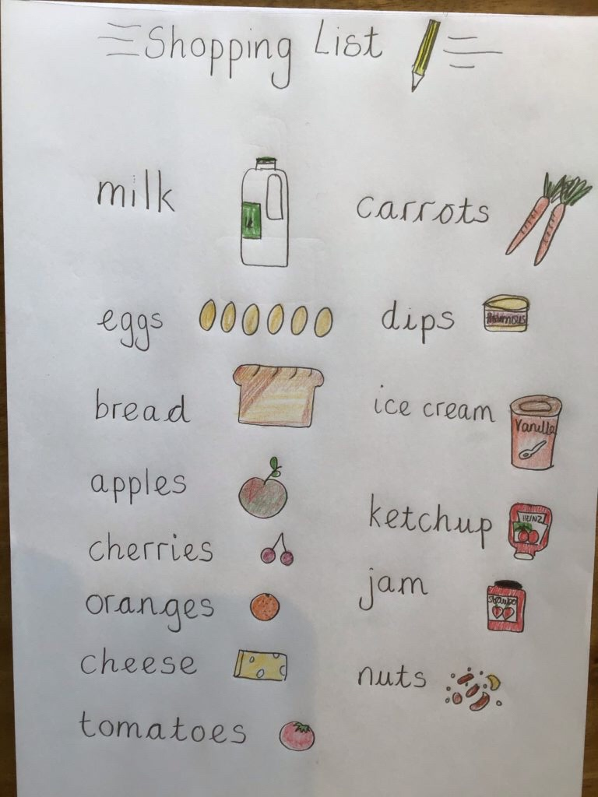
Understand the TITLE!
Keep in mind the GAP: GENRE a list
AUDIENCE yourself PURPOSE to remember all the food
items you need to buy

Slide 11
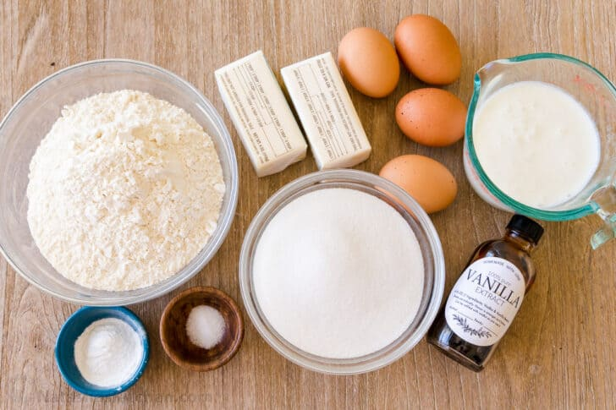
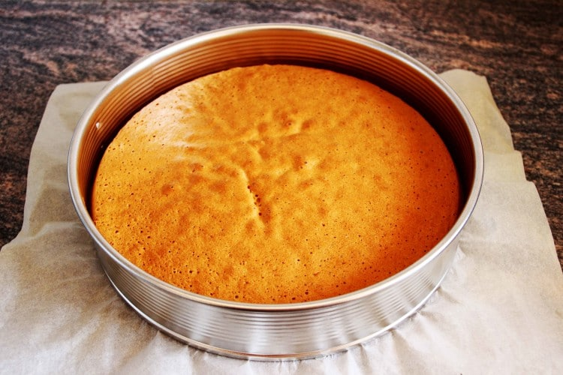
Baking a cake
Ingredients you might need:
sugar
butter
salt
milk
flour
vanilla essence
baking powder

Slide 12
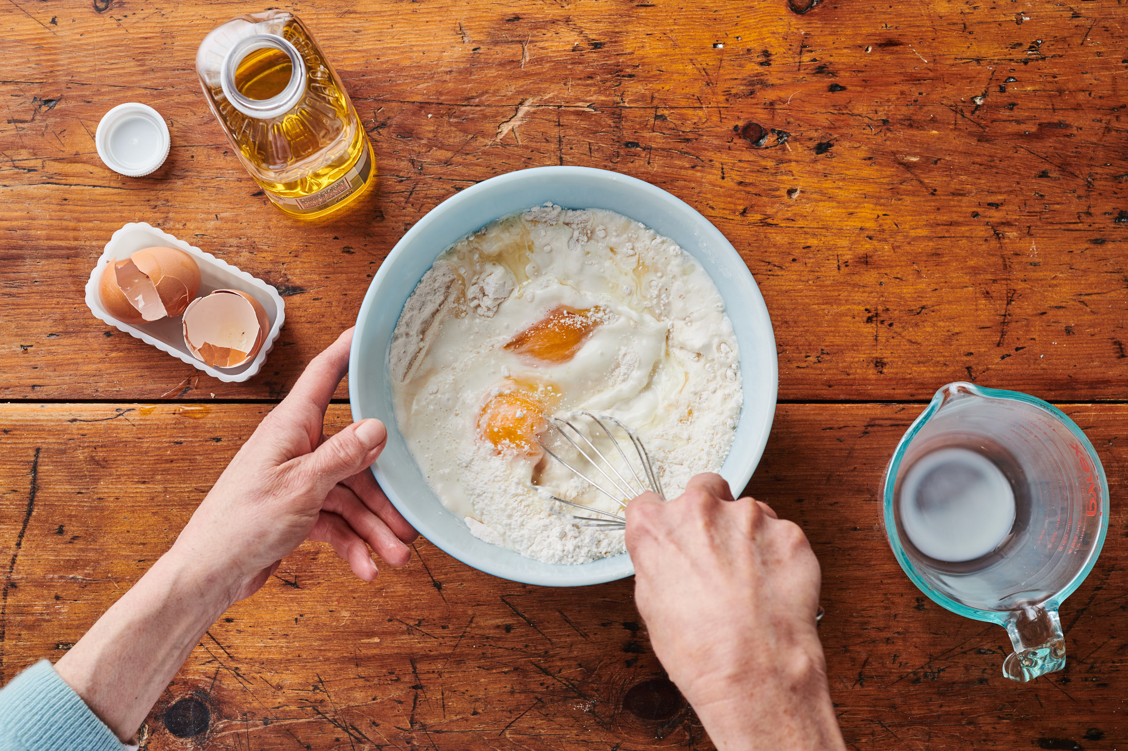
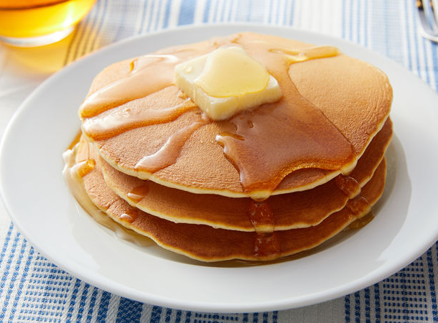
Making pancakes
Ingredients you might need:
milk
sugar
eggs
flour
syrup

Slide 13
Success Criteria

Slide 14
Long Writing Task: A Recount

Slide 15
What is a RECOUNT?
A recount retells an event or experience that happened in the past.
Use the past tense.
A recount entertains or informs e.g. a recount of a traffic accident.
Events are written in a chronological order. The use of time conjunctions such as ‘first’, ‘next’, ‘then’ and ‘later’ is necessary.

Slide 17
Recount Title:
A new shopping mall has opened in your town. You have visited the mall with a friend/relative.
Write a recount about your trip to share it with your friend/relative.

Slide 18
Keep in mind the GAP:
GENRE: recount
AUDIENCE: young readers
PURPOSE: to describe in detail a shopping trip

Slide 19
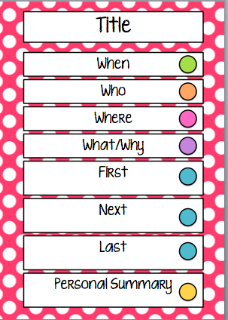
Question
Prompts

Slide 20
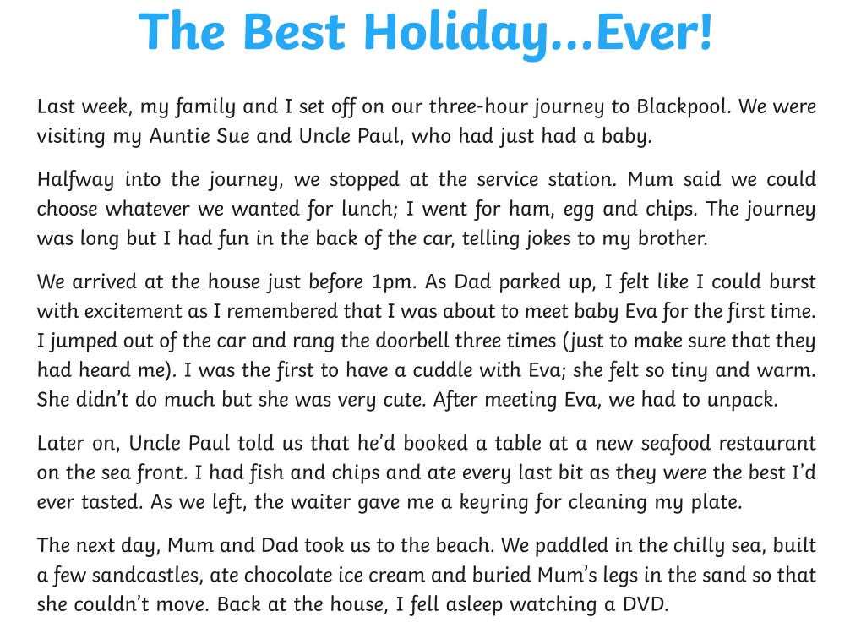

Slide 21
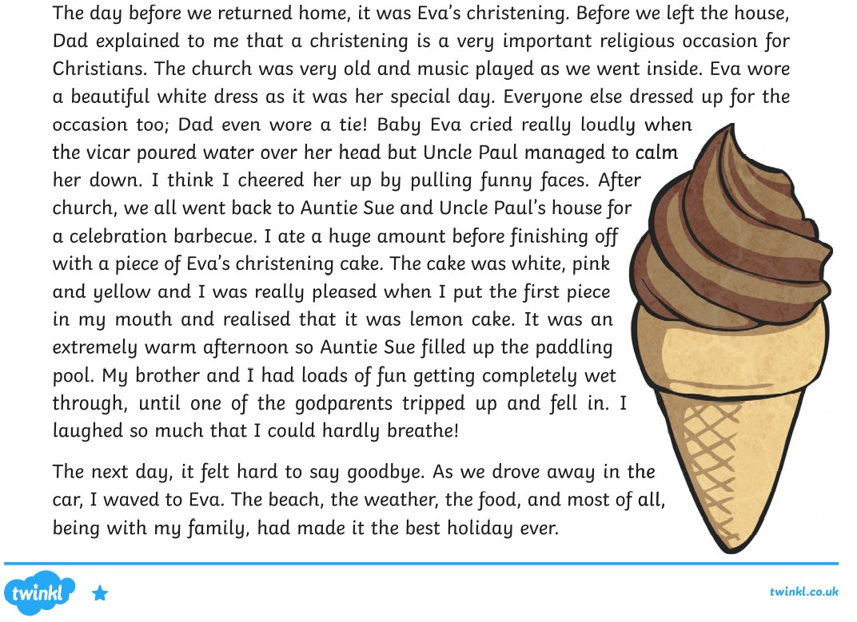

Slide 22
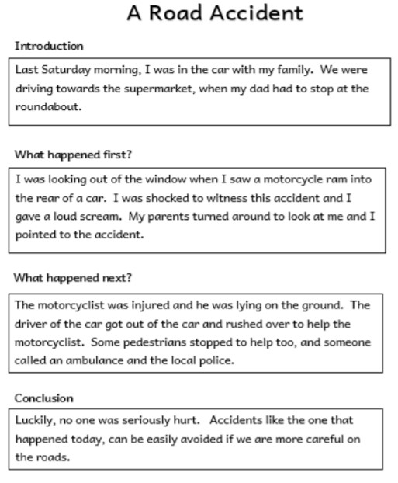
Another writing model of a recount.
You witnessed a road accident. Write a recount of this road accident to share it with your friend.

Slide 23
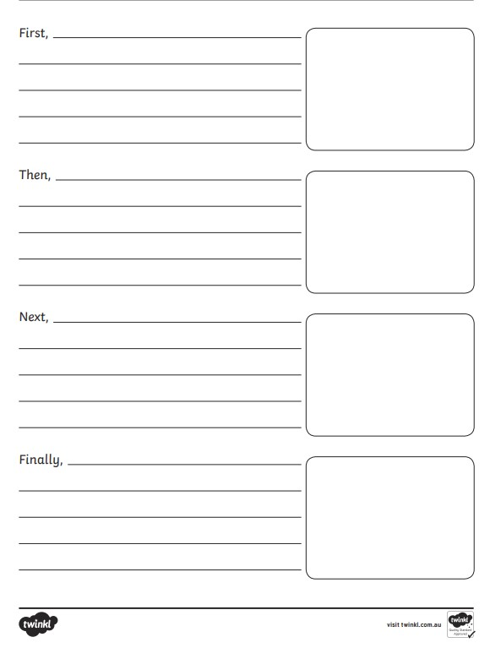
Take a look at the Recount Writing Frame

Slide 24
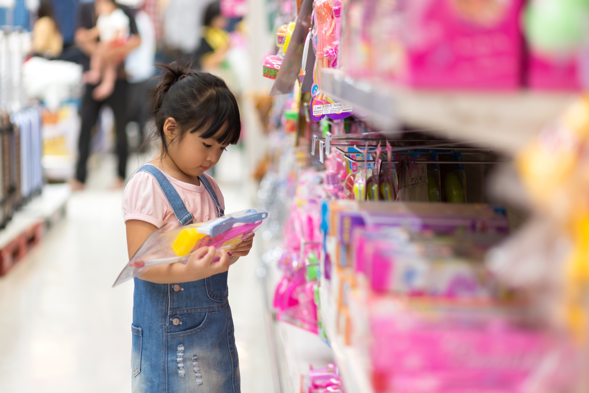
Introduction
When did you go?
Where did you go?
With whom did you go there?
Why did you go there?
How did you go there?

Slide 25
What did you see? (a lot of people, sales were on…)
What did you smell? (freshly baked doughnuts from the coffee shop, which made my mouth water …)
What did you hear? (relaxing music playing in the background/latest music hits on the radio channel/booming voice on the loudspeaker/the chitchatting of people …)
What did you like most? (Christmas/Easter decorations in the shop windows/the offers in the shops/visiting different shops … )
Body 1 – Describe the Place

Slide 26
Body 2 – What did you do?
Which shops did you visit? (clothes shop, shoe shop, …)
What did you buy? (a gift for my sister, a book for myself …)
What did your … buy?(a t-shirt, a pair of shoes, sportswear …)
What did you eat? (a salad, a cup of tea and a doughnut …)
What did you enjoy most? (window shopping, buying things on sale …)
Did something out of the ordinary happen? (left my purse in a shop, lost my earring …)

Slide 27
How long did you stay? (the whole morning, till early afternoon …)
Did you enjoy yourself? (had the best time of my life, enjoyed every second of our trip ...)
Which was the best part of your shopping trip? (I managed to find the perfect gift for my sister …)
How did you feel at the end of the trip? Would you like to go again? (we were dead tired, look forward to …)
Conclusion

Slide 28
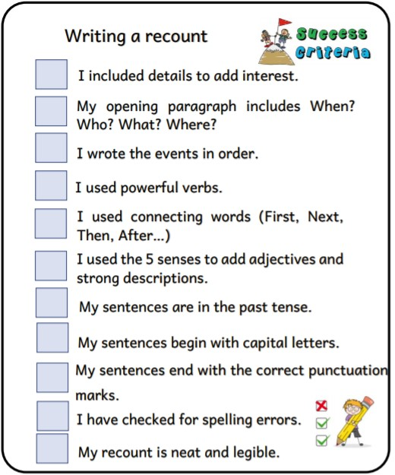
Success
Criteria

Slide 29
Post-Task Activity:
After you write your recount,
share it with someone at home.

