Slide 1
Jobs and Occupations
Lesson 5 - Writing

Slide 2
Notes for the Educator
This lesson is pegged directly to Learning Outcomes W 5.9 I can write a paragraph appropriately for an audience and with a purpose; W5.12 I can make a text more interesting or more relevant to me by changing the vocabulary and W5.14 I can use resources to help me plan my written work and present it accurately.
Teachers are to refer to the Scheme of Work where each lesson is explained in more detail.
Effects are included to make the presentation more interactive. Please present the PowerPoint in Slideshow Mode.
Wherever possible we have included the use of online apps to enhance the teaching and learning experience.
The Notes section underneath the slides may contain some further points to help you during the lesson.
Teachers are encouraged to adapt and make the necessary changes to this document as required to meet the learners’ language needs.
Audio files or links to websites may be included.
The tasks included in the PowerPoint presentation are also being shared as handouts.
For any comments, feedback or suggestions please email us at: marie-claire.camilleri@ilearn.edu.mt; urieth.attard@ilearn.edu.mt; mary.jude.camilleri@ilearn.edu.mt. You may also call the office on: 25983683.

Slide 3
I am learning how to fill in an application form.
I can use a writing frame to plan my writing and present it neatly.
I can write a short paragraph for an audience and with a purpose
I can improve my writing by revising and editing it.

Slide 4
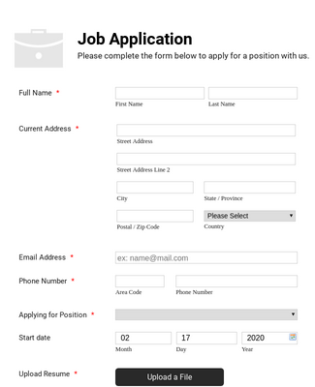
name
surname
date of birth
address
telephone number
email address
hobbies and interests
experiences
Notes:
An application form is a form on which you write down personal details such as name, surname, date of birth, address, telephone number, email address, hobbies and interests, to mention a few.

Slide 5
Become a member of a group/library
Join a club (summer club/football nursery/karate)
Apply for a job
Apply for a passport

Slide 6
Notes:
You can fill an application form by hand but you can also fill in an application form online, that is on the web.

Slide 7
Notes:
These are some examples of how an application form looks like. Different application forms might ask you for different details, depending on what you will be applying for.

Slide 8
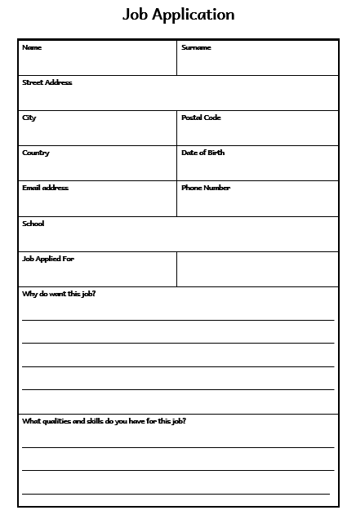

Slide 9
Filling in an Application Checklist
Did I…?
fill in all the spaces?
write all the details such as date of birth, email address and telephone number correctly?
give at least 2 reasons why I want this job?
include 2 qualities that are important for this job?
use interesting words?
use capital letters for proper nouns such as my name and surname, house, address, etc…?
Notes:
Success Criteria for filling in an application form

Slide 10
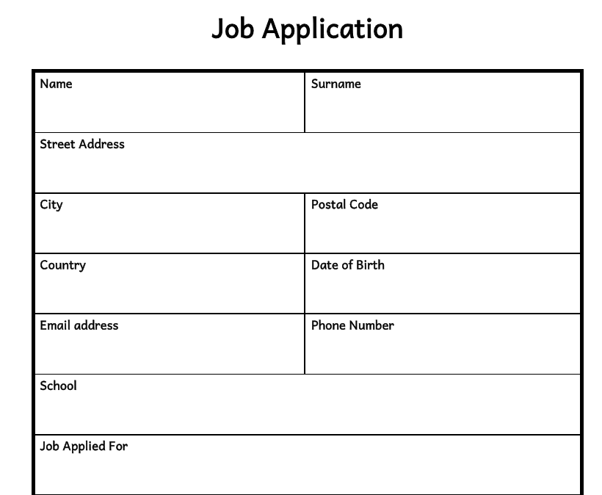
Maria
Grech
24, Cats Street
Mosta
MST 4488
Malta
23-4-2013
27874635
urieth@gmail.com
Mosta Primary B
Zoo Keeper

Slide 11
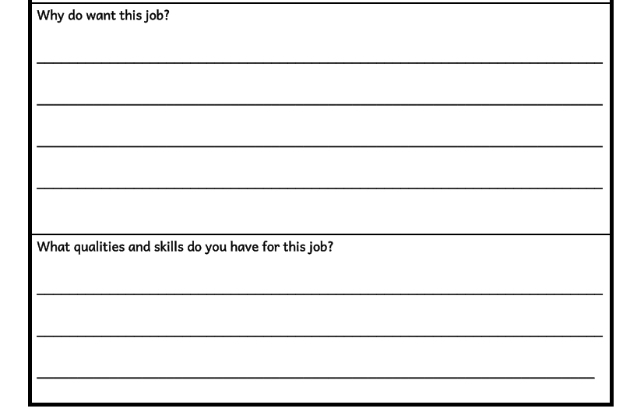
I love being around animals. I enjoy taking care of them, feeding them and keeping them healthy.
Notes:
Here you need to show that you really wish to do this job and that you know how to carry out this job. You need to list down two or three reasons why you are applying for this position, in my case as a zoo keeper. So, I’m going to write:

Slide 12
I love being around animals. I enjoy taking care of them, feeding them and keeping them healthy.
I am very gentle and kind with animals. I have a pet hamster and I feed it and clean after it.
Notes:
Here you need to show that you have what it takes to do this job. You need to list previous experiences, qualities and skills that will help you do this job. :
Now, let’s check and read what we have written. First, we go over it again to try and improve it. If you think you have misspelled words, look them up in a dictionary and write them correctly.

