Slide 1
Jobs and Occupations
Lesson 4 – Speaking

Slide 2
Notes for the Educator
This lesson is pegged directly to Learning Outcome LS 5.8 I can communicate my own questions fluent and accurately with some allowances to self-current in the process.
Teachers are to refer to the Scheme of Work where each lesson is explained in more detail.
Effects are included to make the presentation more interactive. Please present the PowerPoint in Slideshow Mode.
Wherever possible we have included the use of online apps to enhance the teaching and learning experience.
The Notes section underneath the slides may contain some further points to help you during the lesson.
Teachers are encouraged to adapt and make the necessary changes to this document as required to meet the learners’ language needs.
Audio files or links to websites may be included.
The tasks included in the PowerPoint presentation are also being shared as handouts.
For any comments, feedback or suggestions please email us at: marie-claire.camilleri@ilearn.edu.mt; urieth.attard@ilearn.edu.mt; mary.jude.camilleri@ilearn.edu.mt. You may also call the office on: 25983683.

Slide 3
I am learning how to talk about my favourite sport.
I can describe a job by using sentence patterns.
I can add details to my description to make it sound more interesting.
I can self correct some mistakes I make while speaking.

Slide 4
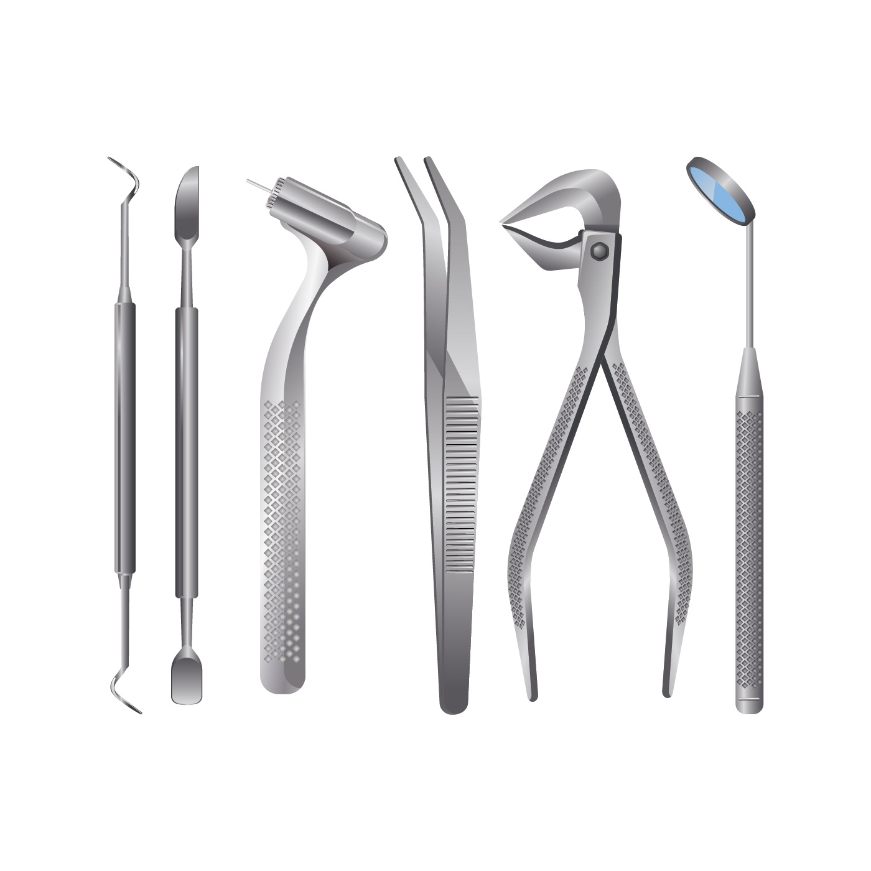
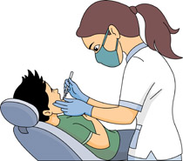
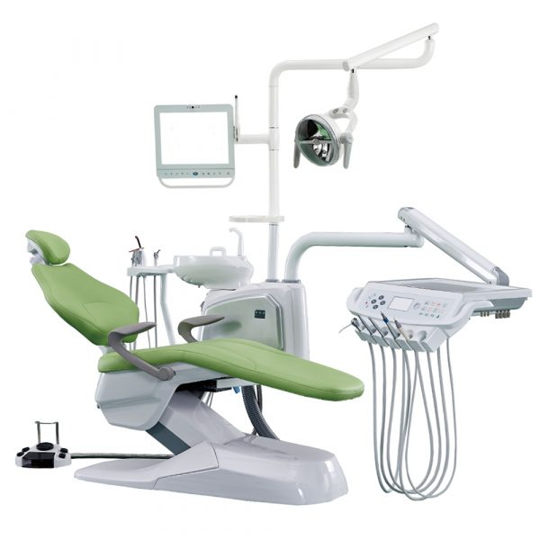
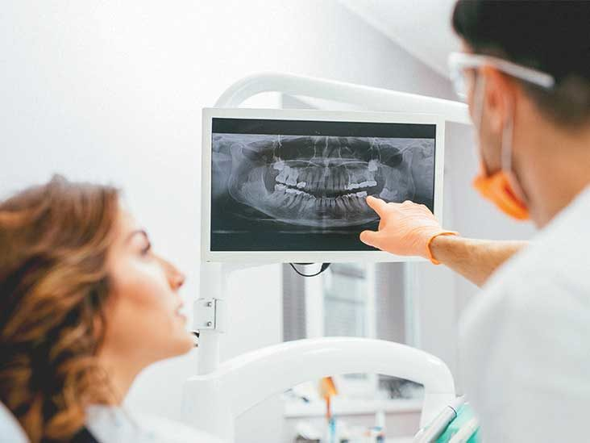
dentist
Notes:
I wear a white coat.
I have a comfortable chair which can lean back.
I use a lot of tools such as the tweezers and a mouth mirror.
Sometimes I use an X-ray machine to look at your teeth.
I am a …

Slide 5
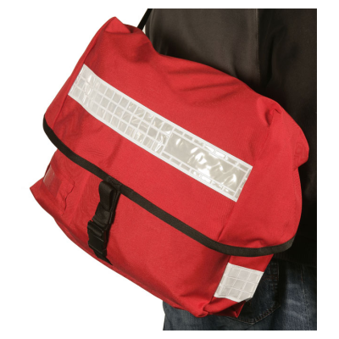
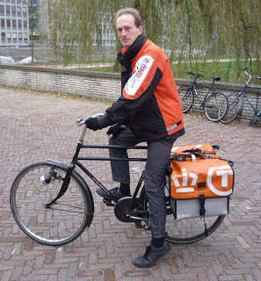
postman
Notes:
Here comes another one:
I wear a uniform.
I work outside, sometimes even in bad weather.
I carry a heavy bag.
Sometimes I ride a bike or the motorbike.
I am a ….

Slide 6
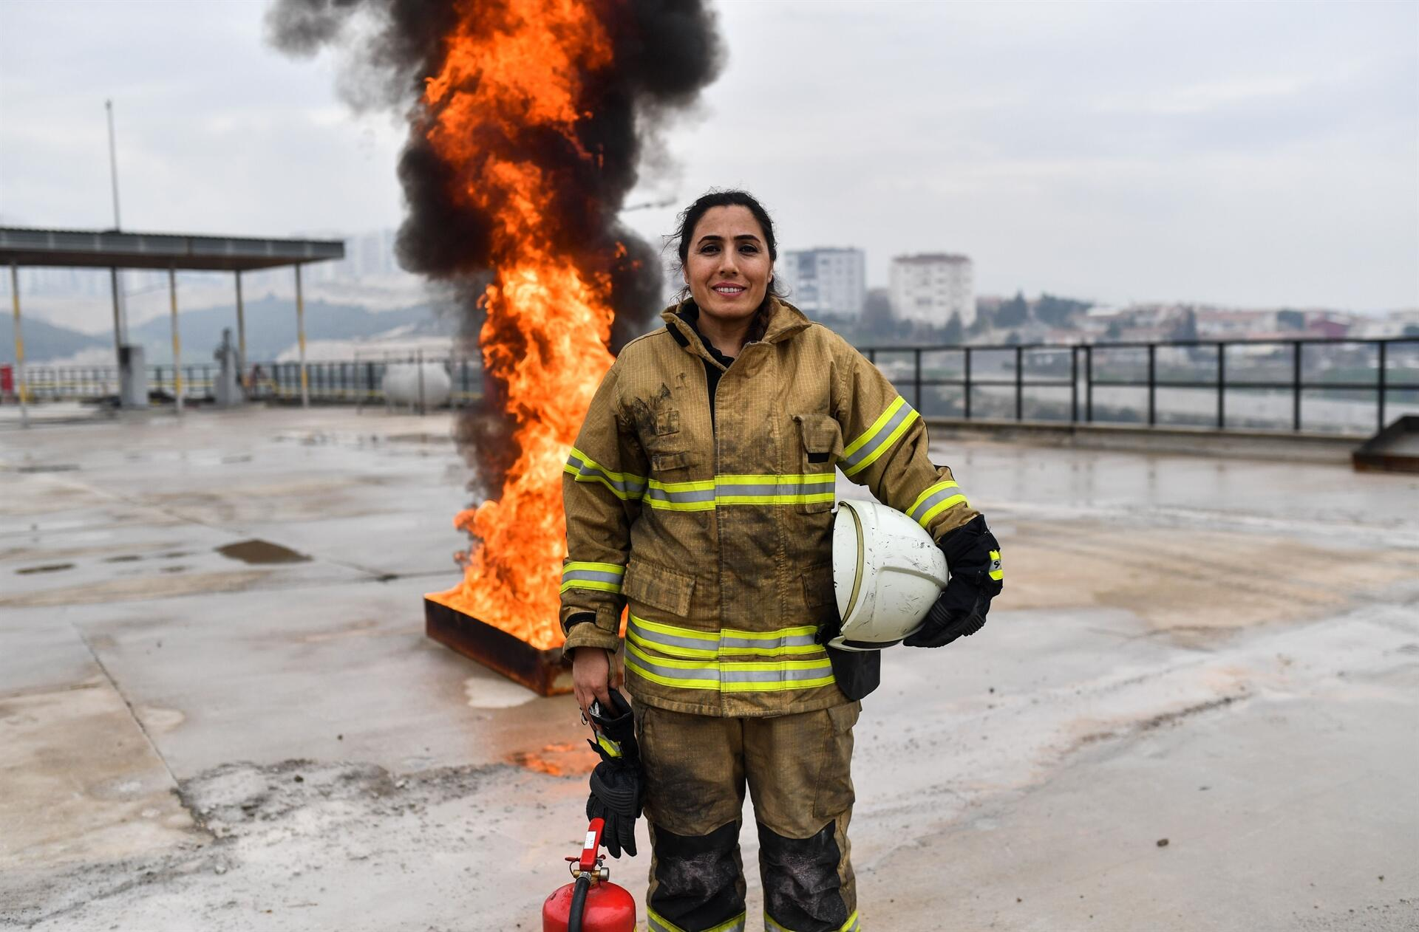

Slide 7
She works as a firefighter.
She puts out fire and rescues people.
She wears a helmet and special clothes.
She needs to be brave and strong.

Slide 8
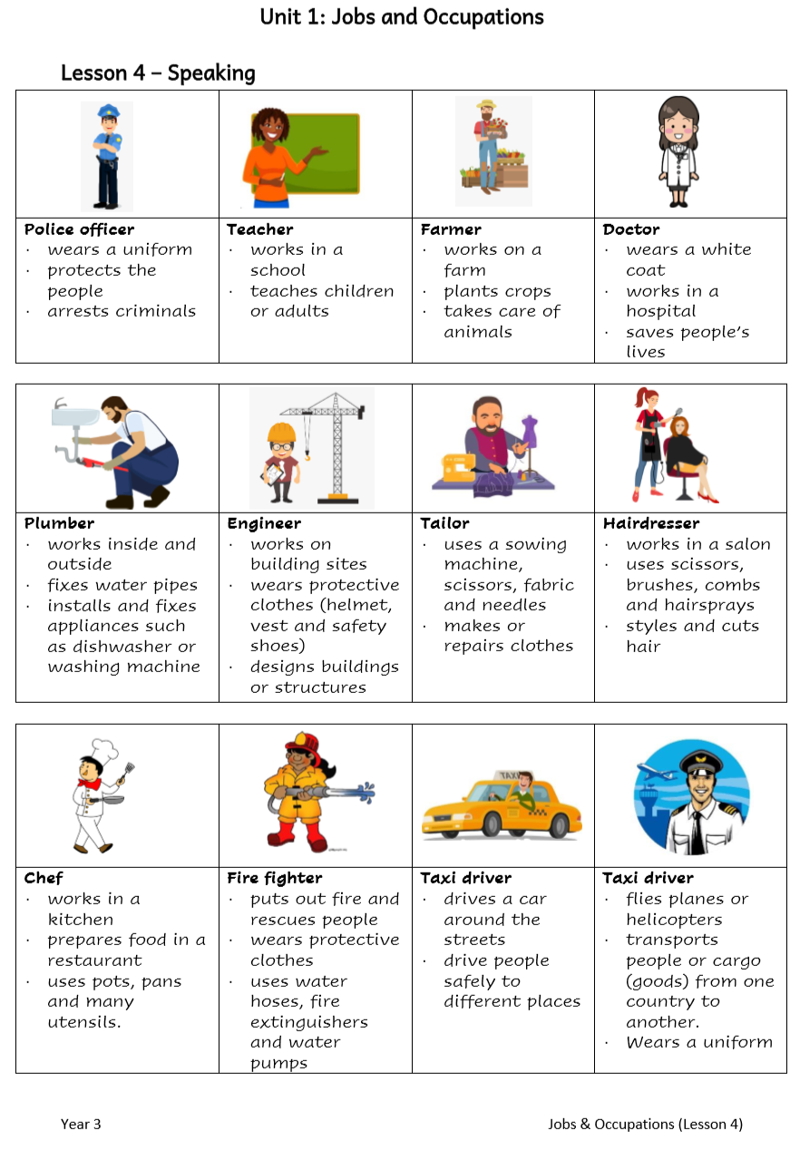
He works as a ….
He works in …
He prepares …
He needs to be …
Notes:
Now, try doing the same for the jobs that you are about to see. I am going to help you by giving you some sentence starters. You may also refer to the handout with the vocabulary that is available with this lesson.

Slide 10
He works as a ….
He works in …
He prepares …
He needs to be …

Slide 11
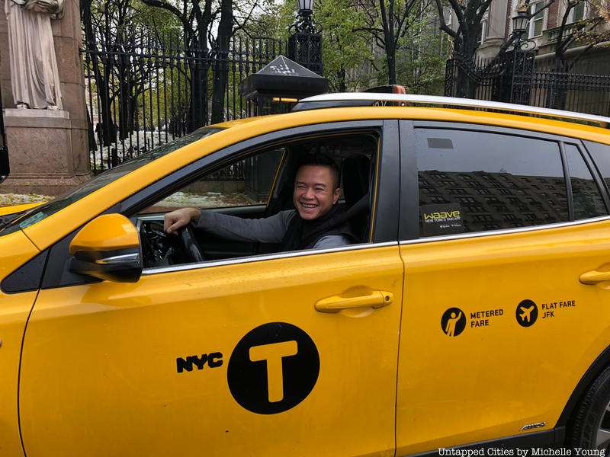

Slide 12
He works as a ……
He works ….…
He drives …..
He needs to be …

Slide 13
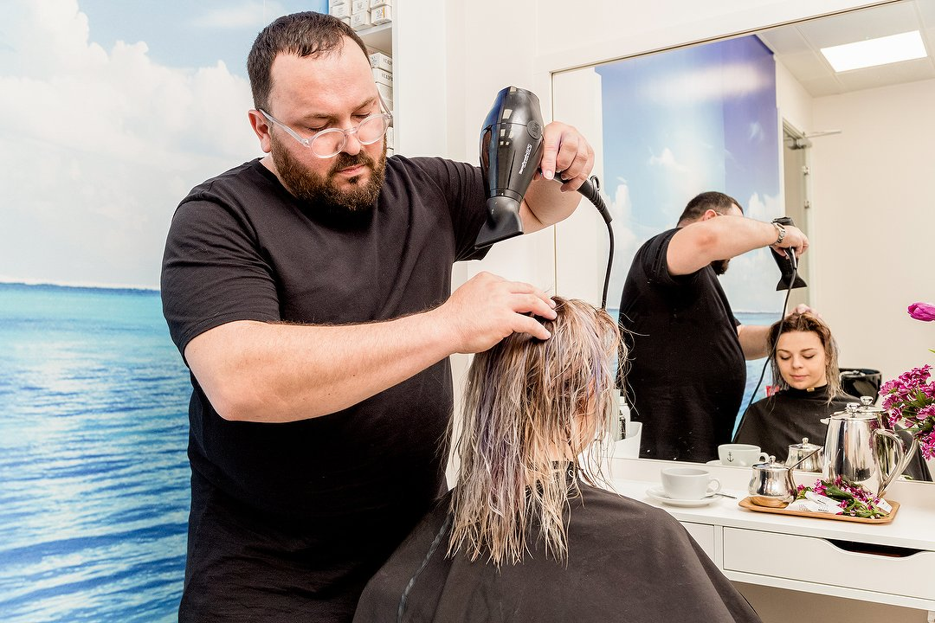

Slide 14
He works as a ……
He works ….…
He uses …..
He needs to be …

Slide 15
In the picture, I am a…
I work….…
I use …..
I need to be …
Notes:
You can ask students to record their responses on FlipGrid.

