Slide 1
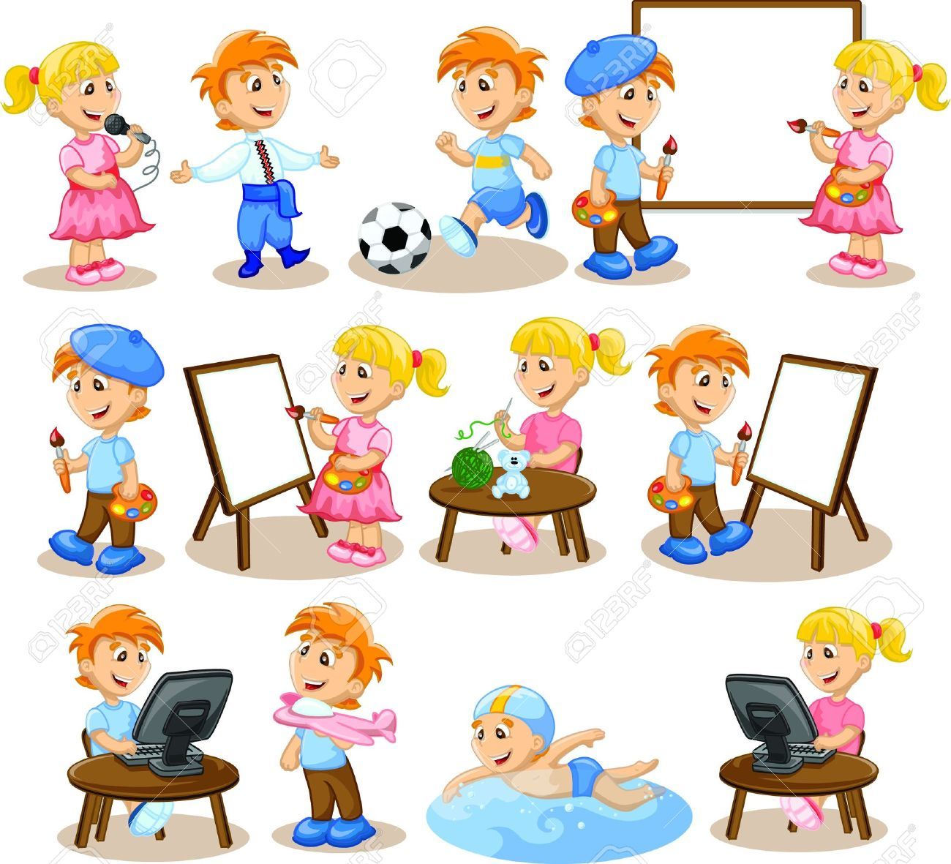
Lesson 4: Writing Topic: Hobbies and Leisure Year: 4

Slide 2
PART 1
Writing captions

Slide 3
LESSON OBJECTIVES
Today I will learn:
what are captions.
how to write captions.

Slide 4
DOWNLOAD THESE RESOURCES
Pictures Worksheet
Success Criteria Worksheet

Slide 5
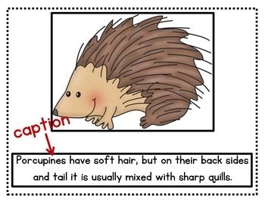
WHAT IS A CAPTION?
A caption consists of a sentence which describes a picture in as few words as possible. It can include a quote or a saying.

Slide 6
Captions: - are short and to the point. - give information about the picture. - include who is in the picture. - state who is doing what, where and why. - are written in the present tense.

Slide 7
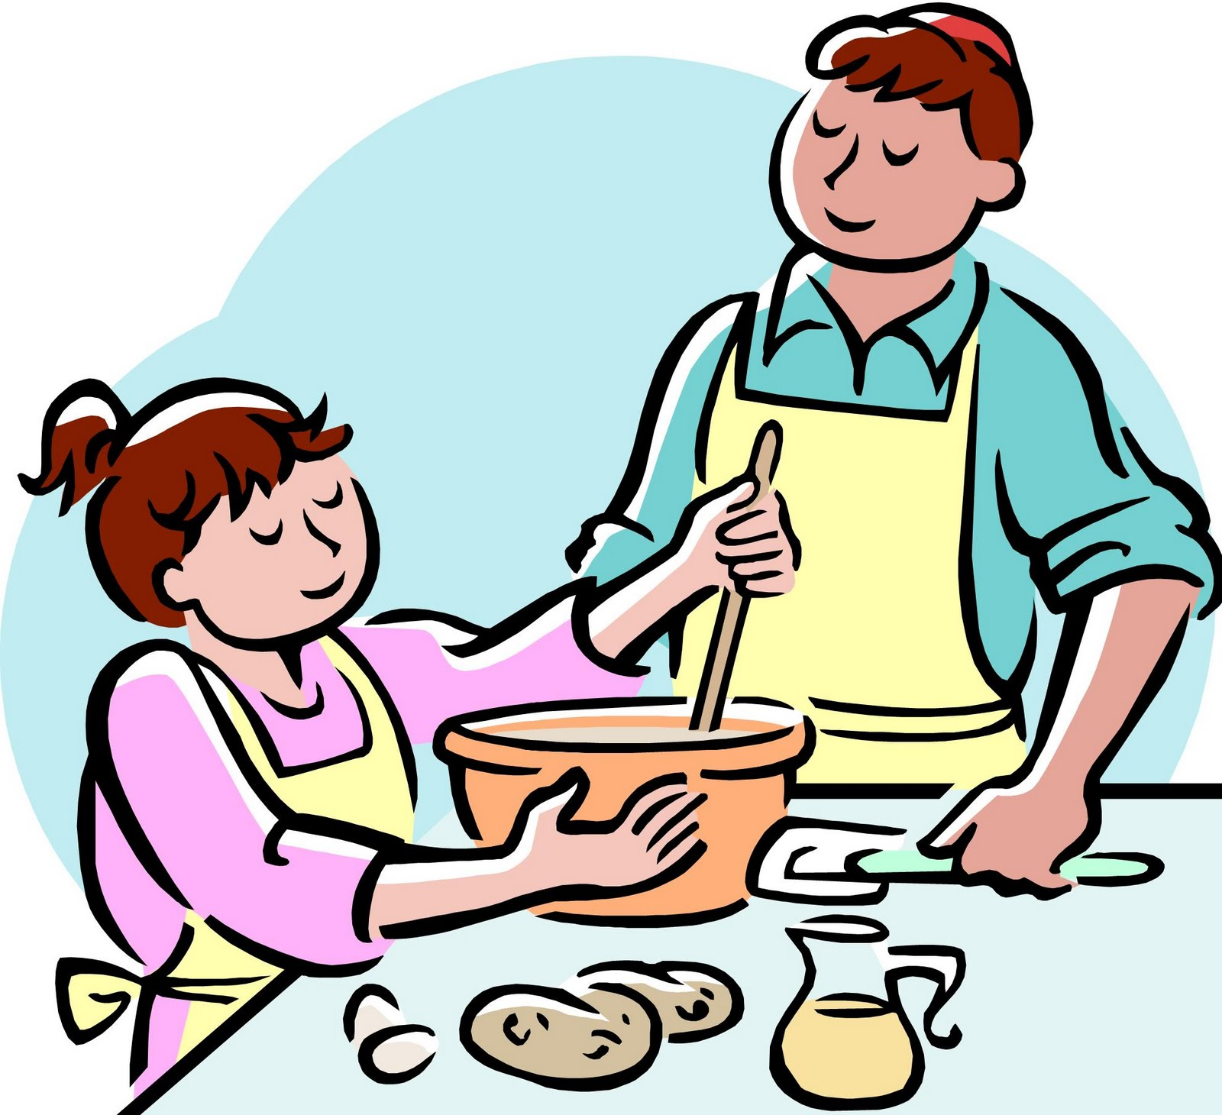
Let’s read the captions under these pictures. What are they describing?
A girl is baking with an adult.
Two siblings are doing crafts together.

Slide 8
This girl is reading with the help of her grandma.
These children are examining stamps.

Slide 9
Writing task:
Your school blog is publishing photos of pupils practising different hobbies during lockdown. Write a caption under each photo to describe what the pupil/s is/are doing in the picture.

Slide 10
Keep in mind the G.A.P:
GENRE – Caption.
Write SPECIFIC sentences to DESCRIBE a picture. USE THE PRESENT TENSE.
AUDIENCE – Young readers.
Use SIMPLE and APPEALING language for young readers.
PURPOSE - To describe what pupils are doing in each photo.
FOCUS should be on the hobby in the picture.

Slide 11
Let’s write captions.

Slide 12
The brother and sister are using colourful markers to draw a picture.

Slide 13
The young girl is flying her colourful kite on the beach.

Slide 14
The boy is at the library reading a thick book.

Slide 15
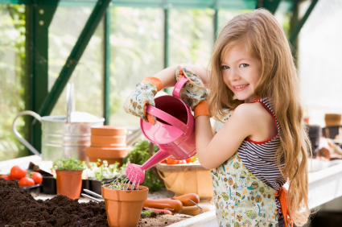
The girl is using a watering can to water the plants.

Slide 16
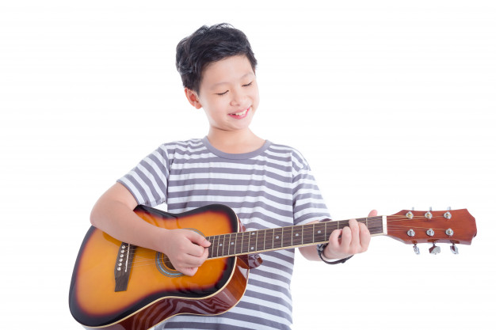
The boy enjoys playing his guitar.

Slide 17
Look at the following pictures on the next slides.
Write a caption beneath them.

Slide 18
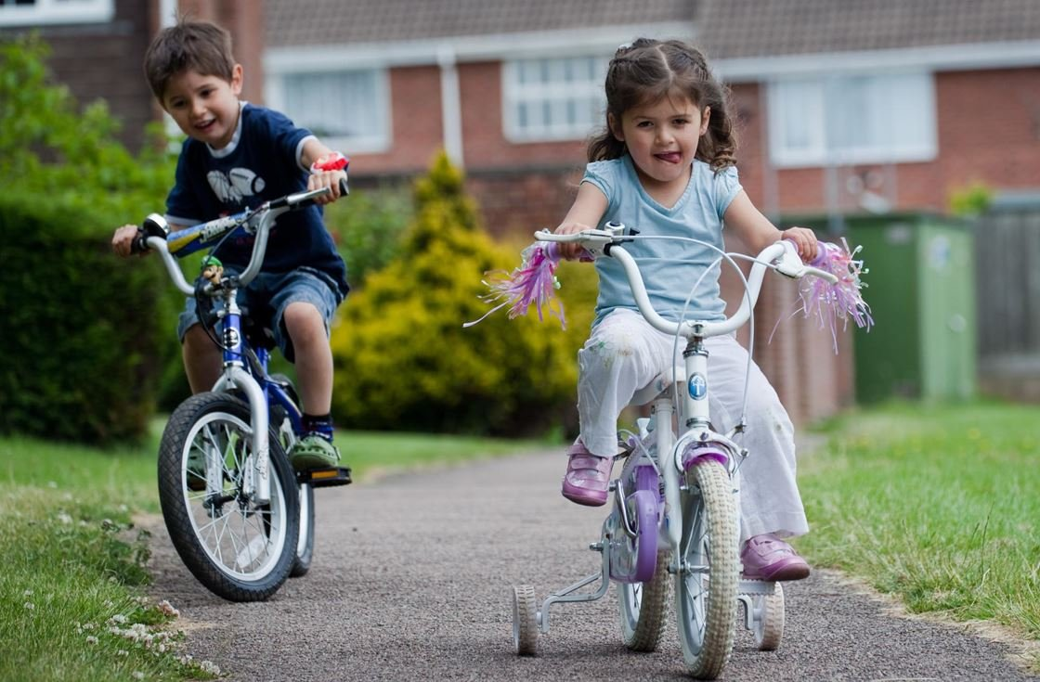

Slide 19
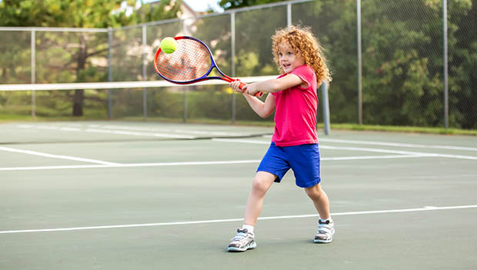

Slide 20
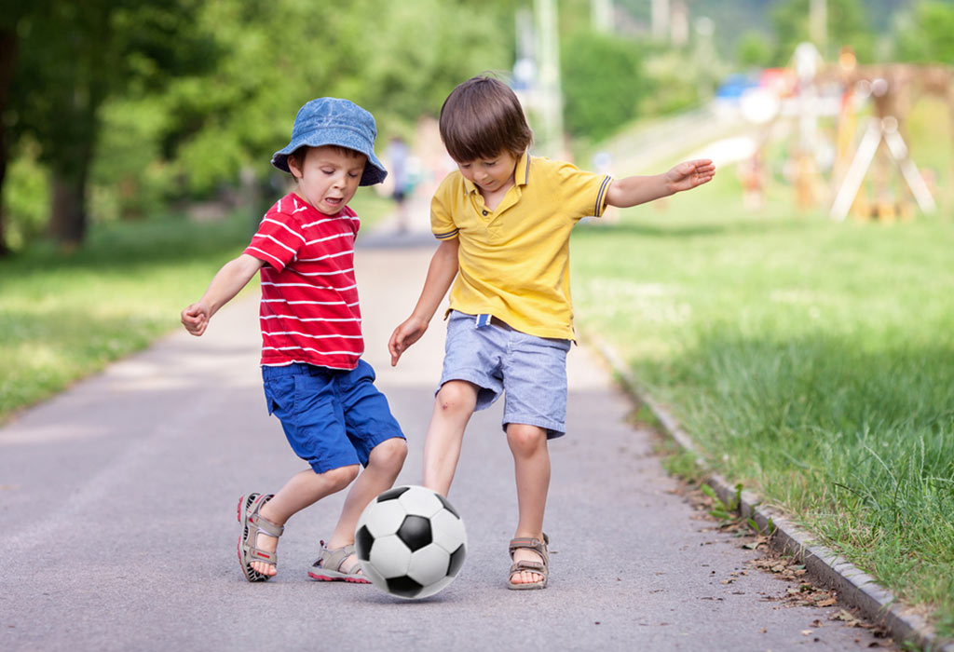

Slide 22
Success Criteria

Slide 23
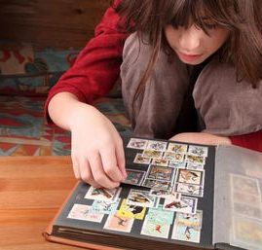
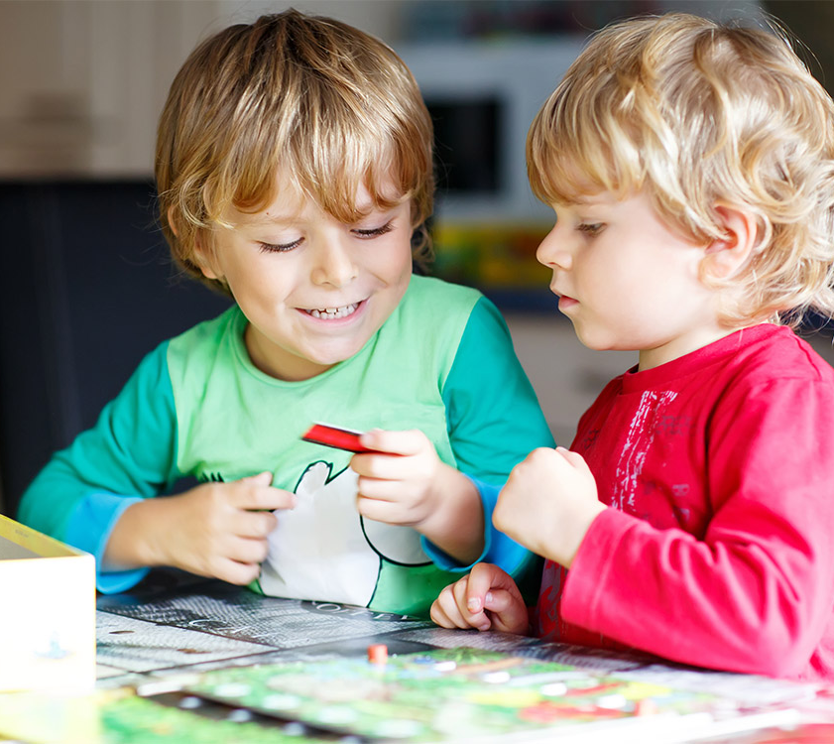
Post-Writing Task:
Take a photo of yourself practising your favourite hobby. Then write a caption beneath it and share it with your friends and relatives.

Slide 24
PART 2
Writing a short message

Slide 25
LESSON OBJECTIVES
Today I will learn:
how to write a short message to invite someone.
what are the success criteria for writing a message.

Slide 26
DOWNLOAD THESE RESOURCES
Writing Frame – Short Message
Success Criteria Worksheet

Slide 27
Writing a short message
Title:
You need someone to play the
Uno-card game with. Write a short message to a friend and invite him/her to play the Uno-card game with you.

Slide 28
Let’s understand the title.
GENRE – Short Message
Be concise and to the point.
Include a salutation and a closing.
AUDIENCE – A friend
Use a friendly, chatty style.
PURPOSE – To invite
Give reasons for your friend to join you.
Share details such as date, place…

Slide 29
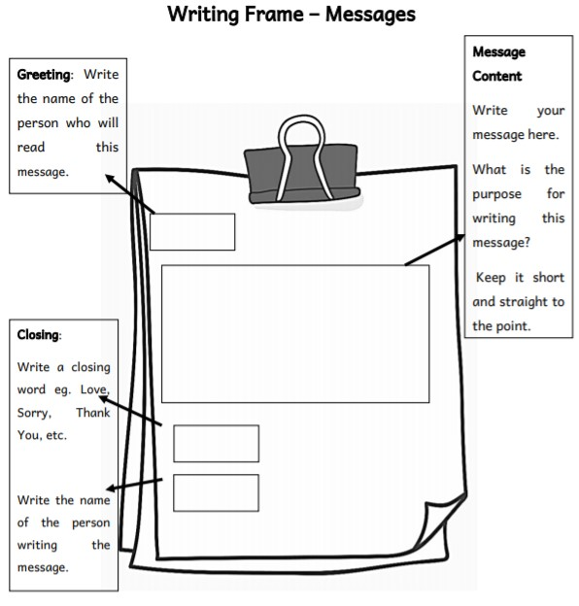
Writing Frame

Slide 30
Follow these points while writing your message
Greet your friend (Hello/Hi/Dear).
Explain why you are writing (to invite him/her to play Uno-card game).
Specify the place and time of the meeting.
Use the first person ‘I’.
Close your message (Love, Your friend, …).

Slide 31
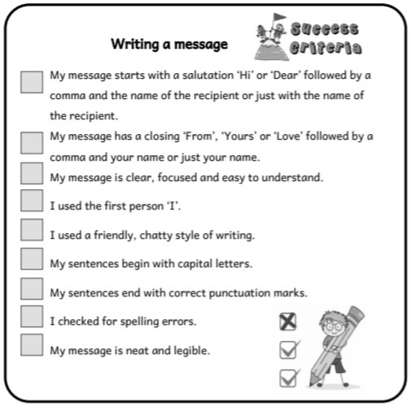
Success Criteria

