Slide 1
Lesson 3 Reading
Year 5
English

Slide 2
Lesson 3 Objectives
In Lesson 3 you will:
listen to a text being read aloud.
read a text silently and aloud.
answer questions about the text.
learn facts about a famous racing competition.

Slide 3
Lesson Resources
Dictionary
Reading Text
Questions Worksheet
Answers Handout

Slide 5
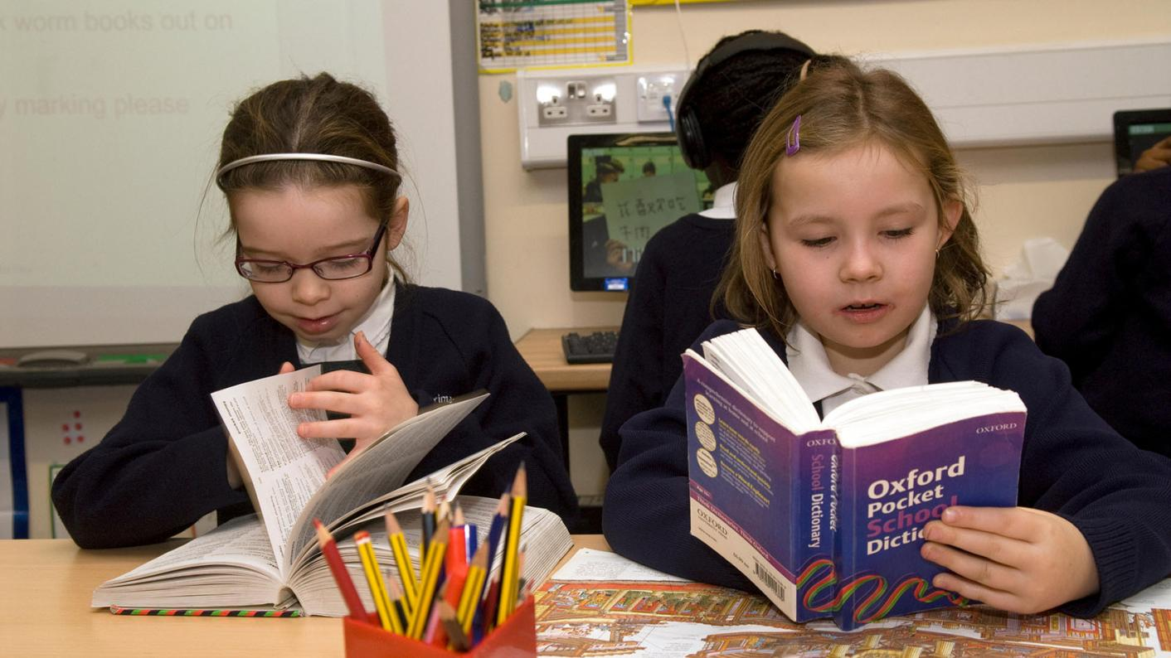
Using a dictionary!

Slide 6
New Words
suburbs
lengthened
estimated
arguably
promote
proposed

Slide 7
New Words
support/encourage
put forward/suggested
arguably
promote
proposed
areas on the edges of towns
made/became longer
roughly calculated
estimated
possibly
suburbs
lengthened

Slide 8
Step 1
READ the text and questions and
try to ANSWER the following question:
WHAT IS THE TEXT ABOUT?

Slide 9
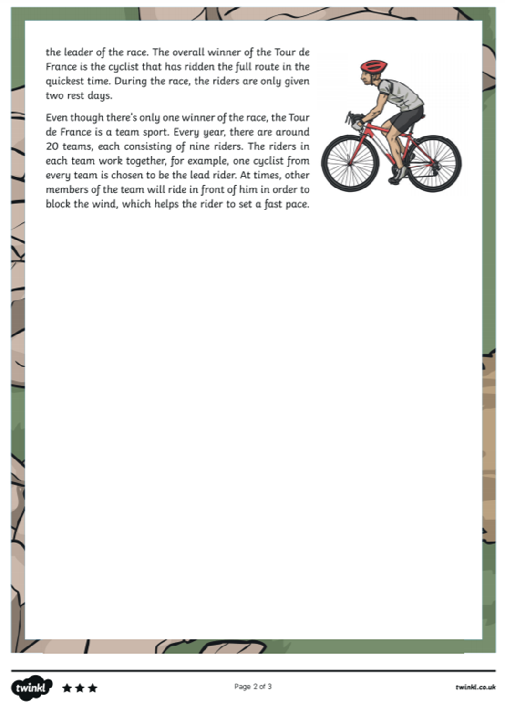
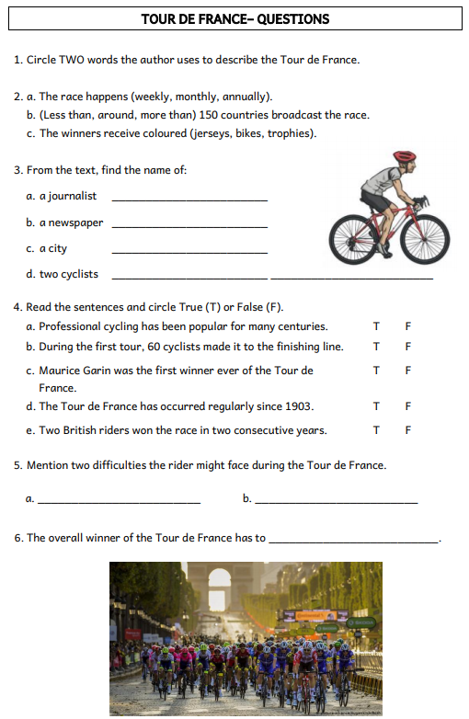

Slide 10
Step 2
READ the text and questions again.
Then ANSWER the following questions:
When was the first ever Tour de France?
What is different about the starting point and route every year?
What is the nickname given to the winner of the red polka dot jersey?
Compare the significance of the green jersey with the white jersey.
Why do other members of the team cycle in front of the team lead rider?
Why do you think different coloured jerseys are given to the winners of each stage?

Slide 11
Step 3: Discuss the questions
1. When was the first ever Tour de France?
The first race began on the 6th of July, 1903.
2. What is different about the starting point and route every year?
Each year, the tour begins in a different country. The route of the race also changes every year, but usually finishes at the Champs-Élysées in Paris.
3. What is the nickname given to the winner of the red polka dot jersey?
The winner of the red polka dot jersey is known as the ‘King of the Mountains’.

Slide 12
Step 3: Discuss the questions
4. Compare the significance of the green jersey with the white jersey.
The white jersey is given to the best rider under 26 years of age and the green jersey is awarded to the best sprinter.
5. Why do other members of the team cycle in front of the team lead rider?
Other members of the team will ride in front of the team lead rider in order to block the wind, helping him to set a fast pace.
6. Why do you think different coloured jerseys are given to the winners of each stage?
To acknowledge the achievements of the best cyclists at the end of each stage and to help spectators and cyclists to identify the different cyclists.

Slide 13
Step 4
LISTEN to me as I
READ the text ALOUD.

Slide 15
Step 5
READ the text ALOUD.

Slide 16
Step 6
Let’s DISCUSS
the questions.

Slide 18
Step 7
WORK OUT the
Questions Worksheet.

Slide 19
Step 8

Slide 20
Step 9
CHECK your answers using the
Answers Handout.

Slide 21
Thank You!

