Slide 1
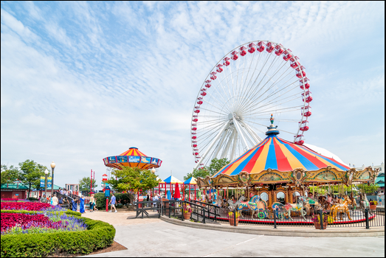
Lesson 4: Writing Topic: Entertainment Year: 4

Slide 2
Lesson Objectives:
During this lesson I will:
learn what an advert is.
write an advert.
learn the success criteria for writing an advert.

Slide 3
Download these resources:
Advert writing frame
Persuasive writing planning Handout
Catchy phrases/slogans Handout
Success Criteria Worksheet

Slide 4
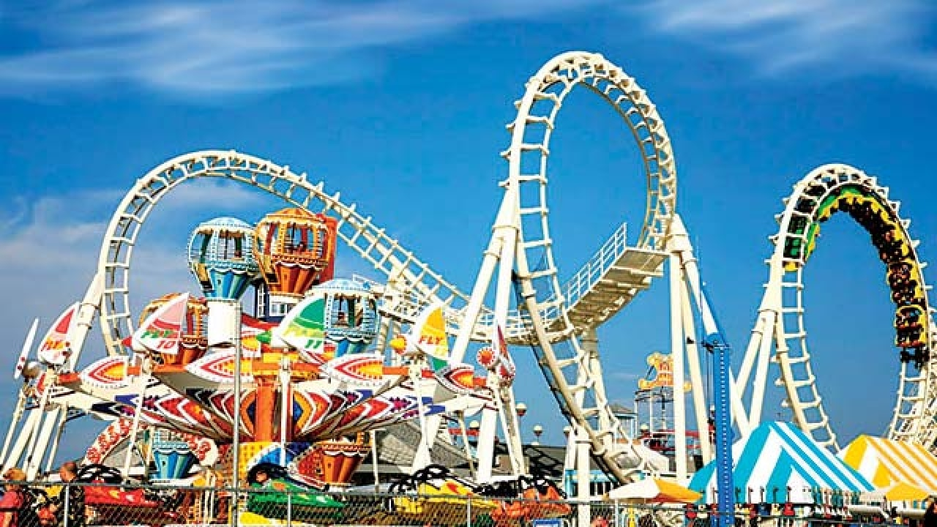
Let’s watch a video-clip together. Then answer the following questions: - What is the video-clip about? - How did you feel when you watched the video-clip? - Have you ever been on any fun rides?

Slide 6
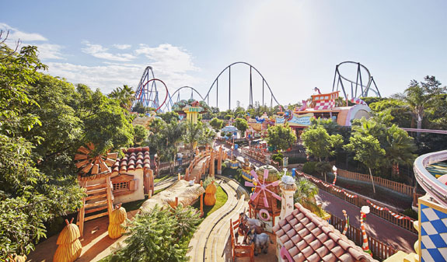
What is the video-clip about? The video-clip is a television advert. It advertises a popular amusement park in Barcelona. It shows most of the rides inside this park.

Slide 7
What is an advert?
An advert promotes a product and tries to persuade the consumers (which means us) to buy it or make use of it.
An advert can promote a place which has just opened. It tries to persuade the people to visit the place.
Adverts can be online, on tv, on billboards, in newspapers …
Adverts PERSUADE, INFORM and PROMOTE!

Slide 8
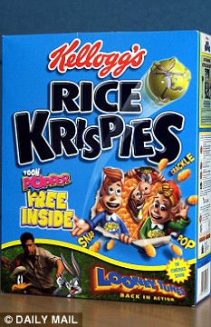
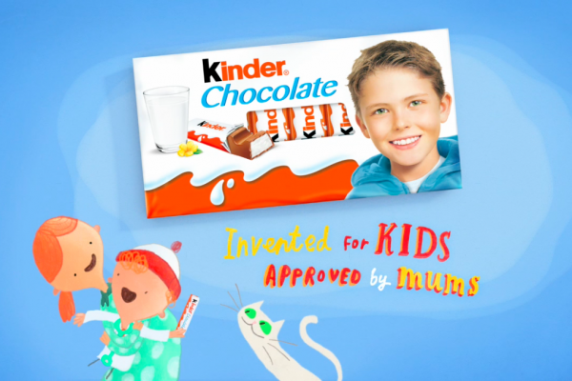

Slide 9
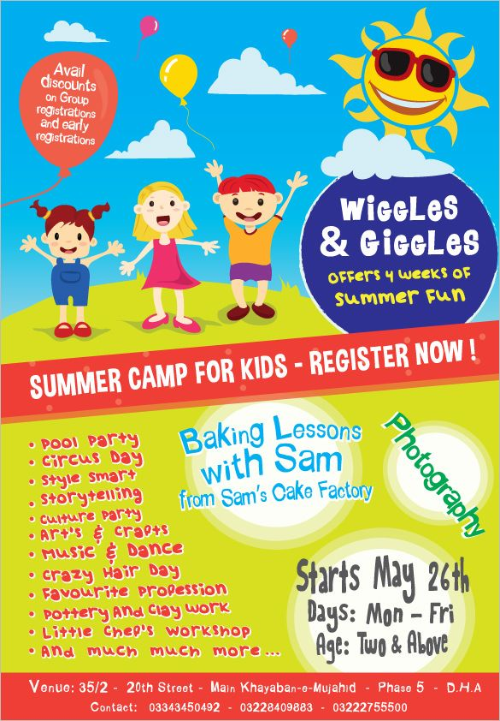

Slide 11
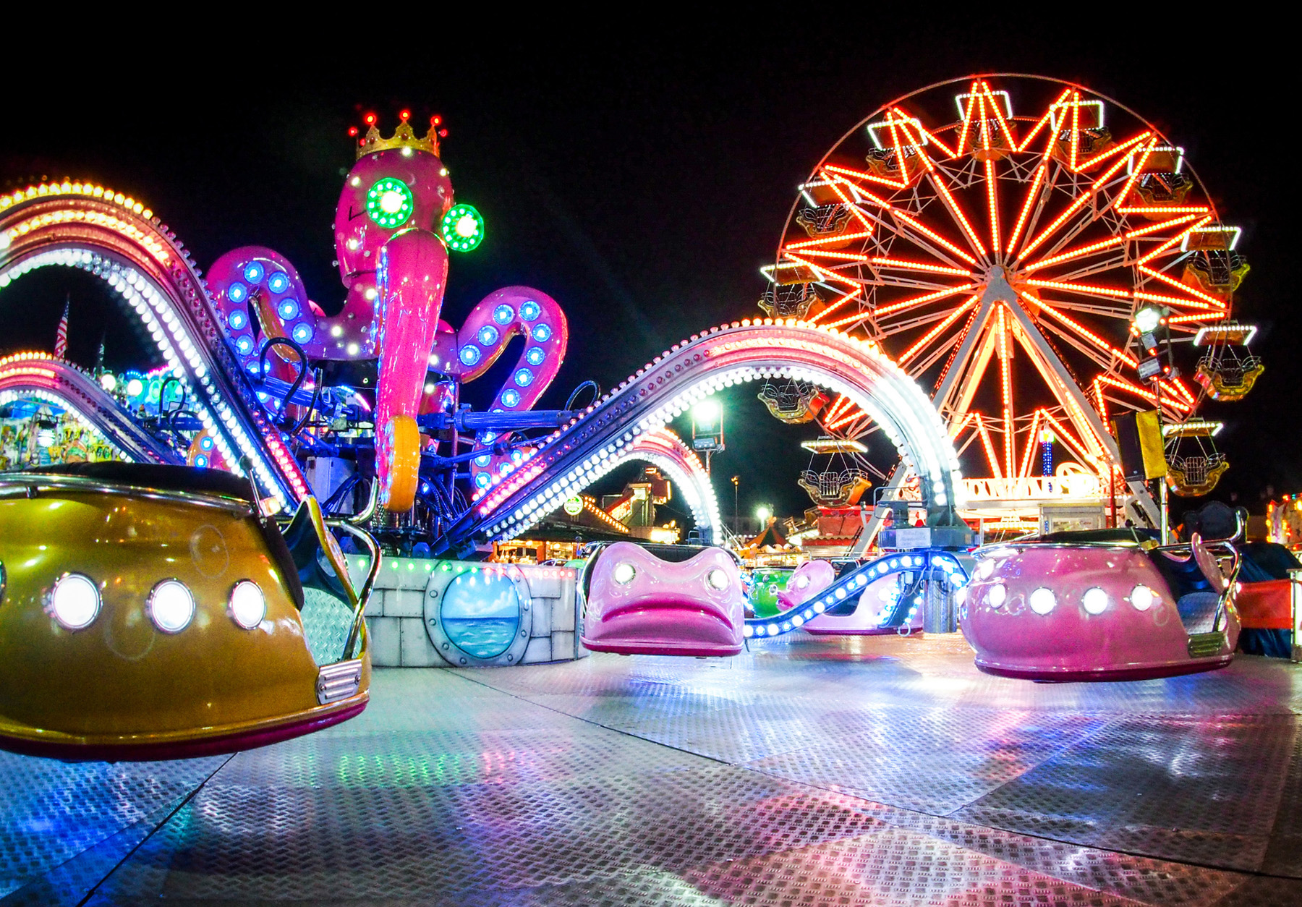
Title:
A new amusement park has opened in your town. Design an advert to encourage people to visit the place.

Slide 12
Keep in mind the GAP:
GENRE an advert
AUDIENCE young readers/others
PURPOSE to inform and to persuade

Slide 13
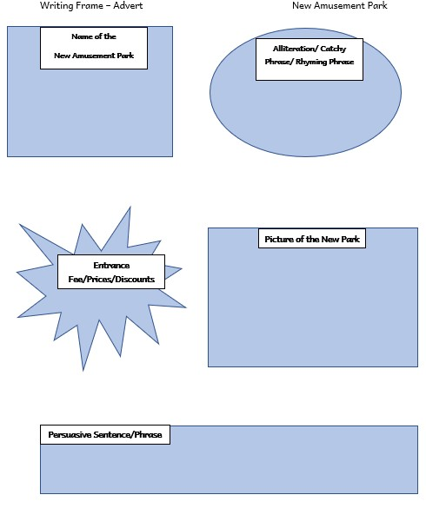

Slide 14
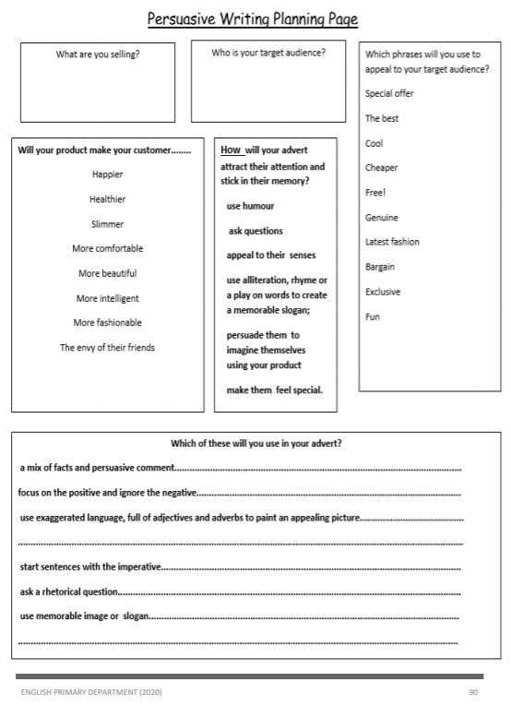

Slide 15
What is alliteration?
Alliteration consists of a series of words in a sentence have the same first consonant sound. The beginning sound of words is repeated in close succession.
Peter Piper picked a peck of pickled peppers.
A good cook could cook as many cookies
as a good cook who could cook cookies.
Black bug bit a big black bear.
Sheep should sleep in a shed.
A big bug bit the little beetle but
the little beetle bit the big bug back.

Slide 17
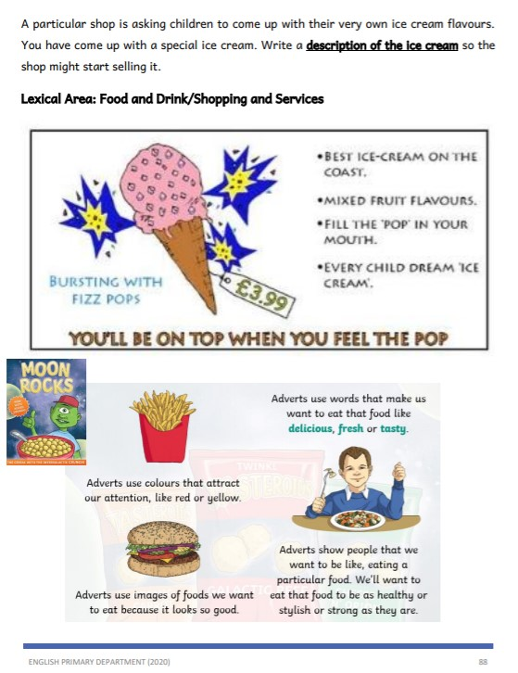

Slide 18
These catchy phrases/slogans can help you while writing your advert.
Face Gravity, Face First. Face your Fears. Higher, Faster and Smoother Than Ever. It’s a World of Adventures. King of Mountains. Love Every Moment. Ride On. Ride Warriors. Roller Coaster Capital of the World. Selected as the Best Water Ride in the Nation.
Again and Again. The Amazement Park. The Future is Riding on It.

Slide 19
These catchy phrases/slogans can help you while writing your advert.
Have fun everywhere.
Fun rides for you.
Get a ride, stay cool.
Feel the Happiness.
You deserve more fun.
We help you to make great memories.
Change your Mood.
We aim to make you happy.
A Next Generation Thrill Ride Blurring the Lines
Between Fiction and Reality. A True Giant Among Coasters. Are You Ready? Discover the Magic.

Slide 20
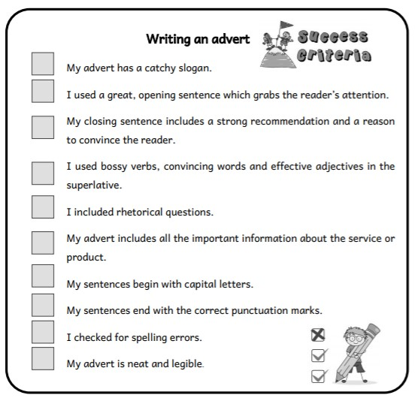
Success
Criteria

