Slide 1
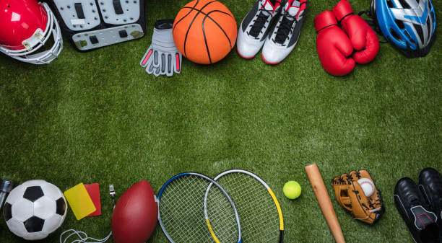
Sports and Games
Lesson 4 - Speaking

Slide 2
Notes for the Educator
This lesson is pegged directly to Learning Outcome LS 5.8 I can communicate my own experiences, likes and dislikes fluently and accurately with some allowance to self-correct in the process.
Teachers are to refer to the Scheme of Work where each lesson is explained in more detail.
Effects are included to make the presentation more interactive. Please present the PowerPoint in Slideshow mode.
Wherever possible we have included the use of online apps to enhance the teaching and learning experience.
The Notes section underneath the slides may contain some further points which can be developed during the lesson.
Teachers are encouraged to adapt this PowerPoint presentation to meet the learners’ language needs.
Tasks included in the PowerPoint presentation are also being shared as handouts.
For any comments, feedback or suggestions please email us at: marie-claire.camilleri@ilearn.edu.mt; urieth.attard@ilearn.edu.mt; mary.jude.camilleri@ilearn.edu.mt. You may also call the office on: 25983683.

Slide 3
I am learning how to talk about my favourite sport.
I can talk about my favourite sport by using sentence patterns.
I can add details to my description to make it sound more interesting.
I can self correct some mistakes I make while speaking.

Slide 4
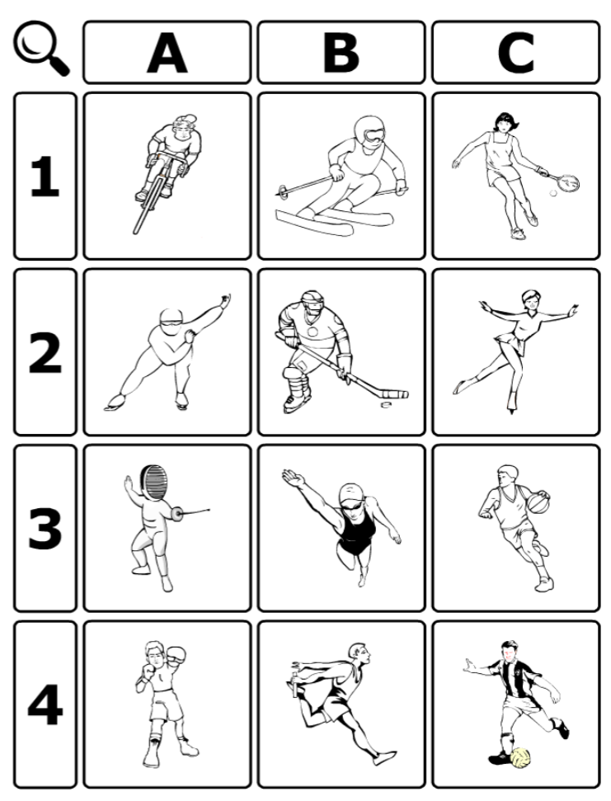
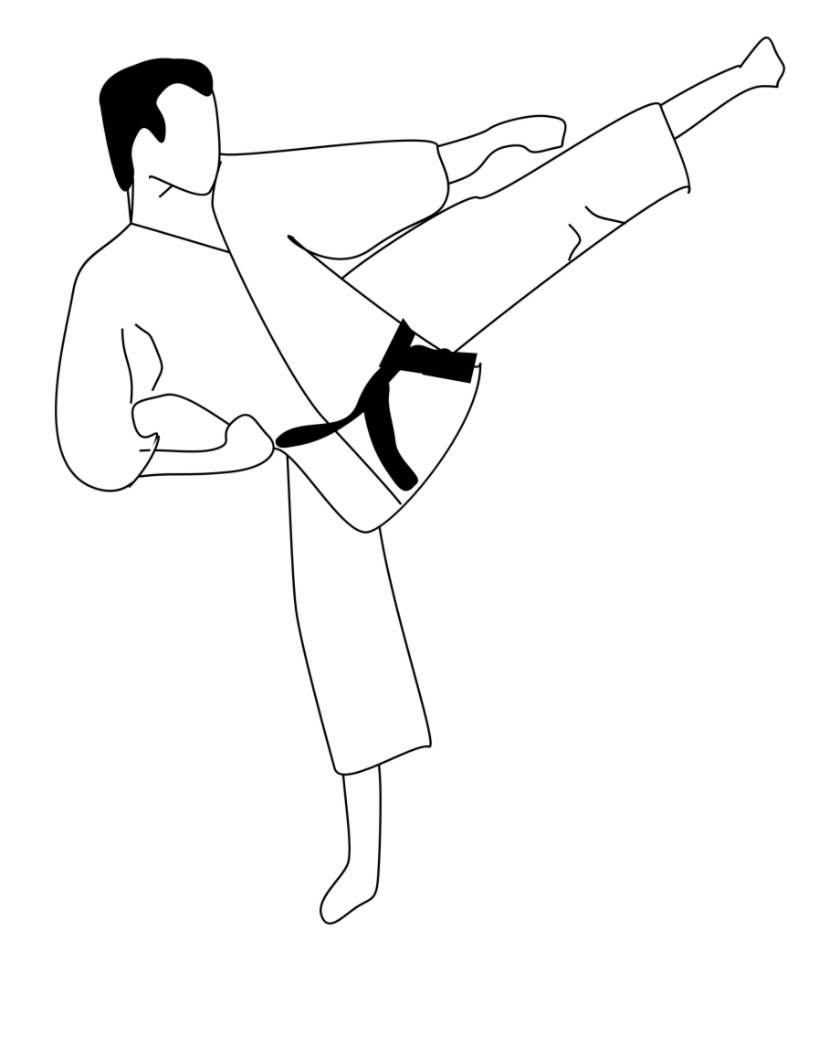
cycling
skiing
tennis
ice skating
judo
hockey
swimming
fencing
basketball
boxing
athletics
football
Notes:
For this game, you will need the handout that is available for you to download. Show learners how it is played by going over the names of the sports, to make sure that they know all the sports.

Slide 5
B2
hockey
Notes:
Choose a sport and say some clues to help the learners guess what sport you have chosen. Learners need to say the letter on the top first and then the number on the side.
Listen carefully to the clues.
This is a team sport.
It is played on an ice rink.
You need to wear a helmet on your head.
You kick the puck using a stick.
The aim is to shoot the puck into the opponent’s goalpost.
Do you know which sport this is? That’s right! It’s B 2 – hockey!

Slide 6
A4
boxing
Notes:
Clues:
This is a sport played by two people
It is played on a ring.
You need to wear gloves to cover your hands.
In this sport you need to punch your opponent to win.
Can you guess, which sport it is?

Slide 7
Choose a sport. Think about 4 to 5 clues to describe the sport. You can say something about:
where it is played,
if it is a team sport or an individual sport,
what you need to wear,
any equipment used
how to play this sport and its aim.

Slide 8
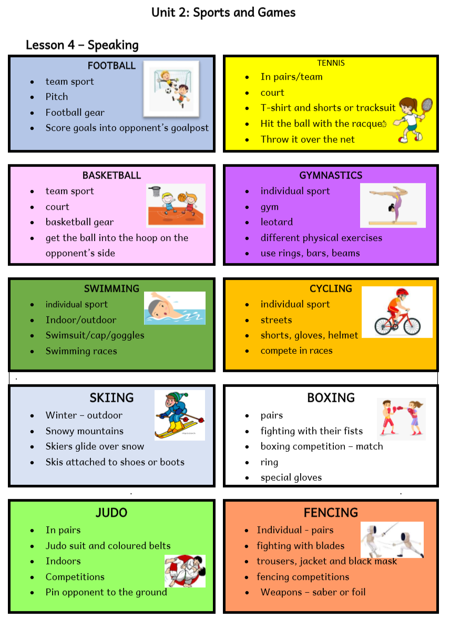
Useful Expressions
Hi. My name is…
I play ….
This sport is a ….
The aim is to…
I wear….
I play this sport ….

Slide 9
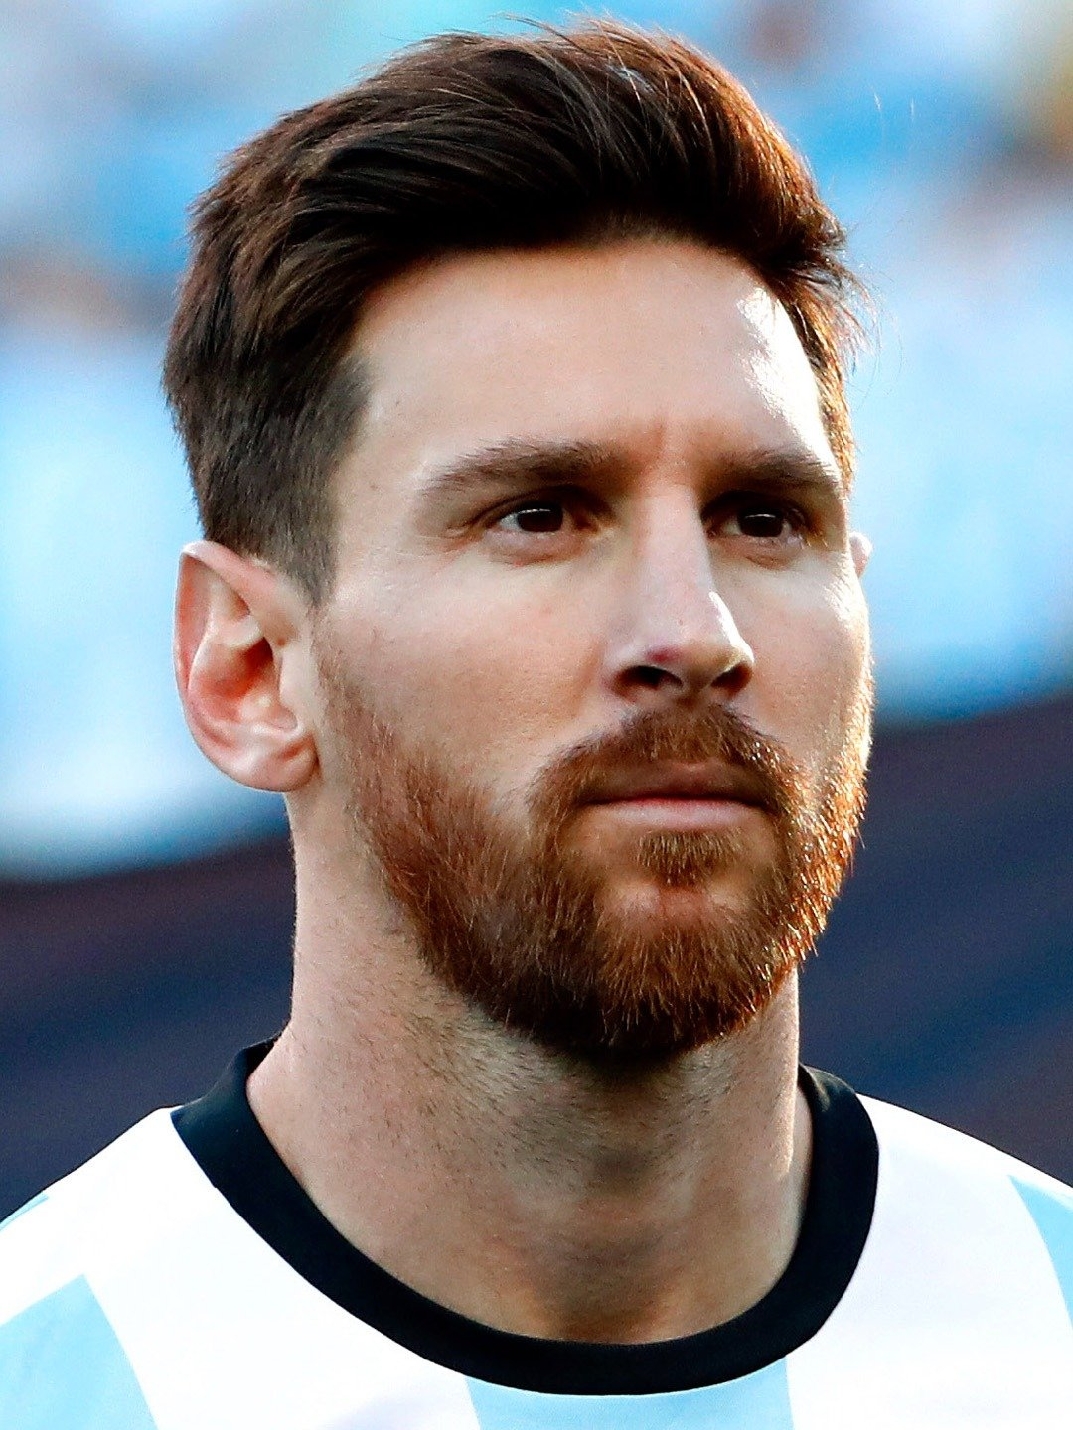
Useful Expressions
Hi. My name is…
I play ….
This sport is a ….
The aim is to…
I wear….
I play this sport ….
I like this sport because…
Lionel Messi
My name is Lionel Messi. I play football with Barcelona FC. Football is a team sport. The aim is to score a goal into the other team’s goal post. To play football, I wear a kit, socks and football shoes. I play this sport on a pitch. I like football because I love running.
Notes:
Do you know who this person is? This is Lionel Messi, a famous football player. Let’s see what he has to say about his favourite sport.
Have learners do the same for the next sport personalities.

Slide 10
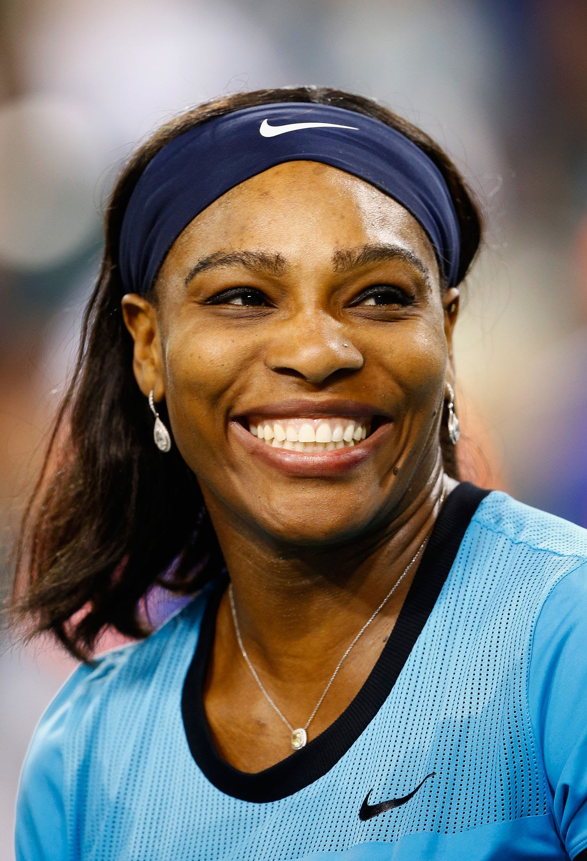
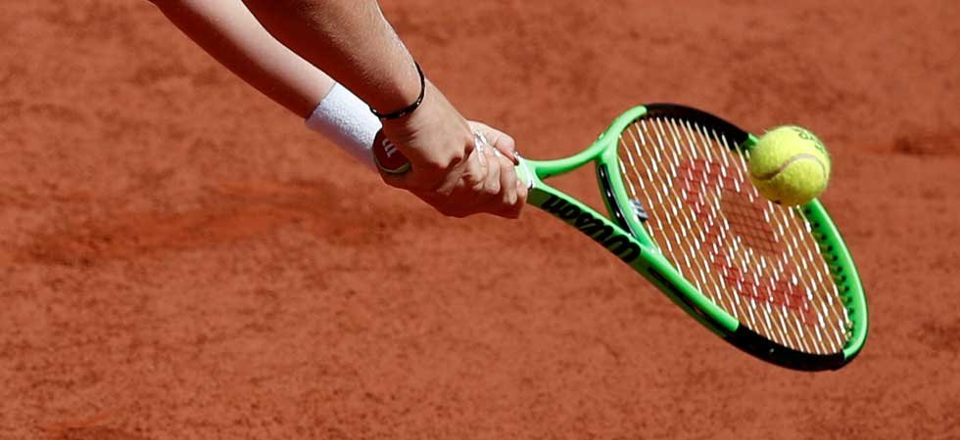
Useful Expressions
Hi. My name is…
I play ….
This sport is a ….
The aim is to…
I wear….
I play this sport ….
I like this sport because…
Serena Williams
My name is _____________. I play ________. This sport is played _________. The aim is to ____________. To play _________, I use a _________ and a _____________. I play this sport ____________. I like _______ because_________.

Slide 11
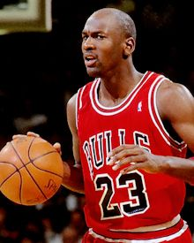
Useful Expressions
Hi. My name is…
I play ….
This sport is a ….
The aim is to…
I wear….
I play this sport ….
I like this sport because…
Michael Jordan
My name is ____________. I play ________. _________ is played _________. The aim is to ____________. To play _________, I wear a _____________. I play this sport ____________.

Slide 12
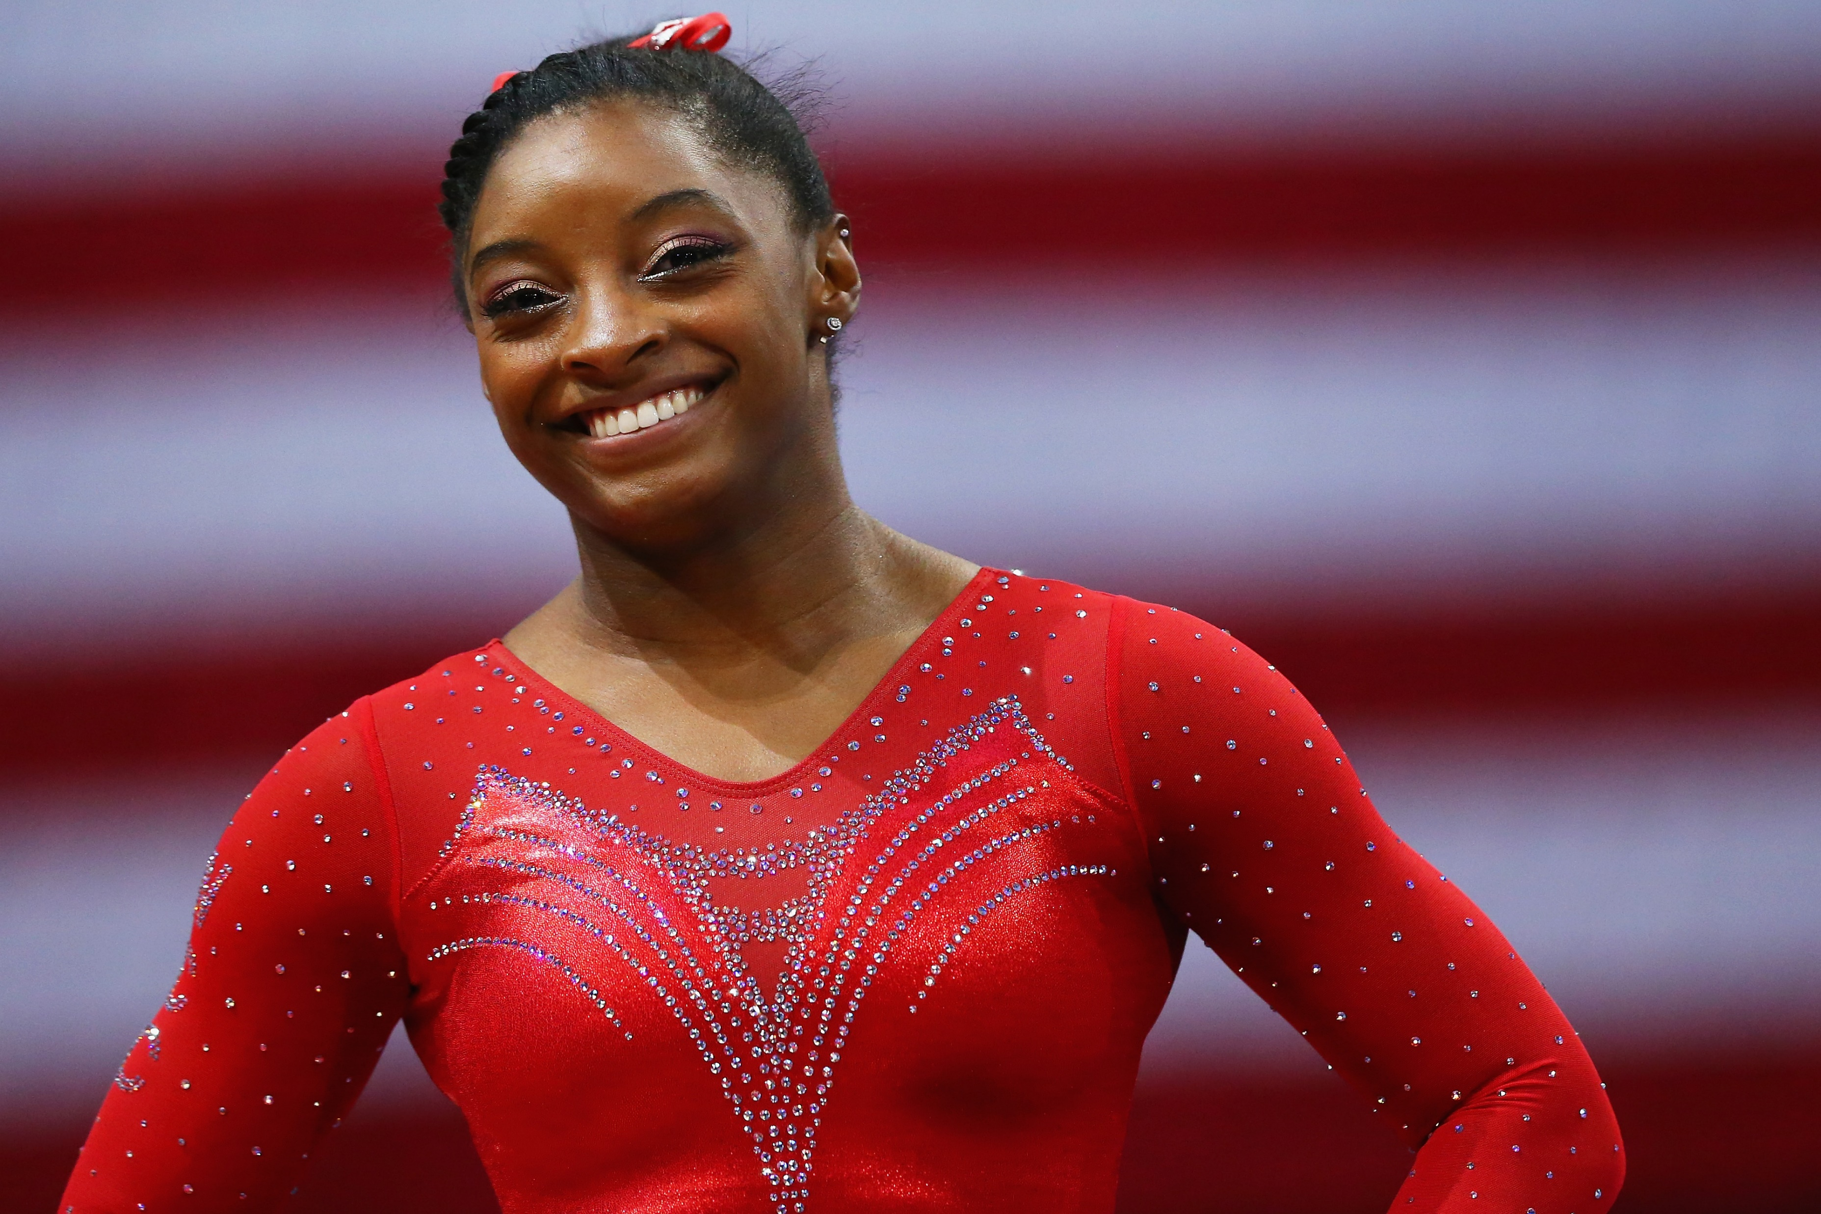
Useful Expressions
Hi. My name is…
I play ….
This sport is a ….
The aim is to…
I wear….
I play this sport ….
I like this sport because…
Simone Biles
My name is ____________. I practise ________. _________ is played ________. I wear a _____________. I practise this sport in a ____________. I like gymnastics because________.

Slide 13
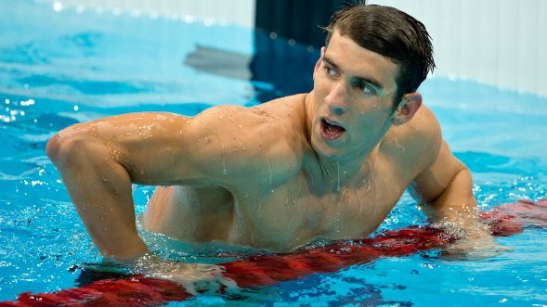
Useful Expressions
Hi. My name is…
I play ….
This sport is a ….
The aim is to…
I wear….
I play this sport ….
I like this sport because…
Michael Phelps
My name is ____________. My favourite sport is _________. I wear _____________ and a __________. I practise this sport in a ____________. I like ________ because________.

Slide 14
Now it’s your turn!
Useful sentence starters
Hi. My name is…
I play ….
This sport is a ….
The aim is to…
I wear….
I play this sport ….
My name is ____________. ______________________________________________________________________________________________________________________________

Slide 15
Now, tell us about your favourite sport.
Use the picture you have drawn about your favourite sport.
The list of Useful Expressions can help you start your sentences.
Useful Expressions
Hi. My name is…
I play ….
This sport is a ….
The aim is to…
I wear….
I play this sport ….
I like this sport because…
Notes:
Learners refer to the picture they drew of the sport they practise or would like to practise
Have learners record their descriptions on Vocaroo or Flipgrid.

Slide 16
Now, tell us about your favourite sport.
Use the picture you have drawn about your favourite sport.
The list of Useful Expressions can help you start your sentences.
Useful Expressions
Hi. My name is…
I play ….
This sport is a ….
The aim is to…
I wear….
I play this sport ….
I like this sport because…
Notes:
Learners refer to the picture they drew of the sport they practise or would like to practise
Have learners record their descriptions on Vocaroo or Flipgrid.

