Slide 1
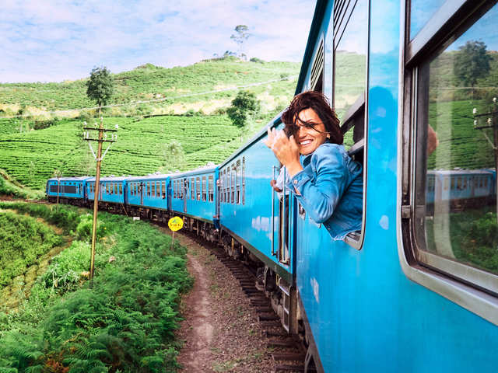
Lesson 5: Literature Topic: Travel Year: 4

Slide 2
Lesson Objectives:
I will:
read a text silently and aloud.
listen to the text being read aloud.
answer questions about the poem.
learn the meaning of personification and alliteration.

Slide 3
Download these resources:
Poem Handout
Poem Worksheet
Picture Worksheet
Answers Handouts

Slide 4
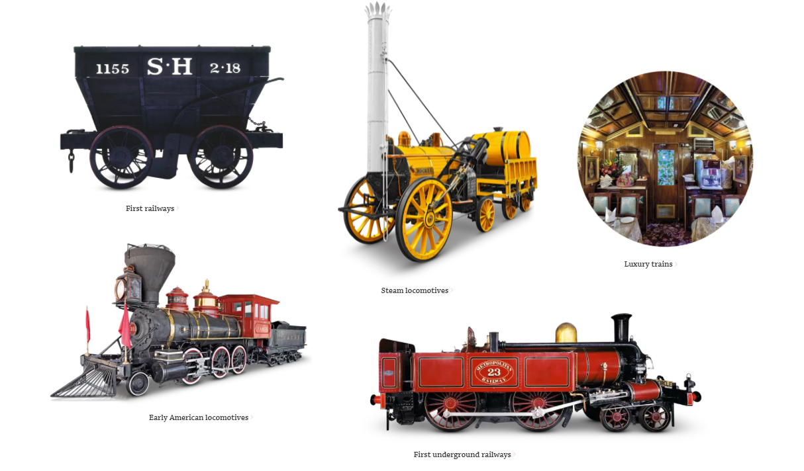
Pre-Task:
CLICK on this link to learn about the history of trains.
https://www.dkfindout.com/us/transportation/history-trains/

Slide 5
New Vocabulary:
engine = a machine that uses energy from fuel or electricity
snort = to force air through the nose with a harsh sound
pant = a hard or quick breath
laboured = produced or done with effort
roaring = making or uttering a roar
dragged = pulled along forcefully
puffed = out of breath

Slide 6
Step 1:
View this video clip - The Song of the Engine
https://www.youtube.com/watch?v=UXiuDr7jTPM

Slide 7
What is the poem about?
The poem is about a train describing its very own journey and the difficulties it encounters on the way. The engine says words of encouragement to itself. When it reaches its destination, the train feels very proud.

Slide 8
Step 2:
Watch the video clip again.
https://www.youtube.com/watch?v=UXiuDr7jTPM

Slide 9
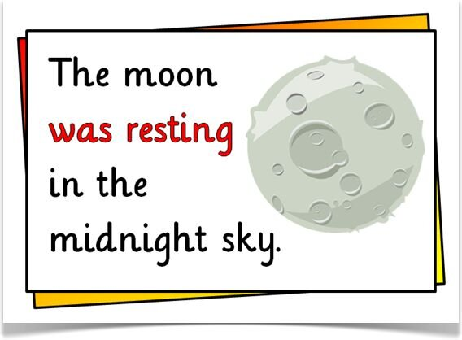
Personification is when you give an animal or object qualities or abilities that only a human can have.
Personification is what writers use to bring non-human things to life. It helps us better understand the writer's message.

Slide 10
Step 3:
Watch and listen to this nursery rhyme.
It makes use of personification.
https://www.youtube.com/watch?v=sJiw-edttDY

Slide 11
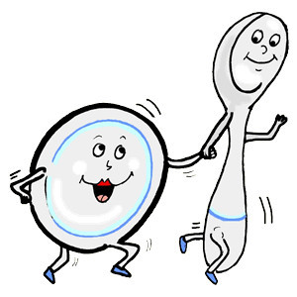
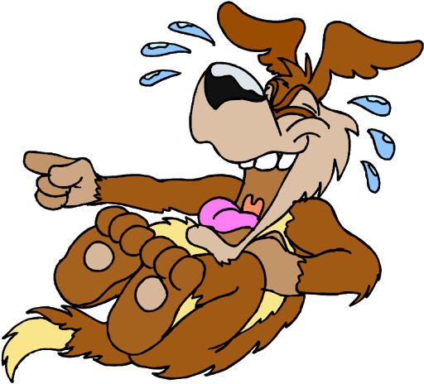
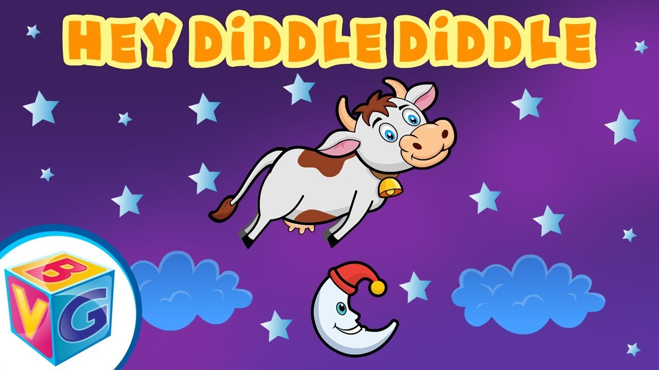
Can a cow jump over the moon?
Can the little dog laugh?
Can the dish run away with a spoon?

Slide 12
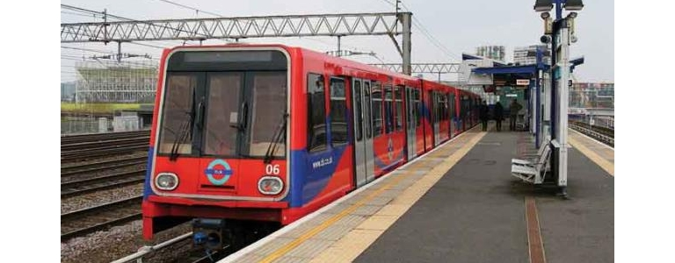
Step 4:
READ the poem silently on your handout.
Try to ANSWER the following questions.
What does the phrase ‘laboured with a will’ mean?
In the last stanza, the author uses several words which start with the same letter. This is called alliteration. Find two sets of words.
Give another title for this poem.

Slide 13
Step 5: Let’s discuss the questions.
What does the phrase ‘laboured with a will’ mean?
The train kept going on and did not give up.
In the last stanza, the author uses several words which start with the same letter. This is called alliteration. Find two sets of words.
‘rickety rackety rack’, ‘roaring rushing race’
Give another title for this poem.
Various titles such as ‘Daring Train’, ‘Willing train’ or ‘Never give up!’

Slide 14
Step 6:
LISTEN to me while I read the poem and the questions.

Slide 15
Step 7:
READ the poem and then ANSWER all the questions.

Slide 16
Step 8:
When you answer all the questions REVISE all the answers.

Slide 17
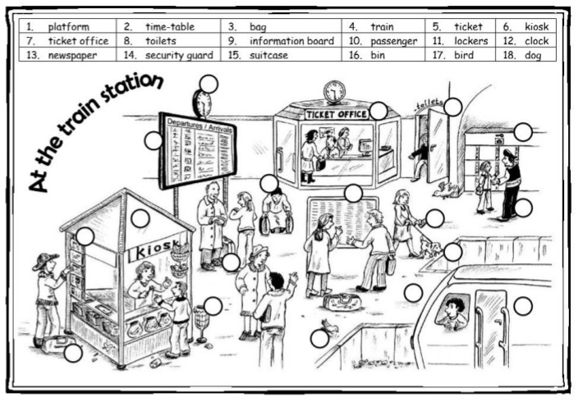
Post- Task: Look at the picture of the train station and fill in with the numbers.

