Slide 1
Lesson 1 Listening
Year 5
English

Slide 2
Lesson Objectives
You will:
listen attentively to a text.
answer questions about the text.
learn how to use the dictionary to find the meaning of new words.

Slide 3
Lesson Resources
Dictionary
Questions Worksheet
Answers Handout

Slide 4
Picture 1
What is happening in this picture?
How does this picture make you feel?

Slide 5
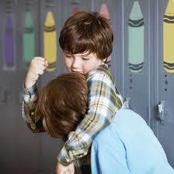
Picture 2
What is happening in this picture?
How does this picture make you feel?

Slide 6
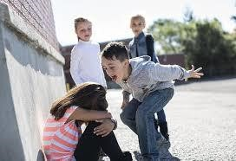
Picture 3
What is happening in this picture?
How does this picture make you feel?

Slide 7
Think!
What does bullying mean to you?
How do you think you can stop bullying?

Slide 8
Using a dictionary!

Slide 9
New words
expert …
someone with special skills or knowledge of a subject

Slide 10
New words
mean horrible
played tricks
geek jealous
advice trust

Slide 11
Step 1
Read the questions in the worksheet.

Slide 12
Step 2
Listen to the text carefully.
You can start answering the questions.

Slide 13
Step 3
I will read the questions to you once.
Listen to the exercises and complete them.

Slide 14
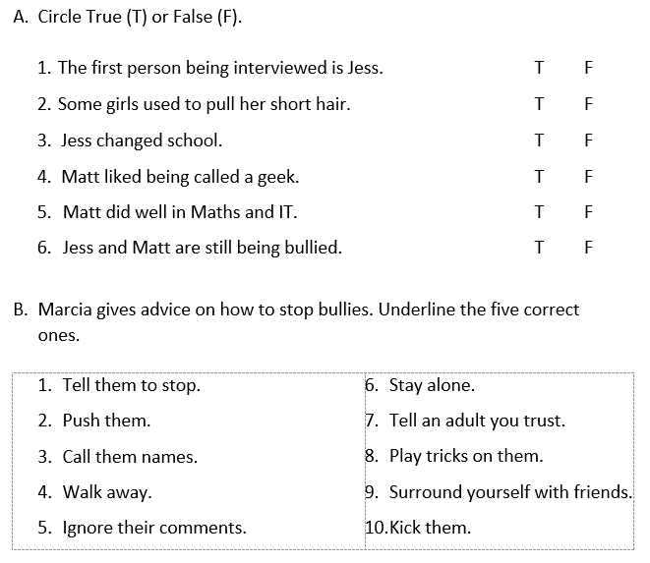

Slide 15
Step 4
Listen to the text for the second time.
I will then read the questions for you.
Try to fill in the rest of the answers.

Slide 17
Step 5
Revise your answers.

Slide 18
Step 6
Check your answers
using the
Answers Handout.

Slide 19
Final Task
What should you do if you experience bullying?
Share the advice which,
Marcia shared with her listeners.

Slide 20
Thank You!

