Slide 1
Lesson 4 Speaking
Year 5
English

Slide 2
Picture Prompt

Slide 3
Lesson 4 Objectives
You will:
answer questions about a picture.

Slide 4
Lesson 4 Resources
Picture Handout

Slide 5
Listening Lesson
Four pupils share their opinions about
the use of tablets versus books at school.

Slide 6
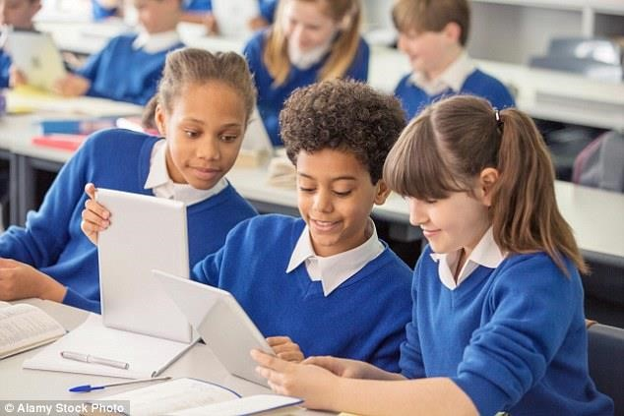

Slide 7
Questions
What can you see in the picture?
What do you think the people in the picture are doing?
Describe one of them.
What do you think happened just before the picture was taken?
What do you think happened just after the picture was taken?
What was the first thing that you noticed when you saw this picture?
Who do you think took this photo?
What do you like about this picture? Why?
What do you think of the use of tablets in classes?
Do you prefer using tablets or books? Why?

Slide 8
Presentation

Slide 9
Lesson 4 Objectives
You will:
gain useful information for planning a presentation.
learn the success criteria to build and deliver a presentation.

Slide 10
Lesson Resources
PowerPoint Presentation/Chart
Success Criteria Handout

Slide 11
Title:
Create a PowerPoint Presentation about the importance of staying safe online
and how to stay safe online.
(You can use a chart.)
You can use the information you READ during the Reading Lesson, and the information you LISTENED to and READ during the Literature Lesson.

Slide 12
Going Online
We go online for lots of reasons:
to watch TV shows;
to play games;
to watch videos;
to talk to friends;
to find out things;
to do homework.
The Internet can be loads of fun!
When do you go online?
Why do you go online?

Slide 13
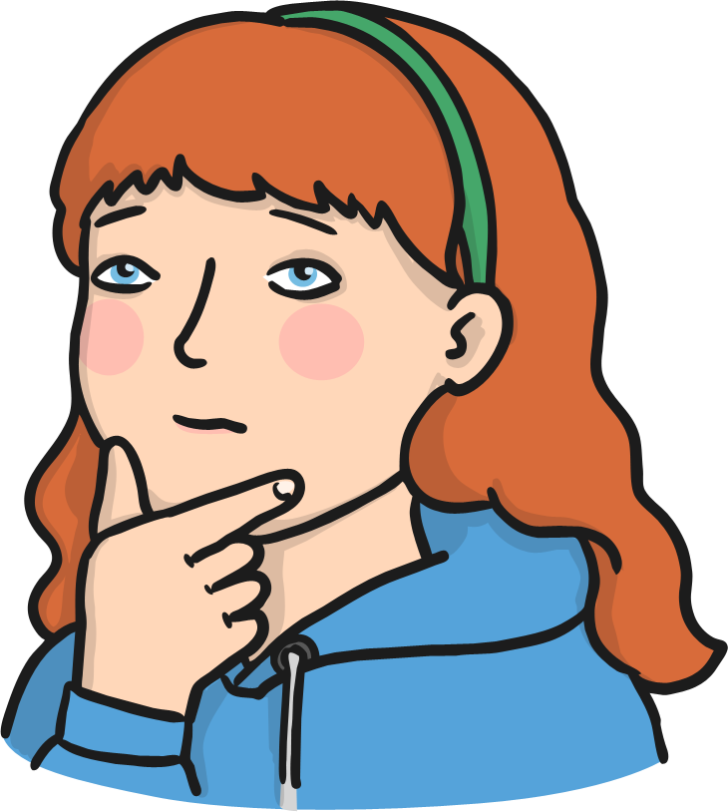
But…
Who do you think owns the Internet?
Who do you think decides what can be put on it?
Who makes sure the things on the Internet are truthful and real?
No one owns the Internet. No one decides what can be put on it.
It can be used by everyone and everyone can add things to it!
Do you think you can trust everything
and everyone on the Internet?

Slide 14
Stay safe online
Remember anyone can use and add things to the Internet, which means that we can’t always trust what we find.
We can’t always trust the people who want to talk to us on the Internet.
We can’t always trust the websites on the Internet. Some may have viruses that can stop our computers from working properly!

Slide 15
How to stay safe:
Try to only use websites you know can be trusted. If you aren’t sure – ask an adult!
As much as possible, try to use websites that are meant for children.
Remember - some people will pretend to be children to talk to you. Never give out your name or address! We don’t really know who we are talking to when we chat on the Internet.
Never arrange to meet an online friend without telling an adult!
Remember if you aren’t sure about anything, ALWAYS ASK A GROWN UP.

Slide 16
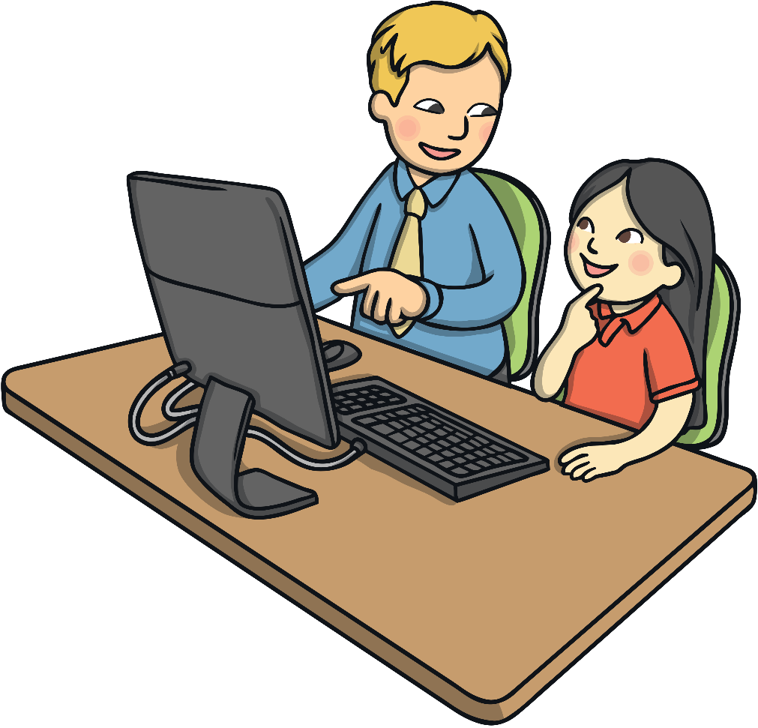
What do you do if you’re upset?
The most important thing to remember is that if you see something that upsets you, you must tell an adult. It might be a grown up you live with or a teacher at school.
They can help you to report the thing you saw.
They can talk to you and make you feel OK.
They can help you find a website that is more trustworthy.
They can help stop the bullies from hurting other people too.

Slide 17
What should you do?
If you see someone else being bullied online, don’t join in or be nasty to the bullies. Tell an adult.
Don’t write unkind things about other people, or use nasty words. You can’t see the person – but it will still hurt them!

Slide 18
Be SMART when using the Internet
S
Safe: You wouldn’t give a stranger on the street personal information, so don’t do it online. Stay safe by not posting or sharing information (name, address, password etc.).
M
Meeting: It is dangerous to meet someone that you have talked to online but never met. Never go without telling someone and always ask permission from parents or carers - they need to come with you!
A
Accepting: There are loads of ways to download information on the Internet. Accepting emails, internet messages, text or pictures from a source you don’t know (a person or company etc.) may contain viruses or inappropriate information!
R
Reliability: Just because it is on the Internet, it does not mean it is true. Anyone can add or edit information on the Internet, or even lie about who they are! Try to stick to websites you trust for information and only chat to friends and family.
T
Tell: If anything happens that leaves you feeling worried or uncomfortable when using the Internet, you need to tell someone. The best people to talk to are trusted adults - parents, carers, teachers etc.

Slide 19
Success Criteria!
Success criteria are a list of steps you have to follow or a list of features you are to include in your task. They will make you aware of what is expected and help you self-assess your work.

Slide 20
Thank You!

