Slide 1
Lesson 2 Reading
Year 5
English

Slide 2
Lesson Objectives
You will:
learn what is a children’s laureate and names of children’s laureates.
how to use the dictionary to find the meaning of new words.
read a text silently.
answer questions about the text.

Slide 3
Lesson Resources
Dictionary
Reading Text
Questions Worksheet
Answers Handout

Slide 4
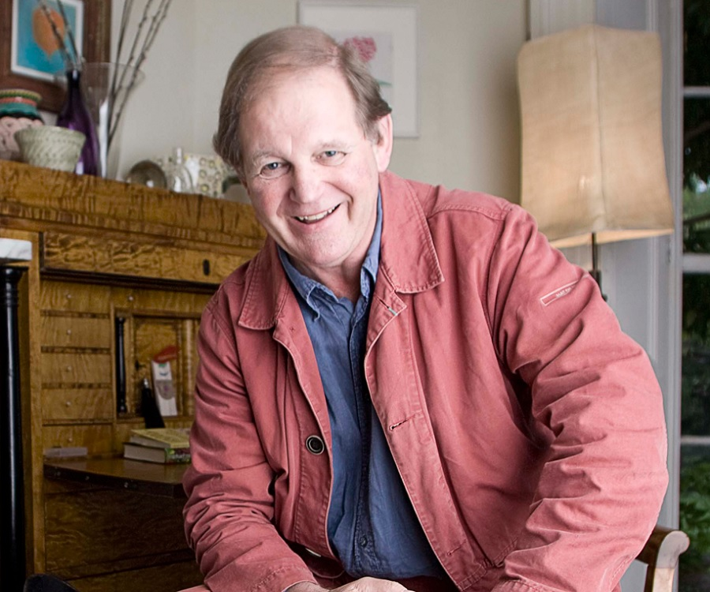
Picture 1
Sir Michael Morpurgo

Slide 5
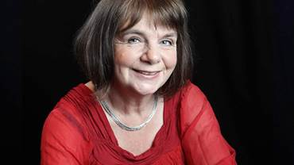
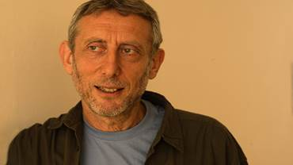
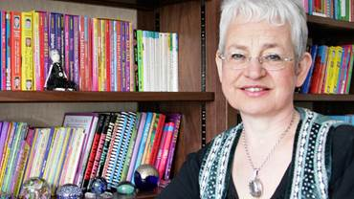
Children’s Laureate
Julia Donaldson
Michael Rosen
Jacqueline Wilson

Slide 6
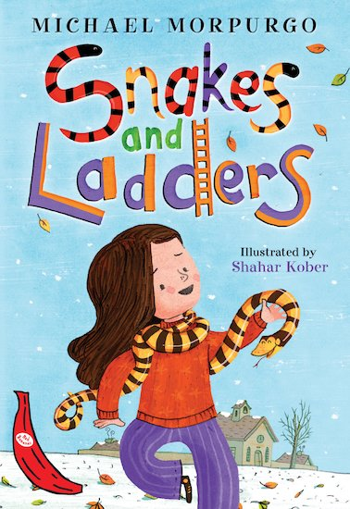
Picture 2
Snakes and Ladders
by
Michael Morpurgo

Slide 7
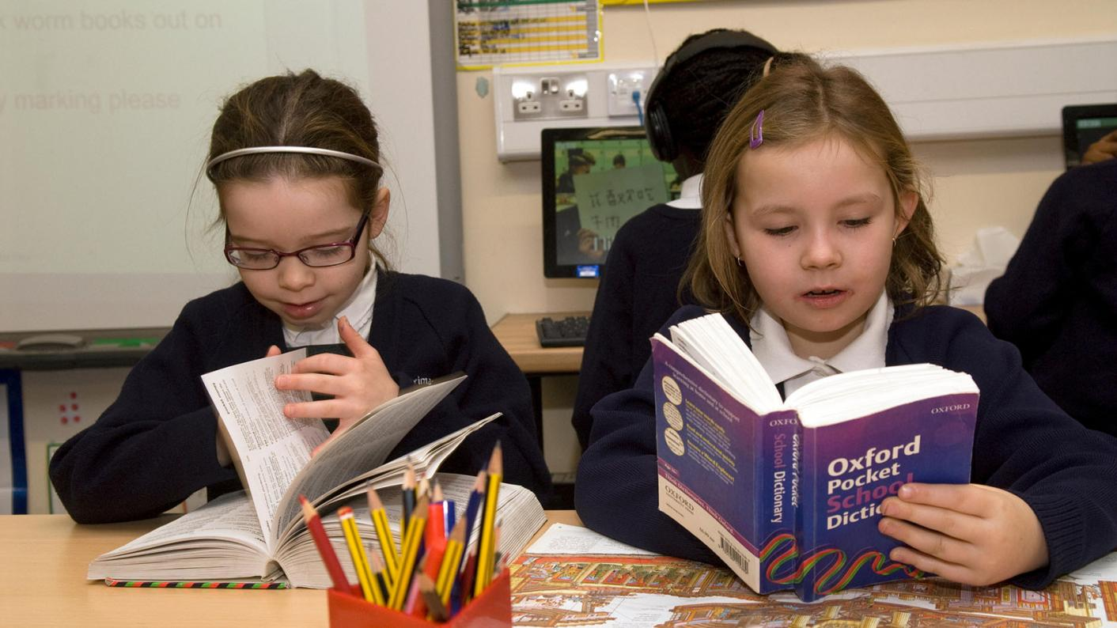
Using a dictionary!

Slide 8
New words
chorused …
something said or expressed by a lot of people at the same time

Slide 9
New words
whirling Nativity
exhibition
yawn sniggered
soggy

Slide 10
Step 1
READ THE HANDOUT WITH THE TEXT AND THE WORKSHEET WITH THE QUESTIONS.

Slide 11
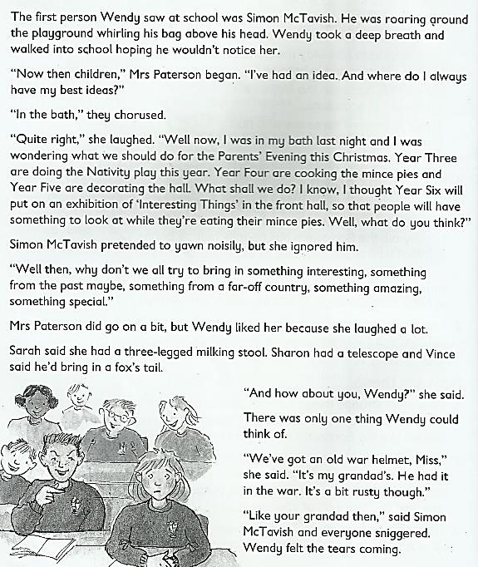

Slide 12
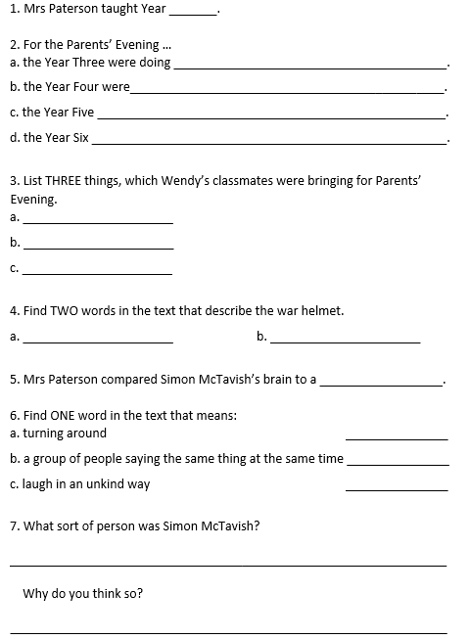
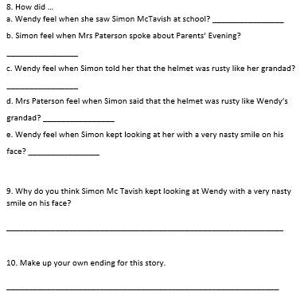

Slide 13
Step 1
Questions:
What was the text about?
Did you like reading it?
How did it make you feel?

Slide 14
Step 2
READ THE TEXT AND QUESTIONS AGAIN.

Slide 15
Questions
What did Wendy do when she saw Simon in the playground?
Where did Mrs Paterson get her best ideas?
Did Wendy like Mrs Paterson?
Was Simon a nice student? Why?

Slide 16
Step 3
Work out the
Questions Worksheet.

Slide 17
Step 4
Revise your answers.

Slide 18
Step 5
Check your answers
using the
Answers Handout.

Slide 19
Thank You!

