Slide 1
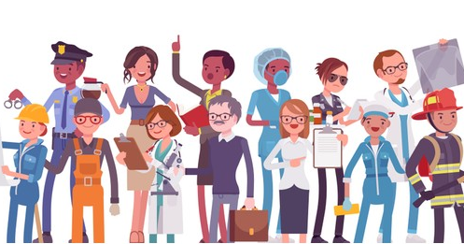
Jobs and Occupations
Lesson 1 - Listening

Slide 2
Notes for the Educator
This lesson is pegged directly to Learning Outcome 6.1.1.Demonstrate enjoyment, interest and attentiveness during listening and viewing activities.
The material for this lesson was adapted from Cambridge Global English Stage 5
Teachers are to refer to the Scheme of Work where each lesson is explained in more detail.
Effects are included to make the presentation more interactive. Please present the PowerPoint in Slideshow mode.
Wherever possible we have included the use of online apps to enhance the teaching and learning experience.
The Notes section underneath the slides may contain some further points which can be developed during the lesson.
Teachers are encouraged to adapt this PowerPoint presentation to meet the learners’ language needs.
Tasks included in the PowerPoint presentation are also being shared as worksheets.
For any comments, feedback or suggestions please email us at: marie-claire.camilleri@ilearn.edu.mt; urieth.attard@ilearn.edu.mt; and mary.jude.camilleri@ilearn.edu.mt. You may also call the office on: 25983683.

Slide 3
Listen to the top 5 most unusual jobs!
Read an interview about an exciting but dangerous job.
Read and respond to a poem about choosing a future job.
Ask questions and talk about the job you would like to do when you grow up.
Write an advert for a job.

Slide 4
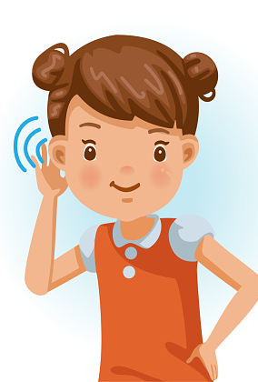
I am learning how to listen for specific information.
I can identify certain information while listening.
I can listen attentively to the listening text.
I am able to complete the tasks.

Slide 5
Pre-Listening:
Think about what kind of jobs the people in your family have. Do they like their jobs? Why or Why not?

Slide 6
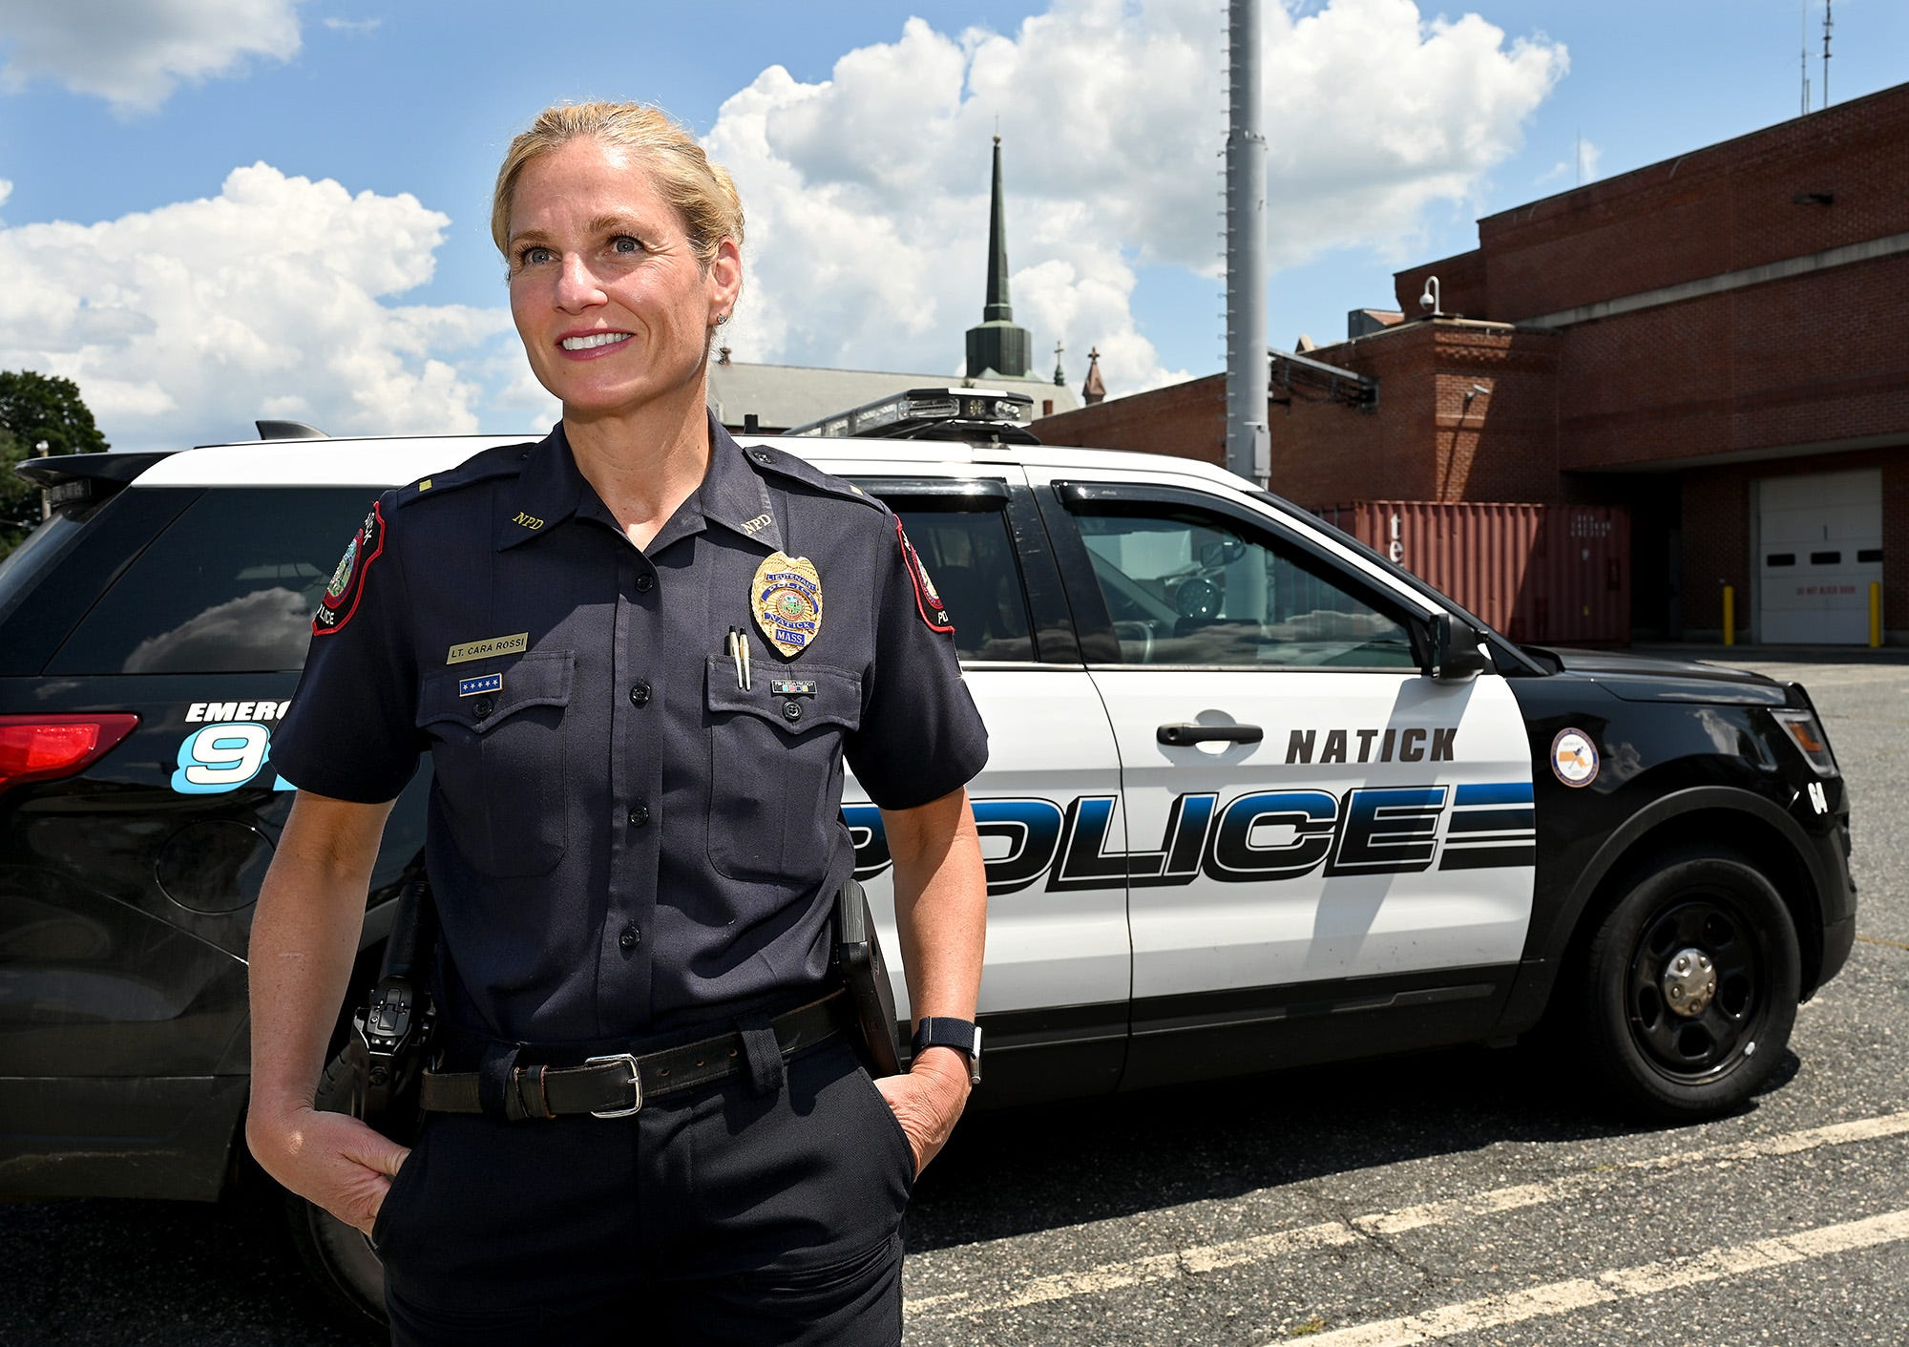
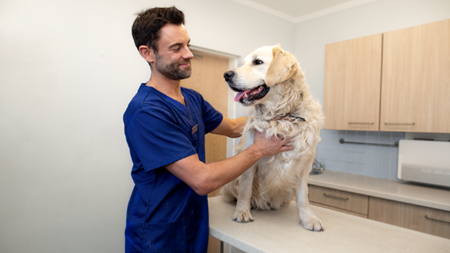
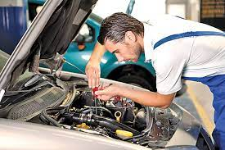
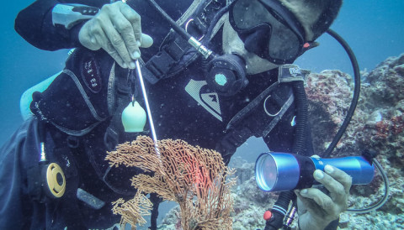
Science teacher
police officer
vet
mechanic
marine biologist
Notes:
Right, now have a look at the pictures and try to guess what job each picture shows. So, first we have…
that we have guessed what jobs these people do let’s think of two things that each person does.

Slide 7
Notes:
For example, we can say that the job of a vet is to treat sick animals and advise animal owners about the proper care for their pets. Now can you do the same for the other jobs?

Slide 8
fruit cleaner
pet detective
ostrich babysitter
elephant dancer
pet food eater
golf ball diver
Notes:
Take some time to look at these pictures of unusual jobs. One of them is not real. Which one do you think it is? What do you think the other jobs involve?
-

Slide 9
Listening Task 1:
Listen to these unusual jobs. Mark the correct order of these jobs. Cross out the one which is not mentioned.
Notes:
Great! Now, we are ready to listen to the audio for today. In today’s listening text we are going to listen to a lady describing the top 5 most unusual jobs.

Slide 10
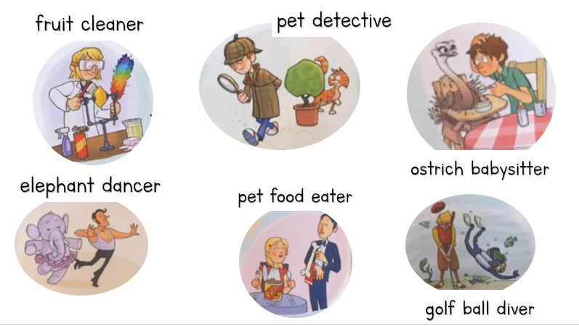
Task 1: Mark the correct order of these unusual jobs.
3
4
2
5
1
Notes:
Which job isn’t mentioned? Which of these unusual jobs would you like to try? Why? Which one would you never do? Why?

Slide 11
Listening Task 2:
Which of these jobs involves…

Slide 12
Task 2: Which of these jobs involves…:
using chemicals and hot steam _____________
tasting the food animals usually eat _____________
roaming the streets looking for clues ______________
spending a lot of time in lakes or ponds ____________
reading while working _____________
fruit cleaner
pet food eater
pet detective
golf ball diver
ostrich babysitter

Slide 13
Listening Task 3:
Are these statements True or False? Correct the wrong answers.
Notes:
Now, we are going to listen to the audio for the 3rd time. In our final task we need to tick whether the statements are True or False. We also need to correct the wrong answers, so you might need to take down notes while listening.

Slide 14
Task 3: Are these sentences True or False?
 |  | True | False
a. | Pet food testers don’t usually eat the food.
b. | Fruit cleaners work in supermarkets.
c. | There is a film about a pet detective.
d. | Looking after ostriches is a very busy job.
e. | Golf ball divers give the ball back to the golfers.

Slide 15
Task 3: Are these sentences True or False?
a. | Pet food eaters don’t usually eat the food.
b. | Fruit cleaners work in supermarkets.
c. | There is a film about a pet detective.
d. | Looking after ostriches is a very busy job.
e. | Golf ball divers give the ball back to the golfers.
don’t work in supermarkets.
quiet.
collect the balls to resell in golf shops.

Slide 16
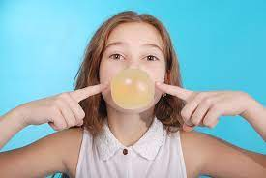
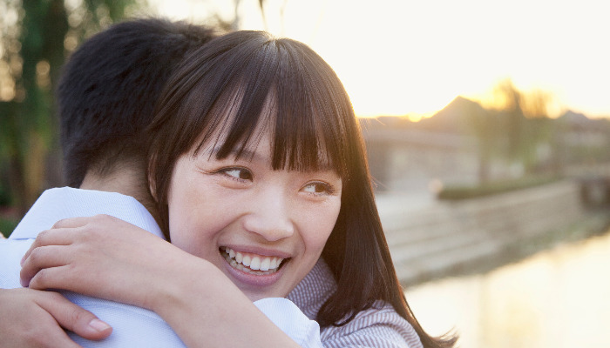
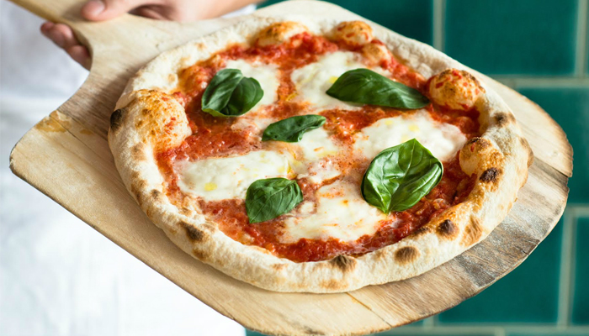
Make up an unusual job.
Notes:
Now, as an ending to this lesson, I would like you to make up an unusual job. Besides the ones we have looked at already there are some other examples of unusual jobs. Did you know for example that you can get paid money to be a paper towel sniffer? They sniff paper towels for manufacturers to make sure they don’t have any undesirable smells.
If you enjoy giving hugs, you can become a professional hugger. You get to hug somebody, and you get paid too!
A gum chewer chews gums to see how long the flavour lasts. You’re only required to blow a few bubbles and tell your boss how the gum tastes!
Why not become a pizza taster – all you need to do is to give feedback on the restaurant’s menu of cheesy, saucy pies. You have to know your margherita from your marinara but you’ll also get to enjoy different pizzas and toppings, which all in all, isn’t so bad! You might need to get a gym membership, but it might be worth it!

Slide 17
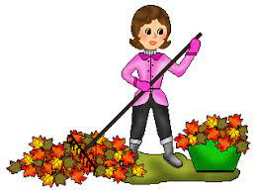
Make up an unusual job.
Leaf cleaners clean leaves in gardens to make them look tidy and nice.
Notes:
So now, I would like you to think of or make up un unusual job. Think of what the job involves and give it a name. Write a short description about it.

Slide 18
Thank you for using this resource. Check out our latest resources below.

