Slide 1
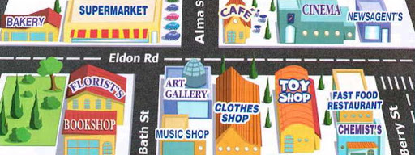
Places and Directions
Lesson 1: Listening

Slide 2
Notes for the Educator
This lesson is pegged directly to Learning Outcome LS 5.2 I can understand audio-visual texts across a range of genres, identifying the main idea and specific information.
It also targets other language outcomes such as: LS 5.8 I can communicate my own experiences, likes and dislikes fluently and accurately with some allowance to self-correct in the process.
The material for this lesson was adapted from: https://learnenglishkids.britishcouncil.org/poems/the-way-the-park
Teachers are to refer to the Scheme of Work where each lesson is explained in more detail.
Effects are included to make the presentation more interactive. Please present the PowerPoint in Slideshow mode.
Wherever possible we have included the use of online apps to enhance the teaching and learning experience.
The Notes section underneath the slides may contain some further points which can be developed during the lesson.
Teachers are encouraged to adapt this PowerPoint presentation to meet the learners’ language needs.
Tasks included in the PowerPoint presentation are also being shared as worksheets.
For any comments, feedback or suggestions please email us at: marie-claire.camilleri@ilearn.edu.mt; urieth.attard@ilearn.edu.mt; mary.jude.camilleri@ilearn.edu.mt. You may also call the office on: 25983683.

Slide 3
Listen to directions to get to the park.
Read a website article about an exciting city.
Read and respond to a poem about living in a busy town.
Give directions to different places in town.
Write directions by using a map.
Notes:
Let me give you a brief outline of what we will be doing in the next five lessons. In the first lesson we will listen to directions to find our way to the park. In our Reading lesson we will read a website article about the capital city of England, London. In our Literature lesson, we will read a poem about a child who lives in a busy town. In our speaking lesson we shall use a map to practise giving directions. And, finally in our writing lesson we will use a map to write directions for a tourist who needs to get to different places in London.
As usual, for these lessons you will need to have with you the following things: a mini whiteboard, a pencil, a rubber and any handouts that are needed for the lesson
Remember that you can pause the lesson whenever you want, so you will have time to work the tasks for each lesson.

Slide 4
I am learning how to listen and respond to an audio-text.
I can understand what the main idea is.
I can listen to specific details and keywords.
I am able to complete the tasks.
Notes:
In this lesson, we are learning how to listen and respond to an audio text. We will know that we are learning by showing that we understand what the main idea is, by listening to specific details and keywords, and by completing the tasks.

Slide 5
Think of all the places in your town.
Make a mind map to show all the places you know of.
Notes:
First, let’s start by writing down all the places in town we know of. You can write them down on a paper or on your mini whiteboard. You may write down a list or in the form of a web.

Slide 6
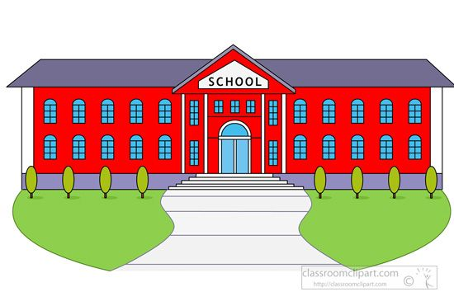
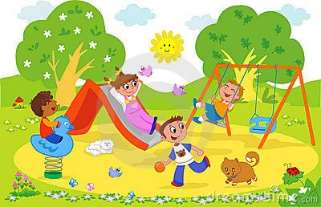
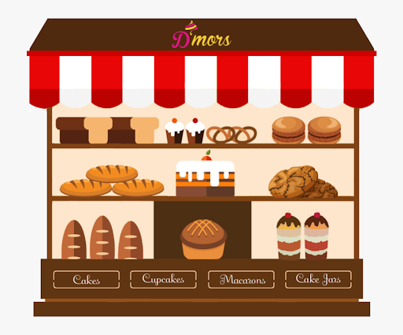
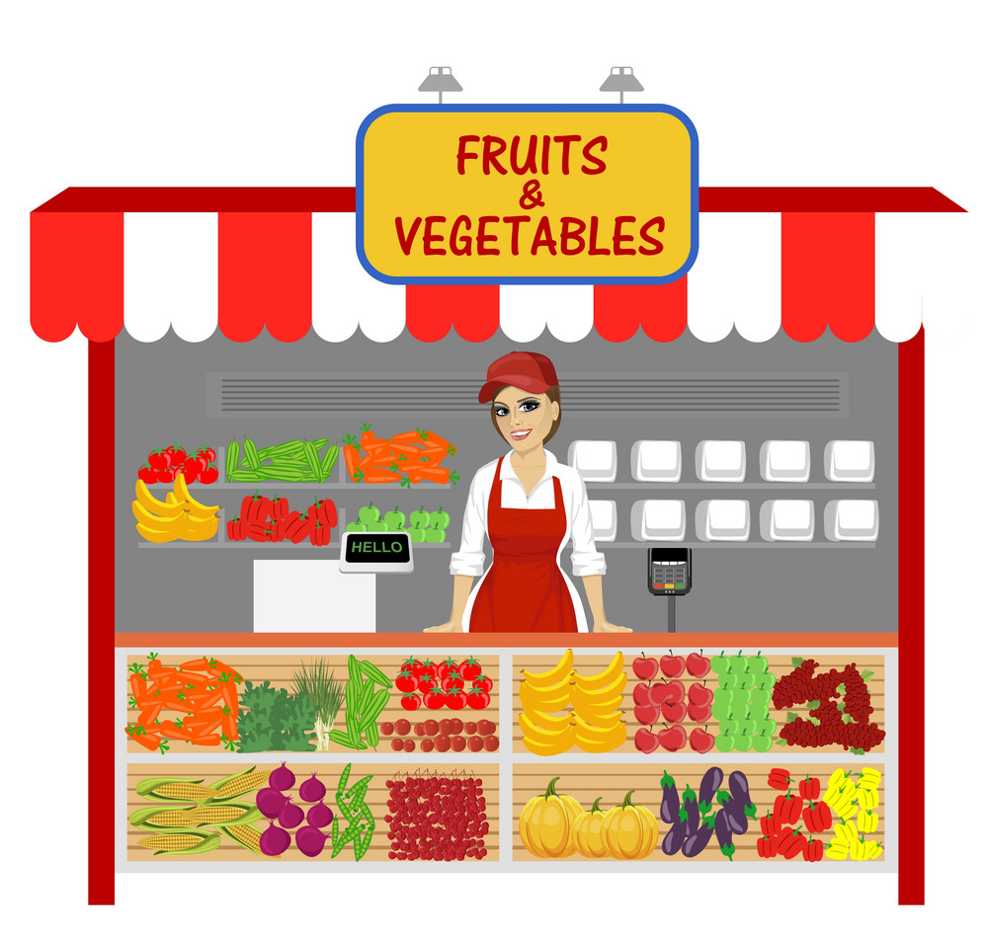
park
library
school
church
supermarket
Places in Town
bookshop
bakery
bank
green grocer
clinic

Slide 7
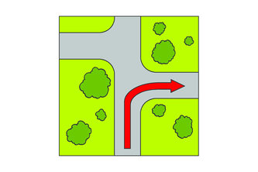
turn right

Slide 8
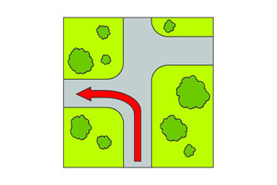
turn left

Slide 9
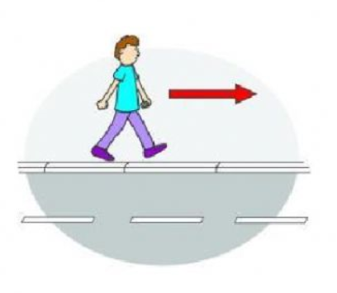
go along

Slide 10
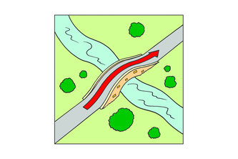
go over

Slide 11
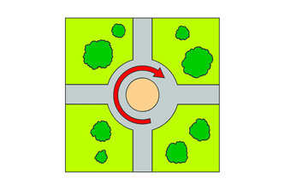
go round

Slide 12
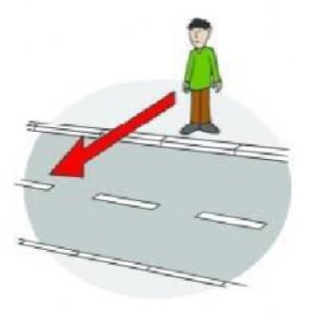
cross the road

Slide 13
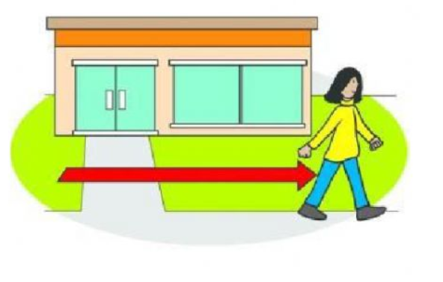
go past

Slide 14
Make a Prediction:
Where do you think the child wants to go?

Slide 15
1st Listening Task:
Listen carefully to the places mentioned in the poem.

Slide 16
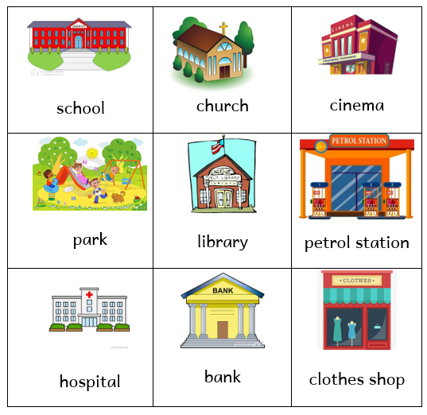
Task 1. Draw a circle around 5 places mentioned in the listening text.
Notes:
For our first task, we need to select 5 places mentioned in the poem.

Slide 17
2nd Listening Task:
What do you need to do at each of these places?
Notes:
Great. Next, we are going to listen to the audio-text for the 2nd time. This time, I would like you to listen carefully to the directions given at each of these places. You can keep the worksheet in front of you while you listen so you can tick the right answer.

Slide 18
Task 2. Listen carefully to the directions and choose what you need to do at each of these places.
At the school front gate,
○ turn left.
○ turn right.

Slide 19
Task 2. Listen carefully to the directions and choose what you need to do at each of these places.
When you see the library,
○ turn right.
○ cross the street.

Slide 20
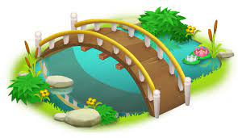
Task 2. Listen carefully to the directions and choose what you need to do at each of these places.
When you see a bridge,
○ walk past it.
○ go over it.

Slide 21
Task 2. Listen carefully to the directions and choose what you need to do at each of these places.
You need to
○ go past the bookshop.
○ turn left at the bookshop.

Slide 22
Task 2. Listen carefully to the directions and choose what you need to do at each of these places.
At the cinema,
○ turn left.
○ turn right.

Slide 23
3rd Listening Task:
Listen carefully to the rhyming words.

Slide 24
Task 3. Match the rhyming words.
like
feet
then
bike
street
dark
see
hen
park
tree
Notes:
Let’s match the rhyming words.

Slide 25
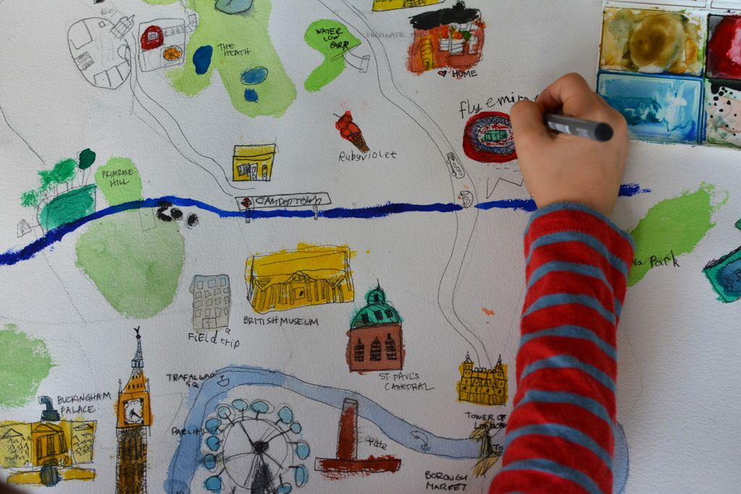
Can you give directions to a place in your town?
Notes:
As a follow up task, draw a simple town map. Make sure to put the important places in your town, you can refer to the list you wrote at the beginning of this lesson. You can also write down street names. Then practise giving directions from your house to a place of your choice by using the map.

Slide 26
Thank you for using this resource. Check out our latest resources below.

