Slide 1
Lesson 5 Writing
Year 5
English

Slide 2
Lesson 5 Objectives
You will learn:
how to create an informative poster.
the success criteria for writing a poster.

Slide 3
Lesson Resources
Title of Poster
Writing Frame Handout
Success Criteria Handout

Slide 4
What is a poster?
A poster is a large printed picture which includes pictures and text.
It needs to be eye-catching and informative.
It serves many functions such as
to inform and to advertise.

Slide 5
How should you plan your poster?
Design your poster. (Writing Frame)
Make it eye-catching.
Choose attention-grabbing pictures.
Use suitable colours.
Write a heading that will grab the reader’s attention and make them pause and think.
Write short, to-the-point phrases and sentences.
Include a catchy slogan.
A final reminder of the product or message.

Slide 6
Title
At school, you will be celebrating
Safer Internet Day.
Create a poster about this day
to display it on the school’s main door.

Slide 7
Pre-Writing
Identify audience.
Identify purpose.
Think about the topic.
Discuss the topic.
Gather ideas.
Take note.
Do freewriting.

Slide 8
Pay attention!
Genre:
POSTER
Audience:
YOUNG READERS
Purpose:
TO INFORM READERS ABOUT INTERNET SAFETY DAY
TO SHARE USEFUL TIPS ON HOW TO STAY SAFE ONLINE
GAP
G: GENRE
A: AUDIENCE
P: PURPOSE

Slide 9
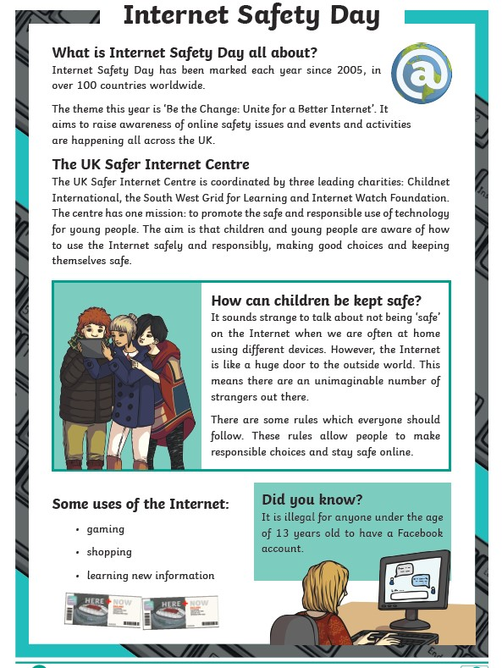
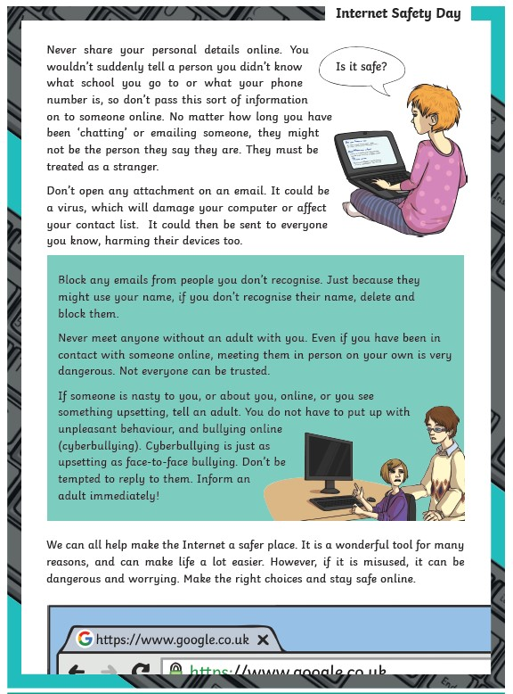
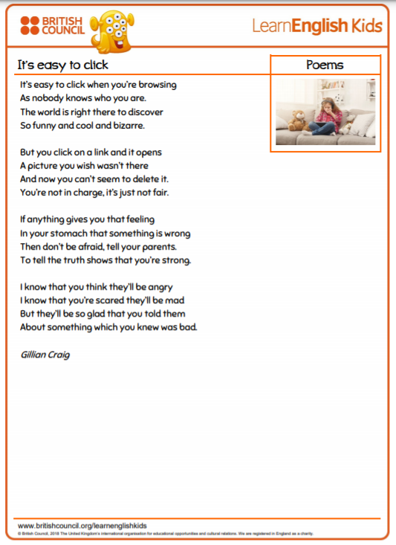
Check it out!
Reading Lesson - Internet Safety Day
Literature Lesson – It’s Easy to Click

Slide 10
Safer Internet Day - Tuesday 9th February 2021
The theme for Safer Internet Day 2021 is 'An internet we trust: exploring reliability in the online world’.

Slide 11
Watch the clip!

Slide 12
Drafting
Refer to your writing frame.
Sequence and organise ideas.
Put thoughts and ideas on paper
to create the first draft.

Slide 13
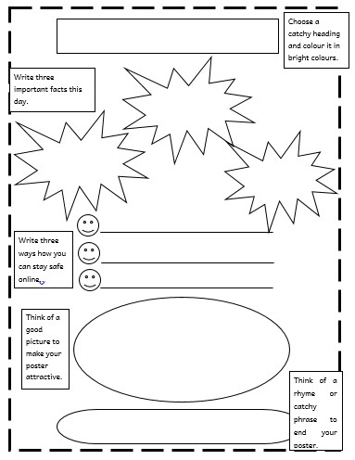
Writing Frame
Choose a catchy heading
and colour it brightly.
Write three important facts about this day.
Write three ways how you can stay safe online.
Include a picture to make your poster attractive.
End your poster with a rhyme or catchy phrase e.g. a slogan.

Slide 14
Revision
Check that writing is
on topic and appropriate.
Add relevant details.
Delete unnecessary words and details.
Look for logical order of ideas or events.

Slide 15
Editing
Apply changes.
Check grammar,
punctuation and spelling.

Slide 16
Publishing
Write your final copy neatly,
including all the revisions you made.
Read it.
Share it.

Slide 17
Success Criteria!
What are success criteria?
Success criteria are a list of steps you have to follow or a list of features you are to include in your task. They will make you aware of what is expected and help you self-assess your work.

Slide 18
Thank You!

