Slide 1
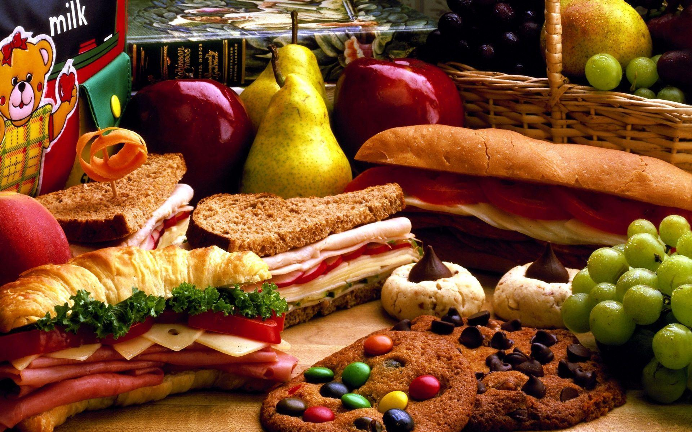
Let’s eat!
Lesson 4 - Speaking

Slide 2
Notes for the Educator
This lesson is pegged directly to Learning Outcome LS 5.8 I can communicate my own experiences, likes and dislikes fluently and accurately with some allowance to self-correct in the process.
Teachers are to refer to the Scheme of Work where each lesson is explained in more detail.
Effects are included to make the presentation more interactive. Please present the PowerPoint in Slideshow mode.
Wherever possible we have included the use of online apps to enhance the teaching and learning experience.
The Notes section underneath the slides may contain some further points which can be developed during the lesson.
Teachers are encouraged to adapt this PowerPoint presentation to meet the learners’ language needs.
Audio files or links to websites may be included.
Tasks included in the PowerPoint presentation are also being shared as handouts.
For any comments, feedback or suggestions please email us at: marie-claire.camilleri@ilearn.edu.mt; urieth.attard@ilearn.edu.mt; mary.jude.camilleri@ilearn.edu.mt. You may also call the office on: 25983683.

Slide 3
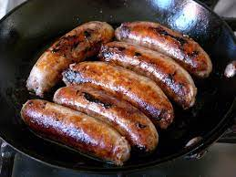
sizzling sausages
Notes:
Listen carefully to the short poem ‘I Like’ by John Foster. As I am reading the poem try to imagine the food I am mentioning (I like sizzling sausages, I like bubbling beans, I like mashed potatoes with gravy and greens. I like cold icecream, I like chocolate cakes, but most of all I like, the jellies that Mum makes)
Let’s think back to the poem. The poet mentions that he likes sausages…how were the sausages described….’sizzling’…sizzling is an onomatopoeic word – it mimics the sound that it describes. It’s almost as if you can hear the sausages sizzling away on the pan.

Slide 4
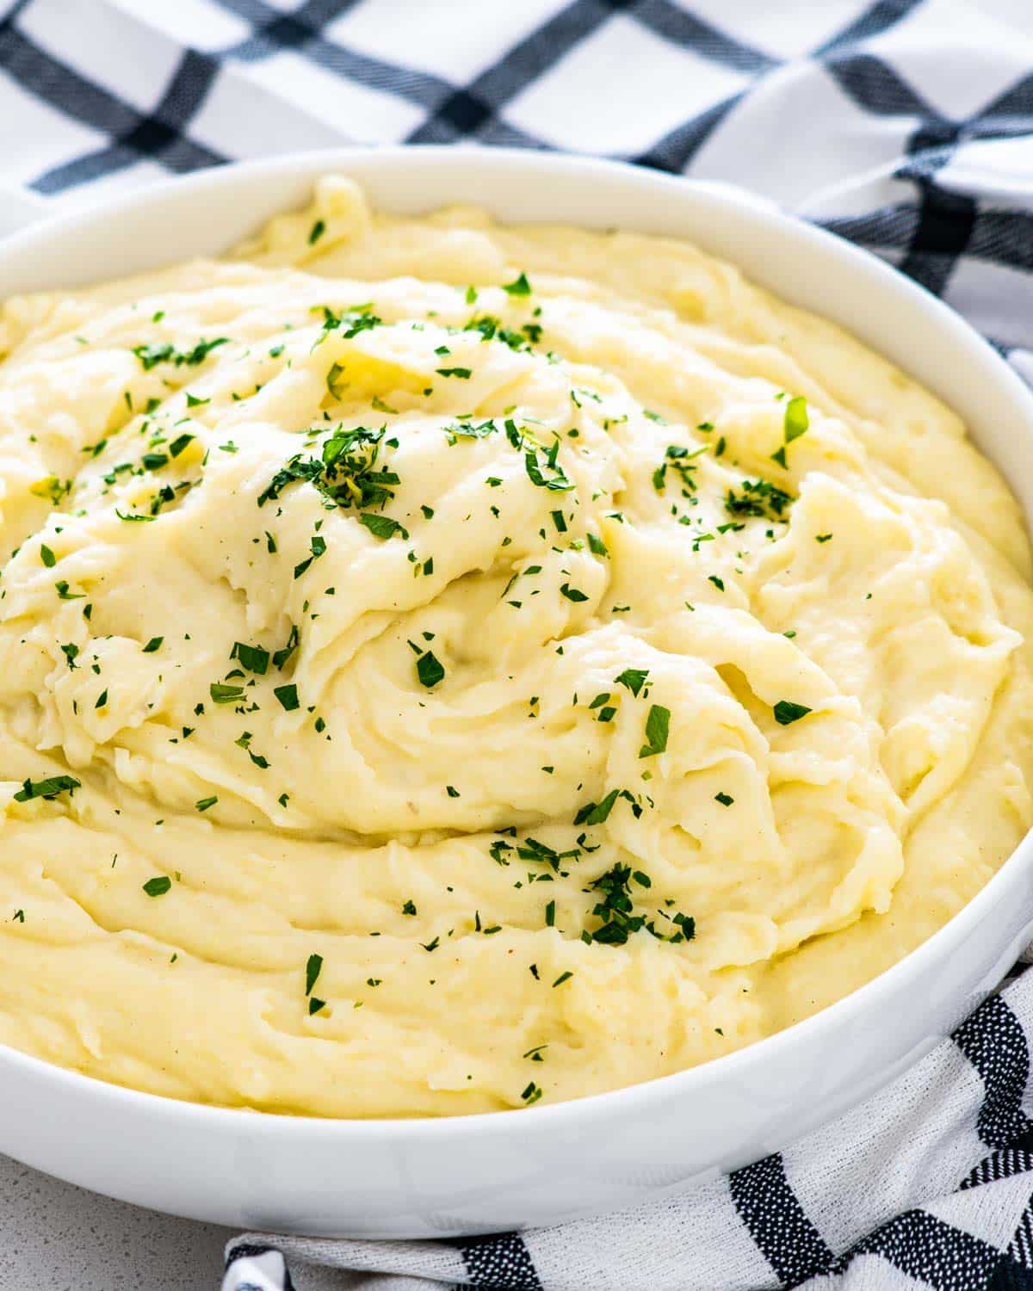
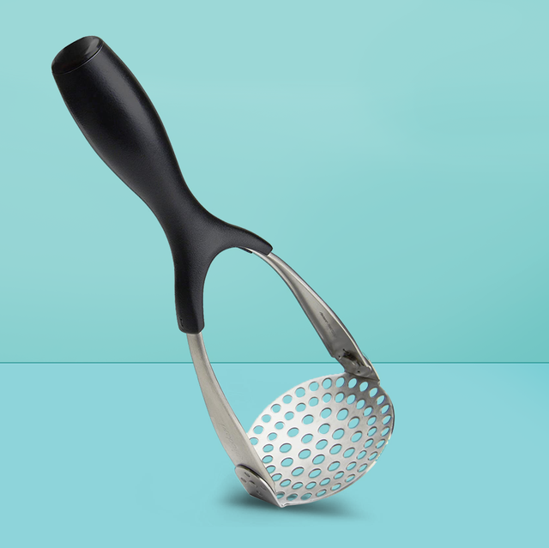
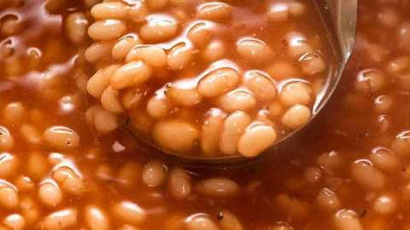
bubbling beans
mashed potatoes
Notes:
Next he says ‘bubbling’ beans. Again here we have another example of an onomatopea – we have the sound – we can almost hear the beans bubbling away in the pot. Next, he says mashed potatoes – what does mashed means?

Slide 5
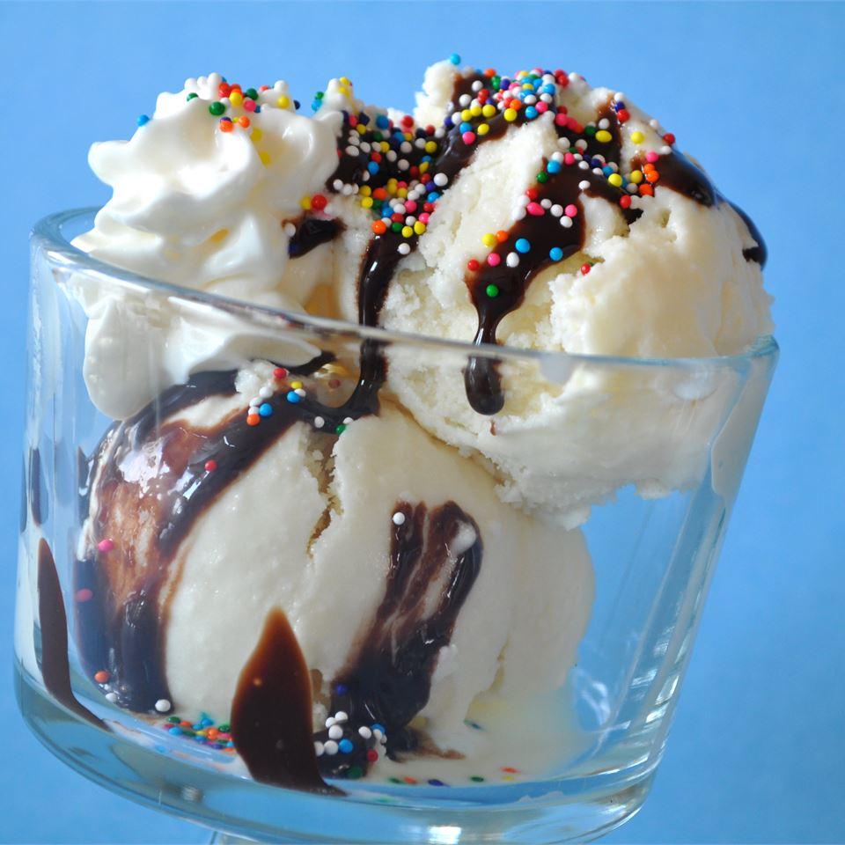
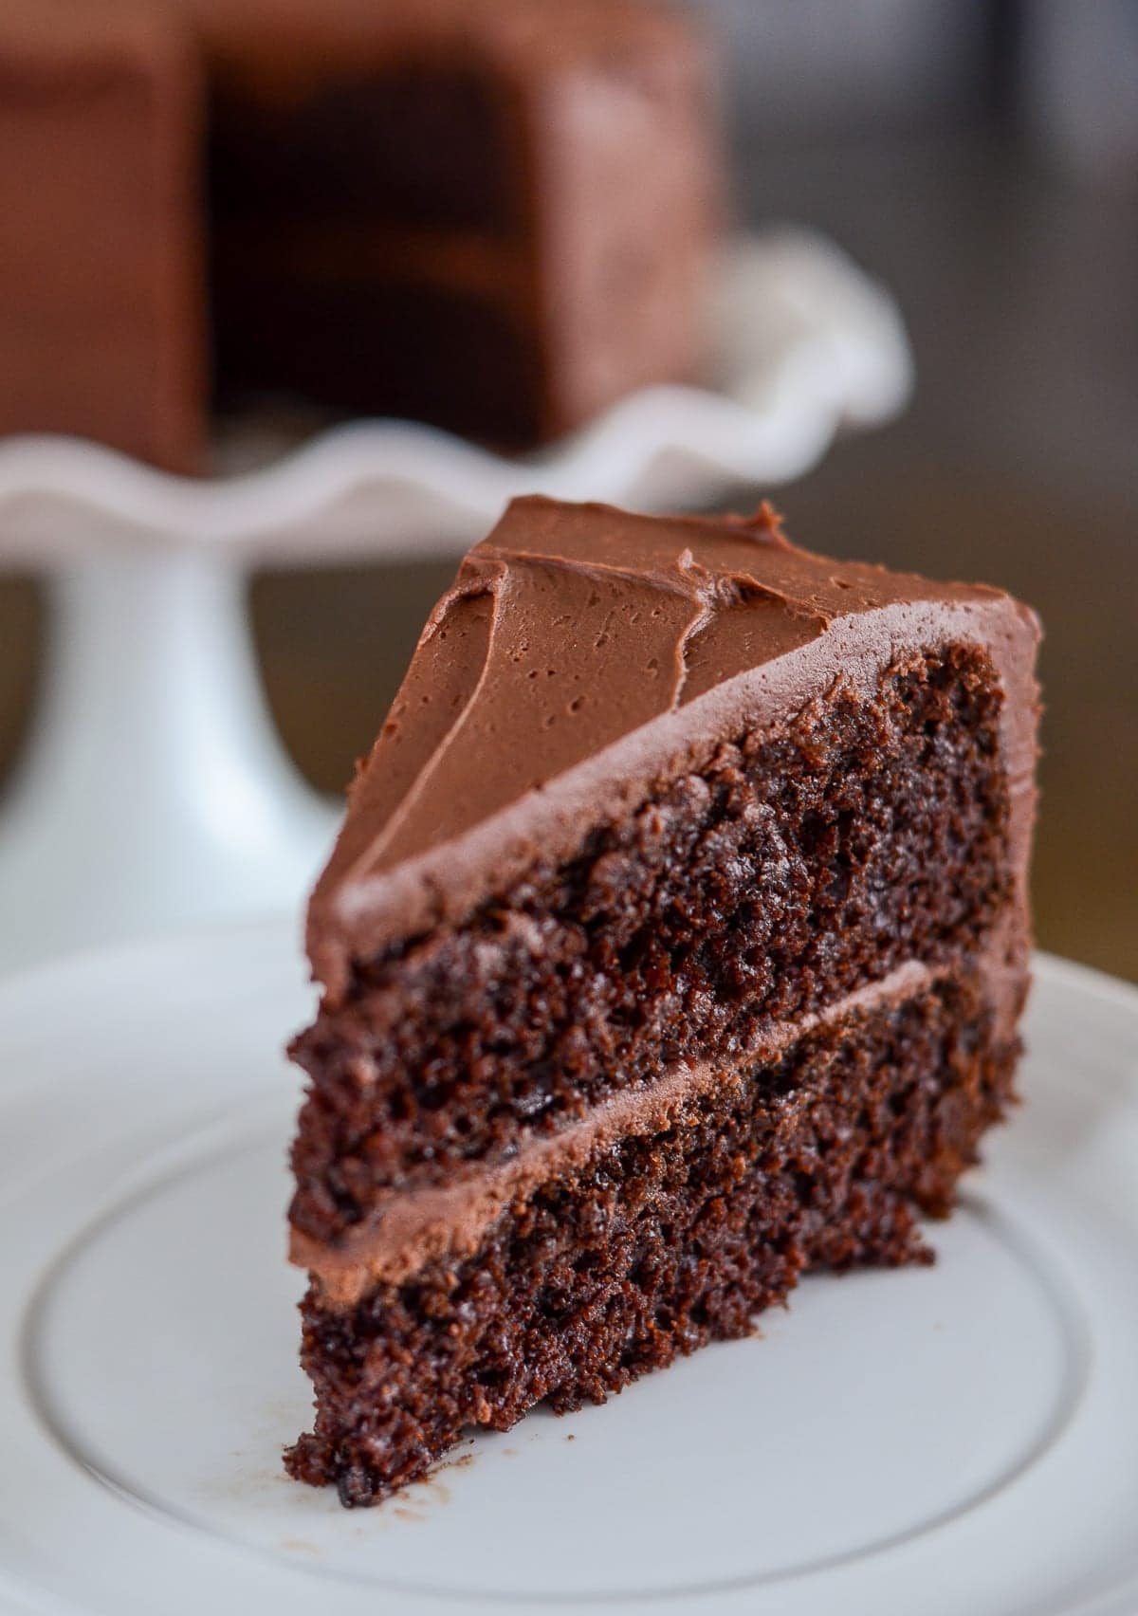
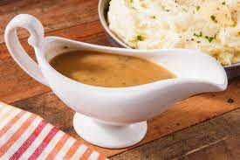
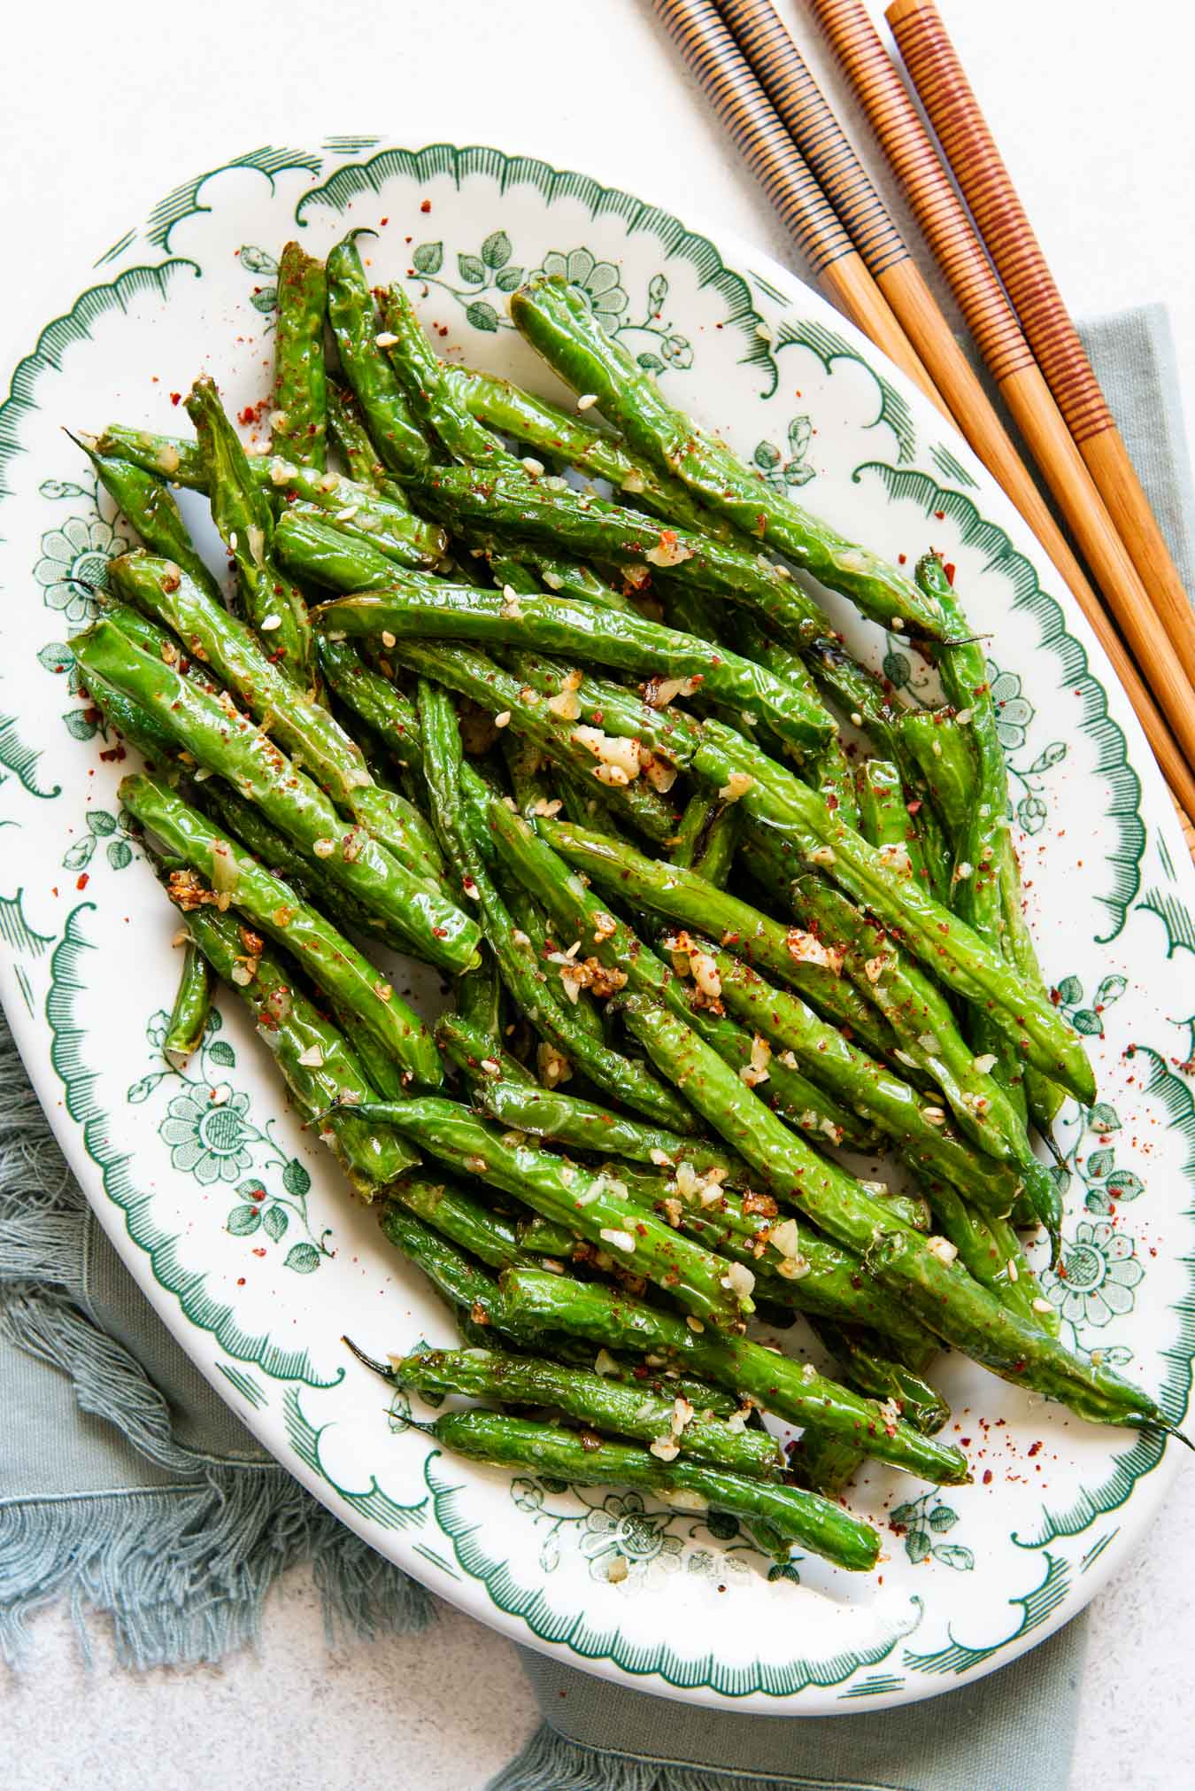
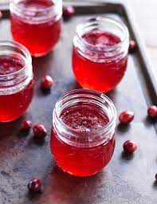
Notes:
The poet also likes gravy and greens – gravy is a thick liquid that you pour over the meat or over the mashed potatoes and greens refer to any vegetables that you serve as a side dish. Sometimes you get roasted vegetables or beans or broccoli. After that, the poet goes on to mention dessert such as cold ice-cream, chocolate cake and most of all he likes the jelly that this mum makes. How can we describe jelly…wobbly, fresh, tasty, cool, refreshing…

Slide 6
I am learning how to talk about foods.
I can describe foods I like to eat.
I can explain the steps of a recipe.
I can self correct some mistakes I make while speaking.

Slide 7
Guess the food
Speaking Activity 1
Notes:
Next, we are going to play a game. As I slowly start revealing the picture, try to guess what food it is. Think about how you managed to guess the food. Then, think of ways how you can describe this food. The word bank on the right of the slide can help you. Ask an adult to sit with you to hear you describe the food.

Slide 9
What is this food?
Do you like it?
What toppings do you normally choose?
Do you prepare it at home or do you get it take-away?
crispy crust
cheese
tomato sauce
basil
ham, sausage,
eggs, chicken

Slide 10
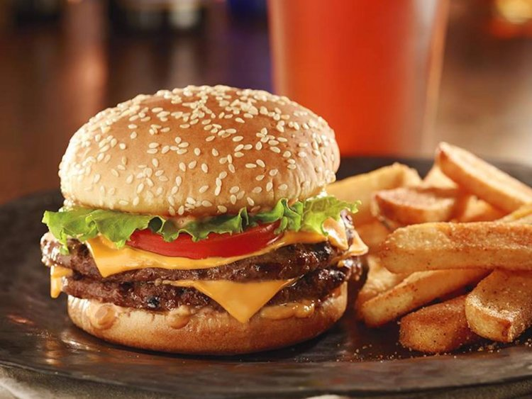

Slide 11
What is this food?
Do you like it?
How do you usually prepare yours?
Do you eat this kind of food often?
bun
patty
lettuce
cheese
tomato
chips/fries

Slide 12
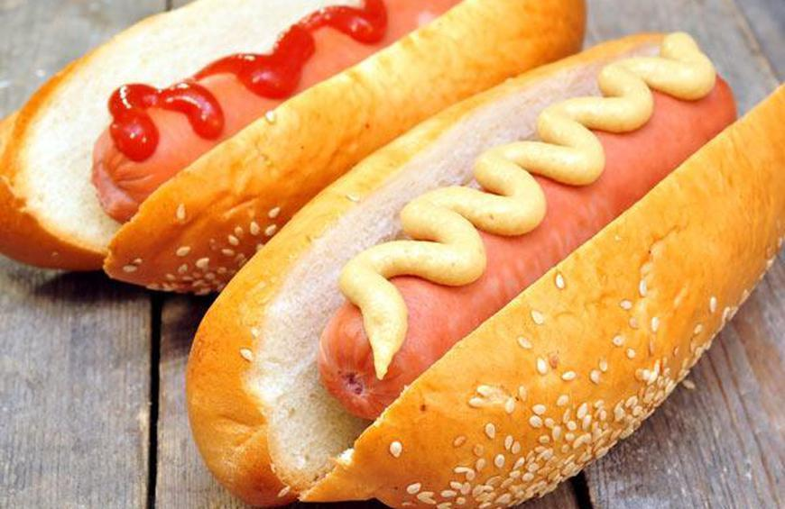

Slide 13
What is this food?
Do you like it?
Where do you usually eat this food?
Do you think this food is healthy? Why?
bread roll
sausage
mustard
tomato sauce
beans
onions

Slide 14
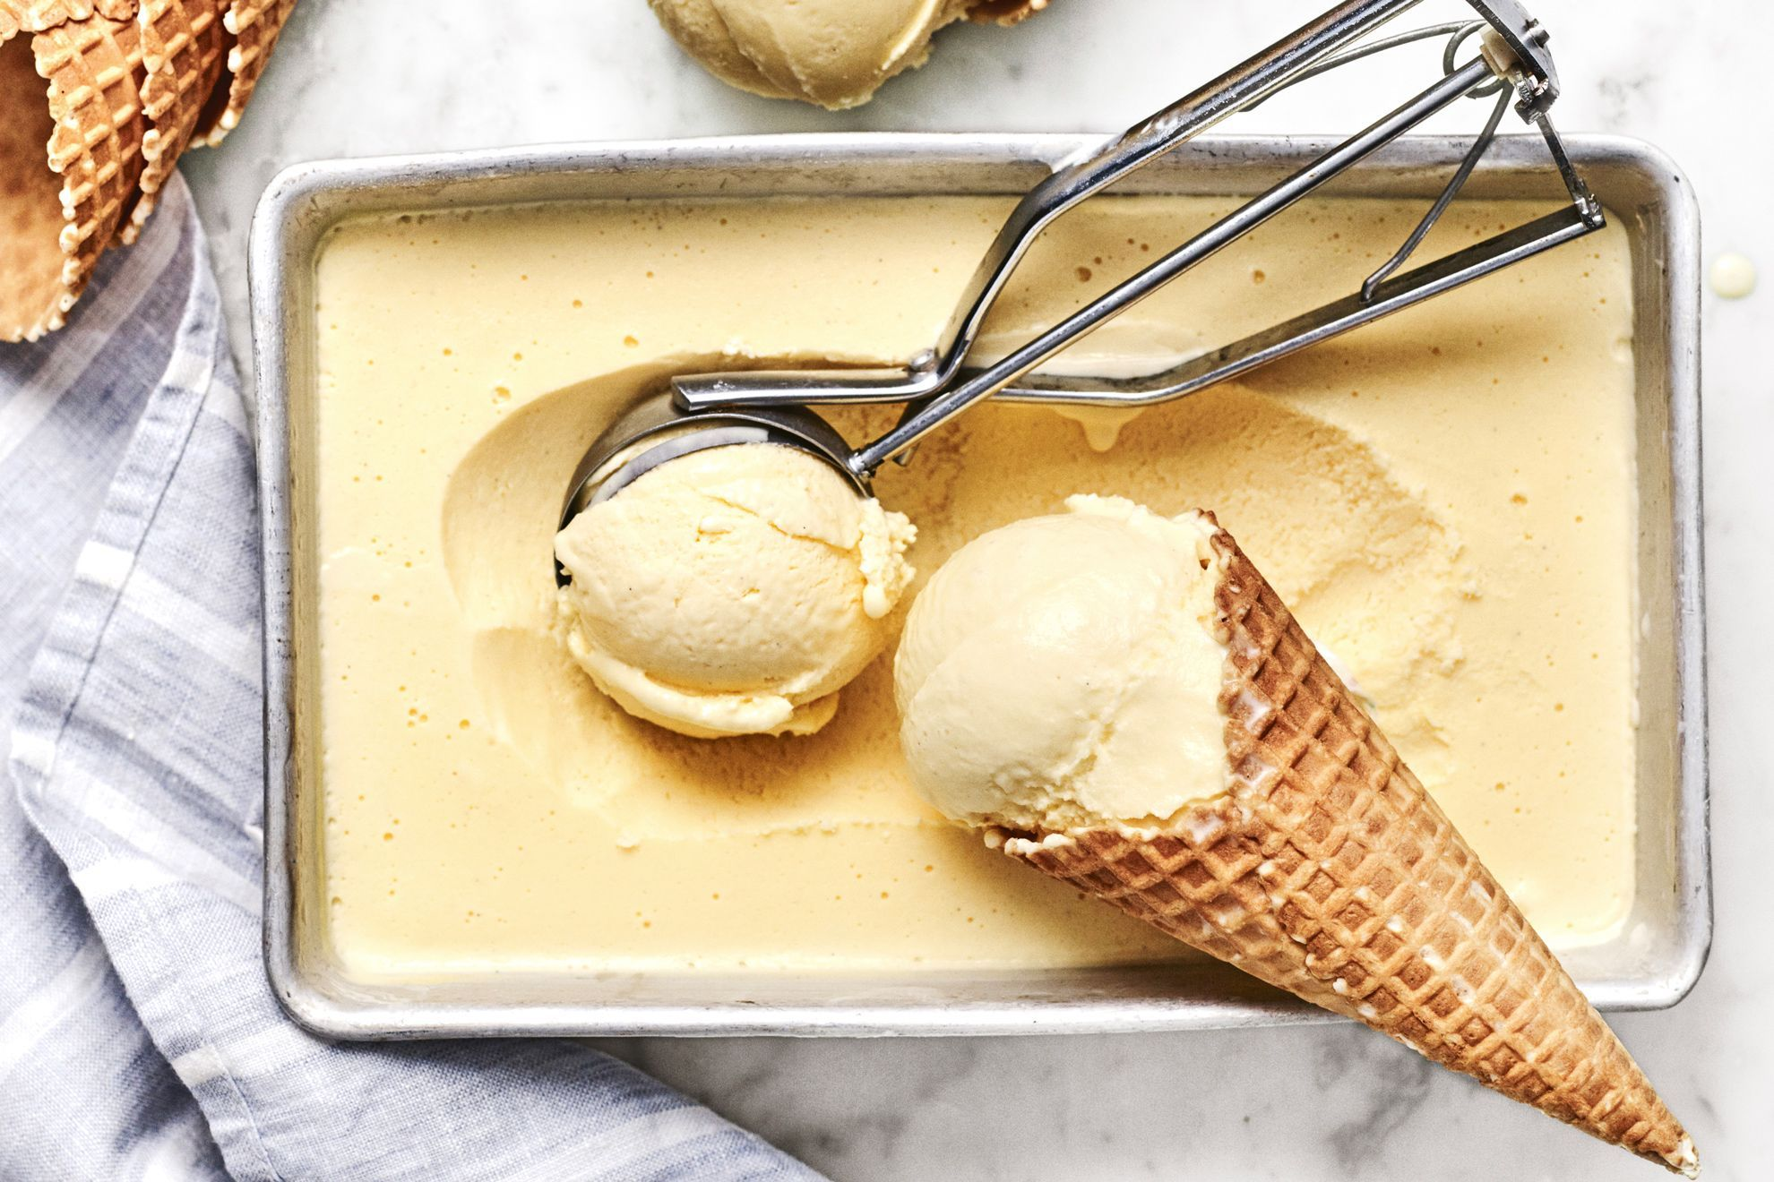

Slide 15
What is this food?
Do you like it?
When do you usually eat this food?
What flavours do you prefer?
Do you prefer ice cream in cone or in a cup?
cone
scoop
vanilla
chocolate
strawberry
dessert

Slide 16
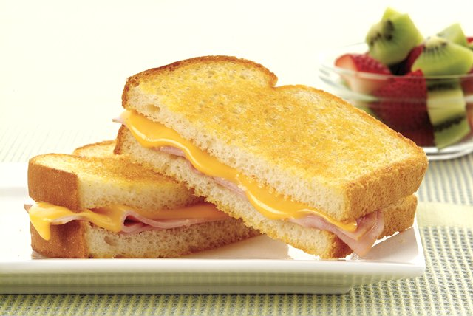

Slide 17
What is this food?
Do you like it?
When do you usually eat this food?
What do you like to put inside?
Do you know how to prepare it yourself?
toasted sandwich
ham and cheese
butter
golden brown
toaster
melted cheese

Slide 18
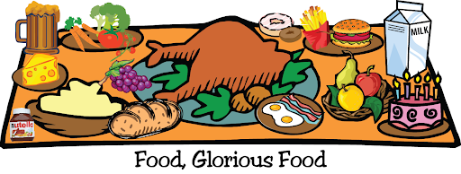
My favourite dish
Speaking Activity 2
Notes:
Right, for our 2nd speaking activity we need to choose a favourite dish. We need to give a short presentation of between 3-5 minutes to explain how to prepare this dish.

Slide 19
Choose a recipe. Prepare a 3-5 minute presentation. Explain how to cook this food so that your friends can prepare it at home.

Slide 20
5. List down any words to describe the actions that you need to do
6. What are the steps for this recipe?
1. What is the name of this recipe?
2. What utensils do you need?
4. What tip can you include?
3. What ingredients do you need?
Notes:
So, let’s start off by brainstorming ideas of what our favourite dish is. We also need to keep in mind the features of a recipe – that is the name, ingredients, utensils and the method. You can download the graphic organiser and fill it in while I am explaining it.

Slide 21
Notes:
You can use the Writing a Recipe Writing Mat to help you with some words. So, after you have planned what to talk about, now it’s time to actually think about how you will present your recipe.

Slide 22
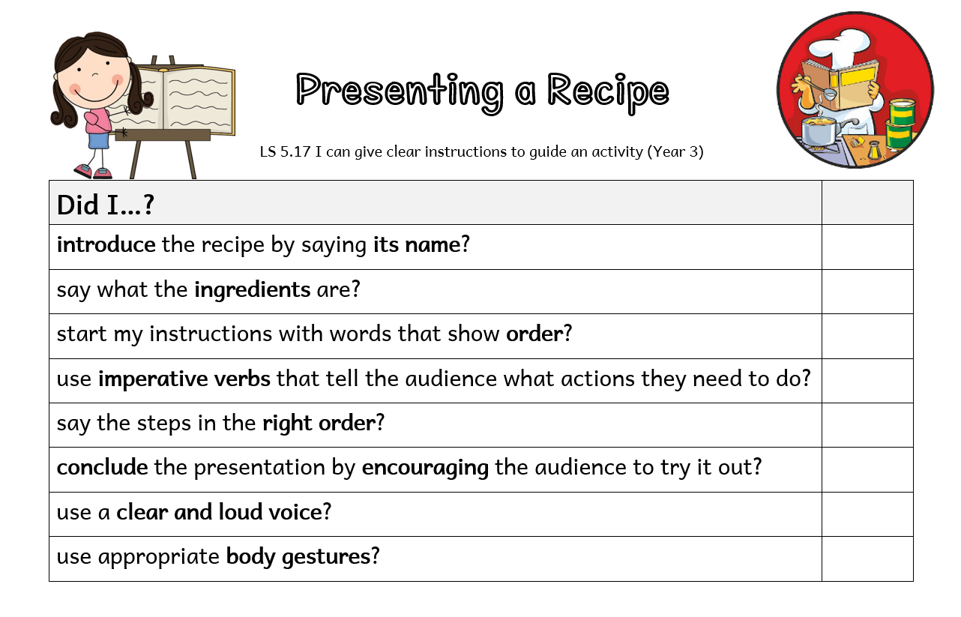
Notes:
In order to do this, you need to refer to the success criteria for presenting a recipe. Let’s go through them one by one.

Slide 23
Thank you for using this resource. Check out our latest resources below.

