Slide 1
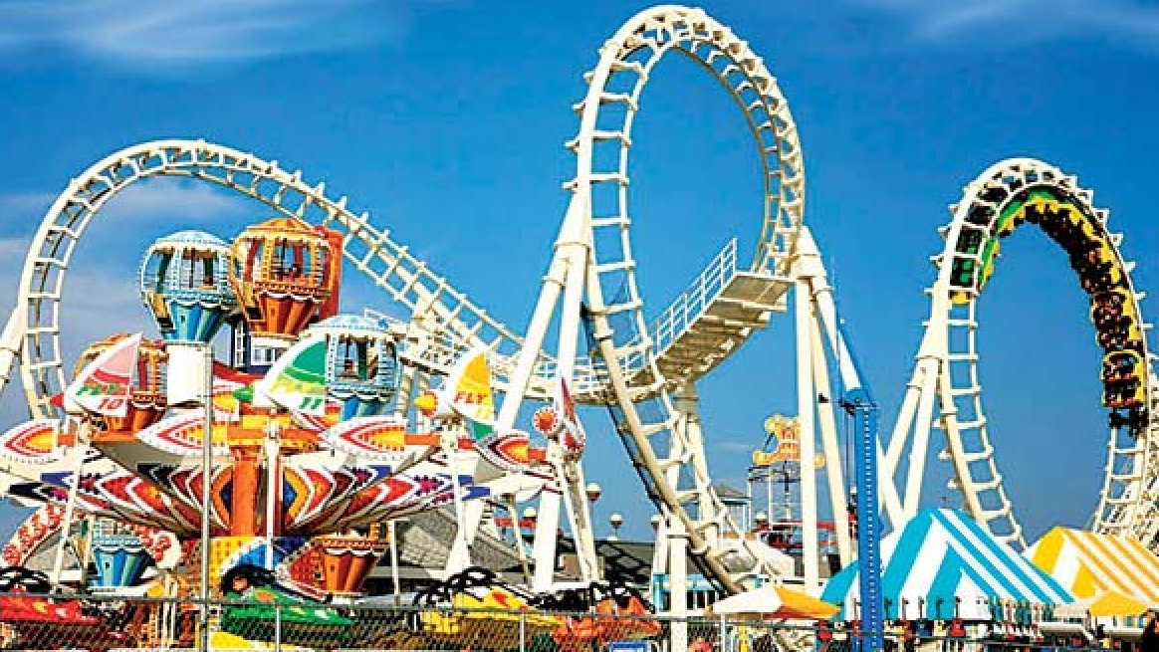
Lesson 2:
Reading
Topic:
Entertainment
Year:
4

Slide 2
Lesson Objectives:
During this lesson I will:
learn about amusement parks.
learn the meaning of new words.
listen to a text being read aloud.
read a text silently and aloud.
answer questions about a text.

Slide 3
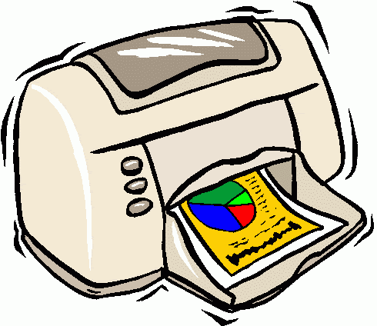
Download these resources:
Reading Text Handout
Questions Worksheet
Answers Handout
Post-Task Worksheet

Slide 4
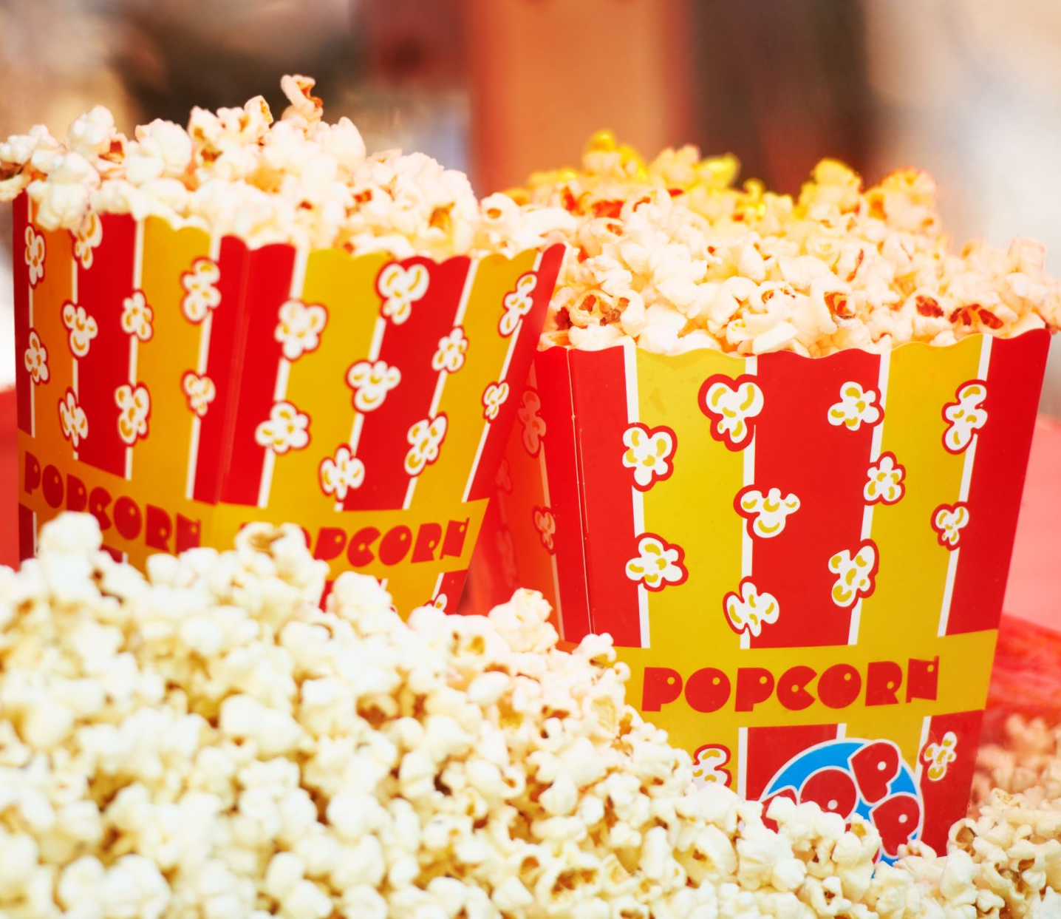
During our listening lesson we heard a story about the circus. Today we will talk about another place of entertainment. Watch this video-clip. https://www.youtube.com/watch?v=yscr5dcwbic

Slide 5
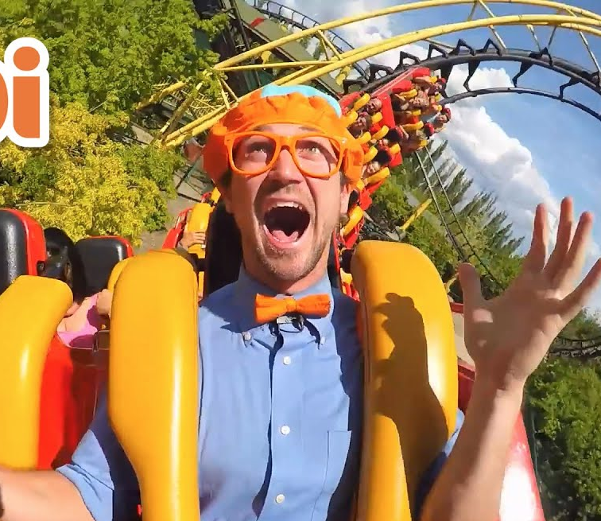
What is the video clip about? Blippie visits an amusement park. In the video clip, he shows us the different rides at the park. He tries some of them himself.

Slide 6
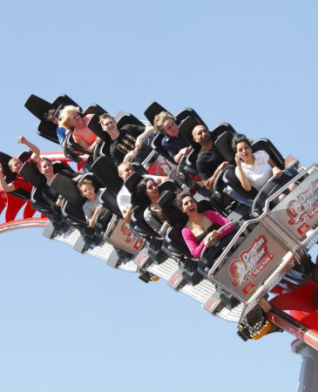
Pre-Teaching of Words:
back and forth
moving backwards then forwards
torn
ripped
messy
not clean and tidy
brightened
to become more cheerful
less fortunate
people who are poor and have less than others

Slide 7
Step 1:
READ the text on the handout.
READ the exercises on your worksheet.
After you read the text and questions try to ANSWER this question:
WHAT IS THE TEXT ABOUT?

Slide 8
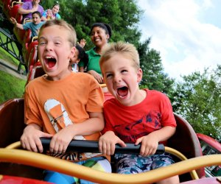
Step 2:
What is the text about?
Robert and Mike went to the amusement park to celebrate Mike’s birthday. They tried different rides and had a great time at the park. In the end they meet a poor boy. They are very kind because they give him tickets to go on a ride and buy some food.

Slide 9
Step 3: READ the text and questions again. Then try to ANSWER these questions:
What did Mike’s mum promise him?
Which ride was Robert’s favourite one?
Why was the boy in torn clothes staring at the rides?
Why was Mike’s mum proud of her son and his friend?

Slide 10
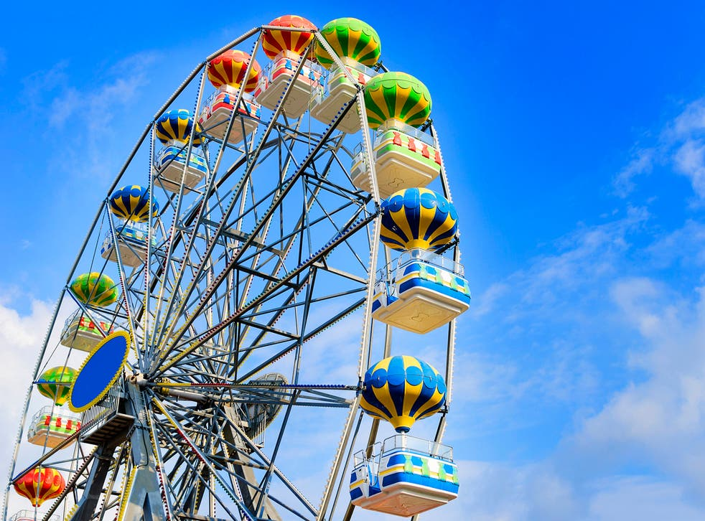
Step 4:
Why did Mike’s mum promise him?
She promised him that one his birthday he could spend a day at the amusement park with a friend.
his birthday.
Which ride was Robert’s favourite one?
The Ferris Wheel was his favourite ride.
Why was the boy in torn clothes staring at the rides?
The boy didn’t have money so he couldn’t go on the rides.
Why was Mike’s mum proud of her son and his friend?
She was proud because they gave Chris two extra tickets to go on a ride and get a hotdog.

Slide 11
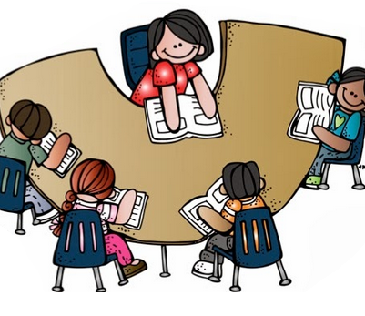
Step 5:
LISTEN to me as I READ the text and the questions aloud.
FOLLOW your text and READ it silently.

Slide 12
Step 6:
READ the text ALOUD.

Slide 13
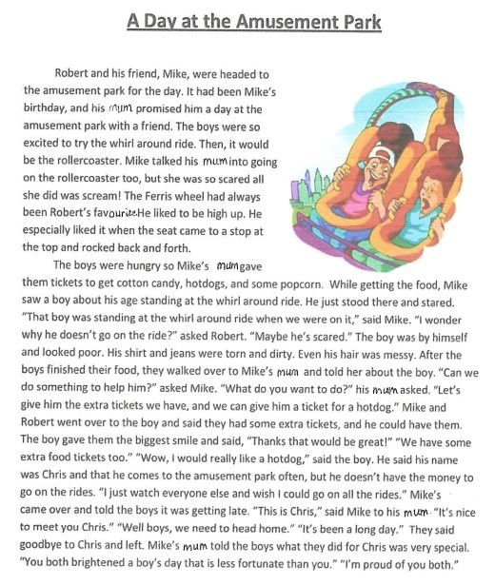

Slide 14
Step 8:
WORK OUT the Questions Worksheet.

Slide 15
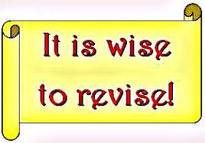
Step 9:

Slide 16
Step 10:
Check your work using the Answers Handout.

Slide 17
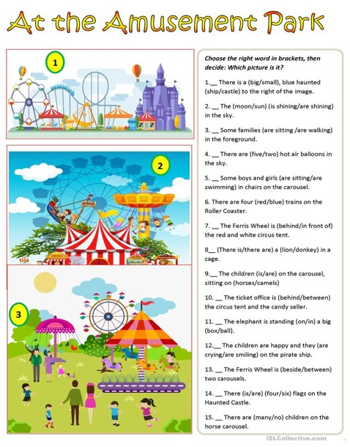
Post-task activity:

