Slide 1
Lesson 5 Speaking
Year 5
English

Slide 3
Lesson 5 Objectives
You will:
explain why you made particular choices/took certain decisions.

Slide 4
Lesson Resources
Sentence Starters
Advantages/
Disadvantages/
Travel Companions Handout
Success Criteria

Slide 5
Speaking Task
Like, Hal, Valentina Tereshkova, Neil Armstrong, Buzz Aldrin, and Michael Collins, you have been selected to embark on a special space mission.
You need to visit a planet in our solar system to collect information, samples and photographs. You are going to go with two other travel companions of your choice.
Let the preparations begin!

Slide 6
My Very Educated Mother Just Served Us Nachos.

Slide 7
Part 1: Choosing a Planet
Look at the research you carried out on a planet after the Listening Lesson and the report you completed during the Writing Lesson.
On the worksheet list the advantages and disadvantages of living on this planet.
Explain your list.

Slide 8
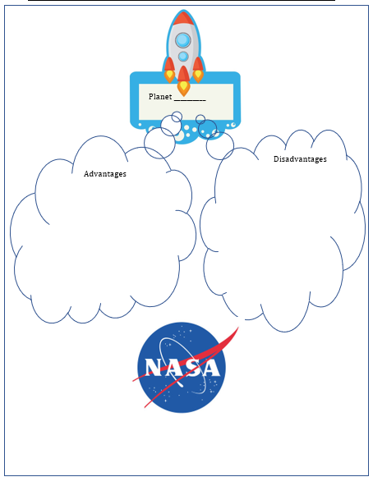

Slide 9
Part 2: Choosing a Companion
View and read the Travel Companions handout.
Choose two of the travel companions.
Give reasons why you want them to join you on your mission.

Slide 10
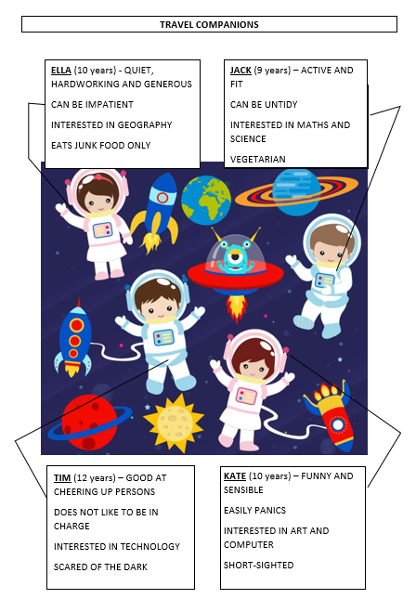

Slide 11
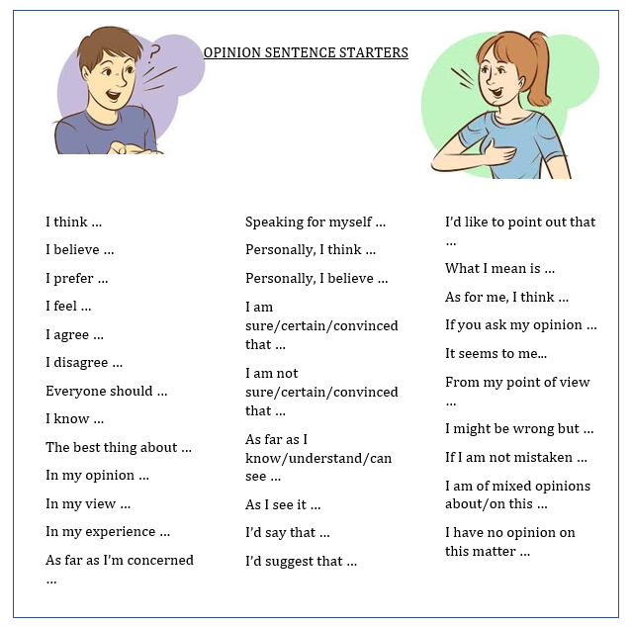
Word Mat

Slide 13
Lesson 5 Objectives
You will learn:
how to plan a presentation.
the success criteria for planning and giving a presentation.

Slide 14
Lesson Resources
PowerPoint Presentation/Chart
Success Criteria Handout

Slide 15
PRESENTATION 1
Create a presentation about
a planet in our solar system.
You can use the information you collected after the Listening Lesson or the non-chronological report you completed after the Writing Lesson.

Slide 16
PRESENTATION 2
Create a presentation about
the first landing on the moon.
You can use the information you listened to
during the Listening Lesson.
Keywords: Neil Armstrong, Apollo 11, space race, Michael Collins, Edwin ‘Buzz’ Aldrin, NASA, Kennedy Space Centre, Florida

Slide 17
Success Criteria!
Success criteria are a list of steps you have to follow or a list of features you are to include in your task. They will make you aware of what is expected and help you self-assess your work.

Slide 18
Thank You!

