Slide 1
Lesson 4 Literature
Year 5
English

Slide 2
Lesson 4 Objectives
You will:
use the dictionary to find the meaning of new words.
read a literary text silently and aloud.
listen to a literary text being read aloud.
identify the character and setting in a literary text.
identify rhyme and onomatopoeic words.

Slide 3
Lesson Resources
Dictionary
Reading Text Handout
Worksheet

Slide 4
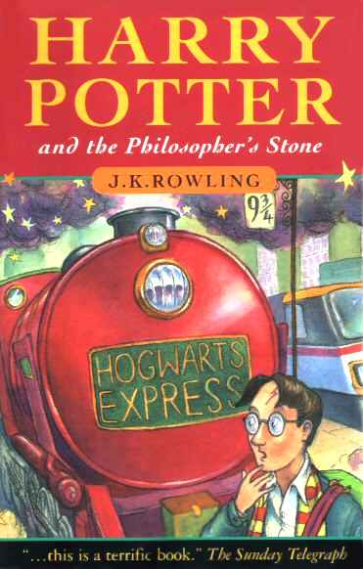
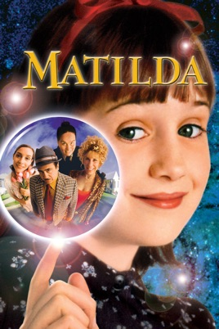
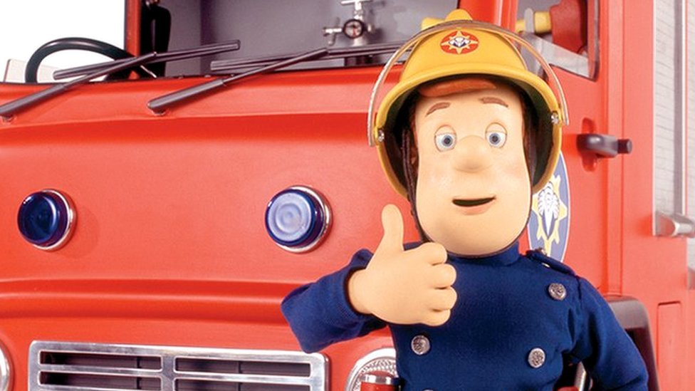
Character
The character is a person or other being in a novel, play, television series, film, or video game. The character may be fictional or based on a
real-life person.

Slide 5
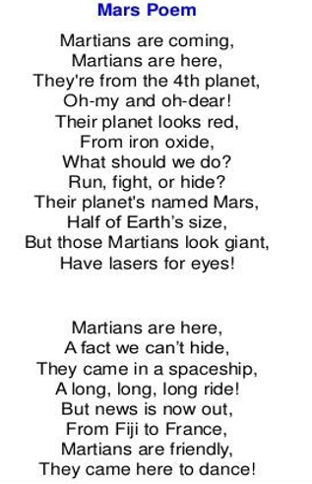
Rhyming Words
Rhyming words are pairs and groups of words that have the same sound.

Slide 6
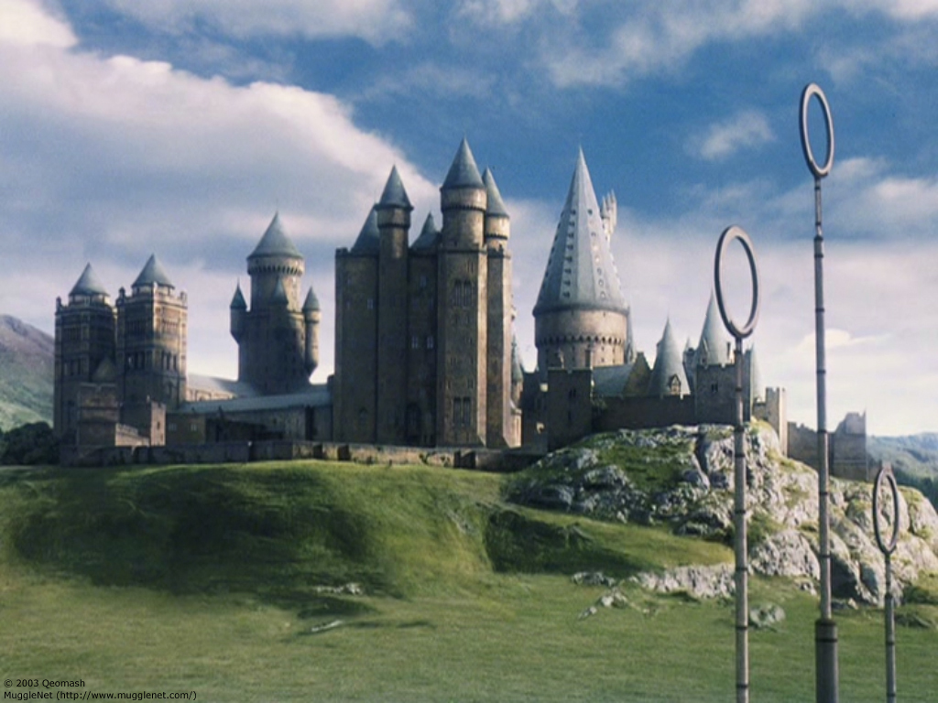
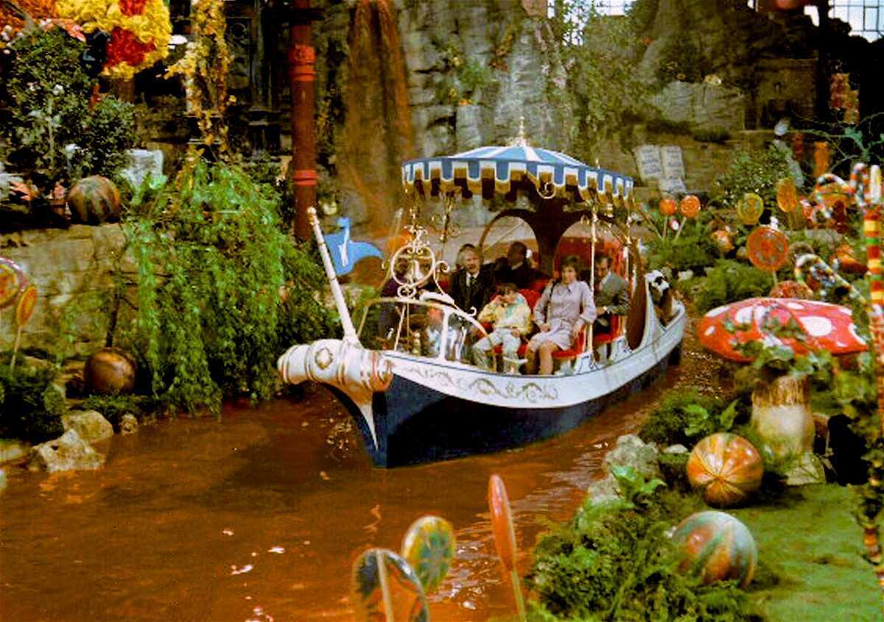
Setting
The setting is the time and place in which the story takes place. Settings can be real or fictional, or a combination of both.

Slide 7
Onomatopoeia
Onomatopoeia
is when a word describes a sound and actually mimics the sound of the object or action it refers to when it is spoken.

Slide 8
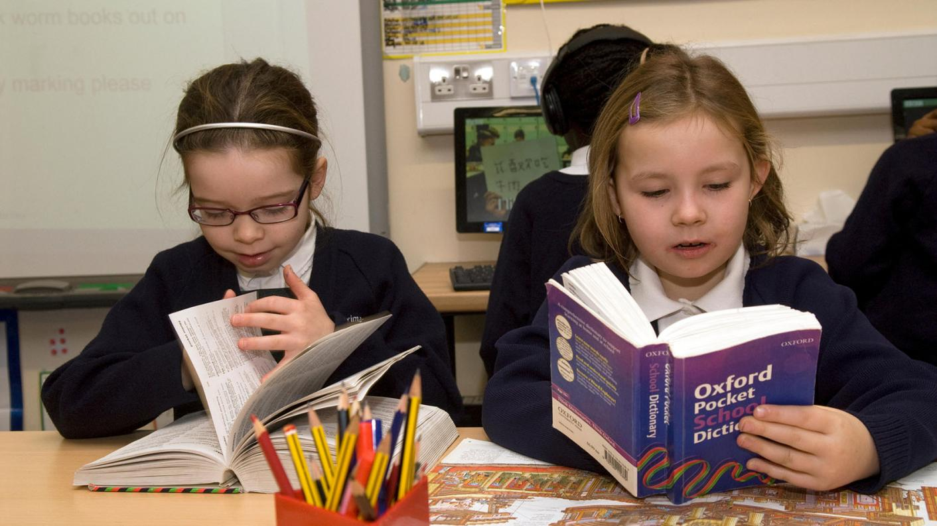
NEW WORDS - Using a dictionary!

Slide 9
snuffle
soars
blink of an eye
squints
craters
chuckles
quest
dazzle
vast
zooms
budge
delight

Slide 10
snuffle
soars
blink of an eye
squints
flies or rises high in the air
one or both eyes partly closed to see more clearly
a very short time
breathe noisily through the nose due to a cold or crying

Slide 11
craters
chuckles
quest
dazzle
laughs quietly
adventurous journey
shine brightly
large holes in the ground

Slide 12
vast
zooms
budge
delight
move
very great in size
something that gives great pleasure
moves fast with a loud, low
hum

Slide 13
Step 1
READ the text silently.
After you read the text ANSWER the following questions:
WHAT IS THE TEXT ABOUT?
HOW DID IT MAKE YOU FEEL?

Slide 14
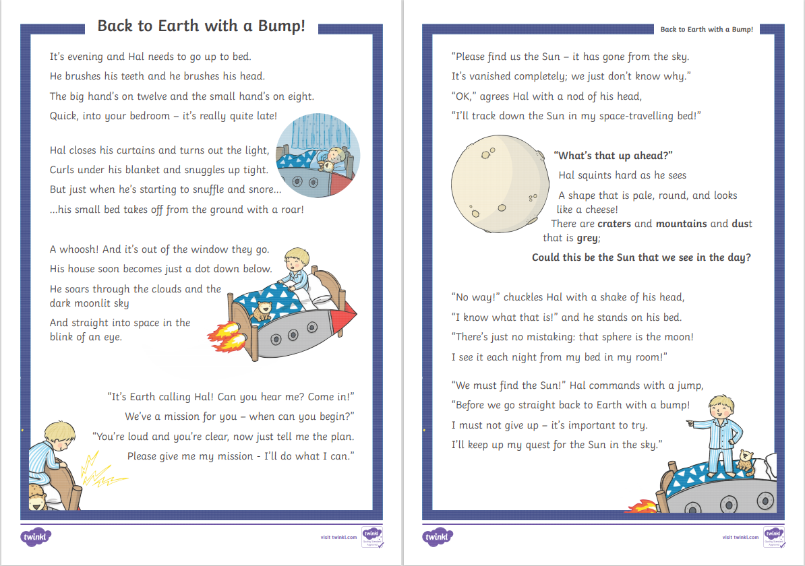

Slide 15
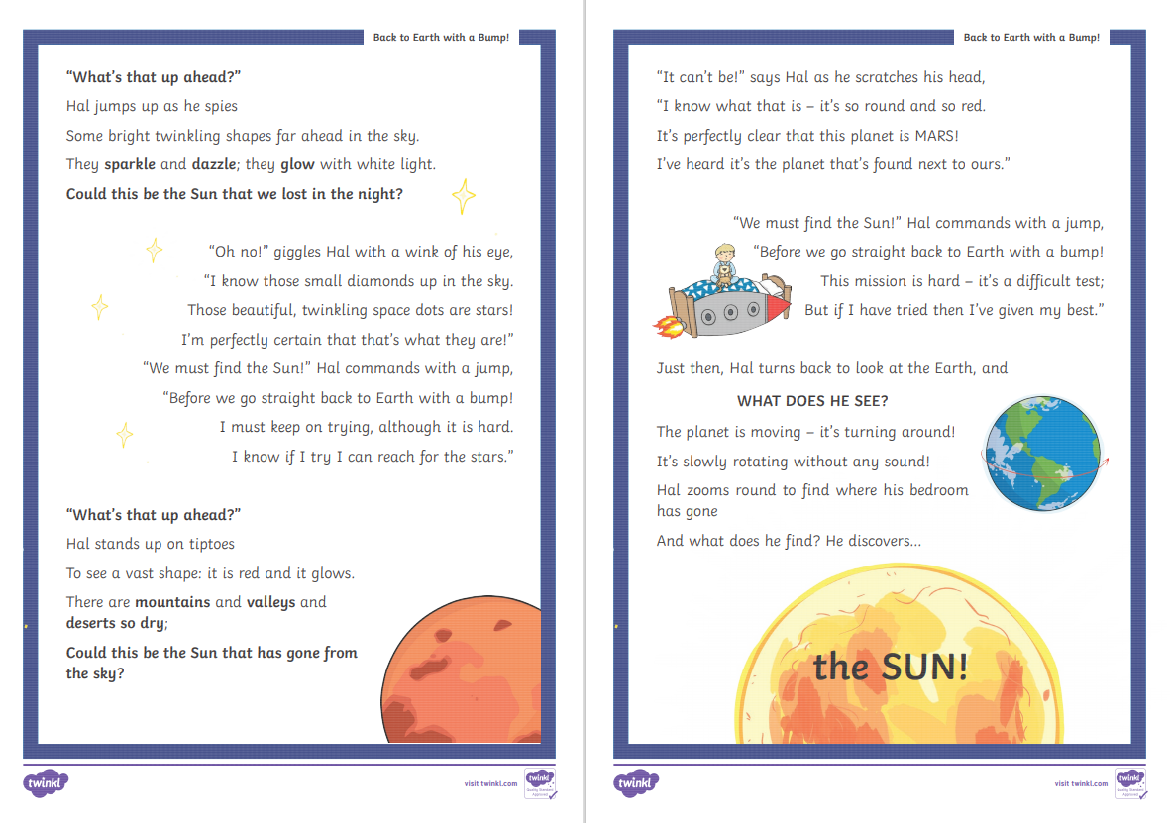

Slide 16
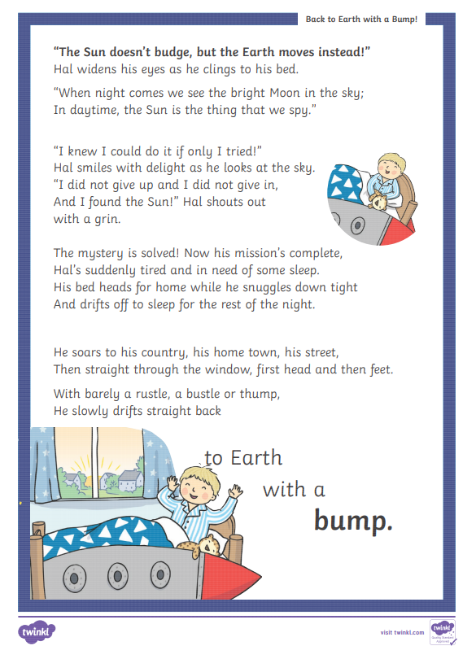

Slide 17
Step 2 - Discuss the question
What is the text about?
The text is a fictitious story about a boy, Hal who is on a special mission.
When Hal is about to fall asleep, his bed takes off and Hal goes around space looking for the Sun. During this special expedition Hal comes across the Moon, Mars, lots of stars and finally he finds
the Sun.

Slide 18
Step 3
READ the text again.
Then try to ANSWER the following questions.

Slide 19
Step 3: Answer these questions!
Who is the main character in the story?
What is the setting of the story?
Where does Hal see grey craters, mountains and dust?
What are the small diamonds in the sky?
What are the three things he saw on planet Mars?
What does Hal notice the Earth doing?
What did you learn about day and night?
What do you notice about the text?

Slide 20
Step 4 - Discuss the questions
Who is the main character in the story?
Hal
2. What is the setting of the story?
The setting of the story is night-time. Hal is in his bedroom and then he zooms off to space.
3. Where does Hal see grey craters, mountains and dust?
On the Moon
4. What are the small diamonds in the sky?
The stars

Slide 21
Step 4 - Discuss the questions
Mountains, valleys and deserts
6. What does Hal notice the Earth doing?
It was rotating.
7. What do you learn about day and night?
We have daytime when the Earth turns towards the Sun and night-time when the Earth turns away from the Sun.
8. What do you notice about the text?
The text is written in the form of a poem. It has a flowing and regular rhythm, rhyming words and onomatopoeic words.

Slide 22
Step 5
LISTEN and
READ SILENTLY
with me.

Slide 26
Step 6
READ the text yourself.

Slide 27
Step 7
WORK OUT
the worksheet.

Slide 28
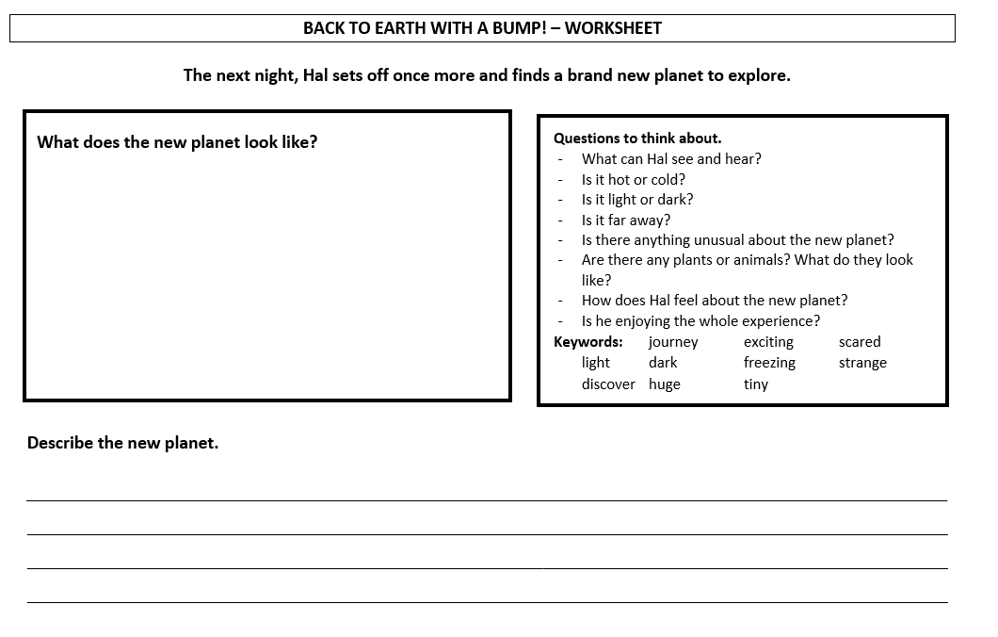

Slide 29
Thank You!

