Slide 1
Lesson 1 Literature
Year 5
English

Slide 2
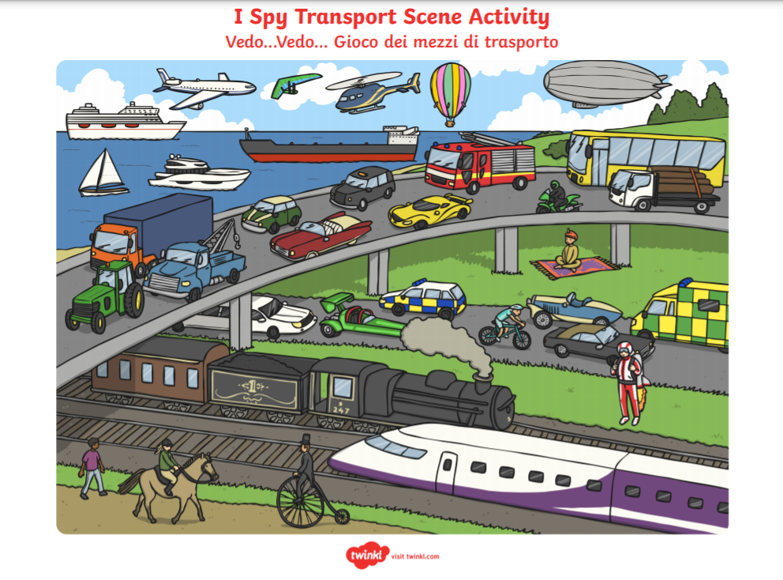
Guess the week’s theme

Slide 4
Lesson 1 Objectives
You will:
read a poem silently and aloud.
listen to the poem being read aloud.
answer questions about the poem.

Slide 5
Lesson Resources
Poem Handout
Worksheet

Slide 6
Step 1
READ the poem silently.
After you read the poem
ANSWER the following questions:
WHAT IS THE POEM ABOUT?
HOW DID IT MAKE YOU FEEL?

Slide 7
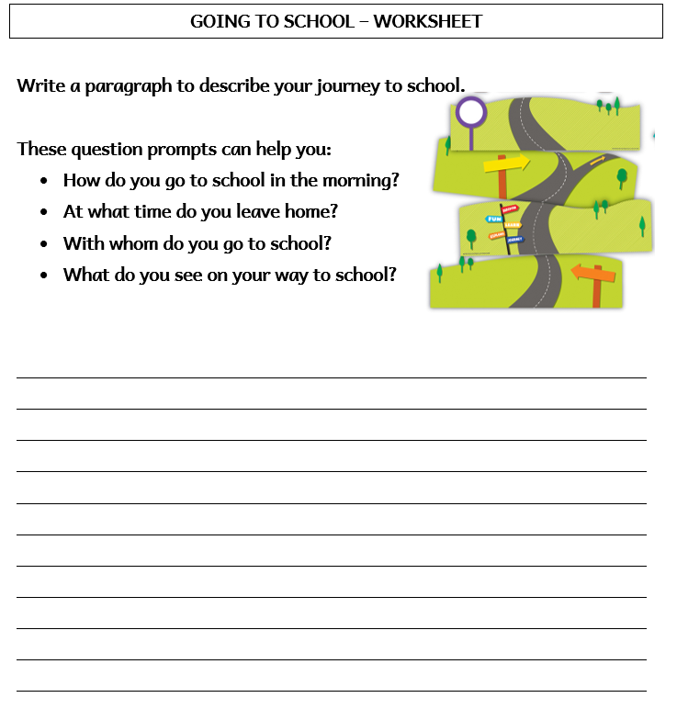
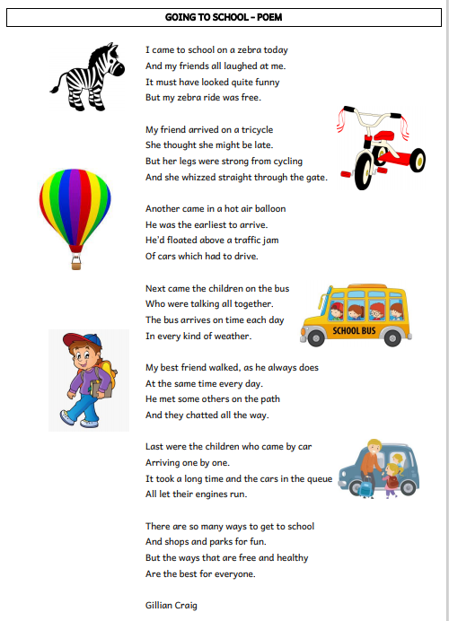

Slide 8
Step 2: Discuss the question
What is the poem about?
The poem is about the different means of transport, which school children use, to get to school.
The poet, Gillian Craig lists a few. Some are real such as the school bus, the tricycle, the car and going to school on foot. Others are impossible in real life such as riding the zebra or floating in a hot air balloon.

Slide 9
Step 3
READ the poem again.
Then try to ANSWER the following questions.

Slide 10
Step 3: Answer these questions!
How many stanzas does the poem have?
How many verses does each stanza have?
Is it a free verse poem? Why?
Why did the poet’s friends laugh at him?
Who arrived first at school? Why?
According to the poet, which are the best ways to travel to school? Do you agree?

Slide 11
Step 4 - Discuss the questions
1. How many stanzas does the poem have?
It has seven stanzas.
2. How many verses does each stanza have?
Each stanza has four verses.
3. Is it a free verse poem? Why?
No, it’s not because it has rhyming words.
He went to school on a zebra.
4. Why did the poet’s friends laugh at him?
The pupil in the hot air balloon because
he floated above the traffic.
5. Who arrived first at school? Why?
6. According to the poet, which are the best ways to travel to school? Do you agree?
The ways that are free and healthy such as going on foot or riding a tricycle.

Slide 12
Step 5
LISTEN and READ SILENTLY.
Then LISTEN to me while I EXPLAIN the worksheet.

Slide 14
Step 6
READ the poem yourself.

Slide 15
Step 7
Complete the worksheet.

Slide 16
Step 8

Slide 17
Thank You!

