Slide 1
Health and Safety
Lesson 5 – Writing

Slide 2
Notes for the Educator
This lesson is pegged directly to Learning Outcomes W 5.9 I can write a paragraph appropriately for an audience and with a purpose; W5.12 I can make a text more interesting or more relevant to me by changing the vocabulary and W5.14 I can use resources to help me plan my written work and present it accurately.
Teachers are to refer to the Scheme of Work where each lesson is explained in more detail.
Effects are included to make the presentation more interactive. Please present the PowerPoint in Slideshow mode.
Wherever possible we have included the use of online apps to enhance the teaching and learning experience.
The Notes section underneath the slides may contain some further points which can be developed during the lesson.
Teachers are encouraged to adapt this PowerPoint presentation to meet the learners’ language needs.
Tasks included in the PowerPoint presentation are also being shared as handouts.
For any comments, feedback or suggestions please email us at: marie-claire.camilleri@ilearn.edu.mt; urieth.attard@ilearn.edu.mt; mary.jude.camilleri@ilearn.edu.mt. You may also call the office on: 25983683.

Slide 3
You go to school with Sick Simon. He’s not sick anymore, by the way! The headmaster of the school would like the children to write some instructions about how to wash their hands. These instructions will be displayed in the bathrooms so that the pupils can read them when they need to wash their hands. He hopes to stop the spread of germs so that the children and the teachers won’t continue getting sick.

Slide 4
G
instructions
fellow pupils at the school
to inform
A
P

Slide 5
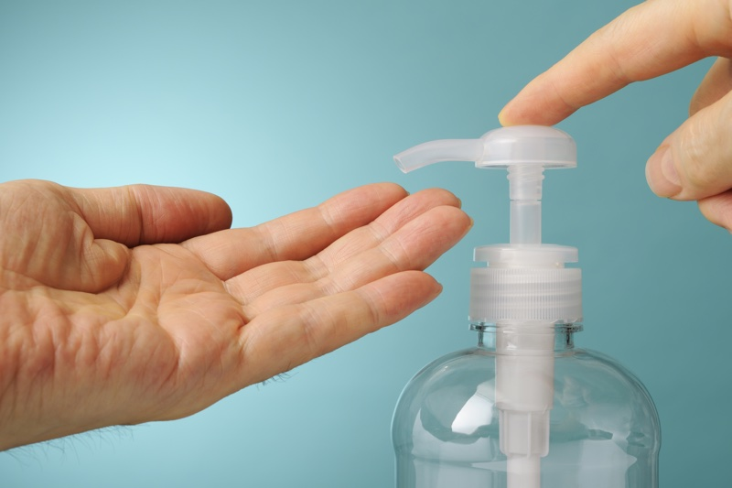
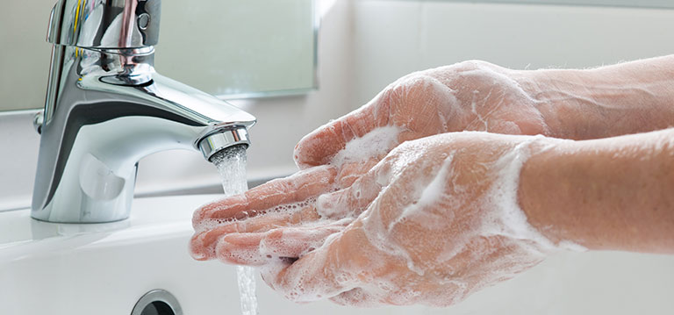
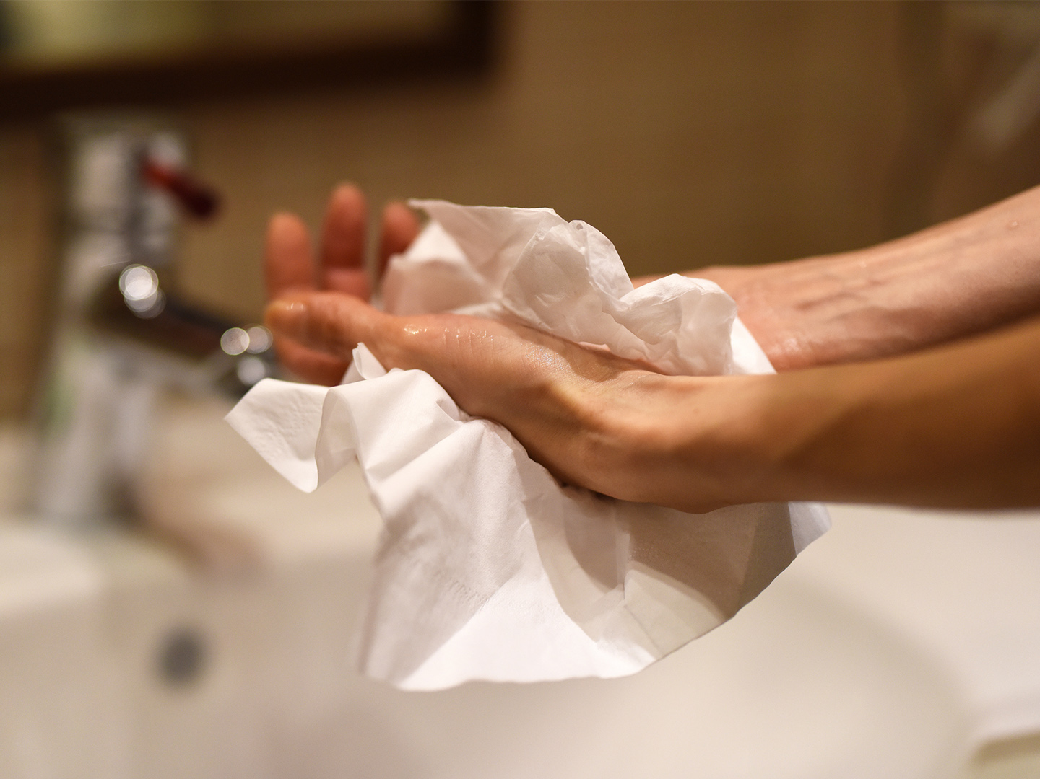
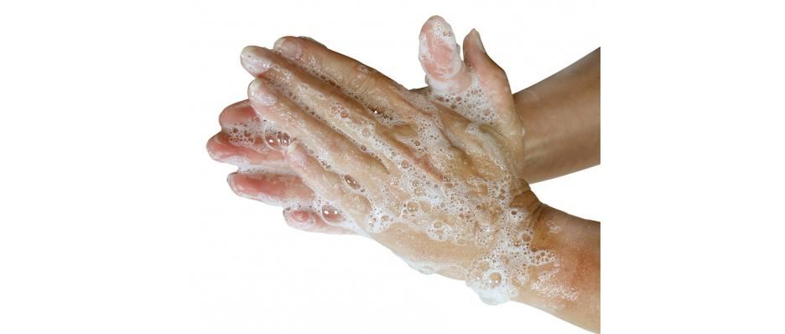
How to wash your hands
turn
apply
rinse
dry
turn
rub
wet

Slide 6
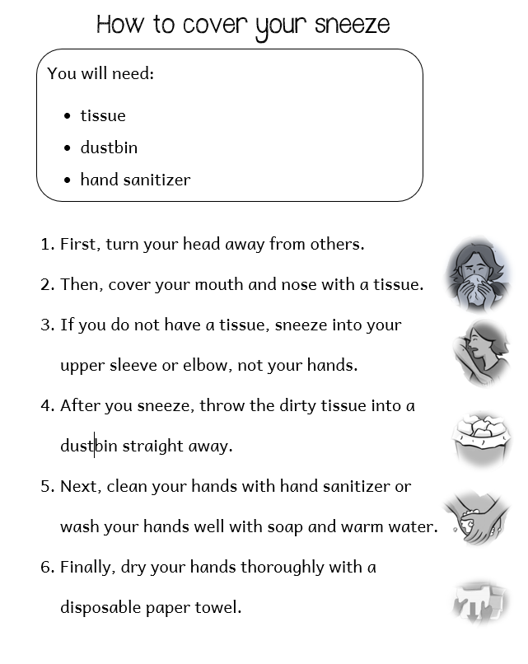
First
Next
After that
Then
Finally

Slide 7
To write good instructions, I need to
think of a catchy title;
write a list of things that are needed;
use numbers or bullets to explain the method;
use bossy words such as: wash, clean and dry;
start sentences with words that show order: first, next, etc…;
write the sentences in order;
keep sentences short and to the point.
1
2
3
4
5
6
7

Slide 8
Writing Instructions Success Criteria

Slide 9
How to wash your hands
Title
Instructions:
picture
1.
2.
3.
4.
5.
6.
What you need:

Slide 11
How to wash your hands
picture
Instructions:
1.first – turn the water
2.next- wet - hands
3. then - apply soap
4.rub – well - fingers
5.after that – rinse
6.finally – dry – paper towel
What you need:
soap
water
paper towel
Notes:
Planning stage. Drafting should follow. You can use OneNote or whiteboard.fi to model the drafting, editing and reviewing stages.

Slide 12
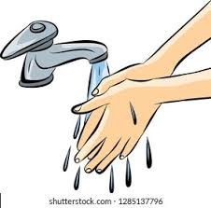
How to wash your hands
Instructions:
1.First turn on the water.
2.Next wet your hands with clean water.
3. Then apply soap or foam on your hands.
4.Rub your hands palm to palm and between your fingers.
5.After that rinse your hands under cold running water.
6.Finally dry your hands with a paper towel.
What you need:
soap
water
paper towel

Slide 13
Thank you for using this resource. Check out our latest resources below.

