Slide 1
Lesson 4 Speaking
Year 5
English

Slide 2
Picture Prompts

Slide 3
Lesson 4 Objectives
You will:
describe different places.
talk about what activities can be done in each place.
share your preferences.
guess your friend/sibling’s choice.

Slide 4
Lesson 4 Resources
Pictures Handout

Slide 5
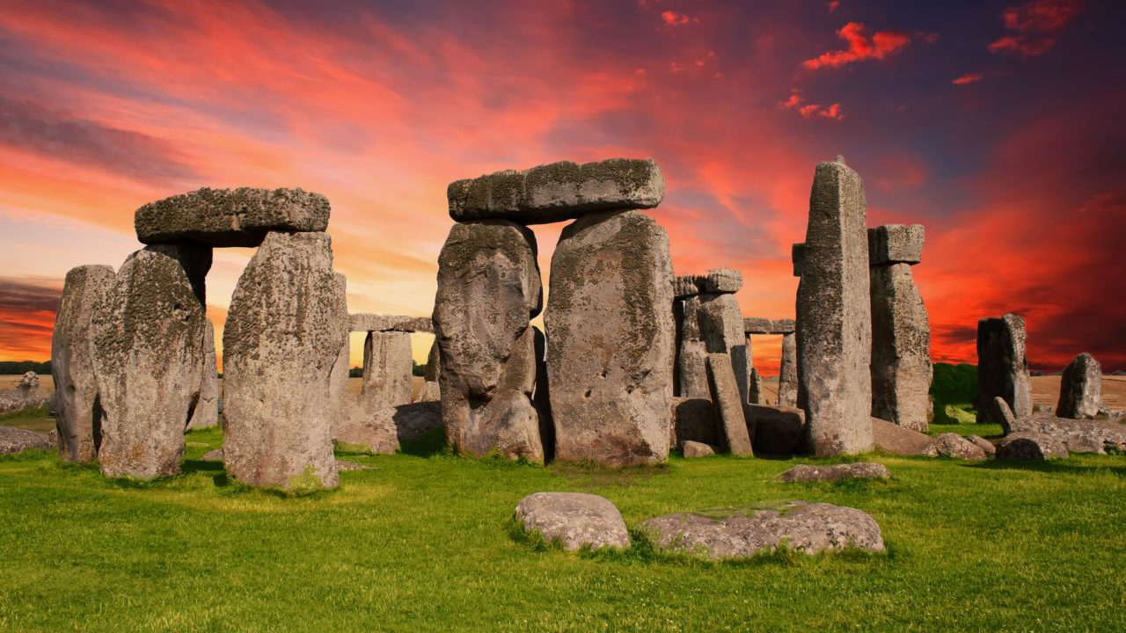
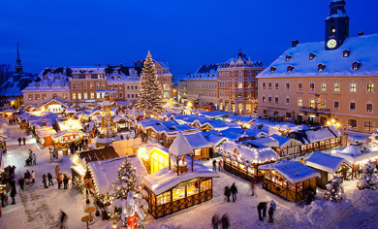
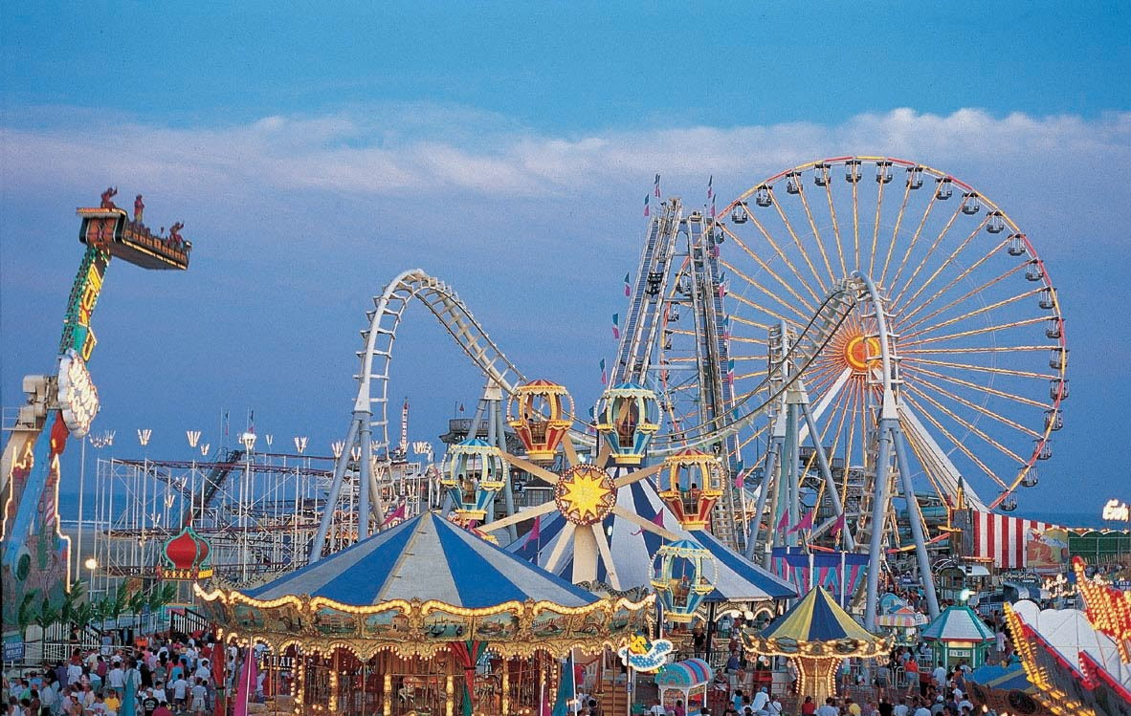
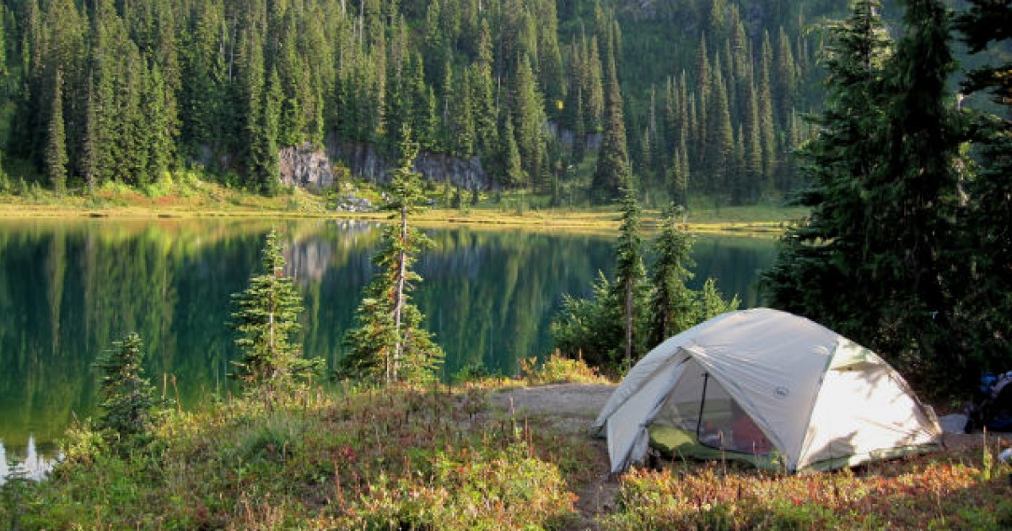

Slide 6
Questions
What can you see in each picture?
What activities can be done in each place?
What do you like about each place?
What’s your favourite place?
Can you predict your friend/relative’s
favourite place?

Slide 7
Information Gap Activity

Slide 8
Lesson 4 Objectives
You will:
learn information about a country.
ask questions to fill in missing information.

Slide 9
Lesson Resources
Worksheet A
Worksheet B
Answers Handout

Slide 10
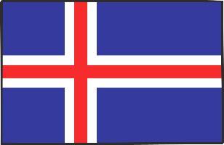
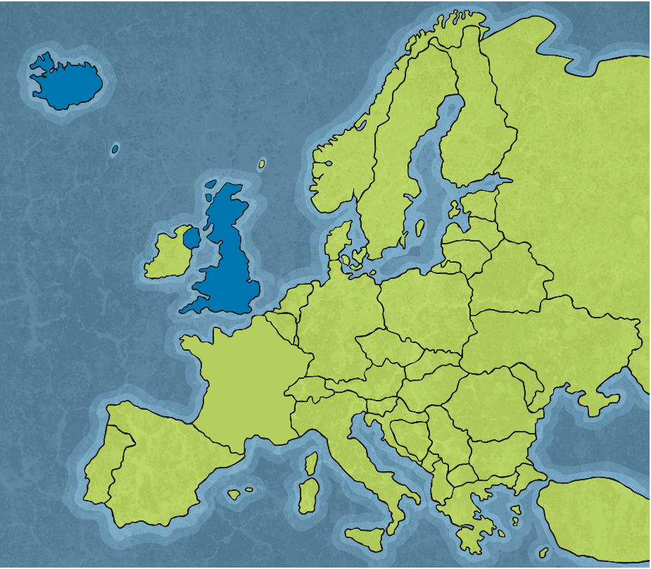
Where Is Iceland?
Iceland is an island near the Arctic Circle in the North Atlantic Ocean. The country nearest to Iceland is Greenland, followed by the Faroe Islands and then Scotland.
Iceland
It is 40,000 square miles, which is about the same size as Portugal. However, 80% of the country is not inhabited, with Iceland having a population of only 320,000 people, half of which live in the capital city, Reykjavik.
Faroe Islands
United
Kingdom

Slide 11
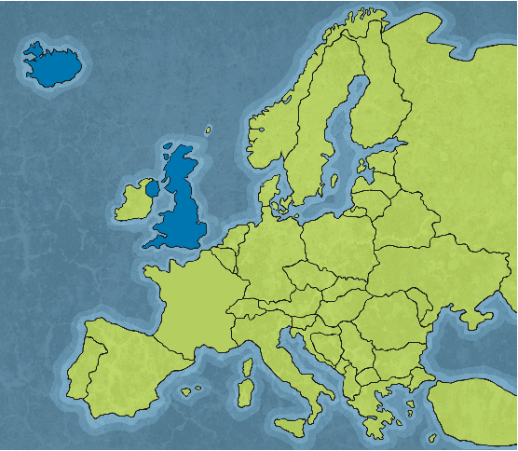
Land of Ice and Fire
Iceland is known as the Land of Ice and Fire. This is because it has the largest glaciers in Europe and some of the most active volcanoes in the world.
The country is famous for its geothermal lagoons and natural hot springs. Geothermal energy which is heat created from deep inside Earth, heats 90% of buildings in Iceland and most of the swimming pools.
Iceland
United Kingdom

Slide 12
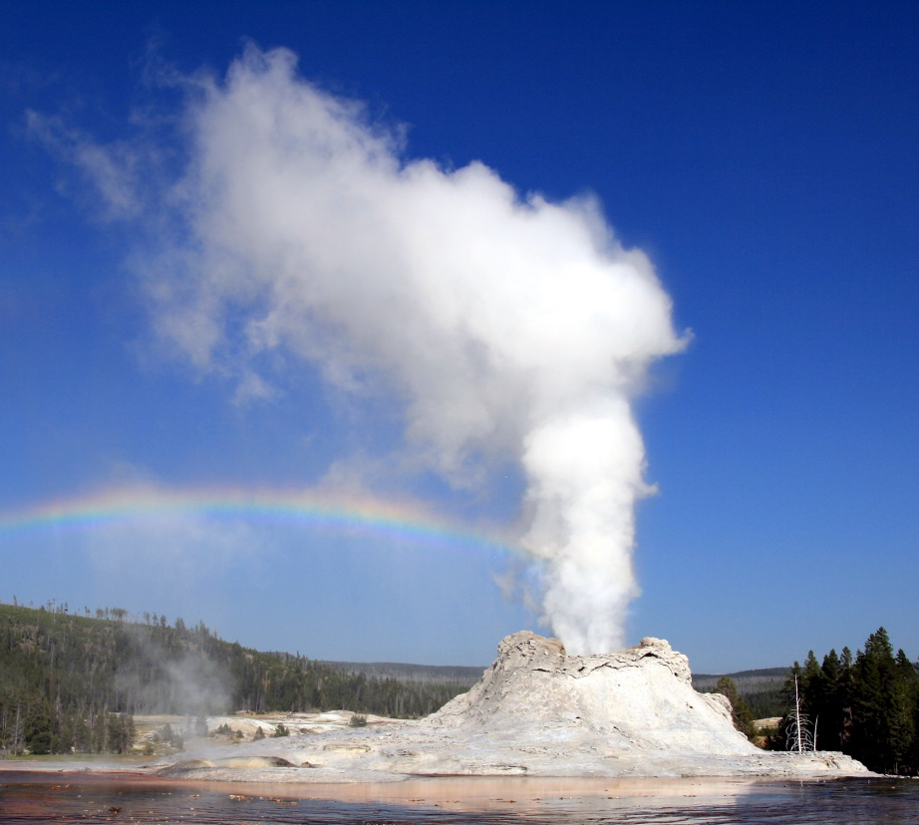
Natural Wonders
Iceland is known for its geysers, waterfalls and black-sand beaches.
Fresh water rivers flow through Iceland and it is recommended that people drink directly from the rivers, as the water is so pure and clean. The hot geysers regularly erupt, sending volumes of hot water into the air.

Slide 13
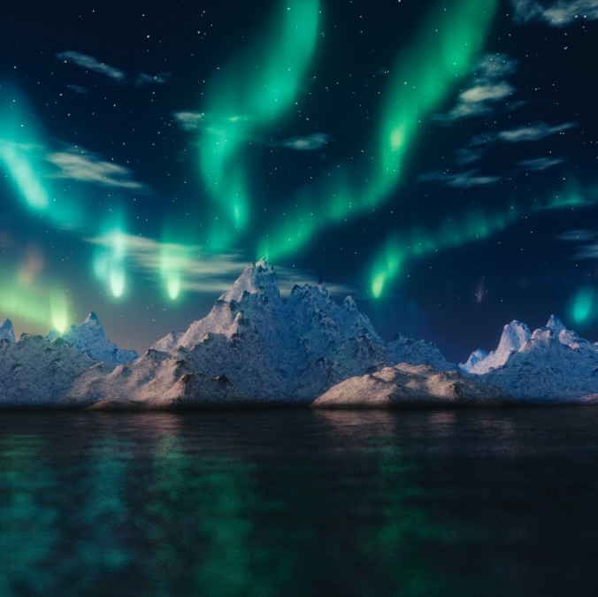
Close to Nature
Due to the location of Iceland, it is an isolated country with extremes in nature. In the summer, Iceland experiences 24 hours of daylight. Imagine being in bed when it is light outside for the whole night!
However, in the winter, there are only a few hours of daylight.
Despite the dark winters, Iceland enjoys the natural phenomenon of the Northern Lights – Aurora Borealis.

Slide 14
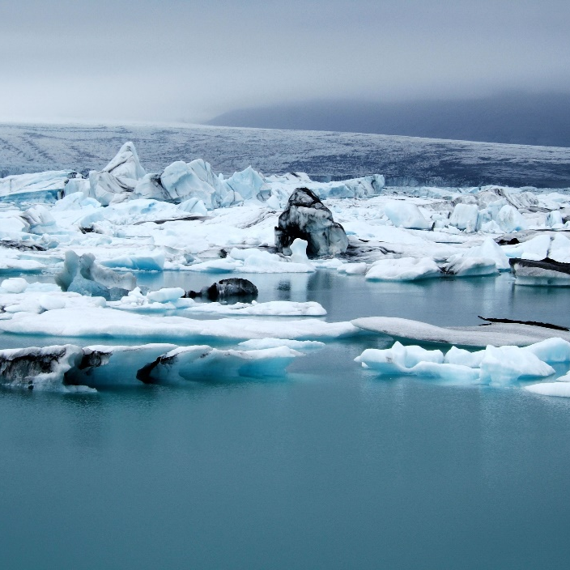
Europe’s Largest Ice Sheet
Iceland has Europe’s largest ice sheet. It is 8,100 km² in size.
Beneath the ice sheet there are numerous volcanoes which can erupt at any time.

Slide 15
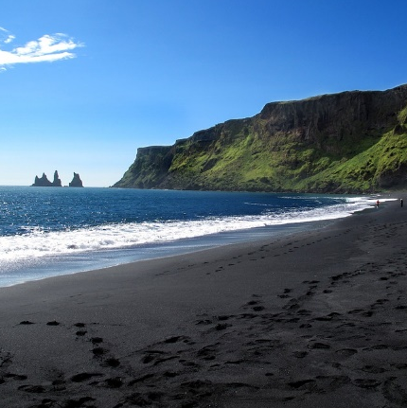
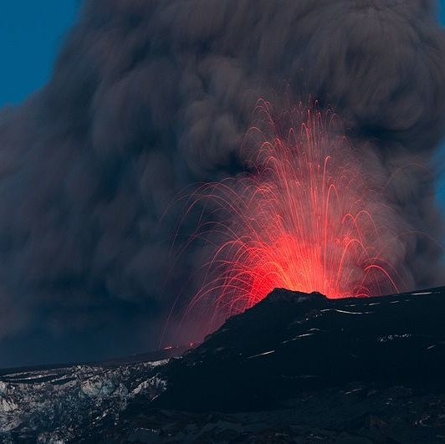
Volcanoes
Iceland sits on two tectonic plates (the jigsaw pieces of Earth’s crust). These shift and cause earthquakes and volcanoes to form. There are about 130 volcanoes in Iceland, some of which are still active. The black-sand beaches are caused by the volcanic minerals and lava fragments from the volcanoes.
Southern black-sand beach
Iceland’s most famous volcano, erupted in 2010 causing a massive ash cloud which disrupted European flights for many days.

Slide 16
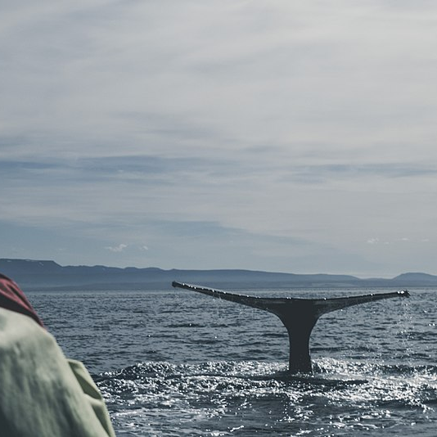
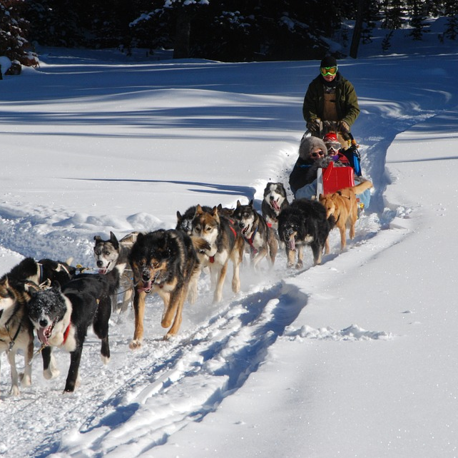
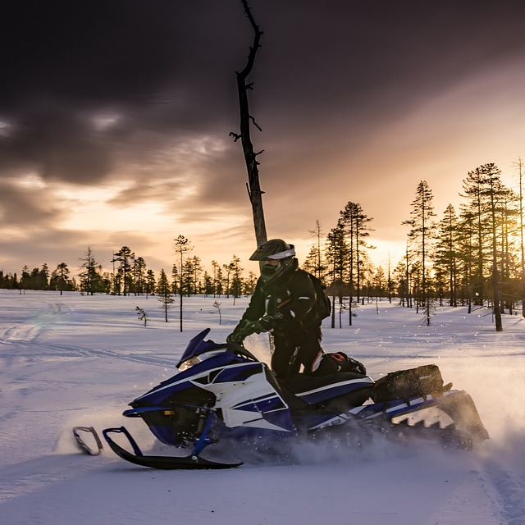
Sport and Leisure
Popular activities like rafting, fishing, diving, whale watching and snorkelling make use of the clean waters surrounding the island, while the snowy mountains lend themselves to hiking, climbing, dog sledding and snowmobiling.

Slide 17
View clip!

Slide 18
Speaking Task
Give Worksheet A to your friend/relative.
Individually, read the text.
Individually, identify what kind of information is missing.
Write down questions to find out the missing information.
5. Now ask each other questions in order to complete your text.

Slide 19
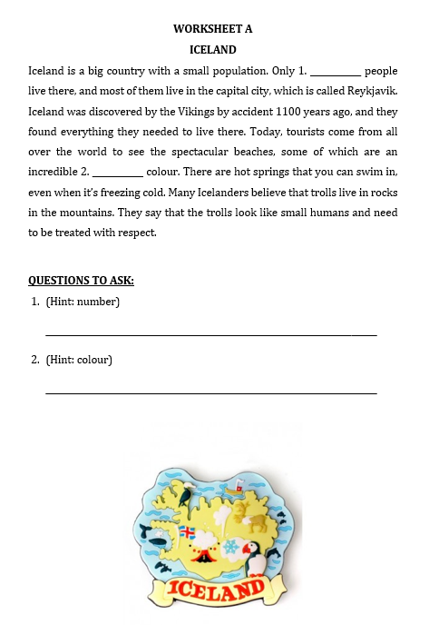
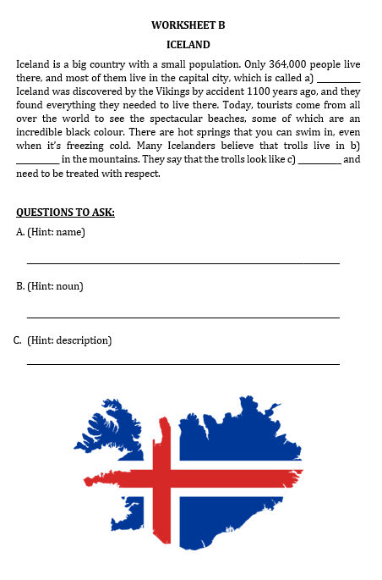

Slide 20
Thank You!

