Slide 1
Lesson 3: Speaking Topic: Travel Year: 4

Slide 2
Lesson Objectives:
During this lesson I will learn how to carry out a conversation to buy a train ticket at the train station.

Slide 3
Download these resources:
Sentence Starters and Prompts Handout.

Slide 4
Step 1: Watch this video clip. Then answer this question: What is the video clip about?

Slide 6
What is the video clip about? It is about buying a ticket at the train station.

Slide 7
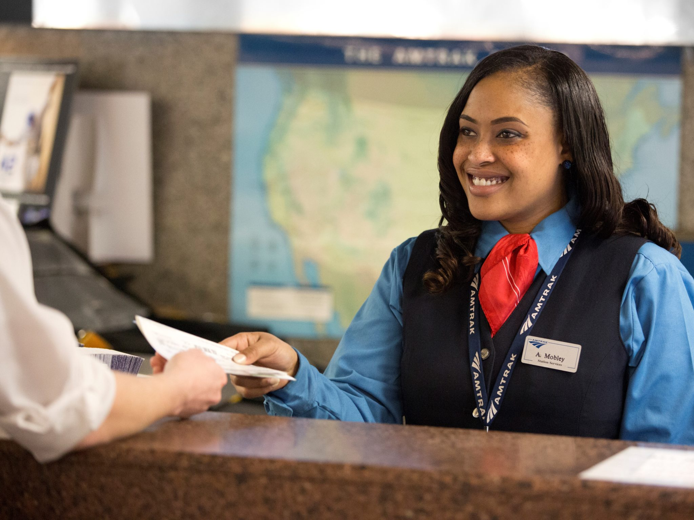
Sentence Starters and Prompts Handout
Officer: May I help you?
Friend/Relative: May I please …?
Officer: Of course, the next train will …
Friend/Relative: How much is …?
Officer: How would you like to travel/What kind of ticket would you prefer?
Friend/Relative: First class/ Second class.
Officer: That will be … please.
Relative/Friend: Here you are …
Officer: Thank you. Here is your change.
Relative/Friend: How long will the journey take, please?
Officer: Around three hours.

Slide 8
Title:
You are Matthew and your friend is the clerk at the ticket booth. It’s almost 2 o’clock in the afternoon and you want to go to Manchester. The train leaves at 2:30 from platform 3. You need a single ticket, which costs €7.50. Buy the ticket from the clerk.
Reverse roles.

Slide 9
These sentence starters may help you.
Can I help you madam/sir, please?
Is it possible for me to take the bike with me on the train?
May I have a return ticket?
Would you like to pay by cash or credit card please?
Can you please enter your pin number?
Is that all?
Thank you for your service.
I appreciate you help.

