Slide 1
English Warm-Ups
Year 4

Slide 2
Notes for the Educator
These Warm-Ups are intended to be used by learners in Year 4.
There are 50 different activities included in this presentation. Each slide presents a different activity. Teachers, may if they wish, reuse slides but change the content.
Order of slides can be changed.
Activities can be used as warm-ups, as time filler activities or simply to reinforce previous learning.
Activities are directly linked to the Year 4 Learning Outcomes. Reference to LOs can be found at the bottom right corner of each slide.
Activities can be shared on the interactive whiteboard or the learners’ tablets.

Slide 3
Word of the Day
motorway: a wide road for fast-moving traffic
1. Draw a picture of a motorway.
3. Which two words make up this word?
5. Use the word in a sentence.
2. What other words does it make you think of?
4. How many syllables has it got?
LAP 5.5

Slide 4
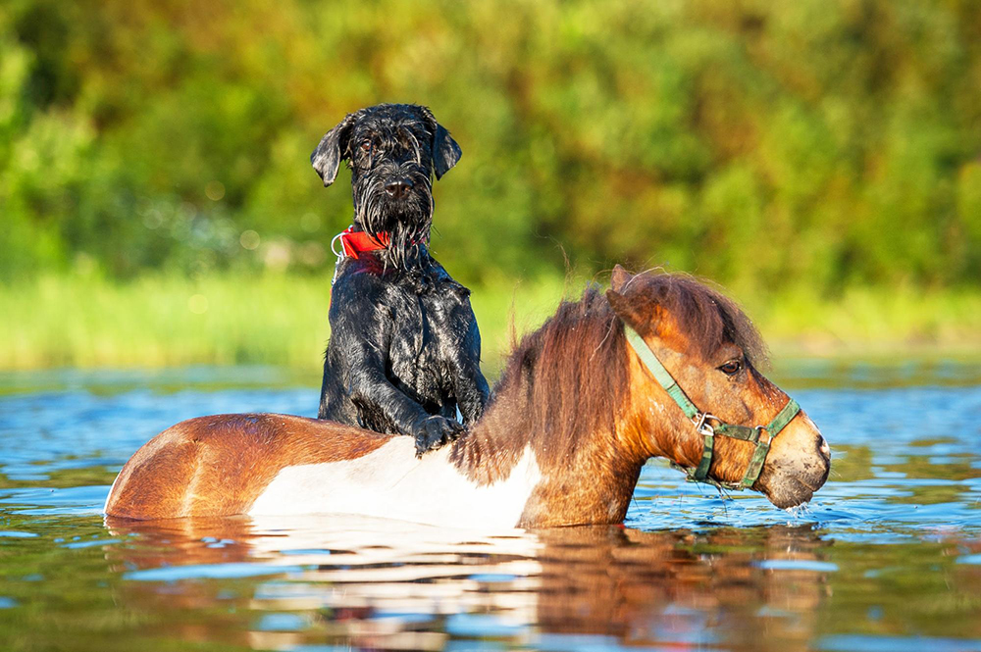
Caption this…
Write a catchy caption for this photo.
LAP 5.4; W 5.8

Slide 5
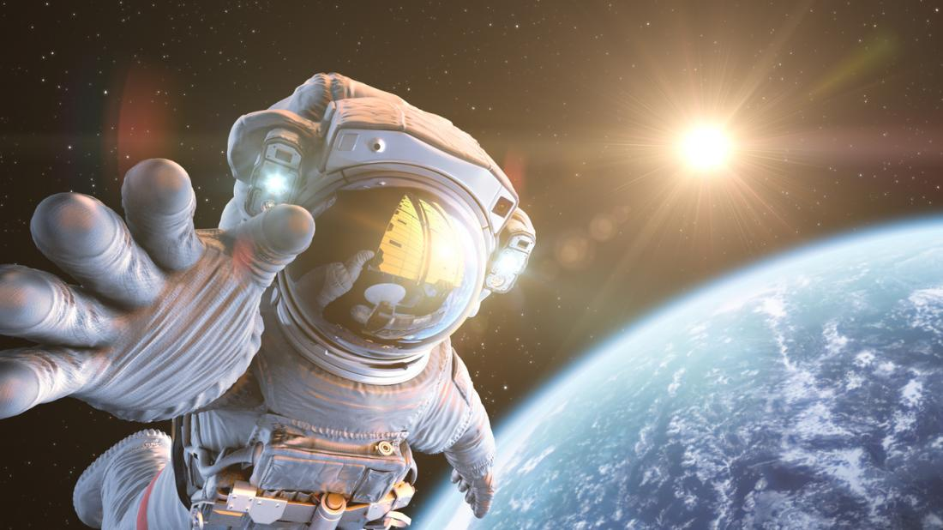
Postcard from space…
Pretend you are an astronaut. Write a postcard back home to tell everyone about your adventures in space .
space
planet
earth
rocket
Dear
weightless
strange
See you soon!
LAP 5.4; W 5.8

Slide 6
Jigsaw pieces
Can you fill in the missing words in each of these sentences using one of the blue jigsaw pieces. Rewrite the sentences on your copybook. Write another sentence of your own using one of the blue jigsaws.
She did not study
she failed the test.
We washed the dishes
we put them away.
she dropped her ice-cream.
I know the answer
I can’t tell you.
Sara began to cry
and
because
but
so
LAP 5.4

Slide 7
Similar meanings
Complete the table with two other words that have the same or very similar meanings.
chill
alarming
tiny | little
mad
true
freezing
scary
hard
tough
furious
small
firm
factual
angry
cold
real
little
frightening
LAP 5.5

Slide 8
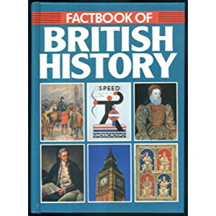
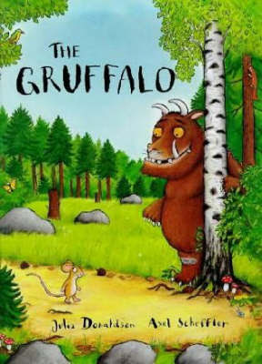
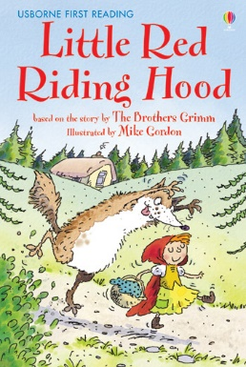
Fiction or Non-Fiction
Decide if these books are FICTION or NON-FICTION.
1
2
3
4
5
6
7
8
9
10
11
12
R 5.9

Slide 9
Test-tube words
Make words in the boxes by taking letters or a combination of letters from each test-tube. The first one is ready.
HO
LI
DA
YS
HO
IS
MB
TS
DE
ES
DA
S
PR
W
CE
LI
EN
HE
ER
YS
LAP 5.5

Slide 10
Fact or Fiction?
A cloud is a large group of tiny water droplets that we can see in the air.
Fact
Fiction
The dog works as a waiter at a very fancy restaurant.
Fact
Fiction
Recycling helps reduce the amount of waste that goes into landfills.
Fact
Fiction
R 5.3

Slide 11
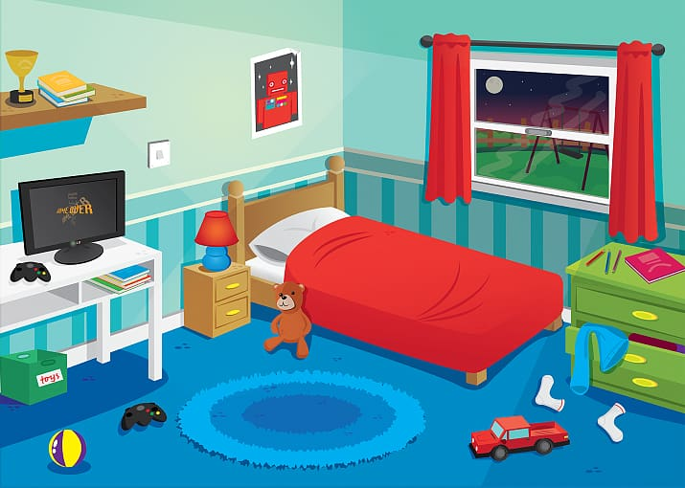
Where is everything?
Look at this bedroom scene. Talk to your partner and describe it.
between
above
next to
under
in
in front of
LAP 5.4; LAP 5.5

Slide 12
Book Covers
Look at the front cover of this book. Say something about it…
I see…
I think…
I wonder…
LS 5.5

Slide 13
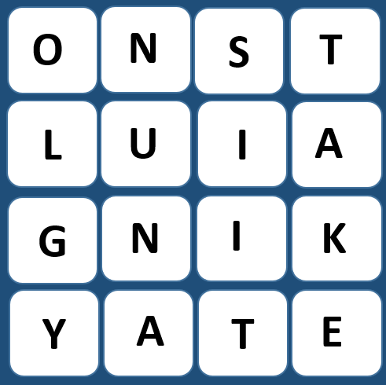
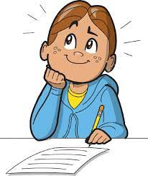
The mind BOGGLES…
How many words can you make using these letter tiles?
LAP 5.5

Slide 14
Grow a word
How many words can you make using these letters?
sp
sport
LAP 5.5

Slide 15
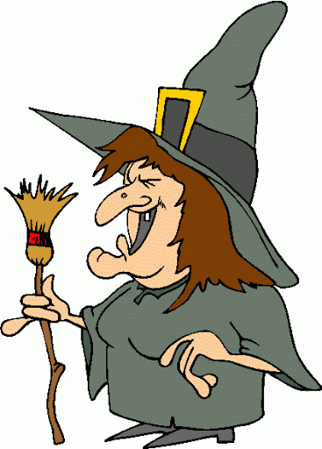
Stretch a sentence
Make this sentence longer.
The witch laughed.
Where?
When?
Why?
How?
LAP 5.4; W 5.11

Slide 16
Tell me more…
Say something about yourself to your partner.
Your partner has to listen to you carefully, select a word from what you have said (e.g. ‘house’) and say “Tell me more about your house.”
Tell your partner more about the word they chose.
LS 5.9; LAP 5.5

Slide 17
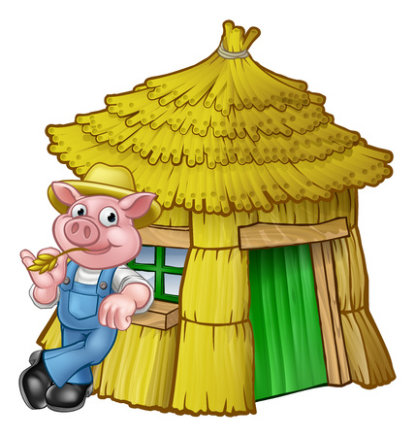
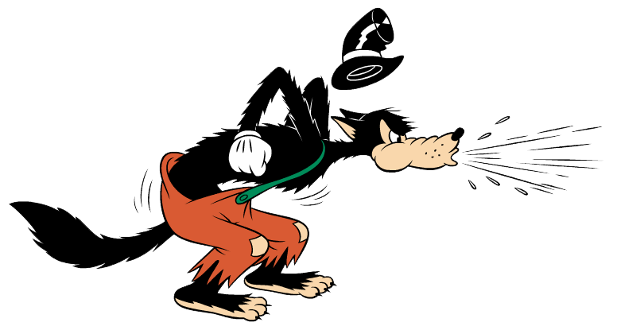
Point of View
Wolf’s perspective
Little Pig’s perspective
LIT 5.5; LIT 5.6

Slide 18
Syllables challenge
In each flower write 3 words with:
1 syllable
3 syllables
5 syllables
4 syllables
2 syllables
LAP 5.5

Slide 19
Give me 5
Give me 5 things that fly.
Give me 5 types of food.
Give me 5 body parts.
Give me 5 kinds of pets.
Give me 5 names of fruit.
Give me 5 musical instruments.
LAP 5.5

Slide 20
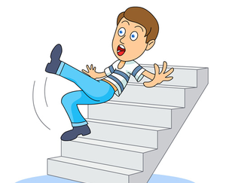
Visual Puzzle
+
=
+
=
+
=
LAP 5.5

Slide 21
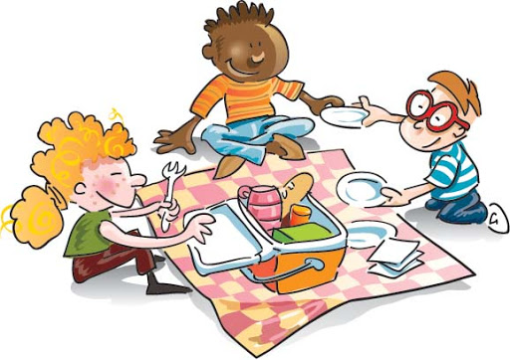
Paragraph challenge
In 5 minutes, write a short paragraph about
A PICNIC
Include at least one
noun
verb
adjective
adverb
Underline a grammar choice, e.g.: all the nouns.
W 5.8; LAP 5.4

Slide 22
Make the longest words
TRAVEL
Think of the longest words you know that begin with each letter of the topic word. Keep your words related to the theme.
errific
ainforest
LAP 5.5

Slide 23
Describe the character
Use 5 describing words (adjectives) to describe the dragon. Think about what it looks like and how his character might be.
LAP 5.4, LAP 5.5

Slide 24
Mixed up question
Reconstruct the question below and discuss it with your partner.
last
watched?
the
the
name
of
film
you
What’s
LAP 5.5

Slide 25
At the library
Listen to the conversation and fill in the library card with the right information.
School Library Card
Name: __________
Surname: ________
Class: __________
Age: ___________
Is there a library at your school? Do you like going to the library?
LS 5.1

Slide 26
Dictionary Scavenger Hunt
Use a dictionary to find the following words:
Find a word with more than 8 letters.
Find a word beginning with a ‘t’ with five consonants.
What is ‘fodder’?
Find 3 words that begin with ‘sh’.
Find a word with more than 5 letters.
Find a word beginning with a vowel.
LAP 5.4

Slide 27
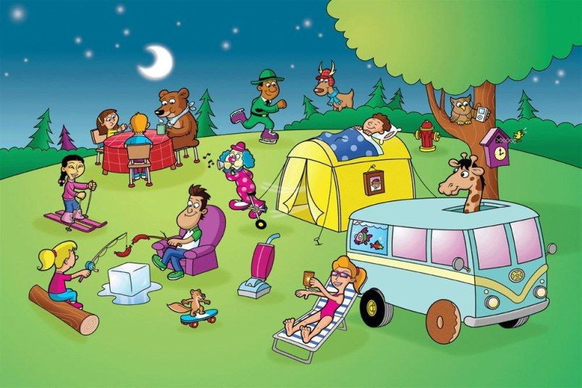
Ask away…
Look at this picture. Think of 5 questions that you would like your partner to answer.
Ask your partner your questions.
Why?
Where?
Who?
What?
How?
LS 5.5; LS 5.9

Slide 28
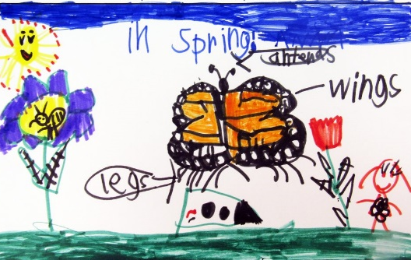
Think, draw and label
Draw it. Include a lot of details.
Add labels to your drawing.
Think of your favourite place. What do you see? What can you hear? What do you do there?
W 5.2

Slide 29
Think, draw and write
Draw your favourite part. Think of the characters, the setting and add some details.
Write about your favourite part of the story.
Think of a story you read. Which is your favourite part?
W 5.7, W 5.8; LIT 5.6; LAP 5.5

Slide 30
List Poem
Write your own list poem about spring. In the blue boxes write down words that remind you of spring. In the green boxes write a describing word for each of those things.
W 5.8, LIT 5.6; LAP 5.5

Slide 31
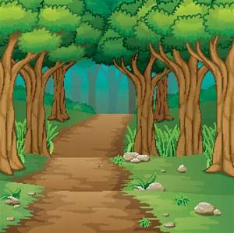
Describe the scene
Use 5 describing words (adjectives) to describe this place.
LAP 5.4, LAP 5.5.

Slide 32
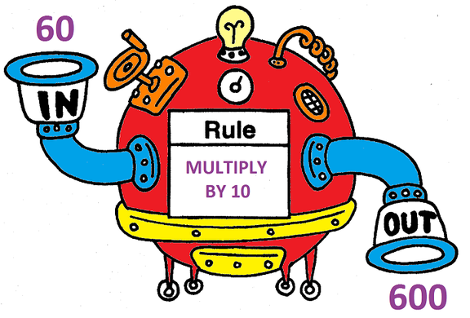
The UN- machine
This is the UN- machine! When the words go through the machine, it adds un- to the beginning of the word. Can you work out what will come out when these words are put in?
pleasant
pack
happy
kind
lock
Add un- at the front of the word
able
safe
lucky
unhappy
well
LAP 5.5

Slide 33
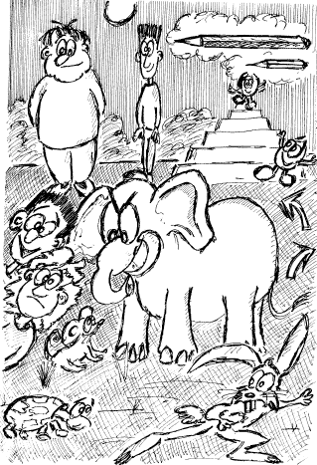
Opposites
Make a list of words that are opposite to each other.
Use the picture to get you started.
short - tall
LAP 5.5

Slide 34
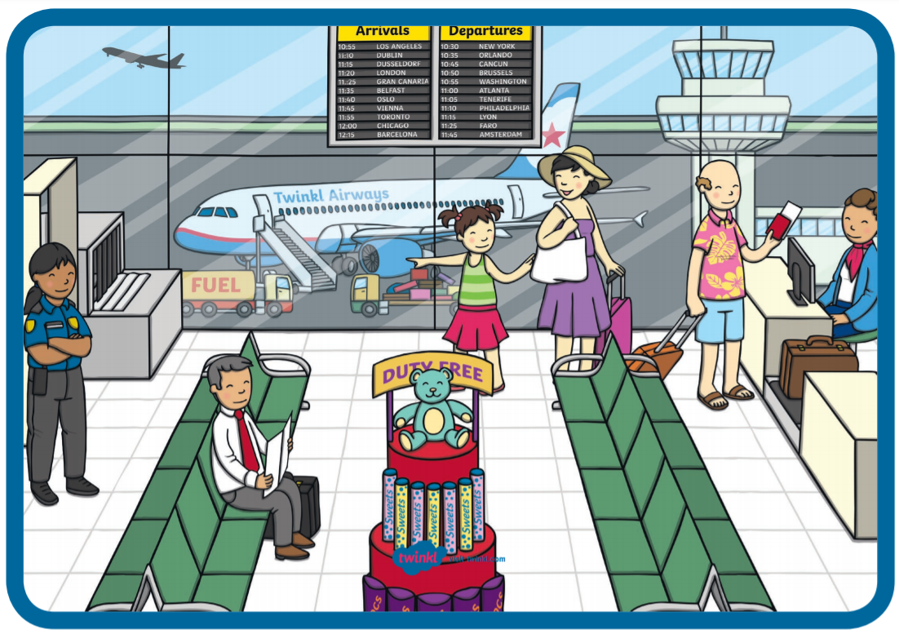
At the airport
Write a paragraph to describe this picture. Remember to use a capital letter at the beginning of each sentence and a full stop at the end.
take-off
passport
loading
luggage
security official
waiting
seats
snacks
W 5.8; LAP 5.4; LAP 5.6

Slide 35
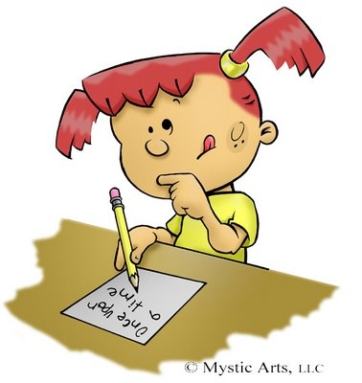
Fixer Upper
Read these sentences carefully and fix the mistakes.
toby and mark go to spain in march
bees is found on every continent except antarctica
martha took her childrens to the zoo yesterday
the gurl throwed the ball over the wuden gait
LAP 5.4

Slide 36
Making Connections
❶
The author said…
This reminds me of…
Use the book that you are reading and make connections.
TEXT TO SELF
TEXT TO TEXT
TEXT TO WORLD
❷
The author said…
This reminds me of…
R 5.6

Slide 37
WOW Words
Pick 5 of these WOW words and use them to write 5 sentences.
tasty
bouncy
sharp
ugly
cute
beautiful
massive
grumpy
tiny
fast
hot
sparkly
W 5.6

Slide 38
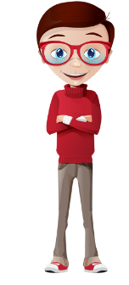
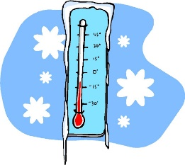
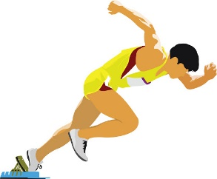
Inventing Similes
Create your own similes.
The moon is as bright as…
The boy is as smart as…
My hair is as soft as….
The room was as dark as…
The day is as cold as…
The athlete runs as fast as…
LIT 5.4

Slide 39
Find the adverb…and change it!
Read these sentences and spot the adverb. Can you think of another suitable adverb to replace it? How does it change the meaning of the sentence?
1. Dad climbed the ladder slowly.
2. She looked at her friend cautiously.
3. The horse bravely jumped over the hurdle.
4. Mila said thank you politely.
W 5.8; LAP 5.4; LAP 5.6

Slide 40
Spin an adjective
gentle
sharp
Spin the wheel to select an adjective. Use this adjective in a sentence of your own. Spin again and repeat.
shiny
pretty
cold
cloudy
huge
LAP 5.4

Slide 41
cv
Root Words
Form new words from each root word.
play
kind
harm
LAP 5.5

Slide 42
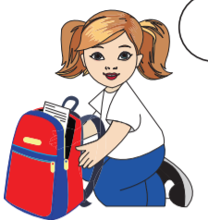
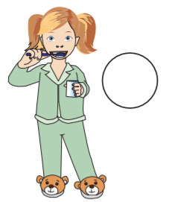
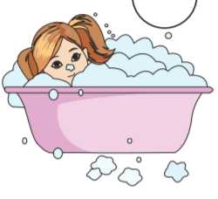
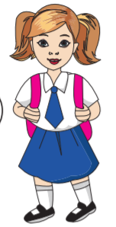
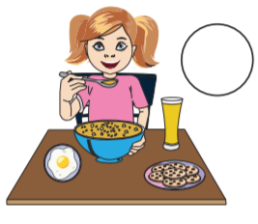
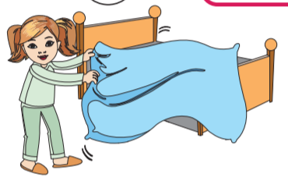
cv
Alice’s Morning Routine
Sequence Alice’s morning routine and describe each activity.
LAP 5.7

Slide 43
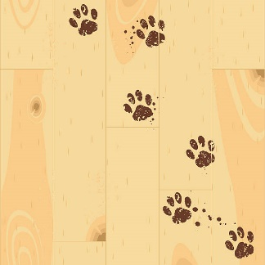
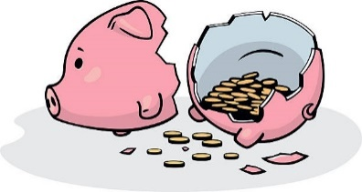
Make an Inference
Look at each picture, and make an inference to describe the picture.
Jacob’s backpack is open because
____________________________________________________
The floor is dirty because
____________________________________________________
Mummy bird carried some worms in her beak
___________________________________________________________
Sam broke open her piggy bank because
__________________________________________________________________
R 5.4

Slide 44
Colour Vowels
Write your spelling words with the vowels in one colour and the consonants in another colour.
alphabet
LAP 5.5

Slide 45
Message in a bottle
Pirate Sam found all these bottles washed up on the seashore. They each contain a message, but the full stops disappeared. Rewrite these messages and add the full stops.
Please help me I am stuck on a desert island You are my only hope
I have buried the treasure You will never find it
I have been captured by my greatest enemy He is keeping me locked up on his ship Help me!
My treasure map has been stolen Please help me find it
LAP 5.6

Slide 46
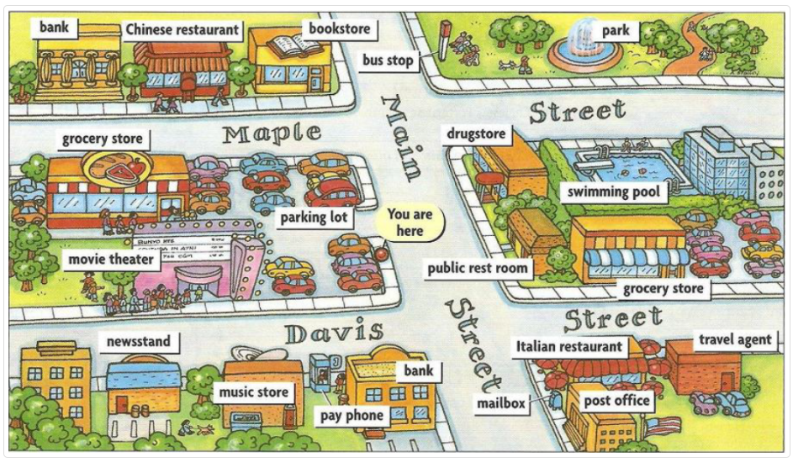
Giving directions
Take it in turns with your partner to ask for and give directions using the map below.
Asking for directions:
Could you tell me how to get to….?
How can I find…?
Which is the best way to….?
How do I get to….?
Where is….?
Excuse me, can you show me the way to…?
Giving directions:
Take the first/second road
It’s on your right/left.
Go straight ahead…
Go up/down…
Cross…
Go along…
Turn left/right.
LS 5.14

Slide 47
Text Messages
Write a short message to invite your friend for a sleepover during the weekend.
Write a short message about something bad that happened to you.
Remind your mum to buy something that you need for school.
W 5.2; W 5.8

Slide 48
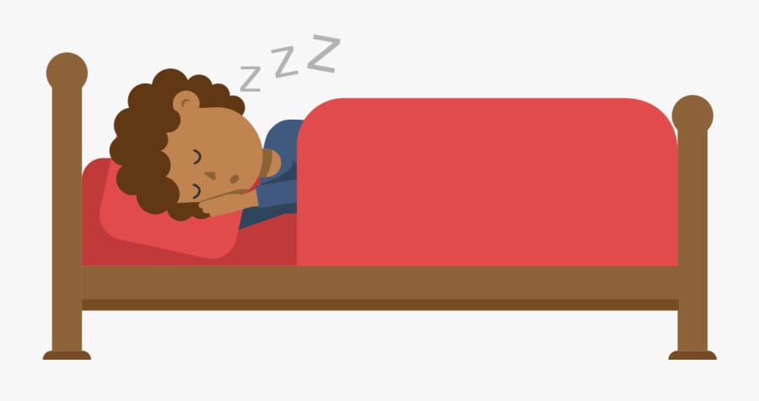
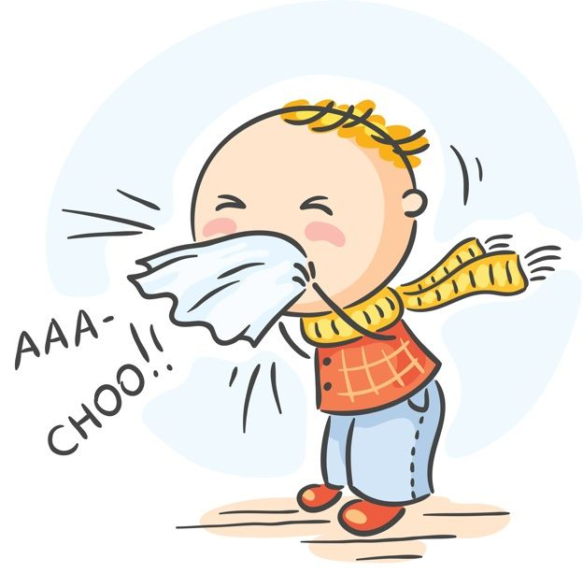
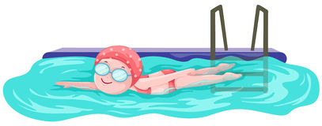
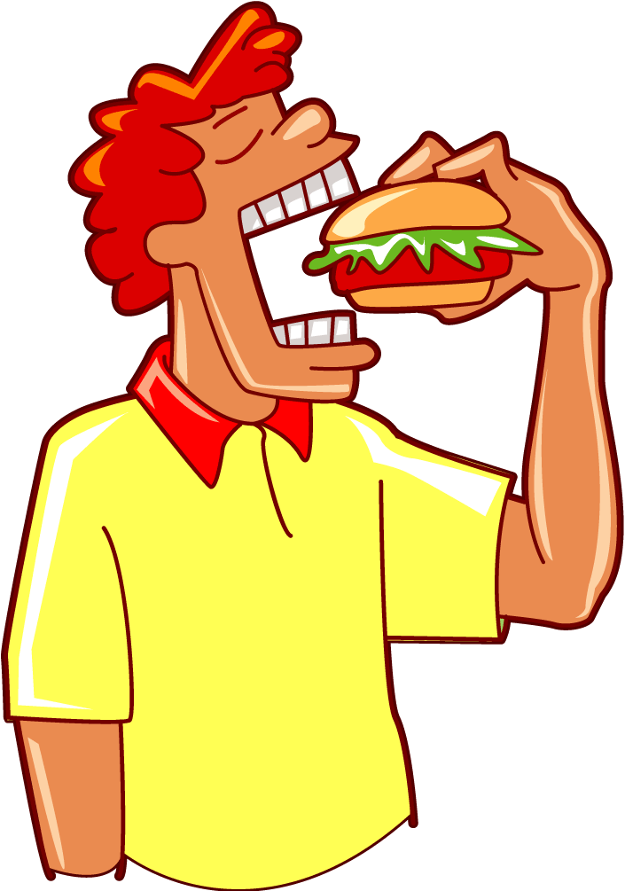
Doing Verbs
❼
Decide what each person is doing and write a sentence using –ing verbs. Describe what happens to the verb when you add –ing.
❶
❷
❸
❹
❻
❽
❺
❼
W 5.2; LAP 5.7

Slide 49
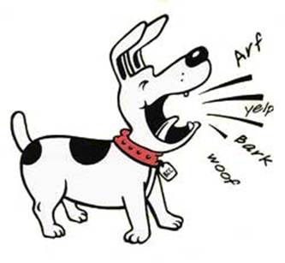
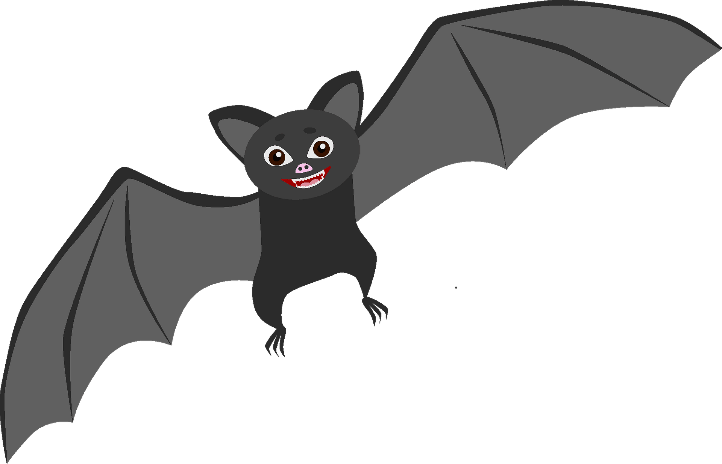
Same Word, Different Meaning
Some words are written the same, sound the same but have different meanings. Look at each picture and write sentences for both meanings.
❶
bark
❷
nail
❹
❸
fall
bat
LAP 5.5

Slide 50
❼
Rapid Writing
Why are these people running?
Where are they going?
What are they running away from?
What will they see on their way?
GET WRITING!
W 5.6, W 5.7

Slide 51
Alphabet line-up
❼
Choose 7 letters.
Choose as many consonants and vowels as you like.
How many words can you make using these letters?
What is the longest word you can make?
LAP 5.5

Slide 52
Copy Cat
❼
Copy the pattern of the sentence. Change the words in colour.
Can you change more words, keeping the same pattern?
The flustered boy ran rapidly down the deserted street.
adjective
noun
verb
adverb
adjective
noun
e.g. The lost dog paced slowly down the dusty lane.
W 5.4, LAP 5.5.

Slide 53
Thank you for using this resource pack. Check out our latest resources below:

