Slide 1
Lesson 3 Writing
Year 5
English

Slide 2
Lesson 3 Objectives
You will:
learn how to plan and write a postcard.
learn what are the success criteria for writing a postcard.

Slide 3
Lesson Resources
Word Mats Handout
Title of Postcard
Writing Frame Handout
Success Criteria Handout

Slide 4
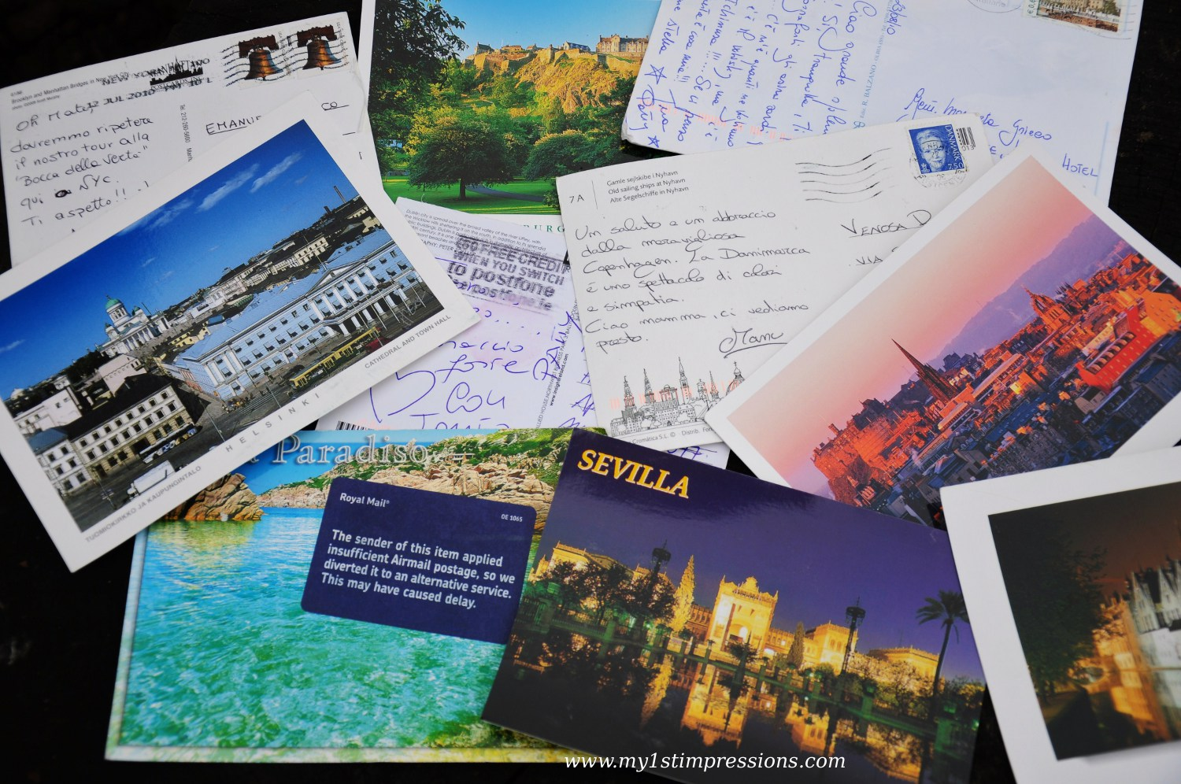
What is a postcard?
A postcard is a piece of thick paper, typically rectangular.
It is mailed without an envelope.

Slide 5
What is the video clip about?

Slide 6
A postcard consists of:
Space for a picture (on the front)
Blank lines for an address.
Space to write about your holiday.
postcard
The name and address of the person receiving it.
Some writing to say what you’ve been doing on your holiday.
Space in the top right corner for a stamp.

Slide 7
Title
You are on holiday in … Write a postcard to your friend/relative to tell him/her about your holiday.

Slide 8
Pre-Writing
Identify audience.
Identify purpose.
Think and discuss.
Gather ideas.
Take note.
Start freewriting.

Slide 9
Pay attention!
Genre:
POSTCARD
Audience:
FRIEND/RELATIVE
Purpose:
TO DESCRIBE
YOUR HOLIDAY
GAP
G: GENRE
A: AUDIENCE
P: PURPOSE

Slide 10
A picture on the front of your postcard showing where you are on holiday.
Dear Tom,
We are having lots of fun on holiday. Yesterday, we went to the beach. I made a huge sandcastle and ate lots of ice cream.
Today we went to a theme park. We went on lots of scary rides but it was lots of fun!
Tomorrow we are going to go on a boat trip. I hope we see dolphins!
From Anna x
Tom Hill
123 High Street
Clifftop Town
HT13 4TW
Source: www.twinkl.com

Slide 11
A stamp in the top right corner.
Dear Tom,
We are having lots of fun on holiday. Yesterday, we went to the beach. I made a huge sandcastle and ate lots of ice cream.
Today we went to a theme park. We went on lots of scary rides but it was lots of fun!
Tomorrow we are going on a boat trip. I hope we see dolphins!
From Anna x
Lines for writing the address.
Tom Hill
123 High Street
Clifftop Town
HT13 4TW
Space to write about your holiday – what you have done and what you will be doing.
The name and address for who you are sending the postcard to.

Slide 12
Include:
Where are you?
Who are you with?
Where are you staying?
What’s the weather like?
What did you do the day before?
What have you experienced?
What have you seen?
What are your plans for the next day?

Slide 13
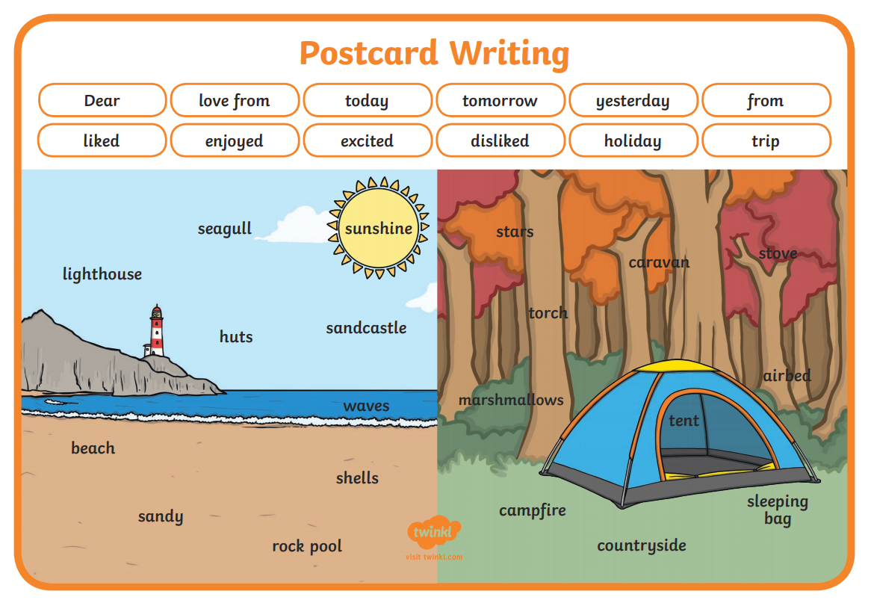

Slide 14
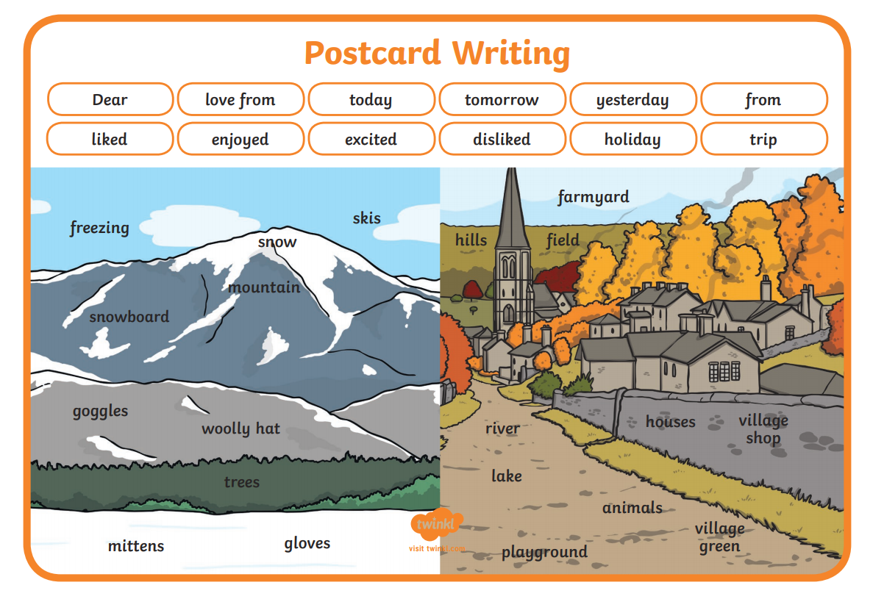

Slide 17
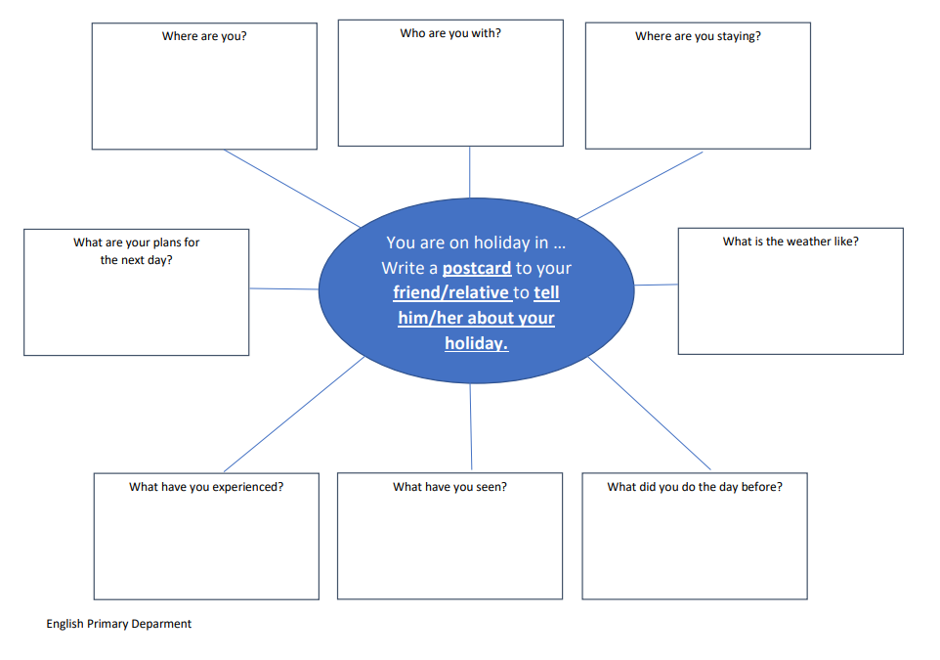
Graphic Organiser

Slide 18
Drafting
Refer to your writing frame.
Sequence and organise ideas.
Put thoughts and ideas on paper
to create first draft.

Slide 19
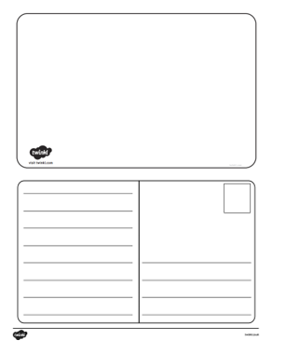
Writing Frame

Slide 20
Revision
Check that writing is
on topic and appropriate.
Add relevant details.
Delete unnecessary words and details.
Look for logical order of ideas or events.

Slide 21
Editing
Check grammar, punctuation
and spelling.

Slide 22
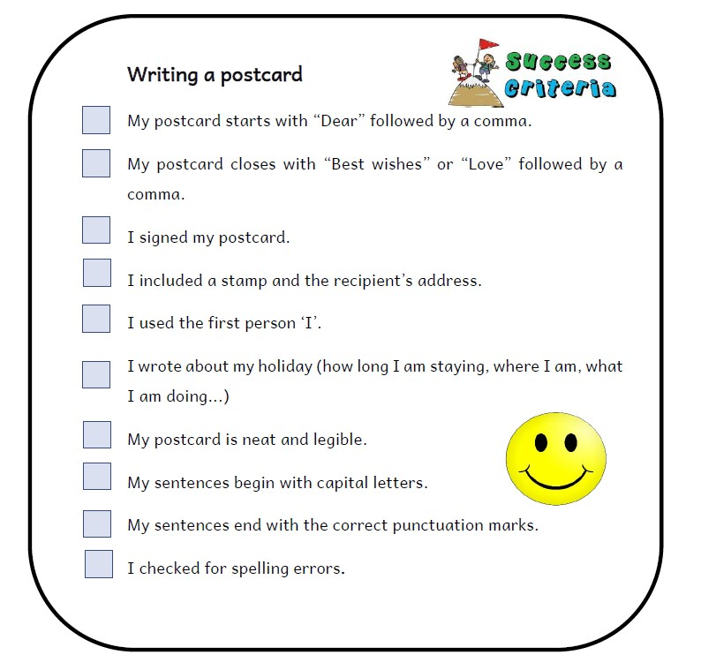
Success Criteria!
What are success criteria?
Success criteria are a list of steps you have to follow or a list of features you are to include in your task. They will make you aware of what is expected and help you self-assess your work.

Slide 23
Publishing
Write your final copy neatly,
including all the revisions you made.
Read it.
Share it.

Slide 24
Thank You!

